Slide 1
Nutrition and Fluids therapy
Lecturer
Wisam Khalid Abduljabbar
FIBMS general surgery

Slide 2
Malnutrition is common
30 per cent of surgical patients with gastrointestinal disease
60 per cent of those in whom hospital stay has been prolonged because of postoperative complications
Higher risk of complications and an increased risk of death

Slide 3
Metabolic response to starvation
short fast lasting 12 hours or less
insulin levels fall and glucagon levels rise
conversion of 200 g of liver glycogen into glucose
Brain tissue, red and white blood cells and the
renal medulla, can initially utilize only glucose for their metabolic Needs
glycogen exist in muscle
(500 g)
Muscle glycogen is broken down (glycogenolysis) and converted to lactate, which is then exported to the liver where it is converted to glucose

Slide 4
duration of fasting (>24 hours)
de novo glucose production from non carbohydrate precursors (gluconeogenesis) takes place, predominantly in the liver
breakdown of amino acids, particularly glutamine and alanine catabolism of skeletal muscle (up to 75 g per day)

Slide 5
With more prolonged fasting
Increased breakdown of fat stores occurs, providing glycerol, which can be converted to glucose
Hepatic production of ketones from fatty acids is facilitated by low insulin levels
After 48–72 hours of fasting, the central nervous system may adapt to using ketone bodies as their primary fuel source
Reduces the need for muscle breakdown by up to 55 g per day
Decline in the conversion of inactive thyroxine (T4) to active tri-iodothyronine (T3).

Slide 6
Metabolic response to starvation
Low plasma insulin
High plasma glucagon
Hepatic glycogenolysis
Protein catabolism
Hepatic gluconeogenesis
Lipolysis: mobilisation of fat stores (increased fat oxidation)
Overall decrease in protein and carbohydrate oxidation
Adaptive ketogenesis
Reduction in resting energy expenditure (from approximately 25–30 kcal/kg per day to 15–20 kcal/kg per day

Slide 7
Nutritional assessment
Laboratory techniques
Body weight and anthropometry
Clinical

Slide 8
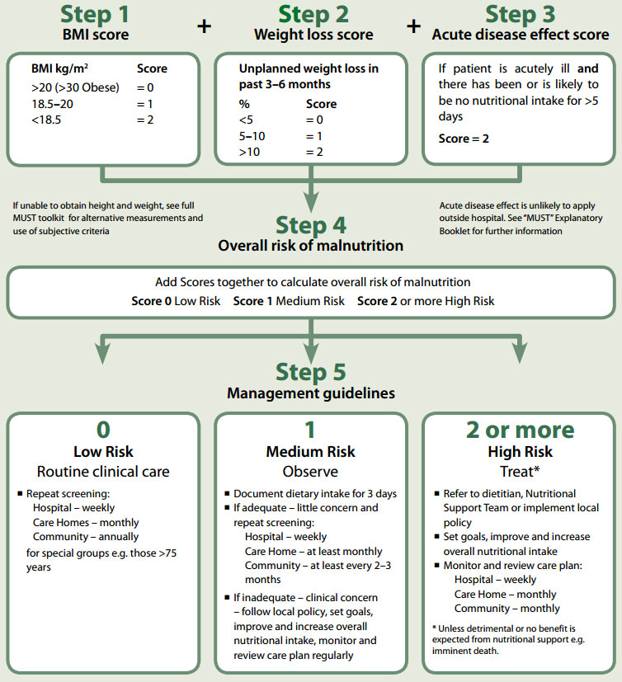

Slide 9
WATER BALANCE IN 70 Kg
Output :
Urine 1500
Insensible losses 900
Faeces 100
Input
Water from beverage 100
Water from solid food 1000
Water from oxidation 300

Slide 10
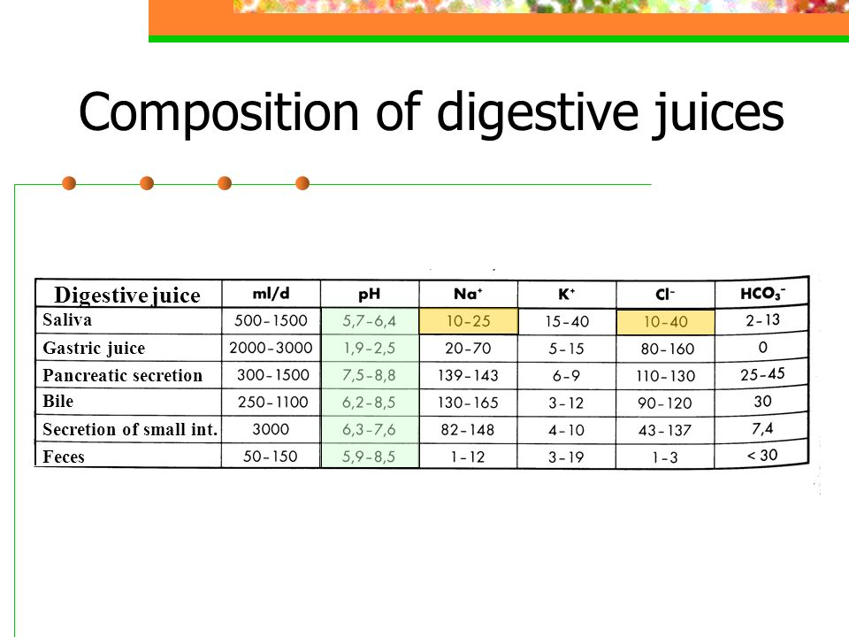

Slide 11
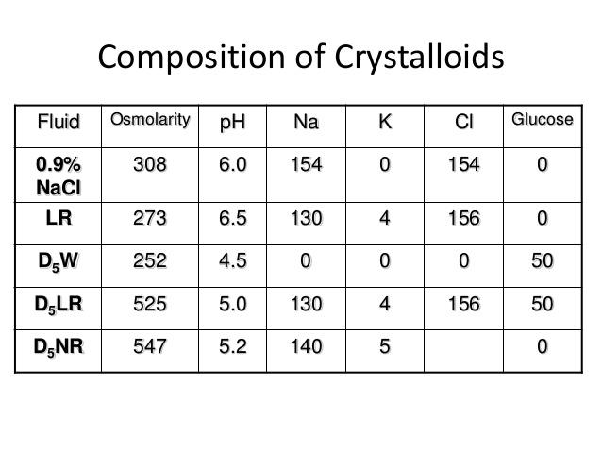

Slide 12
Nutritional requirement
20–30 kcal/kg per day
Hospitalized patient needs 1300-1800 Kcal/day

Slide 13
Monitoring feeding regimens
Daily
Body weight
Fluid balance
Full blood count, urea and electrolytes
Blood glucose
Electrolyte content and volume of urine
and/or urine and intestinal losses
Temperature

Slide 14
weekly
Urine and plasma osmolality
Calcium, magnesium, zinc and phosphate
Plasma proteins including albumin
Liver function tests including clotting factors
Thiamine B1
Acid–base status
Triglycerides

Slide 15
Fortnightly
Serum vitamin B12
Folate
Iron
Lactate
Trace elements (zinc, copper, manganese)

Slide 16
Carbohydrate
central nervous system and certain haematopoietic cells
2 g/kg per day

Slide 17
Fat
Dietary fat is composed of triglycerides
Two saturated : palmitic and stearic
Two unsaturated :oleic and linoleic
Medium chain fatty acid
The basal requirements for glucose (100–200 g/
day) and essential fatty acids (100–200 g/week)

Slide 18
Protein
The basic requirement for nitrogen in patients without pre-existing malnutrition and without metabolic stress is 0.10–0.15 g/kg
In hypermetabolic patients, the nitrogen requirements increase to 0.20–0.25 g/kg per day

Slide 19
Vitamins, minerals and trace elements
Postoperatively, the vitamin C requirement increases to 60–80 mg/day
Supplemental vitamin B12 is often indicated in patients who have undergone intestinal resection or gastric Surgery
Absorption of the fat-soluble vitamins A, D, E and K is reduced
in steatorrhoea and the absence of bile
Magnesium, zinc and iron levels may all be decreased as part of the inflammatory response

Slide 20
FLUID AND NUTRITIONAL
CONSEQUENCES OF INTESTINAL
RESECTION
Up to 50 per cent of the small intestine can be surgically
removed or bypassed without permanent deleterious effects.
extensive resection (<150 cm of remaining small intestine),
metabolic and nutritional consequences arise
The adult small bowel receives 5–6 litres of endogenous secretions
and 2–3 litres of exogenous fluids per day
efficiency of water absorption is 44 and 70 per cent of the ingested load in the jejunum and ileum
sodium are 13 and 72 per cent

Slide 21
The ileum is the only site of absorption of vitamin B12 and bile salts
Transit times in the colon vary between 24 and 150 hours
The efficiency of water and salt absorption in the colon exceeds 90 per cent
colonic function is the fermentation of carbohydrates to produce short-chain fatty acids: enhance water and salt absorption,trophic to colonocyte

Slide 22
Effects of resection
Resection of proximal jejunum results in no significant alterations in fluid and electrolyte levels
Resection of ileum results in a significant enhancement of
gastric motility and acceleration of intestinal transit
Bile salt reduce colonic absorption of water and salt then (diarrhea (oral cholestyramine
With larger resections (>100 cm) dietary fat restriction may be necessary.
Regular parenteral vitamin B12 is required

Slide 23
Short bowel syndrome
in excess of 200 cm of small bowel resected together with colectomy
Two types of patients:
Net absorber
Net secretor
Their usual daily jejunostomy output may exceed 4 litres per 24 hours
net efflux of sodium from the plasma into the bowel Lumen
Treatment begins with restricting the total amount of hypotonic fluids (water, tea, juices, etc.) consumed to less than a litre a day
Patients should be encouraged to take glucose and saline replacement solutions, which have a sodium concentration of at least 90 mmol/L

Slide 24
complications
Peptic ulcer
Cholelithiasis
Hyperoxaluria
Renal stones
Slurred speech
Ataxia
Rx : PPI,somatostatin,loperamide and and codeinephosphate

Slide 25
ARTIFICIAL NUTRITIONAL SUPPORT
Any patient who has sustained 5–7 days of inadequate
intake or who is anticipated to have no intake for this period
should be considered for nutritional support

Slide 26
Enteral feeding
delivery of nutrients into the gastrointestinal tract
variety of nutrient formulations
These vary with respect to energy content, osmolarity,
fat and nitrogen content and nutrient complexity
Polymeric feeds contain intact protein and hence require digestion
Monomeric/elemental feeds contain nitrogen in the form of
either free amino acids or, in some cases, peptides

Slide 27
Sip feeding
patients who can drink but whose appetites are impaired or in whom adequate intakes cannot be maintained with ad libitum Intakes
provide 200 kcal and 2 g of nitrogen per 200 mL carton

Slide 28
Tube-feeding techniques
Nasogastric tubes (Ryle’s)
fine-bore feeding tubes inserted into the stomach, surgical or percutaneous endoscopic gastrostomy (PEG)
post-pyloric feeding utilising nasojejunal tubes or various types of jejunostomy tube
feeding is supervised by an experienced dietician
20–30 ml are administered per hour initially, gradually increasing to goal rates within 48–72 hours
feeding is discontinued for 4–5 hours overnight

Slide 29
Tube blockage is common
Rx by irrigation twice daily with water
For solidified material (chemotrypsin and papain)
Guidewires should not be used????
fine-bore feeding tube is preferable and is likely to cause fewer gastric and oesophageal erosions(more than 1 week NG use)
Soft polyurethane or silicone elastomer and have an internal diameter of
<3 mm.

Slide 30
Fine-bore tube insertion
semi-recumbent
risk of malposition into a bronchus causing pneumothorax
Check for position: x ray and 5cc water injection

Slide 31
Gastrostomy
PEG (percutaneous endoscopic gastrostomy) tubes
Two methods of PEG are commonly used: direct stab and push-through technique
If patients require enteral nutrition for prolonged periods
(4–6 weeks), then PEG is preferable to an indwelling nasogastric
Tube
Complications: necrotizing fasciitis, abdominal wall abscess, sepsis and persistent gastric fistula

Slide 32
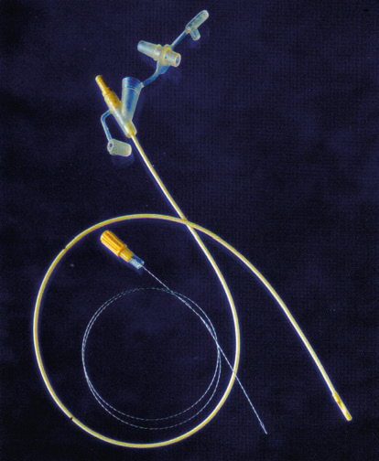

Slide 33
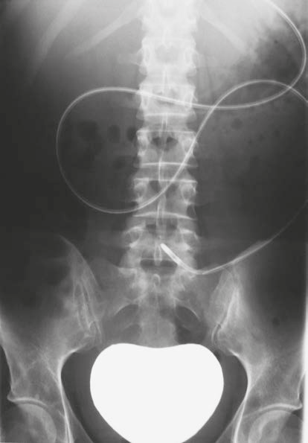

Slide 34
Jejunostomy
become increasingly Popular
Nasojejunal tubes or by placement of needle jejunostomy at the time of laparotomy
Reduction in aspiration or enhanced tolerance of enteral nutrition
Uses : acute pancreatitis and gastric outlet obstruction
Complications: leak , tube displacement and peritonitis

Slide 35
Complications of enteral nutrition
Tube-related
Malposition
Displacement
Blockage
Breakage/leakage
Local complications (e.g. erosion of skin/mucosa)
Gastrointestinal
Diarrhoea
Bloating, nausea, vomiting
Abdominal cramps
Aspiration
Constipation
Metabolic/biochemical
Electrolyte disorders
Vitamin, mineral, trace element deficiencies
Drug interactions
Infective
Exogenous (handling contamination)
Endogenous (patient)

Slide 36
Parenteral nutrition
the provision of all nutritional requirements by means of the intravenous route and without the use of the gastrointestinal tract
Indications :
1-massive resection of small bowel
2-intestinal fistula
3-intestinal failure
Route of delivery: peripheral or central
venous access

Slide 37
Peripheral
short-term feeding of up to 2 weeks
(peripherally inserted central venous catheter (PICC) line)
conventional short cannula in the wrist veins
PICC lines have a mean duration of survival of 7 days
The disadvantage is that when thrombophlebitis occurs
Short cannula in wrist veins, infusing the patient’s nutritional requirements on a cyclical basis over 12 hours

Slide 38
Central
subclavian or internal or external jugular Vein
Disadvantage of internal and external is movement
The infraclavicular subclavian approach is more suitable for feeding (why)
For longer-term parenteral nutrition, Hickman lines are
preferable(why)
In all cases: post-insertion chest x-ray catheter, tip lies in the distal superior vena cava to minimise the risk of central venous or cardiac thrombosis,

Slide 39
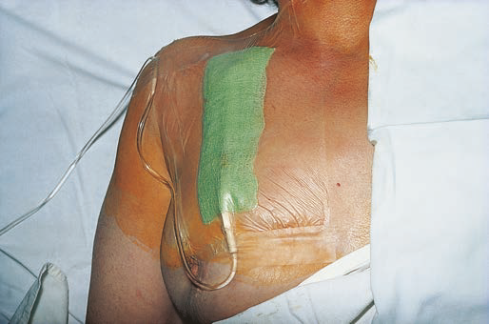

Slide 40
Complications of parenteral nutrition
Related to nutrient deficiency
Hypoglycaemia/hypocalcaemia/ hypophosphataemia/ hypomagnesaemia (refeeding syndrome)
Chronic deficiency syndromes (essential fatty acids,
zinc, mineral and trace elements)

Slide 41
Related to overfeeding
Excess glucose: hyperglycaemia, hyperosmolar dehydration, hepatic steatosis, hypercapnia, increased sympathetic activity, fluid retention,
electrolyte abnormalities
Excess fat: hypercholesterolaemia and formation of
lipoprotein X, hypertriglyceridaemia, hypersensitivity
reactions
Excess amino acids: hyperchloraemic metabolic
acidosis, hypercalcaemia, aminoacidaemia, uraemia

Slide 42
Related to sepsis
Catheter-related sepsis
Possible increased predisposition to systemic sepsis
Related to line
On insertion: pneumothorax, damage to adjacent
artery, air embolism, thoracic duct damage, cardiac perforation or tamponade, pleural effusion, hydromediastinum
Long-term use: occlusion, venous thrombosis

Slide 43
Refeeding syndrome
severe fluid and electrolyte shifts in malnourished patients
undergoing refeeding
More common in parenteral nutrition
hypophosphataemia, hypocalcaemia and hypomagnesaemia
This will affect myocardial function, arrhythmias, deteriorating respiratory function, liver dysfunction, seizures, confusion, coma, tetany and death
Patients at risk: alcoholics, severely malnourished and anorexics
Treatment: slow infusion, matched calorie intake and correction of PO4 and Mg disturbances

