Slide 1
BACTERIAL
PHYSIOLOGY
Dr. oruba Khalid
Lec. : 2

Slide 2


Welcome To

Slide 3

Meet the Microbes!

Slide 4
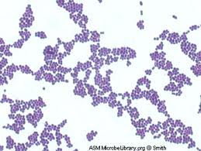
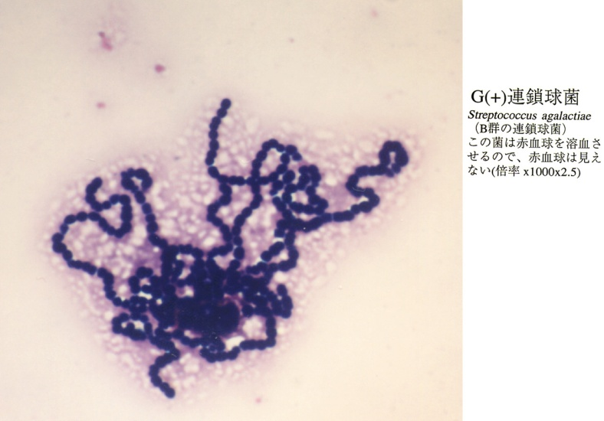
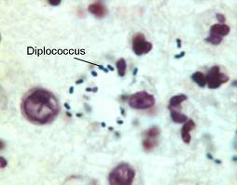
Coccus

Slide 5
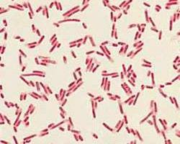
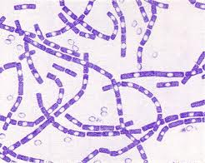
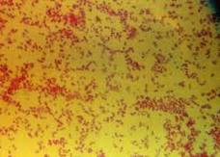
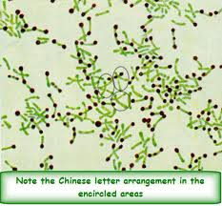
Bacillus

Slide 6
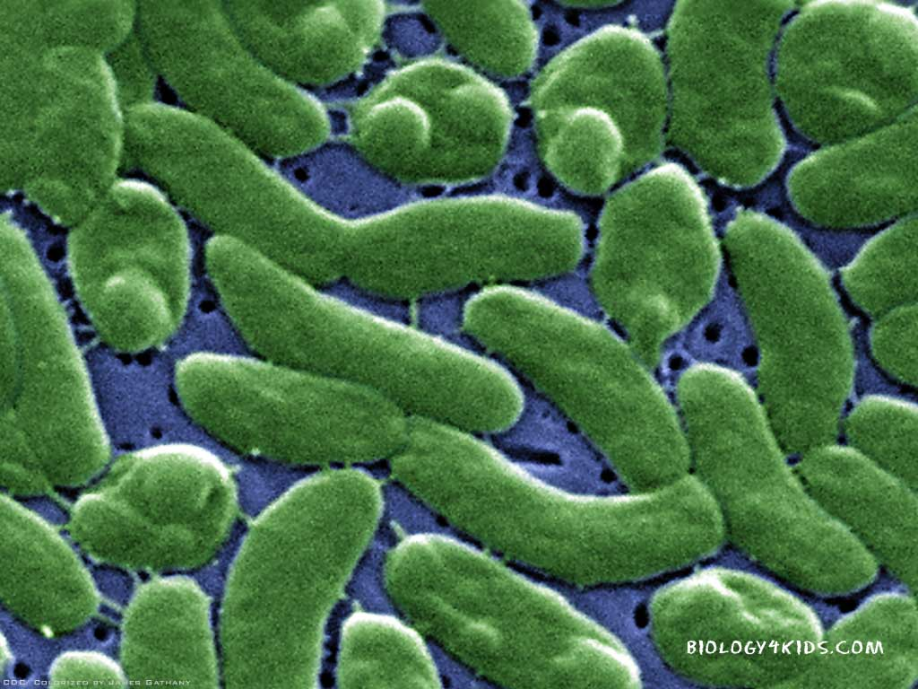

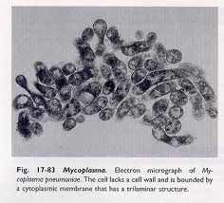
Vibrio
Spirillum Mycoplasma

Slide 7
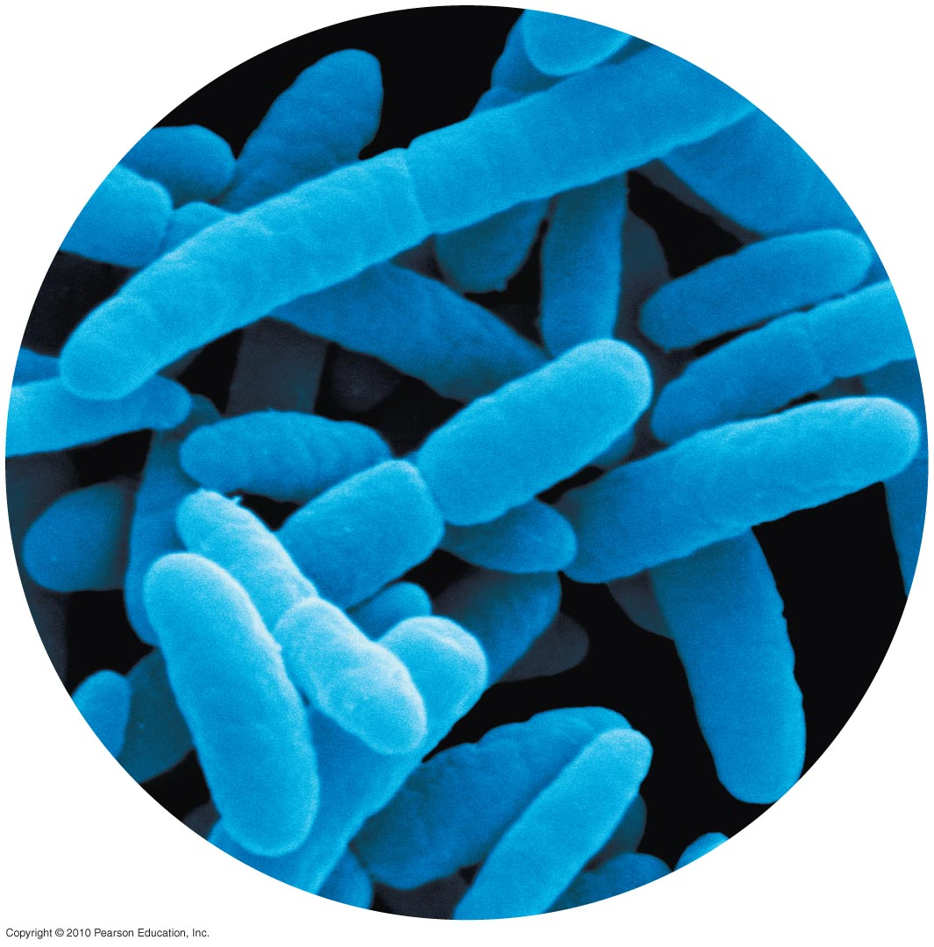
It’s the growth, nutrition and metabolism
WHAT IS PHYSIOLOGY ?

Slide 8
Bacterial Metabolism
Types of Metabolism:
Metabolism is the totality of chemical reactions occurring in bacterial cells.
They can be subdivided into :
A- Catabolic reactions that supply energy.
B- Anabolic (synthetic) reactions that consume energy

Slide 9
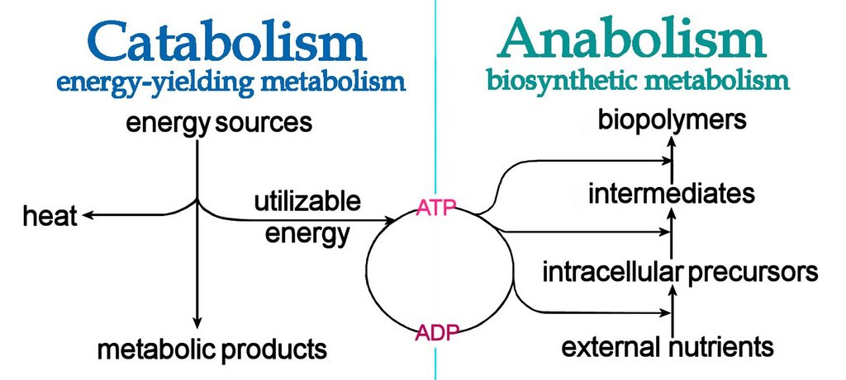
-Catabolic reactions supply both energy and the basic structural elements for the synthesis of specific bacterial molecules.
-In the anabolic reactions , the energy requirement is consumed in form of light or chemical energy—by photosynthetic or chemosynthetic bacteria, respectively.

Slide 10
A-Catabolic Reactions
-Organic nutrient substrates are catabolized in a wide variety of enzymatic processes that can be schematically divided into three phases:
1-Digestion:
-Bacterial exoenzymes split up the nutrient substrates into smaller molecules outside the cell.
The exoenzymes represent important pathogenicity
factors in some cases.
2-Uptake:
-Nutrients can be taken up by means of passive diffusion or, more frequently, specifically by active transport through the membrane(s).

Slide 11
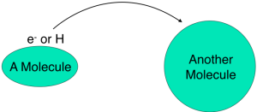
3-Oxidation:
-This process is defined as the removal of electrons and H+ ions.
-The substance to which the H2 atoms are transferred is called the hydrogen acceptor.

Slide 12
-The two basic forms of oxidation are defined by the final hydrogen acceptor:
A – Respiration:
-A series of reactions that convert glucose to CO2 and allow the cell to recover significant amounts of energy
- Glucose + O2 ➔ Carbon dioxide + Water +Energy
- C6H12O6 + O2 ➔ 6CO2 + 6H2O + 38 ATP

Slide 13
B-Fermentation:
-Here an organic compound serves as the hydrogen acceptor.
-The main difference between fermentation and respiration is the energy yield, which can be greater from respiration than from fermentation for a
given nutrient substrate by as much as 10 times .

Slide 14
B-Anabolic Reactions
-Some bacteria (like E. coli) are capable of synthesizing all the complex organic molecules that they are comprised of from the simplest nutrients in a very short time. These capacities are utilized in the field of microbiological engineering.
-Some bacteria are capable of using hydrocarbon compounds as an energy source.

Slide 15
Bacterial Nutrition
Water constitutes 80% of the total weight of bacterial cells.
Proteins, polysaccharides, lipids, nucleic acids & low molecular weight compounds make up the remaining 20%.
For growth & multiplication, the minimum nutritional requirements are water, a source of carbon, a source of nitrogen & some inorganic salts

Slide 16
Classification based on nutrition
Based on nutrition , bacteria are classified as :
Autotrophs – can synthesize all their organic compounds by utilizing atmospheric CO₂ & N_{2.} They have no medical importance.
Heterotrophs – unable to synthesize their own metabolites & depend on the organic compounds.
All pathogenic bacteria are heterotrophs .

Slide 17
Nutritional Factors
Some bacteria require certain organic compounds in minute quantities called as nutritional factors .
It can be :
Essential – Compounds that bacterial growth does not occur in their absence.
Accessory – Compounds that enhance growth but without being absolutely necessary for it

Slide 18
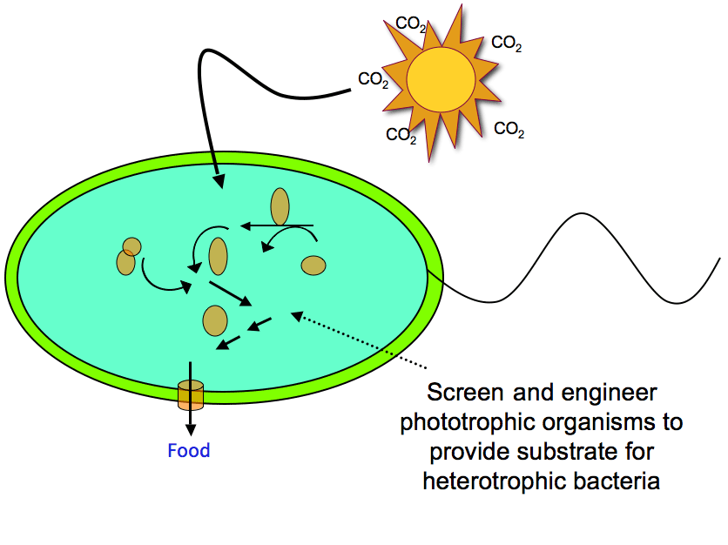
Based on Nutritional Requirement Bacteria Can Be Classified As:
Phototrophs – Bacteria which derive their energy from sunlight.
Chemotrophs – Bacteria which derive energy from chemical reactions.
Organotrophs : require organic sources of hydrogen
Lithotrophs : require inorganic sources of hydrogen like NH₃, H₂S

Slide 19
OTHER GROWTH REQUIREMENTS
Vitamin B complex –
Thiamine
Riboflavine
Nicotinic acid
Pyridoxine
Folic acid
Vit.B 12

Slide 20
BACTERIAL GROWTH
It is an increase in all the cellular components, which end in multiplication of the cell leading to an increase in population.
It involves an increase in the number of individual cells.
Bacteria divide by binary fission.

Slide 21
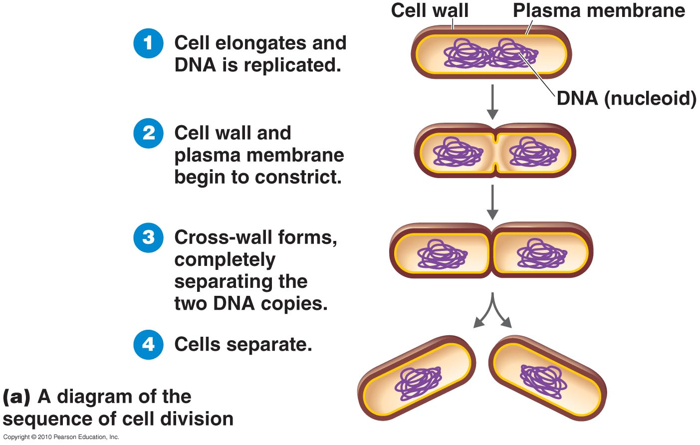
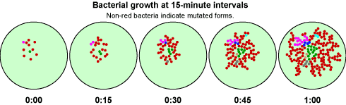
Binary Fission

Slide 22
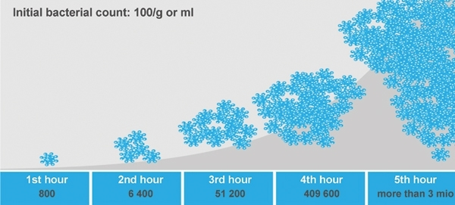
Generation time
Interval of time between two cell divisions
OR
The time required for a bacterium to give rise to 2 daughter cells under optimum conditions

Slide 23
Generation time of E.coli & other medically important bacteria is 20 mins
For tubercle bacilli is 20 hrs
For lepra bacilli is 20 days

Slide 24
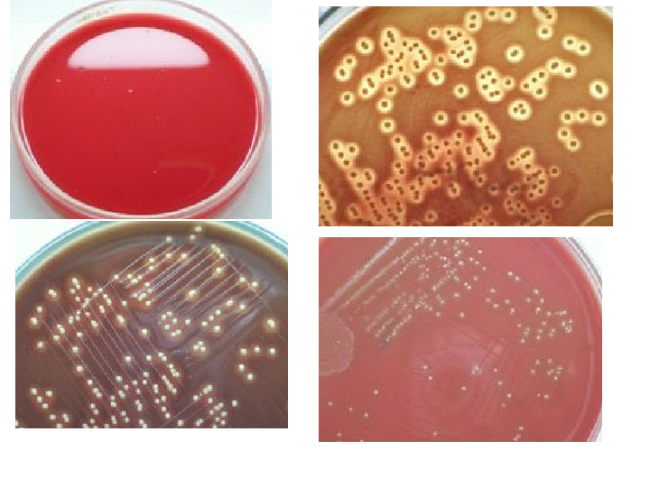
Colony – formed by bacteria growing on solid media.
Each bacterial colony represents a clone of cells derived from a single parent cell.

Slide 25
FACTORS AFFECTING BACTERIAL GROWTH INCLUDE:
Temperature
Atmosphere – O₂ & CO₂
H-ion concentration
Moisture & drying
Osmotic effects
Radiation
Mechanical & sonic stress

Slide 26
1-Temperature
Bacteria vary in their temperature requirements.
Temperature range – growth does not occur above the maximum or below the minimum.
Optimum Temperature – It is the temperature at which growth occurs best, it is 37 C° for most pathogenic bacteria

Slide 27

CLASSIFICATION BASED ON TEMP.
Mesophilic – grows best between 25 C° and 40 C°.
e.g. most pathogenic bacterial
Psychrophilic (cold loving) – grows best below 20 C°
e.g. Flavobacterium spps
Thermophilic – grows best at high temp, 55 – 80 C° e.g. Bacillus sterothermophilus

Slide 28
2-OXYGEN
Depending on the O₂ requirement, bacteria are divided into :
Strict (Obligate) Aerobes – require O₂ for growth e.g. Pseudomonas aeruginosa
Strict (Obligate) Anaerobes – grow in the absence of O₂ & may even die on exposure to O₂ e.g. Bacteroides fragilis
Microaerophilic – grow best in the presence of low oxygen levels
e.g. Campylobacter spp, Helicobacter spp

Slide 29
4.Facultative anaerobe – aerobic but can also grow in the absence of O₂
e.g. Staphylococcus spps
5.Aerotolerant anaerobe – anaerobic, but tolerates exposure to O₂
e.g. Clostridium perfringens
6.Capnophilic organism – requires high CO₂ levels eg Neisseria spps

Slide 30
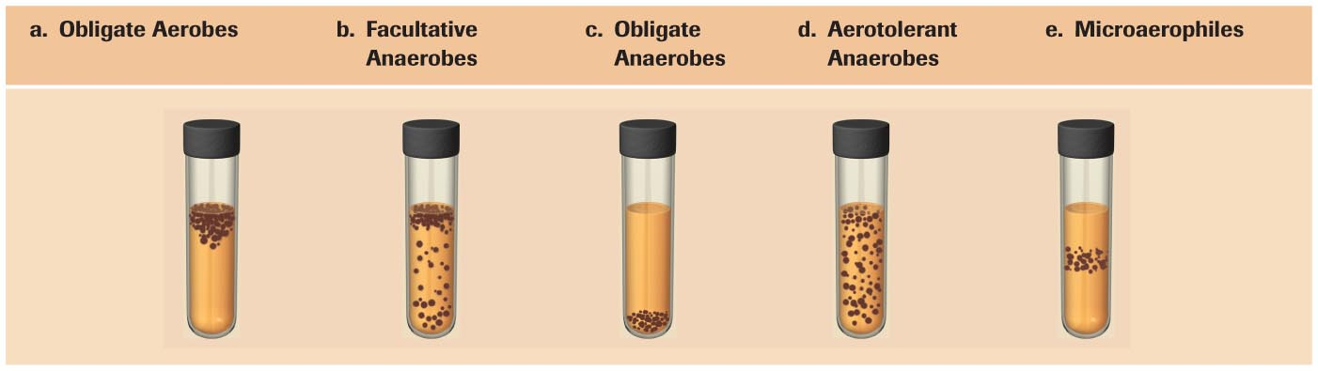
The Effect of Oxygen (O2) on Growth
Grows best in oxygen, but can grow without it
Only grows without oxygen
Grows with or without oxygen
Grows in low concentrations of oxygen
Needs oxygen

Slide 31
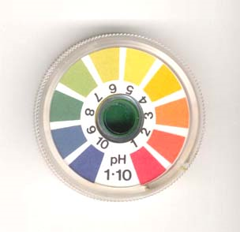
3- H-ion Concentration
pH range, optimum pH
Majority of pathogenic bacteria grow best at neutral or slightly alkaline pH (7.2 – 7.6) .
Lactobacilli require acidic pH
Vibrio cholerae require alkaline pH

Slide 32
4- Moisture and drying
Water is an essential ingredient of bacteria. Hence drying is lethal to cells.
Effect of drying varies :
Trepanoma pallidum are highly sensitive to drying
Staphylococcus spp. withstand drying for months
Spores are resistant to drying and may survive for several decades

Slide 33
5- Osmotic effects
More tolerant to osmotic variation due to mechanical strength of their cell walls.
6- Radiation
X rays & gamma rays exposure – lethal
7- Mechanical & Sonic Stress
May be ruptured by mechanical stress.

Slide 34
BACTERIAL GROWTH CURVE
When a bacterium is added to a suitable medium & incubated, its growth follows a definite course.
If bacterial counts are made at intervals after inoculation & plotted in relation to time, a growth curve is obtained.
Growth curve shows 4 phases : Lag, Log or Exponential, Stationary & phase of Decline.

Slide 35
PHASES OF GROWTH
Lag phase – no increase in number but there may be an increase in the size of the cell.
Log or Exponential phase – cells start dividing and their number increases exponentially.

Slide 36
Stationary phase – cell division stops due to depletion of nutrients & accumulation of toxic products.
- Equilibrium exists between dying cells and the newly formed cells, so viable count remains stationary
Phase of decline – Population decreases due to the death of cells – autolytic enzymes.

Slide 37
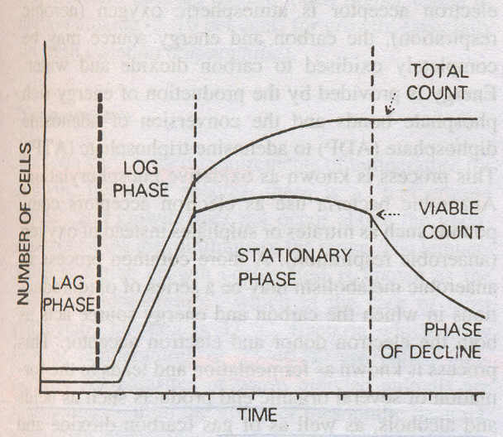

Slide 38
BACTERIAL COUNTS
Growth in numbers can be studied by bacterial counts.
2 methods – Total cell count
- Viable cell count

Slide 39
TOTAL COUNT
Total number of cells in the sample – living + dead.
Can be obtained by :
Direct counting under microscope using counting chambers.
Counting in an electronic device – Coulter counter.

Slide 40
Viable Cell Count
Measures the number of living cells.
Methods – Surface colony count
Dilution method
Plating method
Number of colonies that develop after incubation gives an estimate of the viable count.

Slide 41
References:
1- Jawetz, Melnick, & Adelberg’s.( 2013). Medical Microbiology (Twenty-Sixth Edition).
2- Kenneth Todar. (2008).Todar’s Online Textbook of Bacteriology ,University of Wisconsin.

Slide 42
THANK YOU

