Slide 1
Introduction to Clinical pharmacology

Slide 2
Pharmacology is the body of knowledge concerned with the action of chemicals on biologic systems.
Clinical pharmacology is the area of pharmacology concerned with the use of chemicals in the prevention, diagnosis, and treatment of disease, especially in humans.
Toxicology is the area of pharmacology concerned with the undesirable effects of chemicals on biologic systems.
Drugs may be chemically synthesized or purified from natural sources with or without further modification, but their development and clinical use are based on rational evidence of efficacy and safety derived from controlled experiments and randomized clinical trials.
Much of the success of modern medicine is based on pharmacological science and its contribution to the development of safe and effective pharmaceuticals.
Pharmacology is divided into two main subdivisions, Pharmacokinetics and pharmacodynamics.
Pharmacokinetics is concerned with the processes that determine the concentration of drugs in body fluids and tissues over time, including drug absorption, distribution, metabolism, and excretion (ADME). Pharmacodynamics is the study of the actions of drugs on target receptors and tissues. A shorthand way of thinking about it is that pharmacodynamics is what the drug does to the body, and pharmacokinetics is what the body does to the drug.

Slide 3
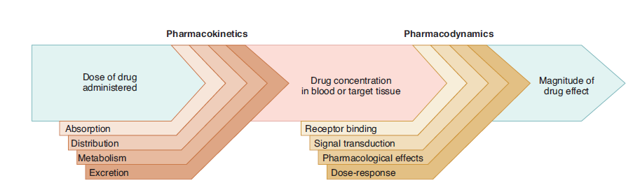

Slide 4
Pharmacodynamics
Pharmacodynamics describes the actions of a drug on the body and the influence of drug concentrations on the magnitude of the response. Most drugs exert their effects, both beneficial and harmful, by interacting with receptors (that is, specialized target macromolecules) present on the cell surface or within the cell. The drug–receptor complex initiates alterations in biochemical and/or molecular activity of a cell by a process called signal transduction.
Signal transduction
Drugs act as signals, and their receptors act as signal detectors. Receptors transduce their recognition of a bound agonist by initiating a series of reactions that ultimately result in a specific intracellular response. [Note: The term “agonist” refers to a naturally occurring small molecule or a drug that binds to a site on a receptor protein and activates it.] Effector molecules or “Second messenger” are part of the cascade of events that translates agonist binding into a cellular response.

Slide 5
The drug–receptor complex
Cells have many different types of receptors, each of which is specific for a particular agonist and produces a unique response. Cardiac cell membranes, for example, contain β receptors that bind and respond to epinephrine or norepinephrine, as well as muscarinic receptors specific for acetylcholine. These different receptor populations dynamically interact to control the heart’s vital functions.
The magnitude of the response is proportional to the number of drug– receptor complexes. This concept is closely related to the formation of complexes between enzyme and substrate or antigen and antibody. These interactions have many common features, perhaps the most noteworthy being specificity of the receptor for a given agonist. Most receptors are named for the type of agonist that interacts best with it. For example, the receptor for histamine is called a histamine receptor.

Slide 6
Receptor states
Receptors exist in at least two states, inactive (Ri) and active (Ra), that are in reversible equilibrium with one another, usually favoring the inactive state. Binding of agonists causes the equilibrium to shift from Ri to Ra to produce a biologic effect. Antagonists occupy the receptor but do not increase the fraction of Ra and may stabilize the receptor in the inactive state. Some drugs (partial agonists) cause similar shifts in equilibrium from Ri to Ra, but the fraction of Ra is less than that caused by an agonist (but still more than that caused by an antagonist). The magnitude of biological effect is directly related to the fraction of Ra. Agonists, antagonists, and partial agonists are examples of ligands, or molecules that bind to the activation site on the receptor.
Major receptor families
Pharmacology defines a receptor as any biologic molecule to which a drug binds and produces a measurable response. Thus, enzymes, nucleic acids, and structural proteins can act as receptors for drugs or endogenous agonists. However, the richest sources of therapeutically relevant pharmacologic receptors are proteins that transduce extra- cellular signals into intracellular responses. These receptors may be divided into four families:
Ligand-gated ion channels
G protein– coupled receptors
Enzyme-linked receptors
Intracellular receptors

Slide 7
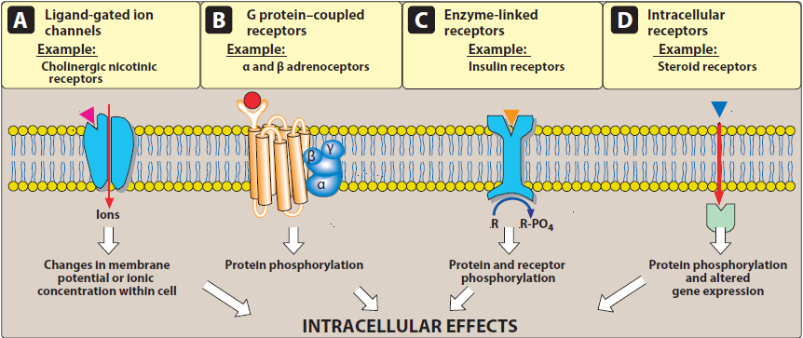

Slide 8
The type of receptor a ligand interacts with depends on the chemical nature of the ligand. Hydrophilic ligands interact with receptors that are found on the cell surface. In contrast, hydrophobic ligands enter cells through the lipid bilayers of the cell membrane to interact with receptors found inside cells.
1. Transmembrane ligand-gated ion channels: The extracellular portion of ligand-gated ion channels usually contains the ligand- binding site. This site regulates the shape of the pore through which ions can flow across cell membranes. The channel is usually closed until the receptor is activated by an agonist, which opens the channel briefly for a few milliseconds. Depending on the ion conducted through these channels, these receptors mediate diverse functions, including neurotransmission, and cardiac or muscle contraction. For example, stimulation of the nicotinic receptor by acetylcholine results in sodium influx and potassium outflux, generating an action potential in a neuron or contraction in skeletal muscle. On the other hand, agonist stimulation of the γ-aminobutyric acid (GABA) receptor increases chloride influx and causes hyperpolarization of neurons.
Voltage-gated ion channels are a class of transmembrane proteins that form ion channels that are activated by changes in the electrical membrane potential near the channel.They possess ligand-binding sites that can regulate channel function. For example, local anesthetics bind to the voltage-gated sodium channel, inhibiting sodium influx and decreasing neuronal conduction.

Slide 9
2. Transmembrane G protein–coupled receptors: The extracellular domain of this receptor contains the ligand-binding area, and the intracellular domain interacts (when activated) with a guanine nucleotide-binding protein (G protein) or effector molecule. There are many kinds of G proteins (for example, Gs, Gi, and Gq), but they all are composed of three protein subunits. The α subunit binds guanosine triphosphate (GTP), and the β and γ subunits anchor the G protein in the cell membrane.
Binding of an agonist to the receptor increases GTP binding to the α subunit, causing dissociation of the α-GTP complex from the βγ complex. These two complexes can then interact with other cellular effectors, usually an enzyme, a protein, or an ion channel, that are responsible for further actions within the cell. These responses usually last several seconds to minutes. Sometimes, the activated effectors produce second messengers that further activate other effectors in the cell, causing a signal cascade effect.
Second messengers are the key distributors of an external signal, as they are released into the cytosol as a consequence of receptor activation and are responsible for affecting a wide variety of intracellular enzymes, ion channels and transporters.

Slide 10
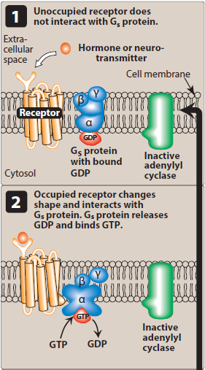
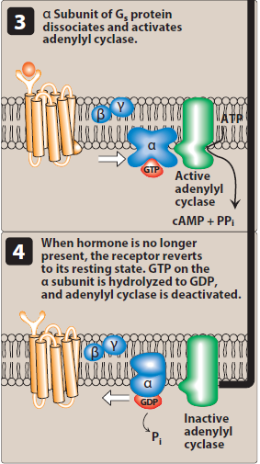

Slide 11
A common effector, activated by Gs and inhibited by Gi, is adenylyl cyclase, which produces the second messenger cyclic adenosine monophosphate (cAMP). Gq activates phospholipase C, generating two other second messengers: inositol 1,4,5-trisphosphate (IP3) and diacylglycerol (DAG). DAG and cAMP activate different protein kinases within the cell, leading to a diversity of physiological effects. IP3 regulates intracellular free calcium concentrations, as well as some protein kinases.
3. Enzyme-linked receptors: This family of receptors consists of a protein that may form dimers or multisubunit complexes. When activated, these receptors undergo conformational changes resulting in increased cytosolic enzyme activity, depending on their structure and function. This response lasts on the order of minutes to hours. The extracellular ligand-binding domain is very large to accommodate their polypeptide ligands (including hormones, growth factors and cytokines).
The most common enzyme-linked receptors (epidermal growth factor, platelet-derived growth factor, atrial natriuretic peptide, insulin, and others) possess tyrosine kinase activity as part of their structure. The activated receptor phosphorylates tyrosine residues on itself and then other specific proteins. Phosphorylation can substantially modify the structure of the target protein, thereby acting as a molecular switch. For example, when the peptide hormone insulin binds to two of its receptor subunits, their intrinsic tyrosine kinase activity causes autophosphorylation of the receptor itself. In turn, the phosphorylated receptor phosphorylates other peptides or proteins that subsequently activate other important cellular signals. This cascade of activations results in a multiplication of the initial signal, much like that with G protein–coupled receptors.

Slide 12
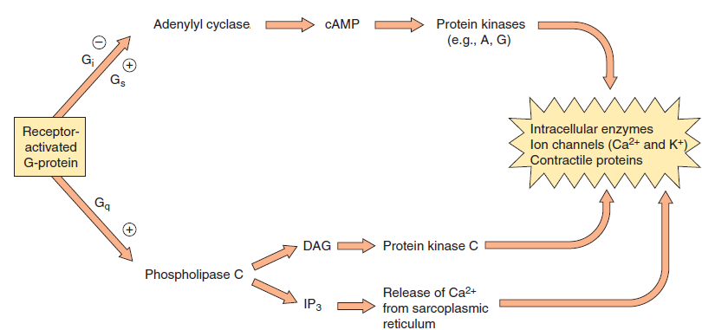

Slide 13
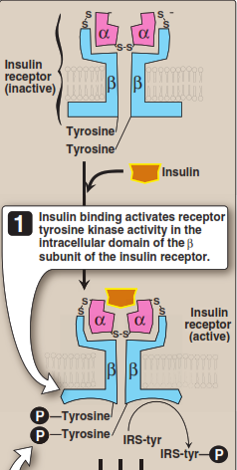
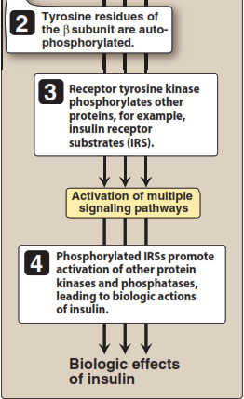

Slide 14
4. Intracellular receptors: The fourth family of receptors differs considerably from the other three in that the receptor is entirely intracellular, and, therefore, the ligand must diffuse into the cell to interact with the receptor. In order to move across the target cell membrane, the ligand must have sufficient lipid solubility. The primary targets of these ligand–receptor complexes are transcription factors in the cell nucleus. Binding of the ligand with its receptor generally activates the receptor via dissociation from a variety of binding proteins. The activated ligand–receptor complex then translocates to the nucleus, where it often dimerizes before binding to transcription factors that regulate gene expression. The activation or inactivation of these factors causes the transcription of DNA into RNA and translation of RNA into an array of proteins. The time course of activation and response of these receptors is on the order of hours to days. Examples include the thyroid hormones and the large group of steroid hormones, including glucocorticoids, mineralocorticoids and the sex steroid hormones. For example, steroid hormones exert their action on target cells via intracellular receptors. Other targets of intracellular ligands are structural proteins, enzymes, RNA, and ribosomes. For example, tubulin is the target of antineoplastic agents such as paclitaxel, the enzyme dihydrofolate reductase is the target of antimicrobials such as trimethoprim, and the 50S subunit of the bacterial ribosome is the target of macrolide antibiotics such as erythromycin.

Slide 15
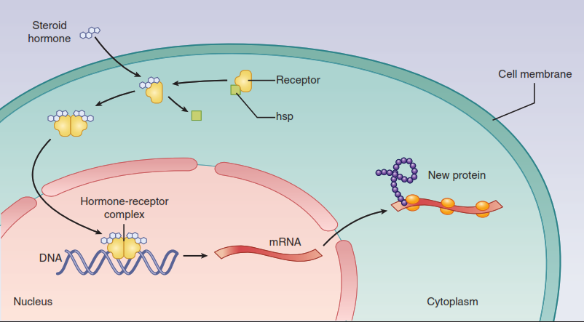

Slide 16
Some characteristics of signal transduction
Signal transduction has two important features:
the ability to amplify small signals
mechanisms to protect the cell from excessive stimulation.
1. Signal amplification: A characteristic of G protein–linked and enzyme-linked receptors is their ability to amplify signal intensity and duration. For example, a single agonist–receptor complex can interact with many G proteins, thereby multiplying the original signal manyfold. Additionally, activated G proteins persist for a longer duration than does the original agonist–receptor complex. The binding of salbutamol, for example, may only exist for a few milliseconds, but the subsequent activated G proteins may last for hundreds of milliseconds. Further prolongation and amplification of the initial signal are mediated by the interaction between G proteins and their respective intracellular targets. Because of this amplification, only a fraction of the total receptors for a specific ligand may need to be occupied to elicit a maximal response. Systems that exhibit this behavior are said to have spare receptors. This might result from 1 of 2 mechanisms. First, the duration of the effector activation may be much greater than the duration of the drug-receptor interaction. Second, the actual number of receptors may exceed the number of effector molecules available.

Slide 17
Spare receptors may function to enhance the speed of cellular response, because an excess of available receptors reduces the distance and therefore the time that a ligand molecule needs to diffuse to find an unoccupied receptor; an example is the excess of acetylcholine nicotinic N receptors that contributes to fast synaptic transmission in the neuromuscular junction. Spare receptors are exhibited by insulin receptors, where it is estimated that 99% of receptors are “spare.” This constitutes a huge functional reserve that ensures that adequate amounts of glucose enter the cell. On the other hand, in the human heart, only about 5% to 10% of the total β-adrenoceptors are spare. An important implication of this observation is that little functional reserve exists in the failing heart, because most receptors must be occupied to obtain maximum contractility.
2. Desensitization and down-regulation of receptors: Repeated or continuous administration of an agonist (or an antagonist) may lead to changes in the responsiveness of the receptor. To prevent potential damage to the cell (for example, high concentrations of calcium, initiating cell death), several mechanisms have evolved to protect a cell from excessive stimulation. When a receptor is exposed to repeated administration of an agonist, the receptor becomes desensitized resulting in a diminished effect. This phenomenon, called tachyphylaxis, is due to either phosphorylation or a similar chemical event that renders receptors on the cell surface unresponsive to the ligand. Intracellular molecules may block access of a G protein to the activated receptor molecule.

Slide 18
Continuous activation of the receptor-effector system may lead to depletion of some essential substrate required for downstream effects. In addition, receptors may be down-regulated such that they are internalized and sequestered within the cell, unavailable for further agonist interaction. These receptors may be recycled to the cell surface, restoring sensitivity, or, alternatively, may be further processed and degraded, decreasing the total number of receptors available. Some receptors, particularly ion channels, require time following stimulation before they can be activated again. During this recovery phase, unresponsive receptors are said to be “refractory.” Similarly, repeated exposure of a receptor to an antagonist may result in up-regulation of receptors, in which receptor reserves are inserted into the membrane, increasing the total number of receptors available. Up-regulation of receptors can make the cells more sensitive to agonists and/or more resistant to the effect of the antagonist.

