Slide 1
Avasular necrosis; AVN( Osteonecrosis, Bone infarction,Ischemic bone necrosis)

Slide 2
Femoral head blood supply

Slide 3
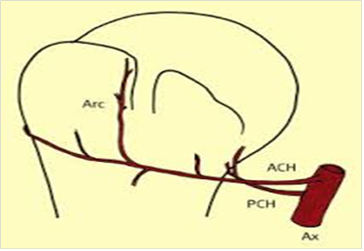
Humerus head blood supply

Slide 4
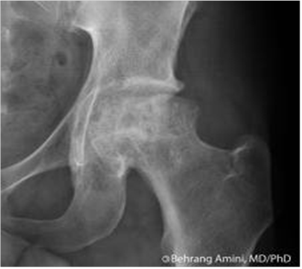
X-Ray of hip joint

Slide 5
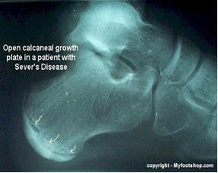
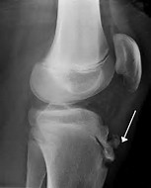
traction type

Slide 6
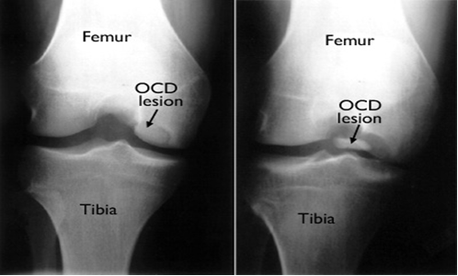
Ostiochonderitis dessicans

Slide 7
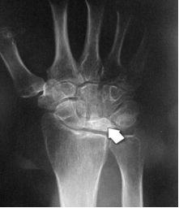
Crushing type

