Slide 1
Wrist & hand disorders

Slide 2
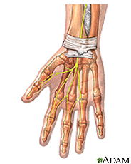
Wrist pain is common. Repetitive motion can damage your wrist. Everyday activities like typing, racquet sports or sewing can cause pain, or even carpal tunnel syndrome. Wrist pain with bruising and swelling can be a sign of injury. The signs of a possible fracture include misshapen joints and inability to move your wrist. Some wrist fractures are a result of osteoporosis.
Other common causes of pain are
Sprains and strains
Tendinitis
Arthritis
Gout and pseudogout

Slide 3
Carpal Tunnel Syndrome
Carpal tunnel syndrome is numbness, tingling, weakness, and other problems in your hand because of pressure on the median nerve in your wrist.

Slide 4
De Quervain syndrome:( de Quervain's stenosing tenosynovitis): is a tenosynovitis of the sheath or tunnel that surrounds two tendons(EPL& APB) that control movement of the thumb. Symptoms are pain at the radial side of the wrist, spasms, tenderness, occasional burning sensation in the hand, and swelling over the thumb side of the wrist, and difficulty gripping with the affected side of the hand. The onset is often gradual. Pain is made worse by movement of the thumb and wrist, and may radiate to the thumb or the forearm.

Slide 5
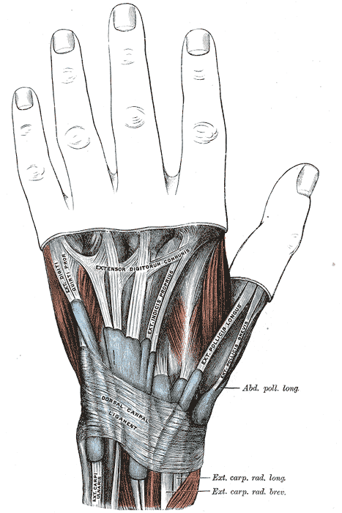

Slide 6
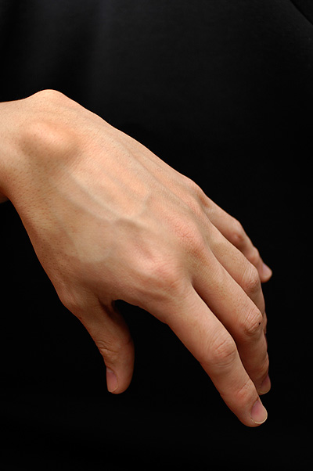
Ganglion cyst:

Slide 7
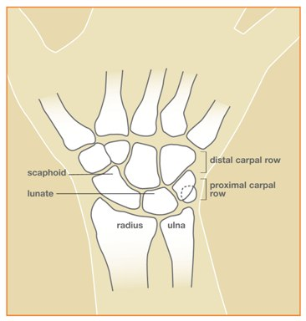
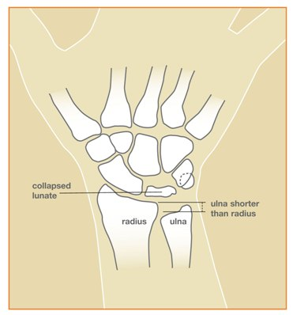
Kienbock’s disease

Slide 8
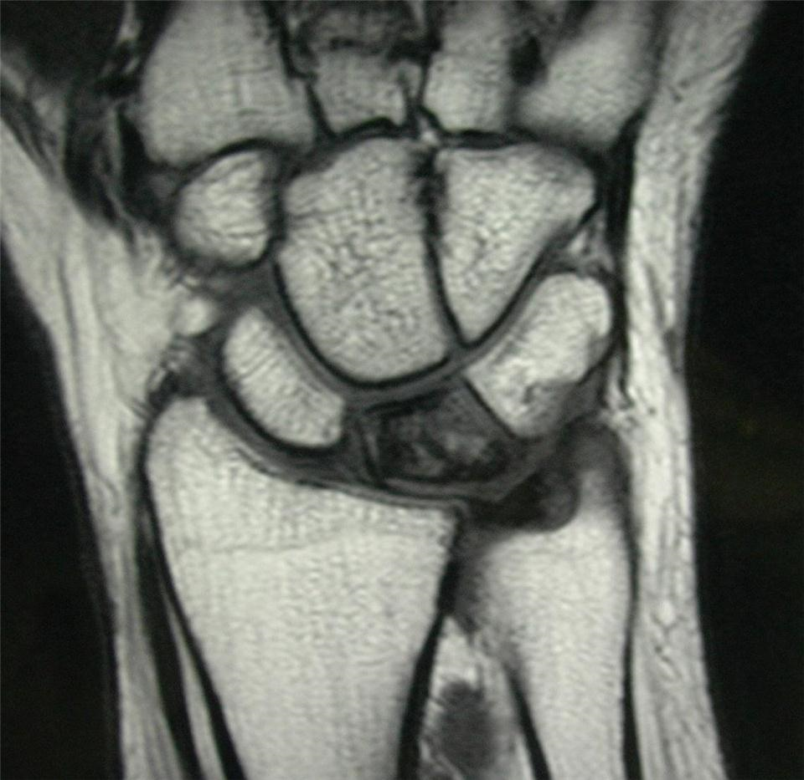

Slide 9
Arthritis of the Hand:
The two most common forms of arthritis from disease are osteoarthritis and rheumatoid arthritis.
-Osteoarthritis is much more common and generally affects older people. Also known as "wear and tear" arthritis, osteoarthritis causes cartilage to wear away..
-Rheumatoid arthritis is a chronic disease that can affect many parts of your body. It causes the joint lining (synovium) to swell.

Slide 10
Hand infections:
-Paronychia
-Felon
-Cellulitis
-Tendon Sheath Infection (“Infectious Tenosynovitis”)
-Bite Wound Infections
-Deep Space Infections
-Septic Arthritis/Osteomyelitis

Slide 11
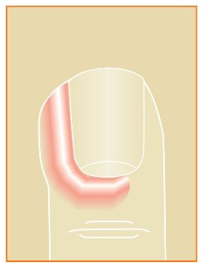

Slide 12
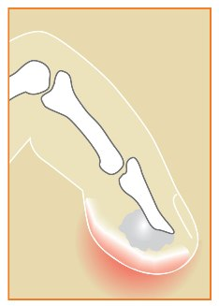

Slide 13
