Slide 1
Upper GIT Bleeding
By
Dr.Mustafa Usama Abdulmageed
General laparoscopic and endoscopic surgery

Slide 2
Upper GIT Bleeding
Objectives :
1- to enumerate the causes of hematemesis and melena .
2-to detect the patient who at high risk ?
3-to discuss every cause and its management .
4-management of upper GIT bleeding (resuscitation ,endoscopic therapy ,surgery, interventional radiology ).
5-Endoscopic classification of upper GIT bleeding .
Definition of Massive upper GIT bleeding

Slide 3
Causes of upper GIT bleeding:
Condition percentages
Ulcer 60
Esophageal 6
Gastric 21
Duodenal 33
Erosions :
Esopghageal 13
Gastric 9
Duodenal 4
Mallory -Weiss tear . 4
Esophageal varices 4
Tumor 0.5
Vascular lesion 0.5
Other : 5

Slide 4
Vascular lesion
include Dieulafoy`s disease .
Isolated gastric varices 2 types.
Watermelon Stomach (Gastric Antral Vascular Ectasia)(GAVE)
Other :
Menetrier`s disease (antrum spared).hypertrophic gastropathy
Aortic enteric fistula .

Slide 5
Risk stratification
is essentially accomplished by answering the following questions:
A. What is the magnitude and the severity of the hemorrhage?
Hypotension, tachycardia, oliguria, low hematocrit, pallor, altered mentation, and/or hematemesis suggest a large blood loss that has occurred over a short period of time.
B. Does the patient have significant chronic disease, particularly lung, liver, kidney, and/or heart disease, which compromises physiologic reserve? If yes, this is a high-risk situation.

Slide 6
C, Is the patient anticoagulated, or immunosuppressed? If yes,this is a high-risk situation.
D. On endoscopy, is the patient bleeding from varices, or is there active bleeding, or is there a visible vessel, or is there a deep ulcer overlying a large vessel (e.g., posterior duodenal ulcer overlying the gastroduodenal artery)?
Could the patient be bleeding from an Arterio enteric fistula? If yes, this is a high-risk situation.

Slide 7
If judged to be low risk, most patients will stop bleeding with supportive treatment and IV PPI.
Selected patients may be discharged from the emergency room and managed on an outpatient basis.

Slide 8
If the patient is judged to be high risk based on one or more of the questions previously listed, then the following should be done immediately:
1. Type and cross-match for transfusion of blood products.
2. Admit to ICU or monitored bed in specialized unit.
3. Consult surgeon.
4. Consult gastroenterologist.
5. Start continuous infusion of PPI.

Slide 9
6. Perform upper endoscopy within 12 hours, after resuscitation and correction of coagulopathy. Endoscopic hemostasis should be considered in most high-risk patients with acute upper GI bleeding.

Slide 10
Bleeding peptic ulcer: gastric ,duodenal ,esophageal
Hx of NSIAD ingestion .
Dx endoscopy .
RX :minimal invasive therapy :Iv PPI H2receptor antagonist .
Endoscopy
Trans catheter embolization .

Slide 15
Bleeding peptic ulcer
Surgery treatment :Indication :
The patient continuous to bleed
Re bleed
Patient with visible vessel in ulcer base
Spurting vessel.
Ulcer with clot in a base .
Elderly ,un fit patient ,atherosclerosis .early surgery
Patients require more than 6 units of blood .

Slide 16
Bleeding peptic ulcer
Bleeding from duodenum: mobilization of the duodenum
Opening the duodenum longitudinally ,under run the bleeding Sp gastroduodenal post. Superior ,closure transverse like pyloroplasty .
In giant ulcer .in proximal duodenum :distal gastrectomy .Roux en y duodenum stump closed
Bleeding from stomach: the same principal under running suture .or large gastrectomy ?? Damage control in friable patient .

Slide 18
Bleeding peptic ulcer:
The surgical options for treating
bleeding PUD include suture ligation of the bleeder; suture
ligation and definitive nonresective ulcer operation (HSV or V +
D); and gastric resection (usually, including vagotomy and ulcer
excision). Gastric ulcer requires biopsy if not resected

Slide 19
Stress ulceration
: major illness or injury ,major surgery or co morbidity .The patient in the intensive care.
The prevention is the best .
Acid suppression with sucralfate .
Endoscopy is useless
Surgery of chronic peptic ulcer .

Slide 20
Gastric ,duodenal,esophageal erosions
Gastric erosions .NSIAD induce erosive gastritis. Most settles spontaneously.

Slide 21
Mallory -Weiss tear :
longitudinal mucosal tear in the cardia rather than full perforation .
Mechanism of injury :
The mechanism is
similar to spontaneous esophageal perforation: an acute increase
in intra-abdominal pressure against a closed glottis in a patient
with a hiatal hernia.

Slide 22
Mallory -Weiss tear :
characterized by arterial bleeding, which may be massive.
Vomiting is not an obligatory factor, as there may be other causes of an acute increase in intraabdominal pressure, such as paroxysmal coughing, seizures,and retching.
Dx :Upper endoscopy confirms the suspicion by identifying one or more longitudinal fissures in the mucosa of the herniated stomach as the source of bleeding.

Slide 23
Mallory -Weiss tear :
In the majority of patients, the bleeding will stop spontaneously with nonoperative management. In addition to blood replacement, the stomach should be decompressed and antiemetics administered, as a distended stomach and continued
vomiting aggravate further bleeding.
A Sengstaken-Blakemore tube will not stop the bleeding, as the pressure in the balloon is not sufficient to overcome arterial pressure.
Endoscopic injection of epinephrine may be therapeutic if bleeding does not
stop spontaneously.

Slide 24
Mallory -Weiss tear :
Only occasionally will surgery be required to stop blood loss.
The procedure consists of laparotomy and
high gastrotomy with oversewing of the linear tear. Mortality is uncommon, and recurrence is rare.

Slide 25
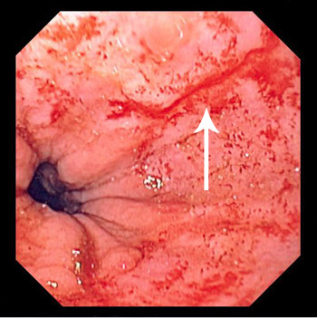

Slide 26
Esophageal varices
Prevention of variveal bleeding :endoscopic surveillance and varivealband liagtion ,medical therapy with b blockers with propranolol and Inderal tab may reduce the risk .
Mx of acute hemorrhage :admission to the ICU ,blood resuscitation ,recombinant factor 7.Cirrhotic patients with risk of spontaneous bacterial peritonitis .vasoactive drug like vasopressin can be used .octereotide 5days or longer ,
Luminal tamponade :balloon tamponade using a Sengstaken-Blakemore
TIPS .surgical shunt

Slide 28
Tumours
Al the tumor of stomach can presented with bleeding .
The bleeding is not massive but un remitting.
Most common is the GIST which is characterized by mucosa break down over the tumor in the gastric wall.

Slide 29
vascular lesion :Isolated gastric varices
::In the absence of esophageal varices.
type 1(fundic),
type 2 include distal to the fundus include proximal duodenum .
sp. For portal hypertension and splenic vein thrombosis .left side portal hypertension .
Rx octreotide or vasopressin .endoscopic sclerotherapy less effective .
Balloon interventional radiology

Slide 30
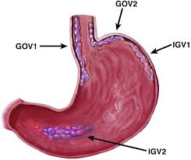

Slide 31
Water- melon stomach or gastric antral vascular ectasia (GAVE)
The parallel red stripes at the top of the mucosal folds of the distal stomach.
characterized by dilated mucosal blood vessels that often contain thrombi, in the lamina propria.
The histologic appearance can resemble portal hypertensive gastropathy, but the latter usually affects the proximal stomach.

Slide 32
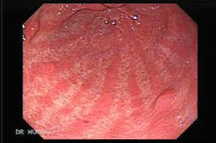

Slide 33
GAVE
Patients are usually elderly women with chronic GI blood loss requiring transfusion.
Most have an associated autoimmune connective tissue disorder, and at least 25% have chronic liver disease.
Nonsurgical treatment options include estrogen and progesterone
endoscopic treatment with the neodymium yttrium-aluminum garnet (Nd:YAG) laser or argon plasma coagulator.
Surgery Antrectomy may be required to control blood loss.

Slide 34
Dieulafoy`s disease
:large sub mucosa arteriovenous malformation in elderly ,presented with upper GIT bleeding .on endoscopy appear large tortuous artery If this artery is eroded, impressive pulsatile bleeding may occur.

Slide 35
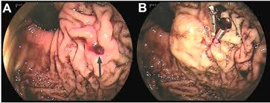

Slide 36
others :Hypertrophic gastropthy ((Ménétrier’s Disease)
Characterized by epithelial hyperplasia and giant gastric fold .mucus production ,hypochorhydria ,aneima .
There are large rugal folds in the proximal stomach, and the antrum is usually spared.
This condition is premalignant .
There is no treatment other than gastrectomy .
The disease is caued by overexpression of transforming growth factor alpha (TGF-α)this peptide bind to EGF .

Slide 37
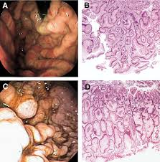

Slide 38
Hypertrophic gastropthy (Ménétrier’s Disease)
Most patients with Ménétrier’s disease are middle-aged men who present with epigastric pain, weight loss, diarrhea,
and hypoproteinemia.
Sometimes, the disease regresses spontaneously.
Gastric resection may be indicated for bleeding, severe hypoproteinemia,or cancer

Slide 39
Aorta enteric fistula
The bleeding is not massive .
Hx of vascular graft .
Dx by CT with angiography .
Rx by expert vascular surgeon .

Slide 40
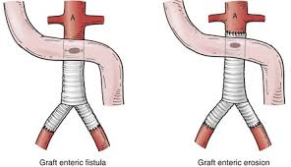

Slide 42
Bezoar and gastric diverticulae
Rare the diverticula occur specially in the fundus and cardia ,usually asymptomatic but my cause bleeding
Rx laparoscopically .
Phytobezoar is common and usually cause obstructive symptoms but rarely ulceration and bleeding.

Slide 44
Thank you for your lessening

