Slide 1
Shock
DR MUSTAFA USAMA
GENERAL LAPARSCOPIC ENDOSCOPIC SURGEON
LECTRUTER IN GENERAL SURGERY

Slide 2
Learning objects
1-to understand pathophysiology of shock and ischemic reperfusion injury .
2-to understand different types of shocks and its resuscitations.
3- who to monitors and end point of resuscitations ?
4- to learn who to use the blood and its component ,advantages and disadvantages of blood transfusions .

Slide 4
Shock
is systemic low tissue perfusion which is inadequate for normal cellular respiration.
With insufficient delivery of oxygen and glucose, cells switch from aerobic to anaerobic metabolism. If perfusion is not restored in a timely fashion, cell death ensues.
(failure to meet the metabolic need of cell that the consequences will ensue ).
The initial injury is reversible but if prolong
Duration will be irreversible.

Slide 5
Pathophysiology of shock
Cellular:
A reduced tissue perfusion at cellular level ,mean low O2 tension the cell change to anaerobic metabolism ,the end products is not carbon dioxide , lactic acidosis.
Glucose metabolism is diminished and anaerobic is abolished the sodium/potassium pump intracellular is stooped ,intracellular lysosomes release and potassium release

Slide 7
Phases of shock
In hemorrhagic shock, the body can compensate for the initial loss of blood volume primarily through the neuroendocrine response to maintain hemodynamics.
This represents the compensated phase of shock.
With continued hypoperfusion, which may be unrecognized, cellular death and injury are ongoing and the decompensation phase of shock ensues. Ischemia/reperfusion injury will often exacerbate the
initial insult.

Slide 8
These effects at the cellular level, if untreated, will
lead to compromise of function at the organ system level, thus leading to the “vicious cycle” of shock .
Persistent hypoperfusion results in further hemodynamic derangements and cardiovascular collapse. This has been termed the irreversible phase of shock and can develop quite insidiously and may
only be obvious in retrospect.

Slide 11
Micro vascular :injury to the capillary endothelium by activation immune and coagulation system leading leaky fluid and tissue edema and cellular hypoxia
Systemic:
Cardiovascular tachycardia and systemic vasoconstriction
Renal
Renin –angiotensin –aldosterone :sodium and water reabsorbtion ,

Slide 12
Respiratory : metabolic acidosis ,compensatory respiratory alkalosis
Endocrine :activation renin angiotensin aldosterone,
Release cortisol and catecholomine

Slide 16
Dx :the clinical sign include
agitation, cool ,clammy extremities, tachycardia, weak or absent peripheral pulses, and hypotension.
Treatment :
The appropriate priorities in these patients are
(a) Secure the airway, (b) control the source of blood loss, and (c) intravenous (IV) volume resuscitation.

Slide 17
Types of shock
Hypovolemic shock:
Cardiogenic shock
Obstructive .
Distributive shock :Septic shock ,anaphylaxis ,spinal cord injury .
Endocrine .
Traumatic .

Slide 18
Hypovolemic shock:
The most common shock
May be hemorrhagic or non hemorrhagic .
Non –haemorrhgic include dehydration,excessive fliud loss (vomiting and diarrhea ).urinary loss diabetes .evaporation.third space ex :fluid loss in the gastrointestinal tract or interstial spaces(intestinal obstruction ,pancreatitis ).

Slide 19
Cardiogenic shock :
clinically defined as circulatory pump failure leading to diminished forward flow and subsequent tissue hypoxia.
Causes:
1- myocardial infarction (most common )
2-pump failure
Mechanical complication :
(vulvular heart disease . Pericardial temponade )
3-cardiac arrythmyia .
4-sever myocardial (blunt, penetrating) injury .
5-cardiomyopathy .
6-left ventricle outflow obstruction: aortic stenosis or failure of left ventricle filling (mitral stenosis).also mitral regurgitation or aortic insuffenciey

Slide 20
7-Metabolic :(sepsis ) 8- drug reaction .
Dx :clinical sign :
Circulatory shock include hypotension, cool and mottled skin, depressed mental status, tachycardia, and diminished pulses. sustained hypotension (i.e., SBP<90 mmHg for at least 30 minutes), reduced cardiac index(<2.2 L/min per square meter), and elevated pulmonary artery wedge pressure (>15 mmHg).
Mortality rates for cardiogenic shock are 50% to 80%
Confirmation of a cardiac source for the shock
Requires electrocardiogram and urgent echocardiography.
other chest radiograph, arterial blood gases, electrolytes, complete blood count, and cardiac enzymes.
Invasive cardiac monitoring, which generally is not necessary, can be useful to exclude right ventricular infarction, hypovolemia, and possible mechanical complications.

Slide 21
Treatment :
Intubation and mechanical ventilation. adequate myocardial O2 delivery
judicious fluid administration
to avoid fluid overload and
development of cardiogenic pulmonary edema.
Dopamine
stimulates receptors (vasoconstriction), β1 receptors (cardiac stimulation), and β2 receptors (vasodilation), with its effects on β receptors predominating at lower doses.
Dopamine may be preferable to dobutamine in treatment of cardiac dysfunction in hypotensive patients.
Intra-aortic balloon pumping
Increases cardiac output and improves coronary blood flow by reduction of systolic afterload and augmentation of diastolic perfusion pressure.

Slide 22
Obstructive shock
is a reduction in preload due to mechanical obstruction of cardiac filling.
Common causes of obstructive shock include
cardiac tamponade,
tension pneumothorax.
massive pulmonary embolus or air embolus.
IVC obstruction: Deep venous thrombosis Gravid uterus on IVC Neoplasm
Increased intrathoracic pressure Excess positive end-expiratory pressure.Neoplasm.
In each case, there is reduced filling of the left and or right sides of the heart leading to reduced preload and a fall in cardiac output.

Slide 23
Dx and treatment to underlying cause .
Distributive shock :Neurogenic .septic ,anaphylactic
Neurogenic shock :
refers to diminished tissue perfusion as a result of loss of vasomotor tone to peripheral arterial beds.
Loss of vasoconstrictor impulses results in increased vascular capacitance, decreased venous return, and decreased cardiac output.
Causes of neurogenic shock
Spinal cord trauma
Spinal cord neoplasm
Spinal/epidural anesthetic.

Slide 24
Diagnosis :
The classic description of neurogenic shock consists of decreased blood pressure associated with bradycardia (absence of reflexive tachycardia due to disrupted sympathetic discharge),
Warm extremities (loss of peripheral vasoconstriction).
Motor and sensory deficits indicative of a spinal cord injury.
Radiographic evidence of a vertebral column fracture.

Slide 25
Treatment :ICU
After the airway is secured and ventilation is adequate, fluid resuscitation and restoration of intravascular volume often will improve perfusion in neurogenic shock.
If the hypotension not restored .@ &B receptors dopamine or phenylepinephrine .the vasoconstrictors for 24-48 hours .

Slide 26
Septic shock and vasodilatory shock :
Vasodilatory shock is the result of dysfunction of the
endothelium and vasculature secondary to circulating inflammatory mediators and cells or as a response to prolonged and severe hypoperfusion.
Thus, in vasodilatory shock, hypotension results from failure of the vascular smooth muscle to constrict
appropriately.
Vasodilatory shock is characterized by peripheral
vasodilation with resultant hypotension and resistance to treatment with vasopressors.

Slide 27
Causes :
Systemic response to infection
Noninfectious systemic inflammation
(Pancreatitis ,Burns)
Anaphylaxis
Acute adrenal insufficiency
Prolonged, severe hypotension
(Hemorrhagic shock ,Cardiogenic shock, Cardiopulmonary bypass)
Metabolic (Hypoxic lactic acidosi,Carbon monoxide poisoning).

Slide 28
Dx:
Patients with sepsis have evidence of an infection, as well as systemic signs of inflammation (e.g., fever, leukocytosis, and tachycardia). Hypoperfusion with signs of organ dysfunction is termed severe sepsis .
Blood culture before antibiotic administration.
Serum lactate level.
Treatment :
mechinical ventilation .
Steriod ,vassopressors (phenyl ipinephrine )
Dobutamine .
iv broad spectum antioboitics .
restoration of fluid crystalloid volume 30ml/kg .
Iv insulin for hyperglycemia.

Slide 29
Anaphylactic shock : massive release of histamine for any allergy .
Endocrine shock :
hypo or hyper thyroidism ,adrenal insufficiency.
Hypothytroidism similar to neurogenic shock in decreasing cardiac and vascular response to circulating catecholamine ,decreasing the cardiac output .
Hyperthyoidism causing high output cardiac failure .
Adrenal insufficiency: shock due to hypovolaemia and
a poor response to circulating and exogenous catecholamines.
Adrenal insufficiency may be due to pre-existing Addison’s disease
or be a relative insufficiency due to a pathological disease
state, such as systemic sepsis.

Slide 30
Severity of shock

Slide 31
Consequences of shock
Unresuscitatable shock
Patients who are in profound shock for a prolonged period of
time become ‘unresuscitatable’.
Cell death follows from cellular ischaemia and the ability of the body to compensate is lost.
There is myocardial depression and loss of responsiveness to fluid
or inotropic therapy.
Peripherally there is loss of the ability to maintain systemic vascular resistance and further hypotension ensues.
The peripheries no longer respond appropriately to vasopressor
agents. Death is the inevitable
Multiple organ failure :
Effects of organ failure
Lung: Acute respiratory distress syndrome
Kidney: Acute liver insufficiency
Clotting: Coagulopathy
Cardiac: Cardiovascular failure

Slide 32
Resuscitation and monitoring
Monitoring :
Minimum
ECG
Pulse oximetry
Blood pressure
Urine output
Additional modalities
Central venous pressure
Invasive blood pressure
Cardiac output
Base deficit and serum lactate .

Slide 33
Fluid therapy
The best fluid between colloid and crystalloid .
( Ringer /hartman solution ,ringer lactate ,normal saline ).
The blood .
Base deficient / serum lactate level >6mmol/l
Sever metabolic acidosis .

Slide 34
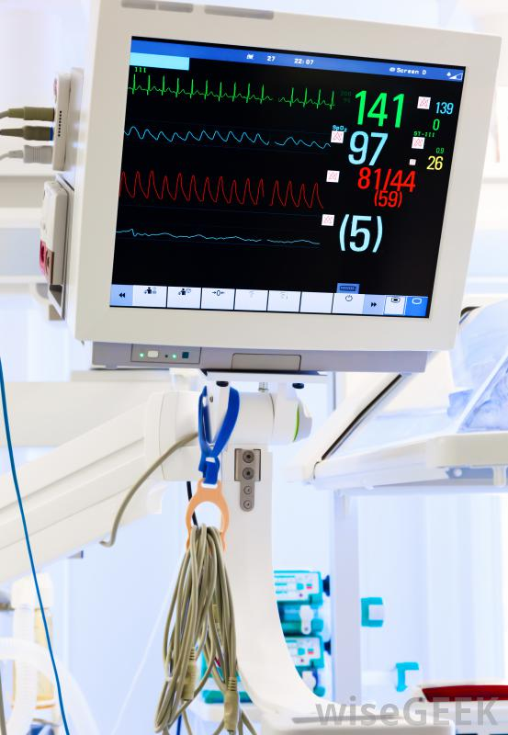

Slide 35
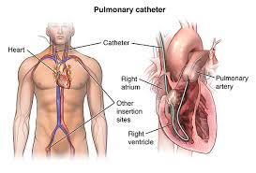

Slide 36
