Slide 1
REPAIR BY CONNECTIVE TISSUE
DR. AYSER HAMEED
LEC.6

Slide 2
Healing or repair by connective tissue is encountered if:-
1. A severe or persistent (chronic) tissue injury that result in damage to parenchymal cells as well as the stromal framework.
2. Injury affects nondividing cells.

Slide 3
Under these conditions, repair occurs by replacement of the nonregenerated cells with connective tissue, or by a combination of regeneration of some cells and scar formation.
Repair begins within 24 hours of injury by the emigration of fibroblasts and the induction of fibroblast and endothelial cell proliferation.

Slide 4
By 3 to 5 days, a specialized type of tissue that is characteristic of healing, called granulation tissue is apparent. The term granulation tissue derives from the pink, soft, granular gross appearance, such as that seen beneath the scab of a skin wound.

Slide 5
Its microscopic appearance is characterized by proliferation of fibroblasts and new thin-walled, delicate capillaries (angiogenesis), in a loose ECM. Granulation tissue then progressively accumulates connective tissue matrix, eventually resulting in the formation of a scar, which may remodel over time.

Slide 6
Granulation tissue formation in wound healing
Rt. There are numerous blood vessels, edema, and a loose extracellular matrix containing occasional inflammatory cells.
Lt. at high magnification, granulation tissue has capillaries, fibroblasts, and a variable amount of inflammatory cells.

Slide 7
Repair by connective tissue deposition consists of four sequential processes:
Formation of new blood vessels (angiogenesis).
Migration and proliferation of fibroblasts.
Deposition of ECM (scar formation).
Maturation and reorganization of the fibrous tissue (remodeling).

Slide 8
Angiogenesis (neovascularization)
The preexisting vessels send out capillary sprouts to produce new vessels. Angiogenesis is a critical process in:-
Healing at sites of injury.
The development of collateral circulations at sites of ischemia.
In allowing tumors to increase in size beyond the limits of their original blood supply.

Slide 9
It has recently been found that endothelial precursor cells may migrate from the bone marrow to areas of injury and participate in angiogenesis at these sites. Much work has been done to understand the mechanisms underlying angiogenesis, and therapies to either enhance the process (e.g., to improve blood flow to a heart ruined by coronary atherosclerosis) or inhibit it (to interfere with tumor growth) are being developed.
New vessels formed during angiogenesis are leaky.

Slide 10
This leakiness explains why granulation tissue is often edematous, and accounts in part for the edema that may persist in healing wounds long after the acute inflammatory response has resolved. Several factors induce angiogenesis, but the most important are VEGF and basic fibroblast growth factor (FGF-2).

Slide 11
VEGF stimulates both proliferation and motility of endothelial cells, thus initiating the process of capillary sprouting. In angiogenesis involving endothelial cell precursors from the bone marrow, VEGF acts through VEGFR-2 to mobilize these cells from the bone marrow and to induce proliferation and motility of these cells at the sites of angiogenesis.

Slide 12
Migration of Fibroblasts and ECM Deposition (Scar Formation):-
Scar formation builds on the granulation tissue framework of new vessels and loose ECM that develop early at the repair site. It occurs in two steps:
1. Migration and proliferation of fibroblasts into the site of injury, and
2. Deposition of ECM by these cells.
The recruitment and stimulation of fibroblasts is driven by many growth factors, including PDGF.

Slide 13
One source of this factor is the activated endothelium, but more importantly, growth factors are also elaborated by inflammatory cells.
Macrophages, in particular, are important cellular constituents of granulation tissue, and besides clearing extracellular debris and fibrin at the site of injury, they elaborate a host of mediators that induce fibroblast proliferation and ECM production.
Mast cells and lymphocytes can contribute directly or indirectly to fibroblast proliferation and activation.

Slide 14
As healing progresses, the number of proliferating fibroblasts and new vessels decreases; however, the fibroblasts progressively become more synthetic, and hence there is increased deposition of ECM. Collagen synthesis, in particular, is critical to the development of strength in a healing wound site.
Collagen synthesis by fibroblasts begins early in wound healing (days 3 to 5) and continues for several weeks, depending on the size of the wound.

Slide 15
The same growth factors that regulate fibroblast proliferation also participate in stimulating ECM synthesis. Net collagen accumulation, however, depends not only on increased synthesis but also on diminished collagen degradation.

Slide 16
Ultimately, the granulation tissue scaffolding evolves into a scar composed of largely inactive, spindle-shaped fibroblasts, dense collagen, fragments of elastic tissue, and other ECM components.
As the scar matures, there is progressive vascular regression, which eventually transforms the highly vascularized granulation tissue into a pale, largely avascular scar.

Slide 17
Many growth factors are involved in the above processes, including TGF-β, PDGF, and FGF as well as cytokines (IL-1 & TNF).
ECM and Tissue Remodeling
The transition from granulation tissue to scar involves shifts in the composition of the ECM; even after its synthesis and deposition, scar ECM continues to be modified and remodeled.

Slide 18
The outcome of the repair process is, in part, a balance between ECM synthesis and degradation. The degradation of collagens and other ECM components is accomplished by a family of matrix metalloproteinases (MMPs), which are dependent on zinc ions for their activity.

Slide 19
MMPs include interstitial enzymes that degrade collagen, fibronectin, proteoglycans, & laminin.
MMPs are produced by a variety of cell types (fibroblasts, macrophages, neutrophils, synovial cells), and their synthesis and secretion are regulated by growth factors, cytokines, and other agents. Their synthesis may be suppressed pharmacologically with steroids.

Slide 20
CUTANEOUS WOUND HEALING
This is a process that involves both epithelial regeneration and the formation of connective tissue scar and is thus illustrative of the general principles that apply to wound healing in all tissues. The events are orchestrated by interplay of growth factors and ECM.
Cutaneous wound healing has three main phases:-
Inflammation.
formation of granulation tissue.
ECM deposition and remodeling .

Slide 21
Larger wounds also contract during the healing process.
Events in wound healing overlap to a great extent and cannot be completely separated from each other.
Based on the nature of the wound, the healing of cutaneous wounds can occur by first or second intention.
Healing by First Intention
One of the simplest examples of wound repair is the healing of a clean, uninfected surgical incision approximated by surgical sutures. This is referred to as primary union or healing by first intention.

Slide 22
The incision causes only focal disruption of epithelial basement membrane continuity and death of a relatively few epithelial and connective tissue cells. As a result, epithelial regeneration predominates over fibrosis. A small scar is formed, but there is minimal wound contraction.
The narrow incisional space first fills with fibrin-clotted blood.
Within 24 hours, neutrophils are seen at the incision margin, migrating toward the fibrin clot.

Slide 23
Within 24 to 48 hours, epithelial cells from both edges have begun to migrate and proliferate along the dermis. The cells meet in the midline beneath the surface scab, yielding a thin but continuous epithelial layer.
By day 3, neutrophils have been largely replaced by macrophages, and granulation tissue progressively invades the incision space. Epithelial cell proliferation continues, yielding a thickened epidermal covering layer.
By day 5, neovascularization reaches its peak as granulation tissue fills the incisional space.

Slide 24
The epidermis recovers its normal thickness as differentiation of surface cells yields a mature epidermal architecture with surface keratinization.
During the second week, there is continued collagen accumulation and fibroblast proliferation that bridge the incision.
The leukocyte infiltrate, edema, and increased vascularity are diminished.
The long process of "blanching" begins, accomplished by increasing collagen deposition within the incisional scar and the regression of vascular channels.

Slide 25
By the end of the first month, the scar comprises a cellular connective tissue largely devoid of inflammatory cells and covered by an essentially normal epidermis. The tensile strength of the wound increases with time.
However, the dermal appendages destroyed in the line of the incision are permanently lost.

Slide 26
Healing by Second Intention (healing by secondary union):-
When cell or tissue loss is more extensive, the repair process is more complex, the inflammatory reaction is more intense, there is abundant development of granulation tissue, and the wound contracts by the action of myofibroblasts.

Slide 27
This is followed by accumulation of ECM and formation of a large scar. This mode of healing occurs in:-
Large wounds.
Abscesses .
Ulcerations.
After infarction in parenchymal organs.

Slide 28
Secondary healing differs from primary healing in several respects:
A larger clot or scab rich in fibrin and fibronectin forms at the surface of the wound.
Inflammation is more intense because large tissue defects have a greater volume of necrotic debris, exudate, and fibrin that must be removed.

Slide 29
Much larger amounts of granulation tissue are formed. A greater volume of granulation tissue generally results in a greater mass of scar tissue.
Secondary healing involves wound contraction. Within 6 weeks, for example, large skin defects may be reduced to 5% to 10% of their original size, largely by contraction. This process has been ascribed to the presence of myofibroblasts, which are modified fibroblasts exhibiting many of the ultrastructural and functional features of contractile smooth muscle cells.

Slide 30
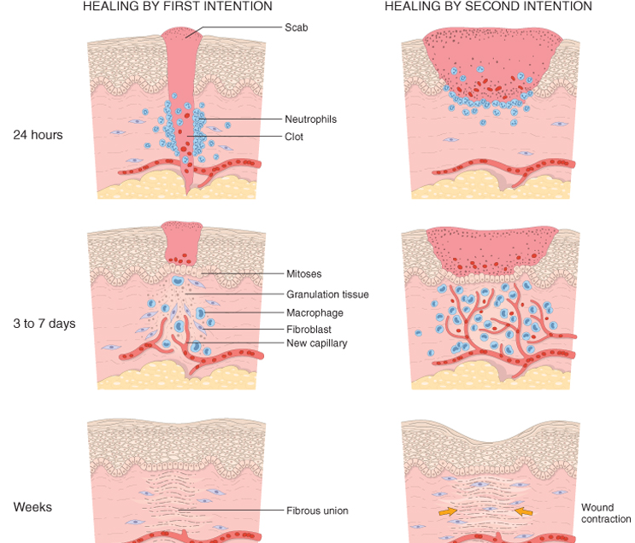
Wound healing
Steps in wound healing by first intention (left) and second intention (right). In the latter, note the large amount of granulation tissue and wound contraction.

Slide 31
Wound Strength
Carefully sutured wounds have approximately 70% of the strength of unwounded skin, largely because of the placement of the sutures. When sutures are removed, usually at 1 week, wound strength is approximately 10% of that of unwounded skin, but this increases rapidly over the next 4 weeks.

Slide 32
The recovery of tensile strength results from collagen synthesis exceeding degradation during the first 2 months, and from structural modifications of collagen (e.g., cross-linking and increased fiber size) when synthesis declines at later times. Wound strength reaches approximately 70% to 80% of normal by 3 months but usually does not substantially improve beyond that point.

Slide 33
PATHOLOGIC ASPECTS OF REPAIR
Wound healing may be affected by several external or internal influences that reduce the quality or adequacy of the reparative process. Particularly important are infections and diabetes.
These adverse influences include:-
1. Infection is the single most important cause of delay in healing; it prolongs the inflammation phase of the process and potentially increases the local tissue injury.
2. Nutrition has profound effects on wound healing; protein deficiency & vitamin C deficiency, inhibits collagen synthesis and retards healing.

Slide 34
3. Glucocorticoids (steroids) have anti-inflammatory effects, and their administration may result in poor wound strength due to diminished fibrosis. In some instances, however, the anti-inflammatory effects of glucocorticoids are desirable. For example, in corneal infections, glucocorticoids are sometimes prescribed (along with antibiotics) to reduce the likelihood of opacity that may result from collagen deposition.
4. Mechanical variables such as increased local pressure or torsion may cause wounds to pull apart, or dehisce i.e. open out or gape.

Slide 35
5. Poor perfusion, due either to arteriosclerosis and diabetes or to obstructed venous drainage (e.g. in varicose veins), also impairs healing
6. Foreign bodies such as fragments of steel, glass, or even bone impede healing.

Slide 36
7. The type (and volume) of tissue injured is critical. Complete restoration can occur only in tissues composed of stable and labile cells; even then, extensive injury will probably result in incomplete tissue regeneration and at least partial loss of function.

Slide 37
Injury to tissues composed of permanent cells must inevitably result in scarring with, at most, attempts at functional compensation by the remaining viable elements. Such is the case with healing of a myocardial infarct.

Slide 38
8. The location of the injury and the character of the tissue in which the injury occurs are also important. For example, inflammation arising in tissue spaces (e.g., pleural, peritoneal, synovial cavities) develops extensive exudates. Subsequent repair may occur by digestion of the exudate, initiated by the proteolytic enzymes of leukocytes and resorption of the liquefied exudate.

Slide 39
This is called resolution, and in the absence of cellular necrosis, normal tissue architecture is generally restored. However, in the setting of larger accumulations, the exudate undergoes organization: granulation tissue grows into the exudate, and a fibrous scar ultimately forms.

Slide 40
Aberrations of cell growth and ECM production
This may occur even in what begins as normal wound healing.
1. Keloid refers to the accumulation of exuberant amounts of collagen that give rise to prominent, raised scars. There appears to be a heritable predisposition to keloid formation, and the condition is more common in blacks.

Slide 41
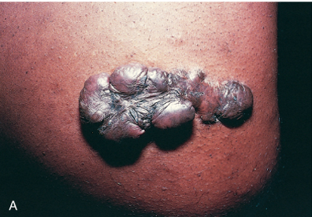
Keloid
Excess collagen deposition in the skin forming a raised scar known as a keloid.
id.

Slide 42
2. Exuberant granulation: healing wounds may also generate excessive granulation tissue that protrudes above the level of the surrounding skin and hinders re-epithelialization. The restoration of epithelial continuity requires cautery or surgical resection of the granulation tissue.

Slide 43
3. Disabling fibrosis associated with chronic inflammatory diseases such as rheumatoid arthritis, pulmonary fibrosis, and cirrhosis have many similarities to those involved in normal wound healing. In these diseases, however, persistent stimulation of fibrogenesis results from chronic immune reactions that sustain the synthesis and secretion of growth factors, fibrogenic cytokines, and proteases.

Slide 44
Collagen degradation by collagenases, normally important in wound remodeling, is responsible for much of the joint destruction seen in rheumatoid arthritis.

Slide 45
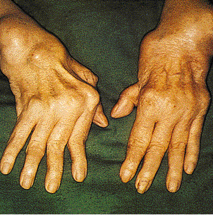
Rheumatoid arthritis
This deformity of the hand is due to rheumatoid arthritis (RA). This autoimmune disease leads to synovial proliferation and joint destruction, typically in a symmetrical pattern involving small joints of hands and feet, followed by wrists, ankles, elbows, and knees. Rheumatoid factor can be identified serologically in most, but not all, RA patients.

