Slide 1
Enterobacteriaceae
Dr.Salma

Slide 2
Enterobacteriaceae Family
Enterics
Large family of small, non-spore-forming Gram-negative rods
Many members inhabit soil, water, decaying matter, and are common occupants of large bowel of animals including humans.
Most frequent cause of diarrhea through enterotoxins
Enterics, along with Pseudomonas sp., account for almost 50% of nosocomial infections.

Slide 3
1- Gram negative non spore-forming rods. Some are motile, others are capsule producing.
2- Facultative anaerobes
3- Ferment glucose with or without gas
4- Not fastidious but can grow on ordinary media
5- Oxidase negative

Slide 4
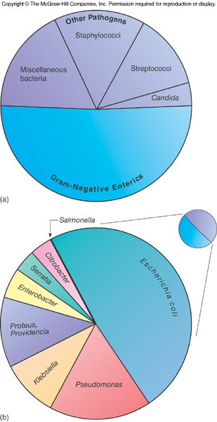

Slide 5
Gram (–)ve rods
1- Enteric rods Facultative an-aerobic (Enterobacteriacea) 2- non - Enteric rods Obligatory aerobic
Facultative an-aerobic
a. Facultative an-aerobic(Enterobacteriacea)
* Microscopic examination
Short G - ve rods , motile (except klebsiella and shigella), non –capsulated (except klebsiella)
Cultural appearance *
the colonies of enterobacteriacea in general (circular ,convex ,smooth colonies ).
On MacConkey : Selective media for enterobacteriacea .
Differential media *Lactose fermenter (pink colonies) such as E.coli and Klebsiella.
*Non- lactose fermenter (colorless colonies) such as Proteus , Salmonella and Shigella.

Slide 6
Enterobacteriaceae
ferment glucose, reduce nitrate
catalase positive and oxidase negative
the ability to ferment lactose Escherichia, Klebsiella, Enterobacter, Citrobacter, and Serratia spp
do not ferment lactose Proteus, Salmonella, Shigella, and Yersinia spp.
Some have prominent capsules

Slide 8
Lactose fermentation

Slide 10
Facultative anaerobes, grow best in air
All ferment glucose, reduce nitrates to nitrites, oxidase negative, and catalase positive.
Divided into coliforms (lactose fermenters) and non-coliforms (non-lactose fermenters)
Enrichment, selective and differential media utilized for screening samples for pathogens

Slide 11
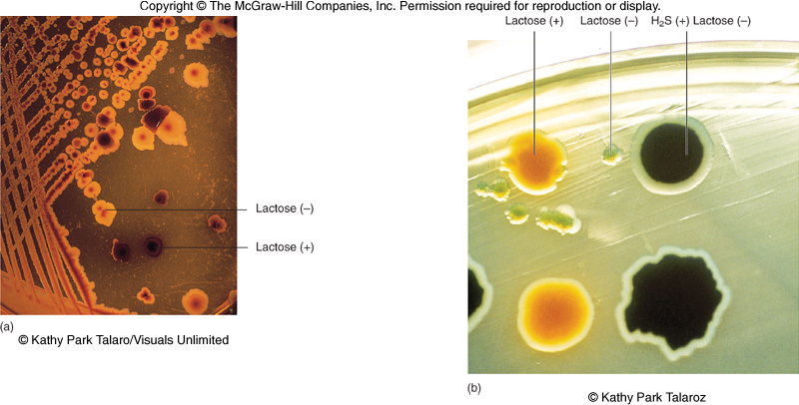

Slide 12
Enterobacteriaceae
become pathogenic when they acquire virulence factor
can originate from an animal
or from a human carrier
or through the endogenous spread of organisms

Slide 13
Antigenic Structures and Virulence Factors
Complex surface antigens contribute to pathogenicity and trigger immune response:
H – flagellar Ag
K – capsule and/or fimbrial Ag
O – somatic or cell wall Ag – all have
Endotoxin
Exotoxins

Slide 16
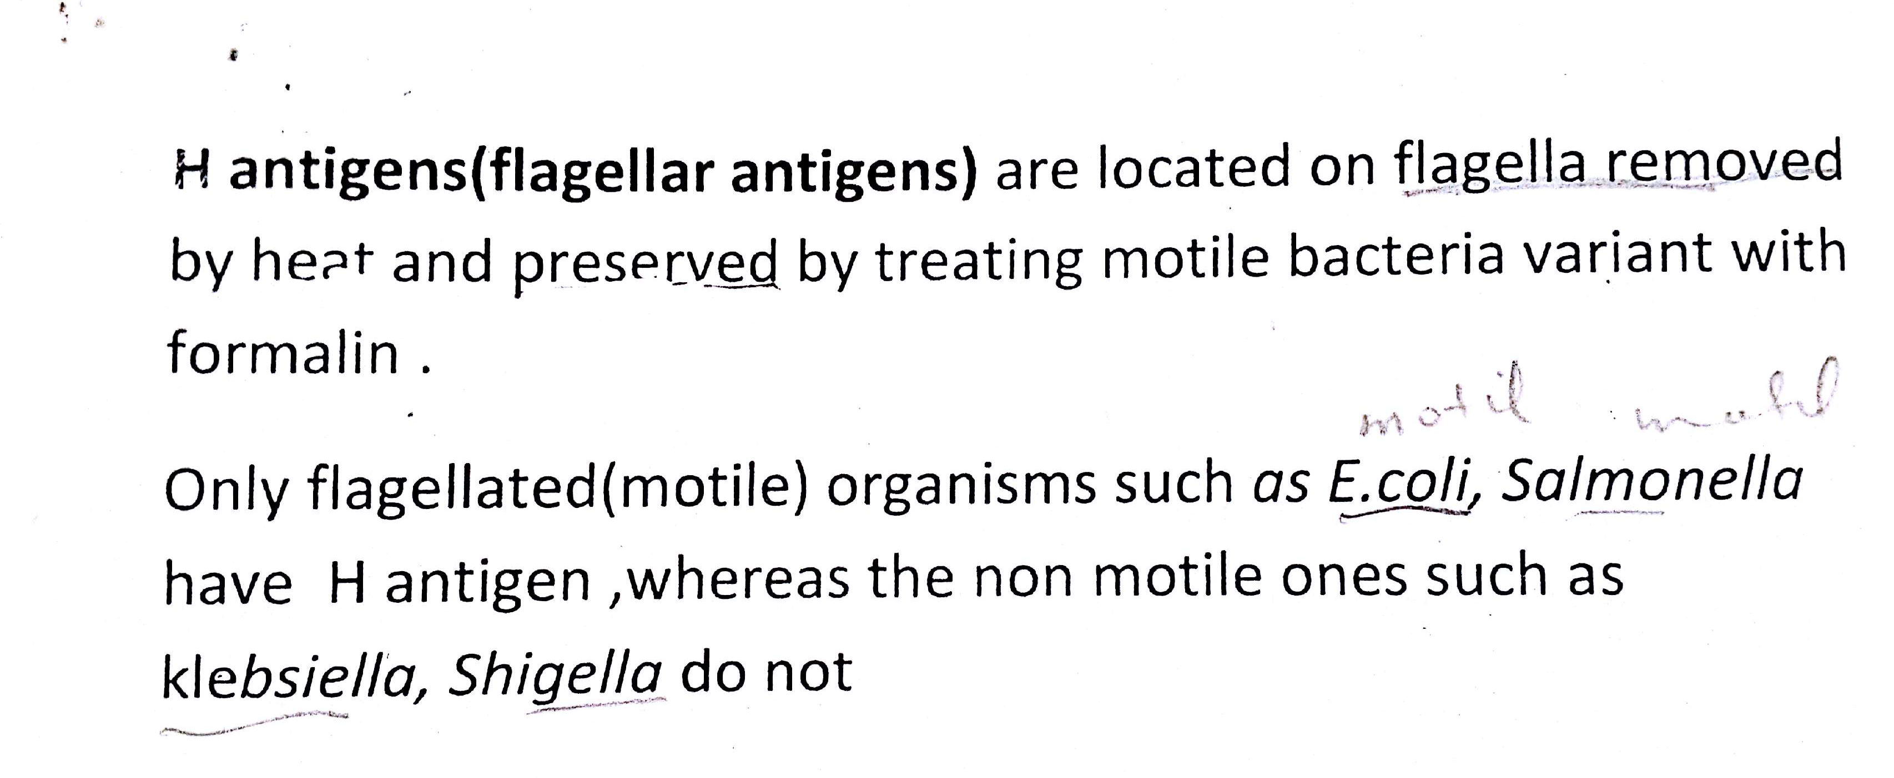

Slide 17
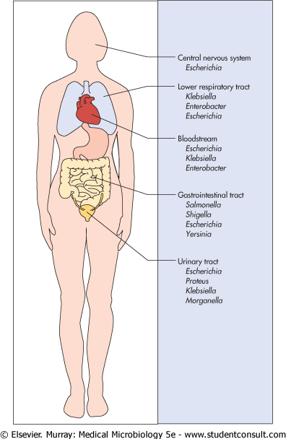
Sites of infections with common members of the Enterobacteriaceae listed in order of prevalence

Slide 18
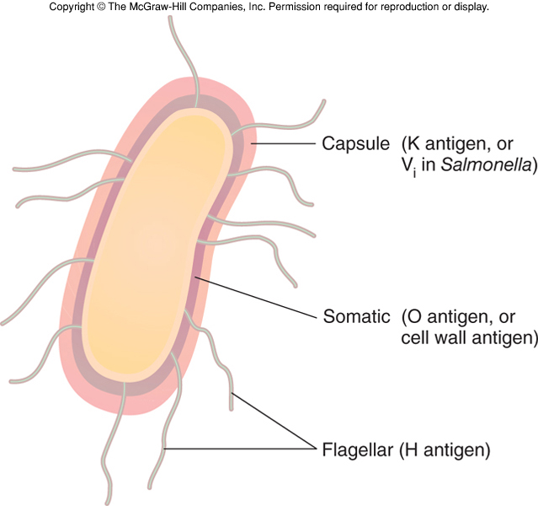

Slide 19
Enterobacteriaceae
Resistance to bile salts
Some have capsules
Common Medically Important Enterobacteriaceae
Citrobacter freundii, Citrobacter koseri
Enterobacter aerogenes, Enterobacter cloacae
Escherichia coli
Klebsiella pneumoniae, Klebsiella oxytoca
Morganella morganii
Proteus mirabilis, Proteus vulgaris
Salmonella enterica
Serratia marcescens
Shigella sonnei, Shigella flexneri
Yersinia pestis, Yersinia enterocolitica, Yersinia pseudotuberculosis

Slide 21
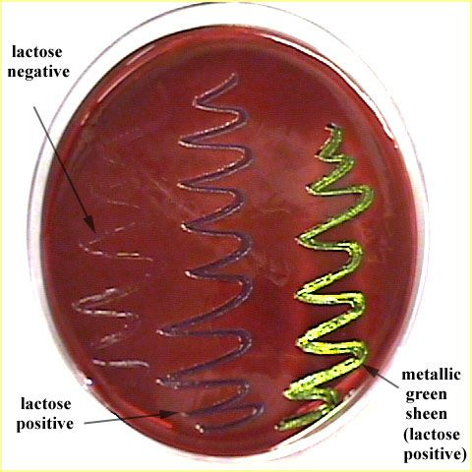

Slide 23
Triple sugar iron (TSI)

Slide 24
Thank you

