Slide 1
Inhibitors of Bacterial Cell Wall Synthesis

Slide 2
Some antimicrobial drugs selectively interfere with synthesis of the bacterial cell wall—a structure that mammalian cells do not possess. The cell wall is composed of a polymer called peptidoglycan that consists of glycan units joined to each other by peptide cross-links. To be maximally effective, inhibitors of cell wall synthesis require actively proliferating microorganisms.
The most important members of this group of drugs are the β-lactam antibiotics (named after the β-lactam ring that is essential to their activity, they include penicillin derivatives, cephalosporins, monobactams, and carbapenems), vancomycin, and daptomycin.
The penicillins were the first antibiotics to be discovered and isolated, and their development introduced the modern era of antimicrobial chemotherapy in the 1940s. Despite the growing problem of microbial resistance to these drugs, they have remained one of the most widely used groups of antibiotics for over 70 years.

Slide 3
Cell Envelope
Two components of the cell envelope that are found in both gram-positive and gram-negative bacteria : the cytoplasmic membrane and the cell wall. The cell wall is much thicker in gram-positive bacteria than it is in gram-negative bacteria. The envelope of each gram-negative bacterium also has an outer membrane that is not found in other types of bacteria.

Slide 4
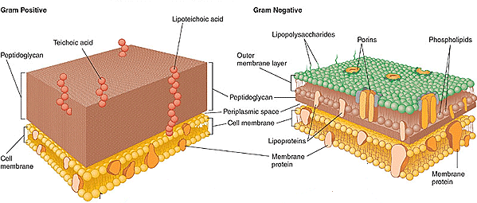

Slide 5
Cytoplasmic and Outer Membranes
The cytoplasmic membrane contains various types of transport proteins, which facilitate the uptake of a wide variety of substrates used by bacteria, and it also contains several enzymes required for the synthesis of the cell wall. These enzymes are collectively known as penicillin-binding proteins (PBPs).
The outer membrane of gram-negative bacteria contains species forms of a complex lipopolysaccharide and various types of protein channels called porins. Porins allow ions and other small hydrophilic molecules to pass through the outer membrane, and they are responsible for the entry of several types of antibiotics.
The bacterial cytoplasmic membrane is the target of two peptide antibiotics, daptomycin and polymyxin. These drugs act directly on the cell membranes to increase membrane permeability and thereby cause the cytoplasmic contents to leak out of the cell.

Slide 6
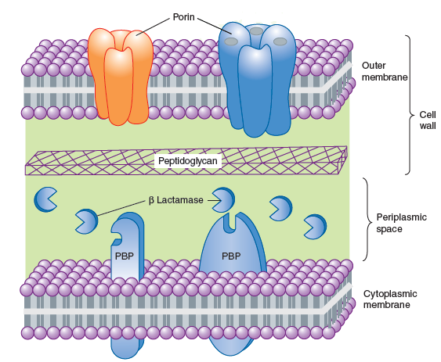

Slide 7
Cell Wall
The cell wall consists primarily of peptidoglycan, a polymer constructed from repeating disaccharide units of N-acetylglucosamine and N-acetylmuramic acid. Each disaccharide is attached to others through glycosidic bonds. Each molecule of N-acetylmuramic acid has a peptide containing two molecules of d-alanine and a pentaglycine side chain. The strands of peptidoglycan in the cell wall are cross-linked by penicillin-binding proteins (PBPs) in a transpeptidation reaction in which the glycine pentapeptide of one strand is attached to the penultimate d-alanine molecule of another strand. During this reaction, the terminal d-alanine is removed.
The cell wall maintains the shape of the bacterium and protects it from osmotic lysis if it is placed in a hypotonic medium. Without a cell wall, the bacterium is unprotected. This is why inhibition of cell wall synthesis by antimicrobial drugs is usually bactericidal. The cell wall is synthesized during bacterial replication, and drugs that inhibit cell wall synthesis are more active against rapidly dividing bacteria than they are against bacteria in the resting or stationary phase.

Slide 8
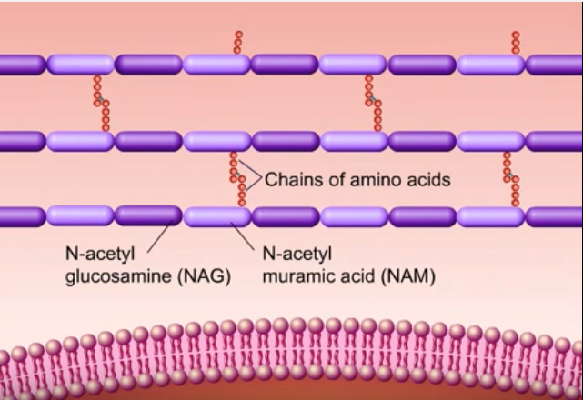
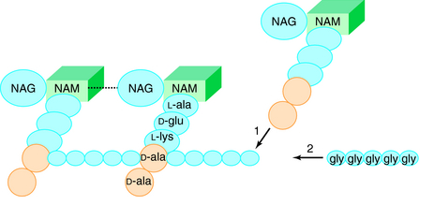

Slide 9
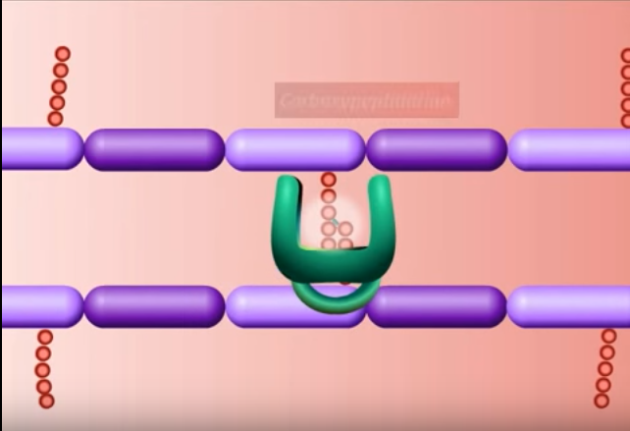

Slide 10
Sites of Drug Action
β-Lactam Drugs
The β-lactam antibiotics bind to the PBPs which are responsible for the assembly, maintenance, and regulation of the peptidoglycan portion of the bacterial cell wall.
The β-lactam antibiotics are structural analogs of the natural D-Ala-D-Ala substrate and form a covalent bond with PBPs and thereby inhibit the catalytic activity of these enzymes. Inhibition of some PBPs prevents elongation or cross- linking of peptidoglycan ,whereas inhibition of other PBPs leads to the bacterium’s autolysis (by inducing the production of degradative enzymes called as autolysins that participate in the normal remodeling of the bacterial cell wall) or to its change to a spheroplast or a filamentous form.
Each bacterial species has a unique set of PBPs to which particular β-lactam antibiotics bind with varying affinities. This partly accounts for the variation in the sensitivity of different organisms to β-lactam antibiotics.

Slide 11
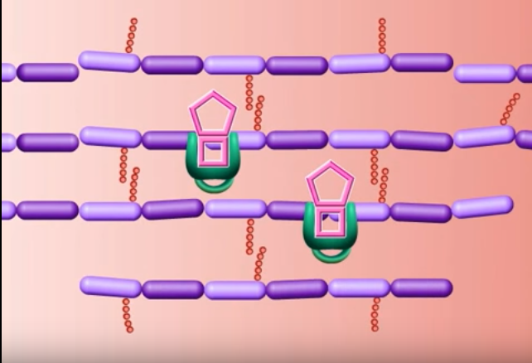

Slide 12
Other Drugs
Bacitracin and fosfomycin inhibit cell wall peptidoglycan synthesis by blocking specific steps in the formation of the disaccharide precursors. Vancomycin binds tightly to the D-alanyl- D-alanine portion of the peptidoglycan precursor and prevents bonding of the penultimate d-alanine to the pentaglycine peptide during cross-linking of peptidoglycan strands.

Slide 13
β-lactam Antibiotics
The β-lactam antibiotics include penicillins, cephalosporins, carbapenems, and a monobactam antibiotic.
Penicillins
The penicillins are among the most widely effective and the least toxic drugs. The antibacterial effect of a penicillin is the result of both inhibition of cell wall synthesis and destruction of the existing cell wall by autolysins.
Penicillins can be grouped according to their antimicrobial activity. Narrow-spectrum penicillins include penicillin G (benzyl penicillin) and penicillin V. Penicillinase-resistant penicillins include dicloxacillin and nafcillin. Extended-spectrum penicillins include the aminopenicillins (amoxicillin and ampicillin) and the antipseudomonal penicillins (piperacillin, ticarcillin).

Slide 14
Chemistry
The penicillins consist of a β-lactam ring fused to a thiazolidine ring to which a unique chemical structure (R group) is attached for each antibiotic. The natural penicillins isolated from strains of Penicillium were originally assigned letter designations because their chemical structures could not be identified at that time. Penicillin G and penicillin V are the only natural penicillins still used today, and they are classified as narrow-spectrum drugs.
Semisynthetic penicillins are produced by substituting a different R group for the R group of natural penicillin. The nature of this side chain affects the antimicrobial spectrum, stability to stomach acid, cross- hypersensitivity, and susceptibility to bacterial degradative enzymes (β- lactamases).
The penicillinase-resistant penicillins have a large, bulky R group that protects them from hydrolysis by staphylococcal penicillinase, a specific type of bacterial β-lactamase.

Slide 15
Spectrum and Indications:
The antibacterial spectrum of the various penicillins is determined, in part, by their ability to cross the bacterial peptidoglycan cell wall to reach the PBPs in the periplasmic space. Factors that determine the susceptibility of PBPs to these antibiotics include the size, charge, and hydrophobicity of the particular β-lactam antibiotic. In general, gram-positive microorganisms have cell walls that are easily traversed by penicillins, and therefore, in the absence of resistance, they are susceptible to these drugs.
Gram-negative microorganisms have an outer lipopolysaccharide membrane surrounding the cell wall that presents a barrier to the water-soluble penicillins. However, gram-negative bacteria have porins that permit transmembrane entry.

Slide 16
The narrow-spectrum penicillins: penicillins G has activity against a variety of gram-positive organisms, gram-negative organisms, and spirochetes. The potency of penicillin G is five to ten times greater than that of penicillin V against both Neisseria spp. and certain anaerobes. Most streptococci are very sensitive to penicillin G, but penicillin-resistant viridans streptococci and Streptococcus pneumoniae isolates are emerging. The vast majority of Staphylococcus aureus (greater than 90%) are now penicillinase producing and therefore resistant to penicillin G. Penicillin G remains the drug of choice for the treatment of gas gangrene (Clostridium perfringens) and syphilis (Treponema pallidum).
Penicillin V, the oral form of penicillin, is indicated only in minor infections because of its relatively poor bioavailability, the need for dosing four times a day, and its narrow antibacterial spectrum. Amoxicillin (see below) is often used instead

Slide 17
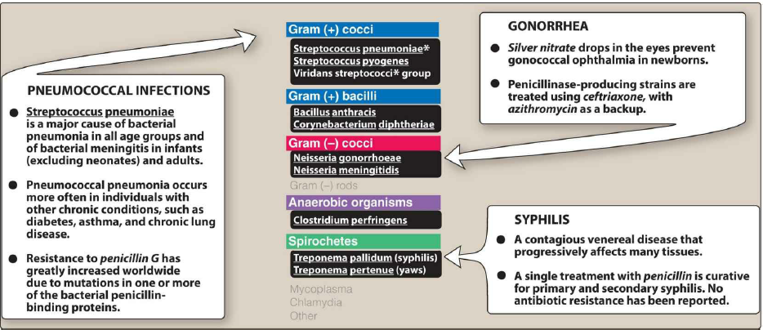

Slide 18
The penicillinase-resistant penicillins (e.g., flucloxacillin, dicloxacillin,oxacillin and nafcillin) were developed to treat penicillin-resistant strains of staphylococci. These penicillins are not active against most other species of penicillinase-producing bacteria. Nafcillin is usually preferred when parenteral administration is required, whereas dicloxacillin can be given orally for less severe infections. Flucloxacillin can be administered by both routes of administration.
The penicillinase-resistant drugs are used to treat serious staphylococcal infections, such as acute endocarditis and osteomyelitis, as well as skin and soft tissue infections. Staphylococci that are resistant to these penicillins are often designated methicillin-resistant Staphylococcus aureus (MRSA) because methicillin was the original drug in this class. Methicillin is seldom used today because of its tendency to cause interstitial nephritis. Bacteria that are resistant to methicillin are also cross-resistant to nafcillin and all other penicillinase-resistant penicillins. Most strains of MRSA are also resistant to cephalosporins.

Slide 19
The extended-spectrum penicillins can be subdivided into the aminopenicillins (amoxicillin and ampicillin) and the antipseudomonal penicillins (piperacillin and ticarcillin).
These drugs have greater activity than penicillin against Gram negative bacteria to include Haemophilus influenzae, Escherichia coli, and Proteus mirabilis because of their enhanced ability to penetrate the Gram-negative outer membrane.
The aminopenicillins are active against many streptococci, some strains of enterococci, and a number of gram- negative bacilli. Amoxicillin is better absorbed orally. Amoxicillin, 250–500 mg three times daily, is equivalent to the same amount of ampicillin given four times daily. Amoxicillin and ampicillin are often combined with a β-lactamase inhibitor: amoxicillin and clavulanate (Augmentin) or ampicillin and sulbactam. The addition of a β-lactamase inhibitor extends the activity of these penicillins to include β-lactamase-producing strains of S aureus as well as some β-lactamase-producing Gram-negative bacteria

Slide 20
Amoxicillin can be used alone to treat respiratory tract infections caused by sensitive bacteria, including otitis media, sinusitis, bronchitis, and community-acquired pneumonia. Many strains of Haemophilus influenzae and Moraxella catarrhalis, however, produce penicillinase, and infections caused by these organisms should be treated with amoxicillin-clavulanate. Amoxicillin and ampicillin are the most active of the oral β-lactam antibiotics against pneumococci and are the preferred β-lactam antibiotics for treating infections suspected to be caused by these strains.
Amoxicillin-clavulanate is also indicated for treating bite wound infections because it is active against the common pathogens causing bite wounds, including Pasteurella multocida and S. aureus. Amoxicillin alone is used for prophylaxis of bacterial endocarditis in persons with heart valve defects.

Slide 21
Ampicillin is active against Listeria monocytogenes and is used to treat meningitis and other infections caused by this organism (listeriosis). It is also used in combination with sulbactam (a β-lactamase inhibitor) to treat infections caused by penicillinase-producing strains of bacteria, including bite wounds and diabetic foot ulcers. Ampicillin (but not amoxicillin) is effective for shigellosis. Ampicillin can be combined with an aminoglycoside (e.g., gentamicin) for the treatment of serious enterococcal infections, such as enterococcal endocarditis.
The antipseudomonal penicillins (piperacillin and ticarcillin) are active against a broad spectrum of gram-positive and gram- negative aerobic and anaerobic bacteria, including some strains of Pseudomonas aeruginosa. Piperacillin combined with a β-lactamase inhibitor, tazobactam, is effective for the treatment of patients with intra-abdominal, skin and soft tissue, lower respiratory tract, complicated urinary tract, and gynecologic infections as well as febrile neutropenia. In some cases, piperacillin or ticarcillin is given in combination with an aminoglycoside antibiotic.

Slide 22
Pharmacokinetics
The route of administration of penicillins depends on the stability of the drugs in gastric acid and by the severity of the infection. Acid-stable penicillins, which include amoxicillin, dicloxacillin, and penicillin V, are effective when given orally. In contrast, acid-labile penicillins, which include Penicillin G , the combination of ampicillin with sulbactam, piperacillin with tazobactam, and the antistaphylococcal penicillins nafcillin and oxacillin must be administered intravenously (IV) or intramuscularly (IM).
Penicillin G is available in two long-acting forms (Depot forms) for intramuscular administration, procaine penicillin G and benzathine penicillin G. A single intramuscular injection of benzathine penicillin, 1.2 million units, is effective treatment for β-hemolytic streptococcal pharyngitis. Given intramuscularly once every 3–4 weeks, it prevents reinfection with the bacteria in rheumatic fever and rheumatic heart disease. Benzathine penicillin G, 2.4 million units intramuscularly once a week for 1–3 weeks, is effective in the treatment of syphilis. Procaine penicillin G produces higher plasma concentrations of penicillin for about 24 hours.

Slide 23
Most of the penicillins are incompletely absorbed after oral administration, and they reach the intestine in sufficient amounts to affect the composition of the intestinal flora. Food decreases the absorption of all the penicillinase-resistant penicillins because as gastric emptying time increases, the drugs are destroyed by stomach acid. Therefore, they should be taken on an empty stomach.
The penicillins are widely distributed to organs and tissues except the central nervous system. Because penicillins readily penetrate the cerebrospinal fluid when the meninges are inflamed, they can be administered intravenously for the treatment of meningitis.
Most penicillin antibiotics are eliminated primarily by active renal tubular secretion and have short half-lives of about 0.5 to 1.3 hours. Nafcillin is primarily cleared by biliary excretion. Oxacillin, dicloxacillin, and cloxacillin are eliminated by both the kidney and biliary excretion. The renal tubular secretion of penicillins is inhibited by probenecid, a drug that competes with penicillins for the organic acid transporter located in the proximal tubule. Probenecid has been used to slow the excretion and prolong the half-life of penicillin G.

Slide 24
Bacterial Resistance
There are three primary mechanisms by which bacteria exert resistance to penicillins and other β-lactam antibiotics: inactivation of the drugs by β- lactamase enzymes, reduced affinity of PBP for the antibiotics, and decreased entry of the drugs into bacteria through outer membrane porins. In some bacteria, resistance can be caused by a combination of these effects.
The production of β-lactamases is the predominant cause of bacterial resistance to penicillins and other β-lactam antibiotics. These enzymes cleave the amide bond in the β-lactam ring and thereby inactivate the antibiotic. β-Lactamases are expressed by both chromosomal and plasmid genes. Some β-lactamases are constitutive, whereas others can be induced by β-lactam antibiotics. In gram-positive bacteria, β-lactamases are secreted as exoenzymes and act extracellularly. In gram-negative bacteria β-Lactamases remain in the periplasmic space where they attack the antibiotic before it can bind to PBP.
The staphylococci were the first major group of bacterial pathogens to acquire β-lactamases that rendered them resistant to penicillin G. Later, many gonococci and other gram-negative bacteria acquired β-lactamases. Resistance of H. influenzae to amoxicillin and other penicillins is primarily caused by these enzymes. Many strains of Enterobacteriaceae, including Escherichia coli and Klebsiella pneumoniae, have acquired plasmid-mediated β-lactamases.

Slide 25
Resistance caused by decreased affinity of PBPs for β-lactam drugs is also a growing problem. Gram-positive bacteria are innately resistant to aztreonam (a monobactam), because their PBPs do not bind to this drug. Resistance of other bacteria to penicillins can be acquired when the structure of PBPs is altered in a manner that reduces the affinity of PBPs for the drugs. Modified PBPs have a lower affinity for β-lactam antibiotics, requiring clinically unattainable concentrations of the drug to effect inhibition of bacterial growth. This explains MRSA resistance to most commercially available β-lactams.
Reduced penetration of drug into the cell is a greater concern in Gram-negative organisms, which have a complex cell wall that includes aqueous channels (porins).Many gram-negative bacteria are innately resistant to penicillins because porins in their outer membrane are impermeable to these drugs. This is also an important mechanism of acquired resistance to penicillins, as in the case of P. aeruginosa resistance to imipenem.

Slide 26
Adverse Effects
Penicillins are a common cause of drug-induced hypersensitivity reactions. Approximately 10% percent of patients have some kind of reaction, ranging from rashes to angioedema (marked swelling of the lips, tongue, and periorbital area) and anaphylaxis. Cross-allergic reactions occur among the β -lactam antibiotics. However, it has been determined that true penicillin allergy occurs in only 7% to 23% of patients who give a history of penicillin allergy. Hypersensitivity reactions occur when penicillin is degraded to penicilloic acid and other compounds that combine with body proteins to form antigens that elicit antibody formation.
An immediate hypersensitivity reaction, which is a type of reaction mediated by immunoglobulin E, can lead to urticaria (hives) or anaphylactic shock. Other types of hypersensitivity reactions can lead to serum sickness, interstitial nephritis, hepatitis, and various skin rashes. Ampicillin is particularly likely to cause a maculopapular skin rash in patients with certain viral infections, such as mononucleosis. This reaction is mediated by sensitized lymphocytes, and its frequency in ampicillin-treated patients with mononucleosis is over 90%.

Slide 27
Penicillin allergy can be confirmed by the use of commercial preparations of penicillin antigens. These preparations contain the major or minor antigenic determinants of penicillin that are formed in the body during penicillin degradation. These preparations are injected intradermally and cause erythema at the injection site in allergic persons. The preparations should be administered by personnel who are prepared to provide treatment for anaphylactic shock in the event that the patient develops a severe hypersensitivity reaction after the injection.
Except for hypersensitivity reactions, the penicillins are remarkably nontoxic to the human body and produce very few other adverse effects.
High concentrations of penicillins can be irritating to the central nervous system and elicit seizures in patients who have received very large doses of these drugs due to the ability of penicillins to cause GABAergic inhibition.
As with other antibiotics, penicillins can disturb the normal flora of the gut and produce diarrhea and superinfections with penicillin-resistant organisms, such as staphylococci and Clostridium difficile. Pseudomembranous colitis can occur in association with C. difficile superinfections.
Decreased coagulation may be observed with high doses of piperacillin, ticarcillin, and nafcillin

Slide 28
β-Lactamase Inhibitors
Clavulanate, sulbactam, and tazobactam are β-lactam drugs that inhibit molecular class A β-lactamases. These drugs have no antimicrobial activity by themselves but serve as surrogate substrates (so-called “suicide inhibitors”) for β-lactamases when given with a penicillin antibiotic. The continued use of β-lactam drugs will require the development of broad-spectrum β-lactamase inhibitors to protect these antibiotics from the increasing threat of microbial inactivation.
The currently available penicillin–β-lactamase inhibitor combinations include amoxicillin plus clavulanate (Augmentin), which is given orally, and three preparations that are administered parenterally: ampicillin plus sulbactam, piperacillin plus tazobactam, and ticarcillin plus clavulanate

