Slide 1
Inhibitors of Bacterial
Cell Wall Synthesis (cont.)

Slide 2
Cephalosporins
The cephalosporins are one of the largest and most widely used groups of antibiotics.
They are β-lactam antibiotics that are closely related both structurally and functionally to the penicillins. They have the same mode of action as penicillins and are more stable to many bacterial β-lactamases and, therefore, have broader spectrum of activity.
Based on differences in their antimicrobial spectrum, they have been divided into four generations. The first-generation cephalosporins are primarily active against gram-positive cocci and a limited number of gram-negative bacilli. Subsequent generations of cephalosporins have increased activity against gram-negative bacilli and less activity against some species of gram-positive cocci.

Slide 3
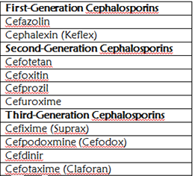
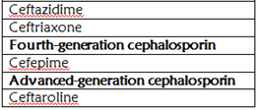

Slide 4
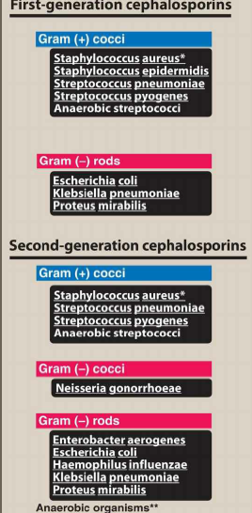
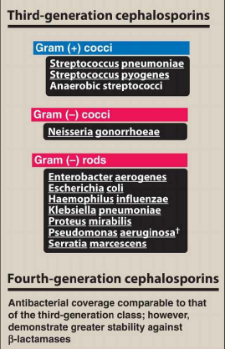

Slide 5
Chemistry
The cephalosporins are semisynthetic drugs, most of which are derived from cephalosporin C, a substance obtained from a species of Cephalosporium.
Cephalosporins have a β-lactam ring and a dihydrothiazine ring. Unlike the penicillins, the cephalosporins have at least two R groups attached to the molecule, thereby enabling the synthesis of a greater number of derivatives with potentially useful properties. In cephamycins, a sub-category of cephalosporins that includes cefotetan and cefoxitin, there is a third R group that is attached to the β-lactam ring.
By manipulating the structure of cephalosporins, it has been possible to obtain drugs with greater resistance to bacterial β-lactamases and with a wider range of antimicrobial activity.

Slide 6
Spectrum and Indications
Cephalosporins have been classified as first, second, third, fourth, and advanced generation, based largely on their bacterial susceptibility patterns and resistance to β-lactamases.
The first-generation cephalosporins act as penicillin G substitutes. They have good activity against most streptococci and methicillin-sensitive staphylococci. They are also active against a few gram-negative enteric bacilli, including E. coli and K. pneumoniae. Most oral cavity anaerobes like Peptostreptococcus are sensitive, but the Bacteroides fragilis group is resistant.
The orally administered drugs (e.g., cephalexin) are primarily used to treat skin and soft tissue infections caused by gram- positive cocci and to treat uncomplicated urinary tract infections. However, many strains of E. coli are now resistant to cephalexin, and it is seldom used for this purpose today. Parenterally administered cefazolin penetrates well into most tissues. It is a drug of choice for surgical prophylaxis and for many streptococcal , staphylococcal infections and aerobic gram-negative enteric bacilli requiring intravenous therapy due to its good tissue and fluid penetration.

Slide 7
In comparison with first-generation cephalosporins, the second-generation cephalosporins have similar activity against gram-positive cocci while demonstrating increased activity against gram-negative bacilli. For example, the second-generation drugs are active against β-lactamase-producing H influenzae or Moraxella catarrhalis and have been used primarily to treat sinusitis and otitis media(that are resistant to amoxicillin and other drugs), and lower respiratory tract infections. Additional sensitive gram-negative organisms include: Enterobacter aerogenes and some Neisseria species.
Oral second- generation drugs, including cefprozil and cefuroxime axetil, are used to treat sinusitis and otitis media. Cefuroxime sodium, a parenteral preparation, has been used as empiric therapy for patients with community-acquired pneumonia. Cefotetan is active against both aerobic and anaerobic gram-negative bacilli, including Bacteroides fragilis, and it is used to treat intra-abdominal, gynecologic, and biliary tract infections caused by these organisms. Cefoxitin has activity similar to that of cefotetan and is used for surgical prophylaxis of infections caused by gram-negative bacteria. However, neither drug is first line because of the increasing prevalence of resistance among B. fragilis.

Slide 8
In comparison with second-generation cephalosporins, the third-generation cephalosporins have greater activity against a wider range of gram-negative organisms, including enteric gram-negative bacilli (Enterobacteriaceae), H. influenzae, and M. catarrhalis. In addition, ceftazidime is active against some strains of P. aeruginosa .Ceftazidime with avibactam is the first cephalosporin/β-lactamase inhibitor combination to be developed and is indicated for treating complicated intraabdominal and urinary tract infections. Several third-generation drugs, including cefpodoxime, cefotaxime, and ceftriaxone, are active against gonococci and have been used as a single- dose treatment for gonorrhea (Intramuscular ceftriaxone in combination with azithromycin is the regimen of choice for treating most gonococcal infections.) Ceftolozane is a third-generation cephalosporin combined with the β-lactamase inhibitor, tazobactam. Ceftolozane-tazobactam is available only in an IV formulation. It is used for the treatment of resistant Enterobacteriaceae and multidrug-resistant Pseudomonas aeruginosa.

Slide 9
Other clinical indications for third-generation drugs include otitis media, pneumonia, meningitis (Ceftriaxone and cefotaxime have become agents of choice because they are able to cross the blood-brain barrier.) , gastrointestinal (as Typhoid fever )and urinary tract infections. Third-generation cephalosporins must be used with caution, as they are associated with significant “collateral damage,”: the selection of drug-resistant organisms and the unwanted development of colonization or infection with multidrug-resistant organisms beside the development of Clostridium difficile infection. [Note: Fluoroquinolone use is also associated with collateral damage.]

Slide 10
Cefepime has been called a fourth-generation cephalosporin because it is active against many gram-negative bacilli, including P. aeruginosa, Citrobacter freundii and Enterobacter cloacae, that are resistant to other cephalosporins. It is highly active against Haemophilus and Neisseria sp. This is attributed to its more rapid penetration of bacteria, its ability to target multiple PBPs, and its lower affinity for several β-lactamases. Cefepime is resistant to plasmid-encoded β-lactamase and relatively resistant to inducible chromosomally encoded β-lactamase. It has been used in treating a variety of systemic infections, including intra-abdominal and urinary tract infections and pneumonia.
However, a recent analysis of clinical trials found that cefepime is associated with higher all-cause mortality than are other β-lactam antibiotics, possibly because of drug-induced encephalopathy; thus its use should be carefully monitored.

Slide 11
Ceftaroline is a new advanced-generation cephalosporin whose unique antimicrobial activity does not allow it be assigned to one of the traditional cephalosporin classes. It is effective against MRSA and penicillin-resistant Streptococcus pneumonia. In addition to its broad gram-positive activity, it also has similar gram-negative activity to the third-generation cephalosporin ceftriaxone. It is administered intravenously and is approved for the treatment of skin and soft tissue infections and community acquired pneumonia. The drug’s activity against MRSA and Streptococcus pneumoniae is a result of its high-affinity binding to PBP-2a, which mediates methicillin resistance in staphylococci, & PBP2x respectively resulting in more efficient inhibition of this enzyme compared with other β-lactam antibiotics.

Slide 12
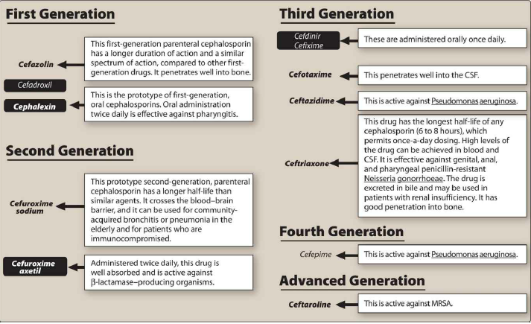

Slide 13
Pharmacokinetics
Compared with penicillins, the cephalosporins are more stable in the body and are less likely to form antigens that evoke hypersensitivity reactions.
The route of administration depends on the particular cephalosporin being used. Some of the cephalosporins are given only orally; others are given only parenterally. Cefuroxime is one of the few cephalosporins available for use by both routes (as cefuroxime axetil for oral administration and cefuroxime sodium for parenteral administration). Some of the parenterally administered cephalosporins are used only intravenously; others are given either intravenously or intramuscularly.
The orally administered cephalosporins are well absorbed from the gut, and their bioavailability usually is not significantly affected by food. Most cephalosporins are excreted primarily by renal tubular secretion, which is inhibited by probenecid. Ceftriaxone and cefixime are excreted primarily in the bile and has a much longer half-life than other cephalosporins.

Slide 14
Bacterial Resistance
Bacteria acquire resistance to cephalosporins through the same three mechanisms by which they acquire resistance to penicillins (Inactivation of the drugs by β- lactamase enzymes, reduced affinity of PBP for the antibiotics, and decreased entry of the drugs into bacteria through outer membrane porins). The cephalosporins are more resistant to β-lactamases than are the penicillins, and resistance to gram-negative β-lactamases increases with successive generations of cephalosporins. Many cephalosporins, however, are susceptible to the extended-spectrum β- lactamases, and some cephalosporins induce certain β-lactamase enzymes. Worldwide resistance to cephalosporins is increasing, as evidenced by the alarming development of gonococcal resistance to cephalosporins. There is a growing need for additional inhibitors of extended-spectrum β-lactamase enzymes that could be administered with cephalosporins.

Slide 15
Adverse Effects
The cephalosporins cause little toxicity to the host and have an excellent safety record. Although cephalosporins can elicit hypersensitivity reactions, the incidence of this is lower for cephalosporins than for penicillins. Cephalosporins exhibit some cross-sensitivity with penicillins, and about 5% of persons allergic to penicillin will also be allergic to cephalosporins. Persons who have had a mild hypersensitivity reaction to penicillin usually do not cross-react to a cephalosporin. However, a person who has had a severe hypersensitivity reaction to penicillin (e.g., an anaphylactic reaction) has a greater risk of cross-reacting and should usually not be given a cephalosporin. The highest rate of allergic cross-sensitivity is between penicillin and first-generation cephalosporins.
A few cephalosporins can cause platelet dysfunction and bleeding, including cefotetan, cefmetazole, cefamandole, and cefoperazone. These cephalosporins can potentiate the effects of anticoagulants and antiplatelet drugs and thereby increase the risk of bleeding. These same cephalosporins can also produce a disulfiram-like reaction if they are taken with alcohol.

Slide 16
Monobactam
Aztreonam is a monocyclic β-lactam (monobactam) antibiotic (β-lactam ring is not fused to another ring). Its spectrum of activity is limited to aerobic Gram-negative organisms.It is active against many strains of Enterobacter, Citrobacter, Klebsiella, and Proteus species as well as P. aeruginosa (Gram-negative spectrum is similar to that of the third generation cephalosporins).Aztreonam is used to treat serious infections (such as pneumonia, meningitis, and sepsis) caused by susceptible organisms and is particularly useful for infections caused by multidrug- resistant strains of these organisms. The drug is administered intravenously and is extensively metabolized before undergoing renal excretion.
Aztreonam can cause hypersensitivity reactions and thrombophlebitis. It only rarely shows cross-sensitivity with penicillins and cephalosporins and can usually be used in persons allergic to other β-lactam antibiotics.

Slide 17
Carbapenems
Carbapenems are penicillin-like antibiotics in which the sulfur atom of the thiazolidine ring is replaced with a carbon atom. These agents are bactericidal to a wide range of gram- positive and gram-negative bacteria, including many aerobic and anaerobic gram-negative bacilli, and they are resistant to many β-lactamases. Imipenem has high affinity for PBP-2, whereas meropenem binds to both PBP-2 and PBP-3. The greater affinity of meropenem for PBP-3 may account for its superior activity against P. aeruginosa and other gram-negative organisms. Meropenem-vaborbactam is a combination of a carbapenem and a β-lactamase inhibitor. It is approved for the treatment of complicated urinary tract infections including pyelonephritis. Ertapenem is a newer agent with good in vitro activity against extended-spectrum β-lactamase–producing organisms. Doripenem is a newer ultra-broad-spectrum antibiotic that is particularly active against P. aeruginosa.
Carbapenems are used to treat a wide range of systemic infections,
including endocarditis, pneumonia, and urinary tract, pelvic, skin and soft tissue, and intra-abdominal infections. They are particularly useful for infections caused by multidrug-resistant organisms and for mixed infections caused by aerobic and anaerobic enteric bacilli.

Slide 18
Carbapenems are administered intravenously. Imipenem undergoes cleavage by a dehydropeptidase found in the brush border of the proximal renal tubule. This enzyme forms an inactive metabolite that is potentially nephrotoxic. Compounding the imipenem with cilastatin protects the parent drug and, thus, prevents the formation of the toxic metabolite and prolongs its activity in the body. Other carbapenems are not susceptible to dehydropeptidase. The carbapenems are eliminated by renal tubular secretion, which can be inhibited by probenecid. Dosage adjustments are required when these drugs are given to persons with renal impairment.
The carbapenems exhibit cross-sensitivity with penicillins and other β-lactam antibiotics and should not be administered to patients who are allergic to these drugs. Though generally well tolerated, Imipenem/cilastatin can cause nausea, vomiting, and diarrhea. They can cause seizures in patients with epilepsy. Less commonly, carbapenems may cause anemia, leukopenia, thrombocytopenia, and altered bleeding time.

Slide 19
Other Bacterial Cell Wall Synthesis Inhibitors
Vancomycin
Vancomycin is a glycopeptide antibiotic that is active against many gram-positive cocci and gram-positive bacilli. It is active against MRSA and methicillin-resistant Staphylococcus epidermidis (MRSE) and it usually is the first choice for treating skin and soft tissue infections and other infections caused by these organisms.
It is active primarily against gram-positive bacteria due to its large molecular weight and lack of penetration through gram-negative cell membranes.
Vancomycin is also used to treat streptococcal and enterococcal infections caused by penicillin-resistant organisms, including endocarditis and necrotizing fasciitis. Vancomycin (in combination with cefotaxime, ceftriaxone, or rifampin) is also recommended for treatment of meningitis suspected or known to be caused by a penicillin resistant strain of pneumococcus. However, some strains of staphylococci and enterococci have acquired resistance to vancomycin through mutations that alter the amino acid sequence of the cell wall pentapeptide containing D-alanine.
Vancomycin is also active against Bacillus, Clostridium, and Corynebacterium species. Although it has been used to treat diarrhea and pseudomembranous colitis caused by C. difficile, metronidazole is usually preferred for this infection.

Slide 20
Vancomycin is poorly absorbed from the gut and must be administered parenterally to treat systemic infections, though it is given orally to treat gastrointestinal C. difficile infections. Vancomycin is distributed to most body fluids and tissues, and it is excreted in the urine by the process of glomerular filtration. The half-life of vancomycin is normally about 6 hours, but the half-life is markedly prolonged in patients with renal failure.
Improvements in the manufacturing of vancomycin preparations have reduced the incidence of nephrotoxicity and ototoxicity associated with their use. Vancomycin, however, should be used cautiously with other nephrotoxic drugs, including aminoglycosides and amphotericin B. The ototoxic effects of vancomycin can include both vestibular dysfunction (ataxia, vertigo, nystagmus, and nausea) and cochlear dysfunction (tinnitus and hearing loss). Ototoxicity is usually caused by excessive serum concentrations and is reversible when these concentrations are reduced. If vancomycin is infused at an excessive rate, it can cause hypotension and an erythematous rash on the face and upper body known as the red neck or red man syndrome.

Slide 21
Telavancin is a synthetic derivative of vancomycin that is approved for the treatment of skin and soft tissue infections caused by methicillin-sensitive and methicillin-resistant S. aureus and vancomycin-sensitive Enterococcus faecalis. The drug appears to be equivalent to vancomycin in most respects.
Telavancin is considered an alternative to vancomycin in treating acute bacterial skin and skin structure infections (ABSSSIs) and hospital-acquired pneumonia caused by resistant gram-positive organisms, including MRSA. The use of telavancin in clinical practice is limited by significant adverse effects (for example, renal impairment), interaction with anticoagulants, risk of fetal harm in pregnant women.
Dalbavancin and oritavancin are semisynthetic lipoglycopeptides derived from teicoplanin. Both agents have extremely long half-lives of greater than 10 days, which allows for single-dose administration for the management of ABSSSI.

Slide 22
Daptomycin
Daptomycin is a bactericidal concentration-dependent cyclic lipopeptide antibiotic that causes rapid depolarization of the cell membrane, inhibits intracellular synthesis of DNA, RNA, and protein. It is an alternative to other agents for treating infections caused by resistant gram-positive organisms, including MRSA and vancomycin- resistant enterococci (VRE). Daptomycin is indicated for the treatment of complicated skin and skin structure infections and bacteremia caused by S. aureus. Additionally, daptomycin is inactivated by pulmonary surfactants; thus, it should never be used in the treatment of pneumonia. Adverse effects may include Myalgias, elevated hepatic transaminases and creatine phosphokinases and rhabdomyolysis.

Slide 23
Bacitracin
Bacitracin is an antibiotic derived from a Bacillus subtilis strain. The drug inhibits cell wall peptidoglycan synthesis by blocking the regeneration of bactoprenol phosphate, the lipid carrier molecule that transfers peptidoglycan subunits to the growing cell wall. Bacitracin is active against gram-positive cocci, including staphylococci and streptococci, and it is primarily used for the topical treatment of minor skin and ocular infections. It is often combined with polymyxin or neomycin in ointments and creams. Bacitracin is very nephrotoxic and is not used systemically.
Fosfomycin
Fosfomycin is a is a bactericidal synthetic derivative of phosphonic acid that blocks cell wall synthesis by inhibiting the enzyme UDP-N-acetylglucosamine enolpyruvyl transferase, which catalyzes the first step in peptidoglycan synthesis.
Fosfomycin is active against enterococci and many gram- negative enteric bacilli, including E. coli, Citrobacter species, Klebsiella species, Proteus species, and Serratia marcescens. The drug is specifically approved for the treatment of uncomplicated urinary tract infections caused by E. coli or E. faecalis. For this purpose, fosfomycin is administered orally as a single dose because it is excreted in its active form in the urine and maintains high concentrations over several days. Fosfomycin sometimes causes diarrhea but is otherwise well tolerated and is associated with few adverse effects.

Slide 24
Polymyxins
The polymyxins are cation polypeptides that bind to phospholipids on the bacterial cell membrane of gram-negative bacteria. They have a detergent-like effect that disrupts cell membrane integrity, leading to leakage of cellular components and ultimately cell death.
Polymyxins are concentration-dependent bactericidal agents with activity against most clinically important gram-negative bacteria, including P. aeruginosa, E. coli, K. pneumoniae, Acinetobacter species, and Enterobacter species.
Only two forms of polymyxin are in clinical use today, polymyxin B and colistin (polymyxin E). Polymyxin B is available in parenteral, ophthalmic, otic, and topical preparations. Colistin is only available as a prodrug, colistimethate sodium, which is administered IV or inhaled via a nebulizer. The use of these drugs has been limited for a long time, due to the increased risk of nephrotoxicity and neurotoxicity (for example, slurred speech, muscle weakness) when used systemically. However, with the increase in gram-negative resistance, they have seen a resurgence in use and are now commonly used as salvage therapy for patients with multidrug-resistant infections.

Slide 25
Cycloserine
Cycloserine inhibits many Gram-positive and Gram-negative organisms, but it is used almost exclusively to treat tuberculosis caused by strains of Mycobacterium tuberculosis resistant to first-line agents. Cycloserine is a structural analog of d-alanine and inhibits the incorporation of d-alanine into peptidoglycan pentapeptide.
Cycloserine causes serious, dose-related central nervous system toxicity with headaches, tremors, acute psychosis, and convulsions.

