Slide 1
Plastic and reconstructive surgery
Dr Yaseen Abdullah
Plastic surgeon

Slide 2
Learning objectives
To understand
The spectrum of plastic surgical techniques used to restore bodily form and function
The relevant anatomy and physiology of tissues used in reconstruction
The various skin grafts and how to use them appropriately
The principles and use of flaps

Slide 3
Plastic : Greek word : to mould or shape
Plastic and reconstructive surgery involve using various techniques to restore form and function to the body when tissues have been damaged by injury , cancer, or congenital loss

Slide 4
The scope of plastic surgery
The tools of reconstruction are used for a wide range of conditions:
●● trauma:
●● soft-tissue loss (skin, tendons, nerves, muscle);
●● hand and lower limb injury;
●● faciomaxillary;
●● burns;
●● cancer:
●● skin, head and neck, breast, soft tissue sarcoma;
●● congenital:
●● clefts and craniofacial malformations;
●● skin, giant naevi, vascular malformations;
●● urogenital;
●● hand and limb malformations;
●● miscellaneous:
●● Bell’s (facial) palsy;
●● pressure sores;
●● aesthetic surgery;
●● chest wall reconstruction

Slide 6
Secondary intention

Slide 7
Primary closure

Slide 9
Classification of wound closure and healing
●● Primary intention
Wound edges opposed
Normal healing
Minimal scar
●● Secondary intention
Wound left open
Heals by granulation, contraction and epithelialisation
Increased inflammation and proliferation
Poor scar
●● Tertiary intention (also called delayed primary intention)
Wound initially left open
Edges later opposed when healing conditions favorable

Slide 11
Skin grafts
a surgical operation in which a piece of healthy skin is transplanted to a new site on a patient's body.
Transferred without their blood supply
Skin grafts can be:
A split-thickness skin graft (STSG) is a skin graft including the epidermis and part of the dermis.
A full-thickness skin graft (FTSG)consists of the epidermis and the entire thickness of the dermis.

Slide 12
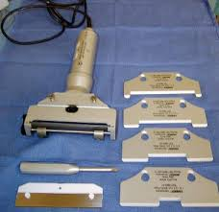
STSG can be harvested by electrical power dermatome

Slide 13
Or by hand held knife

Slide 15
STSG recipient site

Slide 16
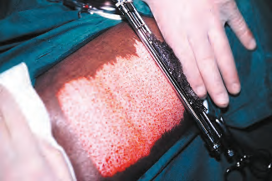
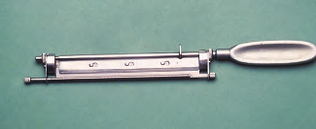
Thicker knife-gap settings give rise to fewer but brisker bleeding points on the donor site

Slide 17
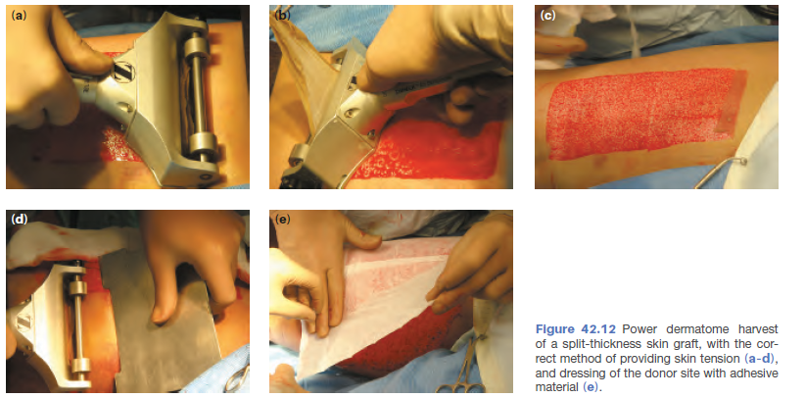

Slide 18
STSG donor site heal by epithelialization

Slide 20
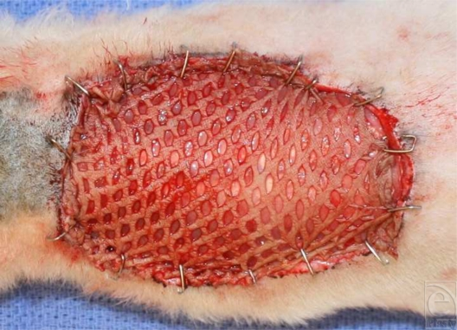
Meshed grafts have more size and less haematoma risk but they are ugly with more contracture

Slide 21
Split-thickness skin grafts
●● Thicker knife-gap settings give rise to fewer but brisker bleeding points on the donor site.
●● Thicker grafts heal with less contracture and are more durable.
●● Thinner donor sites heal better.
●● Grafts are hairless and do not sweat (these structures are not transferred).

Slide 22
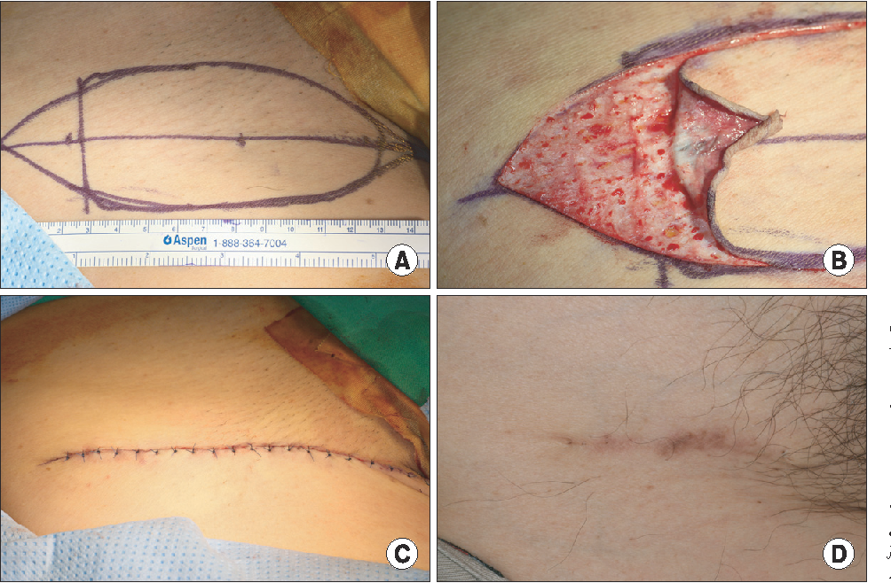
FTSG donor site closed by primary intention

Slide 24
How does a skin graft survive?

Slide 25
How does a skin graft survive?
imbibition of plasma from the wound bed intially
after 48 hours, fine anastomotic connections are made, which lead to inosculation of blood.
Capillary ingrowth then completes the healing process with fibroblast maturation.
Because only tissues that produce granulation will support a graft, it is usually contraindicated to use grafts to cover exposed tendons, cartilage or cortical bone.

Slide 27
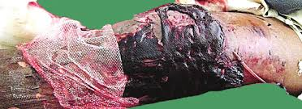
Causes of graft failure
Pus
Haematoma
Exudate
Dead or non vascularized bed
Shearing force
group A β-haemolytic Streptococcus can destroy split grafts completely (and also convert a donor site to a full-thickness defect

Slide 30
Skin flaps
A skin flap consists of skin and subcutaneous tissue that survives based on its own blood supply.
Transferred with their blood supply

Slide 32
Classification of flaps according to blood supply
Random flaps have no named blood supply
Axial flaps are supplied by a named artery and vein. This allows for a larger area to be freed from surrounding and underlying tissue, leaving only a small pedicle containing the vessels.
Pedicled flaps remain attached to the donor site via a pedicle that contains the blood supply
Island flap attached only to the blood vessel
free flap: Fully detached from vascular supply and reconnected to recipient vessels using microvascular technique

Slide 33
Classification of flaps according to location
a. Local flap: Shares side with the defect
b. Regional flap: In same region of the body as the defect, but does not share defect
margin.
c. Distant flap: Not in the region of the defect, located in a different part of the body

Slide 34
Classification of flaps according to Method of transfer
a. Advancement
b. Transposition
c. Rotation

Slide 35
Eg. Local (transposition, random)flap: share border with the defect

Slide 37
Eg.Distant , axial

Slide 40
Transposition Z plasty to lengthen scar contracture

Slide 43
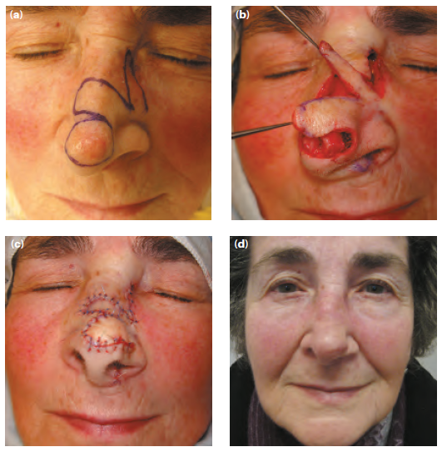

Slide 49
Tissue expansion
A technique that involves placing a device – usually an expandable balloon constructed from silicone – beneath the tissue to be expanded, and progressively enlarging the volume with fluid while the overlying tissue accommodates to the changed vascular pressure

Slide 52
Tissue expansion
Advantages
●● Well-vascularised tissue
●● Tissue next to defect, so likely to be of similar consistency
●● Good colour match
Disadvantages
●● Multiple expansion episodes (sometimes painful)
●● Cost of device
●● High incidence of infection and extrusion (especially limbs)

Slide 53
Free flap
A free flap is a piece of tissue that is disconnected from its' original blood supply, and is moved a significant distance to be reconnected to a new blood supply. ... The blood vessels feeding the flap are usually very small and the “re-plugging” of the flap is done through microvascular surgery

Slide 55
Free tissue transfer (or free flap)
Advantages
●● Being able to select exactly the best tissue to move
●● Only takes what is necessary
●● Minimises donor site morbidity
Disadvantages
●● More complex surgical technique
●● Failure involves total loss of all transferred tissue
●● Usually takes more time unless the surgeon is experienced

Slide 56
Signs of arterial insufficiency
a. Cool temperature
b. White color
c. Slow capillary refill >2 seconds
d. Slow or absent pinpoint bleeding
e. Low turgor
. Signs of venous insufficiency
a. Increased temperature
b. Blue to purple color
c. Brisk capillary refill <2 seconds
d. Brisk pinpoint bleeding, dark in color
e. Increased turgor, tense, swollen
f. If congested, unwrap, release sutures and consider leech therapy

Slide 57
The most common causes of flap failure are:
●● poor anatomical knowledge when raising the flap (such that the blood supply is deficient from the start);
●● flap inset with too much tension;
●● local sepsis or a septicaemic patient;
●● the dressing applied too tightly around the pedicle;
●● microsurgical failure in free-flap surgery (usually caused by
problems with surgical technique);
●● tobacco smoking by patient.

Slide 58
‘Wet, warm and comfortable’
The best advice for postoperative flap care for major tissue transfers is to keep the patient ‘wet, warm and comfortable’.
This means that the patient should be well hydrated with a hyperdynamic circulation, a very warm body temperature and well-controlled analgesia to reduce catecholamine output.

