Slide 1
Cleft lip and palate
Dr. Yaseen Abdullah
Plastic surgeon
FIBMS plastic surgery

Slide 2
Learning objectives
To understand:
The aetiology of developmental abnormalities of the face, mouth and jaws
The Classification of cleft lip and palate
The timing of surgery of cleft lip and palate

Slide 3
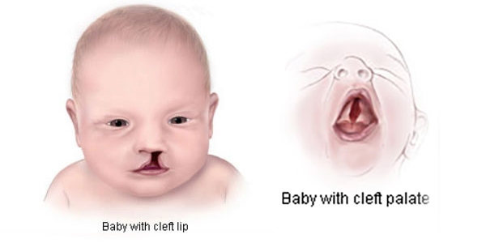
CL:isolated
cleft lip
CP: isolated cleft palate
CLP:cleft lip
and palate

Slide 4
incidence
Cleft lip and palate 1:1600 live births
Isolated cleft palate 1:1000 live births
CLP more common in oriental groups than black
CLP>CP>CL
CLP more in male / CP more in female
CL more in left side

Slide 5
Aetiology
Both genetic and environmental
Family history
Syndromes (esp. CP)
Maternal epilepsy
Drugs: steroid ,diazepam and phenytoin
Antenatal folic acid supplementation may prevent CLP

Slide 6
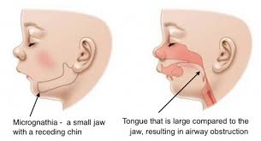
Pierre robin sequence
Retrognathia
Glossoptosis: posteriorly displaced tongue
Cleft palate

Slide 7
Classification of cleft lip
Unilateral or bilateral
Complete(the nose is involved) or incomplete

Slide 9
Incomplete and complete unilateral CL

Slide 10
Unilateral complete CL

Slide 11
Bilateral CL

Slide 13
Classification of CP
Unilateral or bilateral
Hard and soft or soft palate
Bilateral complete cleft palate occurs when the nasal septum and vomer are separated from the palatine process

Slide 14
Normal palate

Slide 18
Cleft soft palate

Slide 19
Early management

Slide 20
feeding
isolated CL can take breastfeeding
CP may have difficult suction and may need
Modified teats
Enlarging the hole of the teat

Slide 21
Airway problem
Prone position
Nasopharyngeal tube
Tongue lip adhesion

Slide 22
Timing of surgery
CL 3-6 months- Millard rotation advancement flaps
CP 6-18 months

Slide 23
Cleft palate repair

Slide 24
complications
Hearing
Recurrent otitis media
Sensory neural hearing loss
Speech problems
Hearing problems
Velopharyngeal inssufficiency
Dental problems
Facial growth problems

Slide 25
Aesthetic surgery and medicine

Slide 26
botox
Botulinum toxin (BTX) is a neurotoxic protein produced by the bacterium Clostridium botulinum and related species . It prevents the release of the neurotransmitter acetylcholine from axon endings at the neuromuscular junction and thus causes flaccid paralysis.

Slide 28
Frown lines : corrugator and procerus muscles

Slide 29
Crows feet : orbicularis oculi

Slide 30
Migraine headche

Slide 31
Axillary hyperhidrosis

Slide 32
fillers
Injectable filler (injectable cosmetic filler, injectable facial filler) is a soft tissue filler injected into the skin to help fill in facial wrinkles, restoring a smoother appearance. Most of these wrinkle fillers are temporary because they are eventually absorbed by the body. Some people may need more than one injection to achieve the wrinkle-smoothing effect. The effect lasts for about six months or longer. Successful results depend on health of the skin, skill of the health care provider, and type of filler used.

