Slide 1
Aesthetic surgery
Dr. Yaseen Abdullah

Slide 2
Rhinoplasty
commonly known as a nose job, is a plastic surgery procedure for correcting and reconstructing the nose.

Slide 4
Dorsal hump reduction
incremental reduction of both the cartilaginous septum and the bony dorsal deformity

Slide 6
Tip plasty
Altering nasal tip shape through :
Cephalic trim of lower lateral cartilage
Lower lateral cartilage suturing
Tip grafts

Slide 10
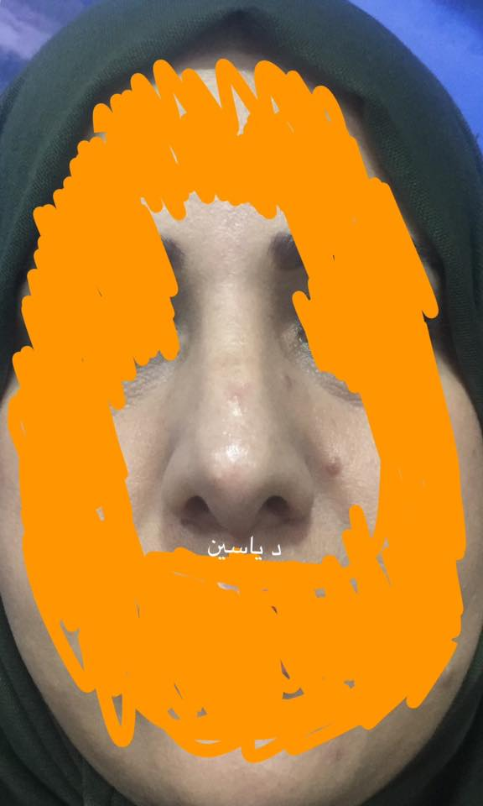

Slide 11
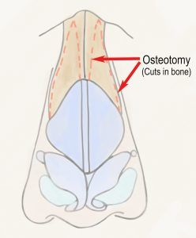
osteotomy
To narrow the lateral walls of the nose

Slide 13
blepharoplasty
Blepharoplasty (Greek: blepharon, "eyelid" + plassein "to form") is the plastic surgery operation for correcting defects, deformities, and disfigurations of the eyelids; and for aesthetically modifying the eye region of the face

Slide 14
Involves excision of redundant skin , silver of orbicularis oculi and preseptal fat

Slide 16
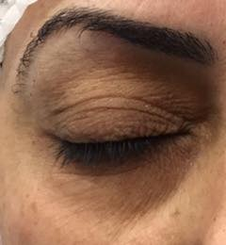

Slide 17
abdominoplasty
cosmetic surgery of the abdomen that typically involves removal of excess skin and fat and tightening of the abdominal muscles— called also tummy tuck

Slide 19
Involves
Excision of excess skin
Muscle plication
Umbilicus repositioning

Slide 20
The ideal patient for abdominoplasty
Normal or near normal weight (not obese)
Has excess skin
Has abdominal wall laxity

Slide 21
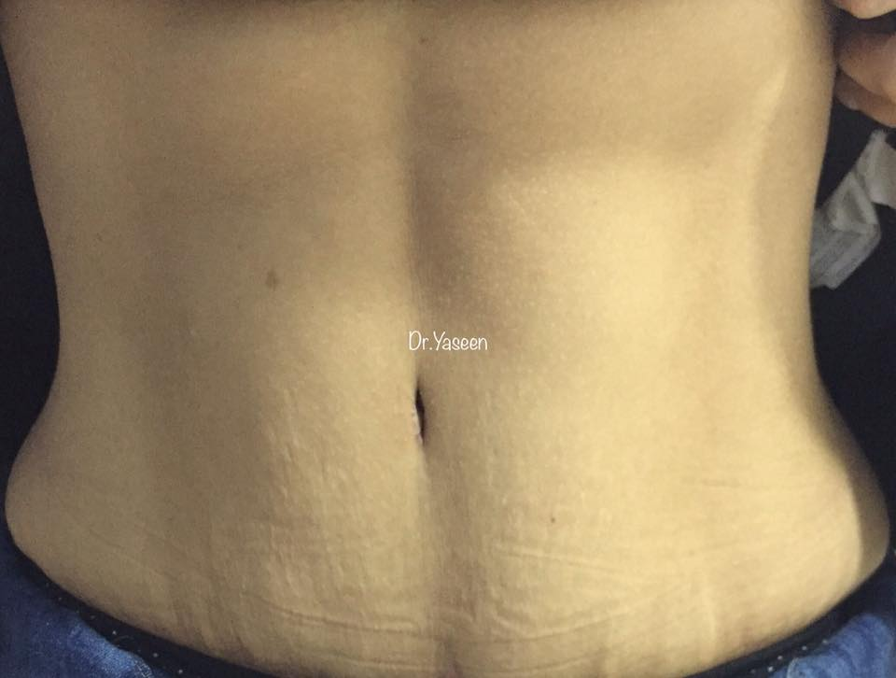

Slide 22
liposuction
The surgical suctioning of fat deposits from specific parts of the body
The ideal patient
Normal or near normal weight
No excess skin or abdominal wall laxity
Has diet resistant fat deposit

Slide 24
techniques
Suction assisted liposuction
Ultrasound assisted liposuction
VASER
Power assisted liposuction

Slide 25
skin resurfacing
To destroy the layers of skin down past the level of the abnormality (wrinkle , lentigines , acne scar … ), followed by healing of the skin to replace the removed layers with fresh healthy skin

Slide 26
types
Chemical peeling
Laser resurfacing (co2 or erbium laser)
Dermabrasion

Slide 29
Laser hair removal
is the process of hair removal by means of exposure to pulses of laser light that destroy the hair follicle

Slide 30
types
ND YAG
Alexandrite
Diode
Alexandrite is more powerful than diode which is more powerful than ND YAG

Slide 31
Selective photothermolysis

Slide 32
The damage result from direct photothermal destruction, whereby a light source emitting a wavelength in the absorption spectrum of the desired chromophore melanin (600–1100 nm) results in selective heating of the hair shaft, follicular epithelium, and hair matrix.

Slide 33
Cooling methods with laser
Contact cooling with gel
Cryogen (candela)
Air cooling

Slide 34
Works on dark hair
Need multiple session
Laser hair reduction not 100% removal
Not associated with skin ca

