Slide 1
Diabetic Foot
Definition:
Infection, ulceration or destruction of deep tissues associated with neurological abnormalities & various degrees of peripheral vascular diseases in the lower limb.
(based on WHO definition)

Slide 2
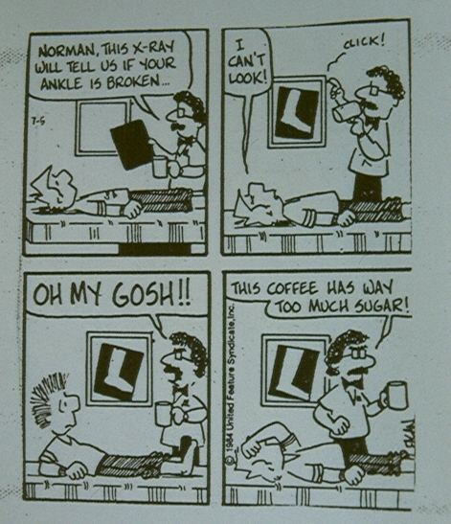
Epidemiology
Fewer than 20% of diabetic patients are regularly given foot examinations by their primary care physicians

Slide 3
Epidemiology
40% - 60% of all non traumatic lower limb amputation
Majority of patients with type 2 DM and long standing type 1 DM
85% of diabetic related foot amputation are preceded by foot ulcer
Approximately 15% of DFUs result in amputation

Slide 4
Epidemiology
Good diabetic foot care will decrease amputation in ½ - ¾ cases

Slide 5
Social & Economic Factors
Diabetic foot complications are expensive
(cost of healing 7000-10000 USD)
(healing with amp. 43000-63000USD)
Intervention of foot care is cost effective in most societies

Slide 6
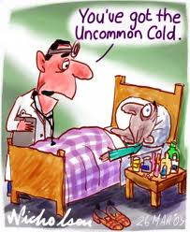
Pathophsiology of Foot Ulceration
Neuropathic
Ischemic
Neuro –ischemic
Infection
Infection
Neuropathy
Ischemia

Slide 7

Pathophysiology Peripheral Arterial Disease
→ High blood sugar expedites
arthrosclerosis giving peripheral
vascular disease (reduction of blood
supply to the foot).
→ The delivery of essential nutrients
and oxygen to the foot is
compromised leading to anaerobic
infections and tissue necrosis.
Peripheral arterial disease
Artherosclerosis
narrows or blocks
the arterial lumen
Foot ischaemia
Foot ulcer
Necrosis/ Gangrene
Infection
Artheroma plaque narrowing the arterial lumen
Ischaemic toes due to artherosclerosis

Slide 8
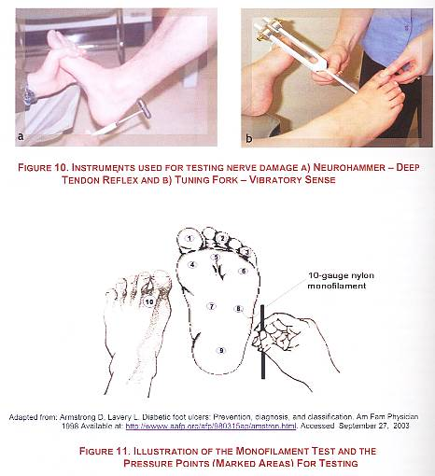
Pathophysiology Neuropathy
Neuropathy
Motor
Sensory
Autonomic
Muscle wasting
Foot weakness
Postural deviation
↓ Proprioception,
Unawareness
of foot position
Reduced
sweating
A-V Shunt* open
Permanent
↓ nociception
( pain feeing)
Stress on bones & joints
Plantar pressure
Dry skin
Increase foot
Blood flow
Callus formation
Fissures and
cracks
Bulging foot veins,
Warm foot
Deformities, stress
and shear pressures
Trauma
Ulcer
Infection
*Shunts: blood vessels that bypass capillaries and lead directly from arteries to veins

Slide 9
Biomechanics of foot wear
Biomechanical abnormalities are consequence of neuropathy, they lead to abnormal foot pressure
Foot deformity & neuropathy increase the risk of ulcer
Pressure relief is essential for ulcer healing and/or prevention
Frequent inspection of shoes & insoles is mandatory
Appropriate foot wear significantly reduce ulcer recurrence

Slide 10
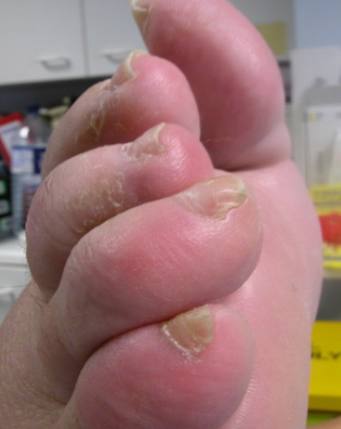
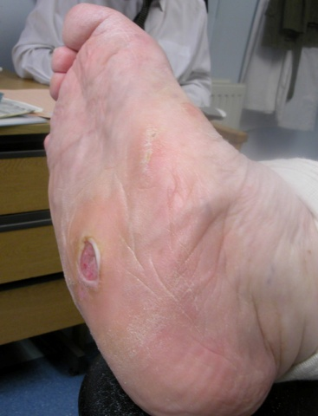
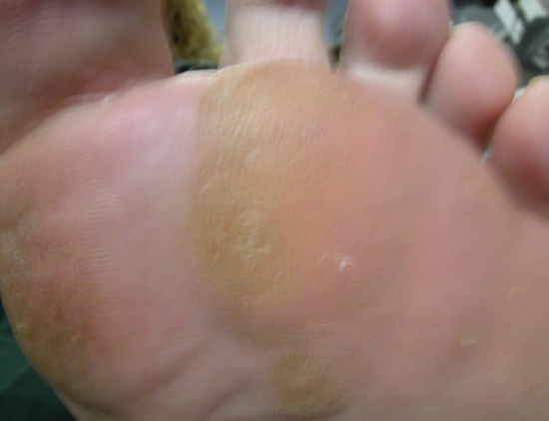
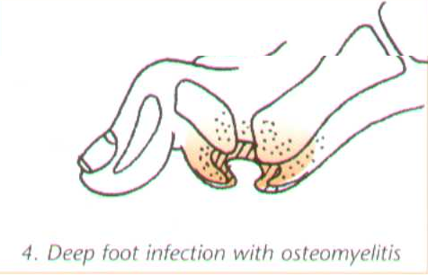
Some type of deformities
Claw toes
Charcot foot deformity
Callus on the sole
3

Slide 11
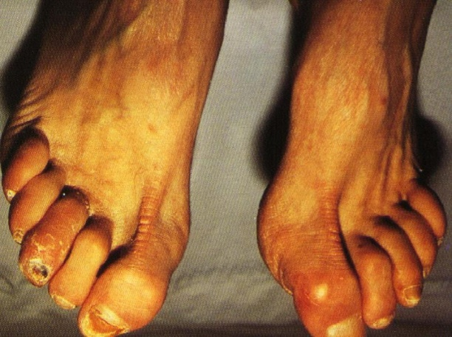
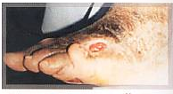
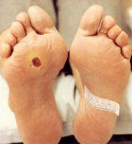
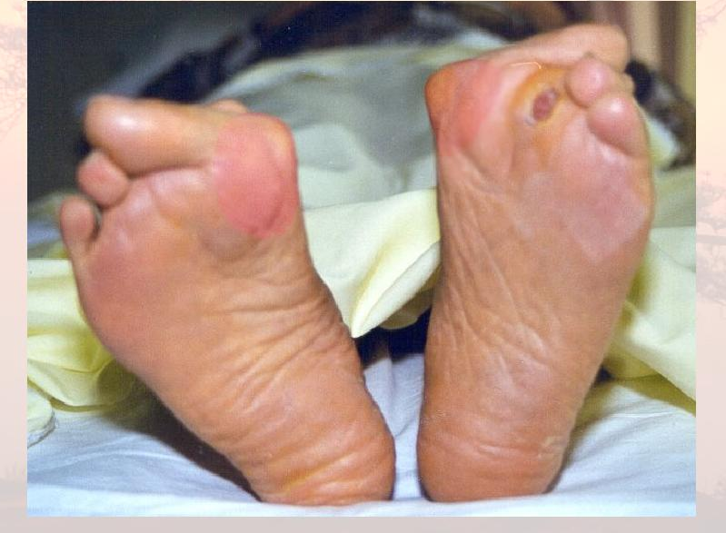
COMMON FOOT PROBLEMS
CHARCOT JOINT
HAMMER TOE
ULCER
HALUX VALGUS

Slide 12
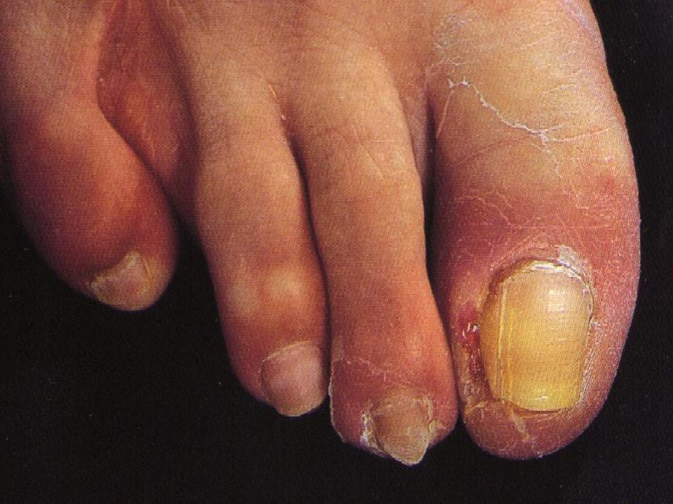
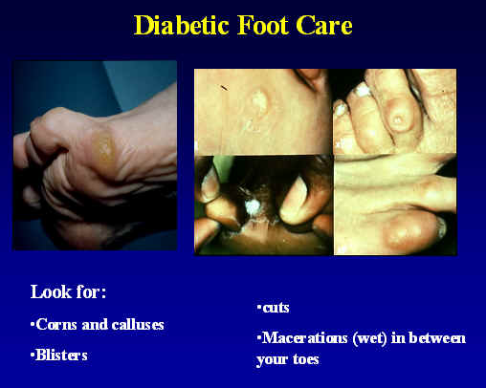
INGROWN TOENAILS
CORN & CALLUS

Slide 13
Management of Diabetic Foot
Diabetic foot problems are becoming
more common
Prevention is the best option
The most effective preventative
measure for major amputation is
screening and referral to a foot care
clinic for high risk clients

Slide 14
Management
The primary goal of ulcer treatment is quick and infection free wound closure
Three fundamental parts to healing protocol:
Regular/skilled debridement and dressing with appropriate wound healing agents.
Treatment of soft tissue infection and\or amputations
Offloading the wound is described by many authors as the single most important aspect of healing.

Slide 15
Patient Evaluation
Medical
Vascular
Orthopedic
infectious diseases specialist or a medical microbiologist.
Identification of “Foot at Risk”

Slide 16
Patient Evaluation
Medical
  Optimized glucose control
  Treatment of other medical problem .
  Decreases by 50% chance of foot problems

Slide 17
Patient Evaluation
Vascular
  Assessment of peripheral pulses of paramount importance
  If any concern, vascular assessment for
  Bypass surgery .

Slide 18
Patient Evaluation
Orthopedic
  Ulceration
  Deformity and prominences
  Contractures

Slide 19
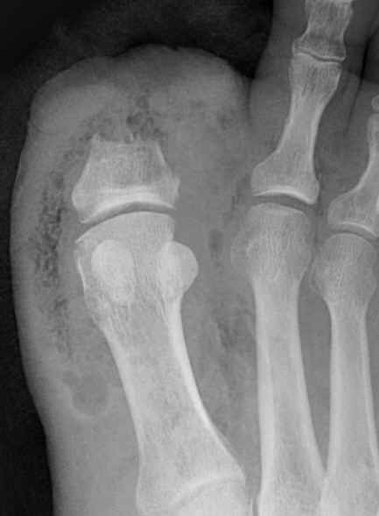
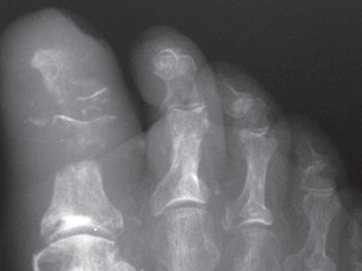
Patient Evaluation
X-ray
  Lead pipe arteries
  Bony destruction (Charcot or osteomyelitis)
  Gas, F.B.’s

Slide 20
Patient Evaluation
CT can be helpful in visualizing bony anatomy for abscess, extent of disease
MRI has a role uncertain cases of osteomyelitis
Angiography and Doppler study .

Slide 21
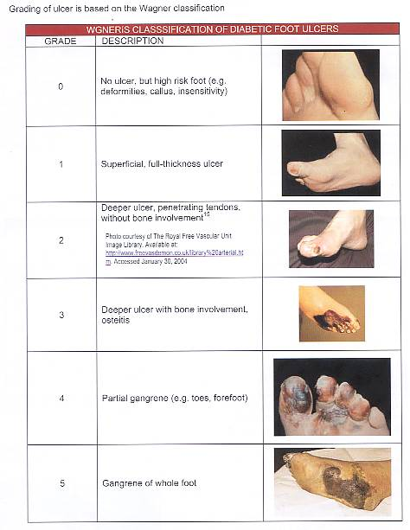
Intact skin (impending ulcer)
Superficial full thickness ulcer
deep to tendon or ligament no bone involvement
GRADING ULCER
(WAGNER CLASSIFICATION)
osteomyelitis
gangrene of toes or forefoot)
gangrene of entire foot

Slide 22
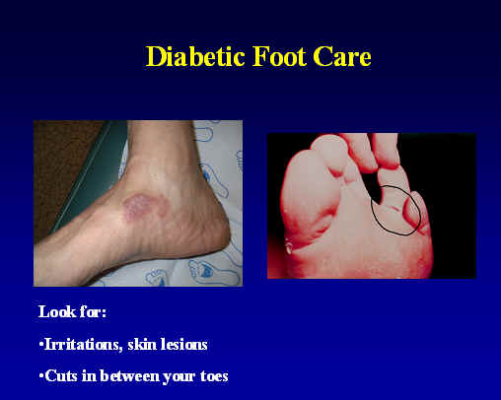
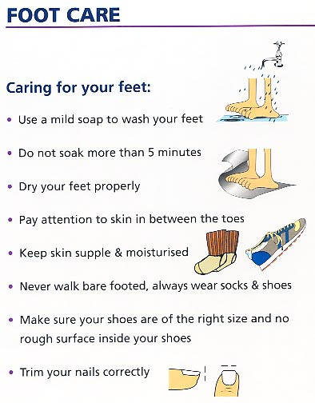
Treatment
Patient education
  Ambulation
  Shoe ware
  Skin and nail care
  Avoiding injury
    Hot water
    F.b
IRRITATIONS, SKIN LESIONS
CUTS BETWEEN YOUR TOES
BLISTER

Slide 23
Treatment
Wagner 0-2
  Total contact cast Distributes pressure and allows patients to continue ambulation
  Principles of application
    Changes, Padding, removal
  Antibiotics if infected
  Surgical if deformity present that will reulcerate
    Correct deformity
    exostectomy

Slide 24
Treatment
Wagner 3
  Excision of infected bone
  Wound allowed to granulate
  Grafting (skin or bone) not generally effective
After ulcer healed
  Orthopedic shoes with accommodative (custom made insert)
  Education to prevent recurrence

Slide 25
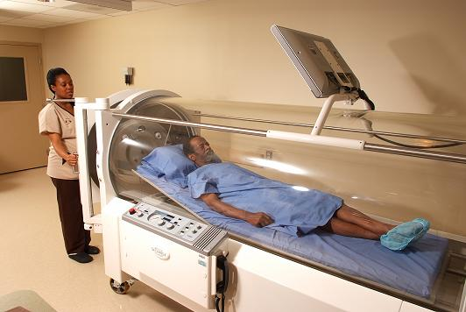
Other non surgical treatment modality
Hyperbaric oxygen treatment has been shown in multiple studies to have some efficacy in diabetic wound healing, with an overall healing rate of 76% compared with 48% without the use of hyperbaric oxygen and an amputation rate of 19% compared with 45% without hyperbaric oxygen.

Slide 26
Other non surgical treatment modality
VCT
The effects of vacuum-compression therapy (VCT)on the healing of ischemic ulcers.a machine with cycles of vacuum and subsequent compression to increase capillary filling. Use of the machine enhances the delivery of oxygen and nutrients to the wound, which, in turn, facilitates healing.
Extracorporeal shockwave
treatment can be helpful for healing of chronic ulcers and has been shown in one study to be more successful for healing ulcers than hyperbaric oxygen treatment.

Slide 27
Orthotic Treatment of Diabetic Ulcers
What orthotic treatments are currently being used?
 Total contact casting
 Cast walkers (Air cast, Royce, etc)
 Half shoe
 Therapeutic shoes with Custom foot orthoses
 Shoes with traditional dressing changes
  CROW (Charcot Restraint Orthopedic Walker)

Slide 28
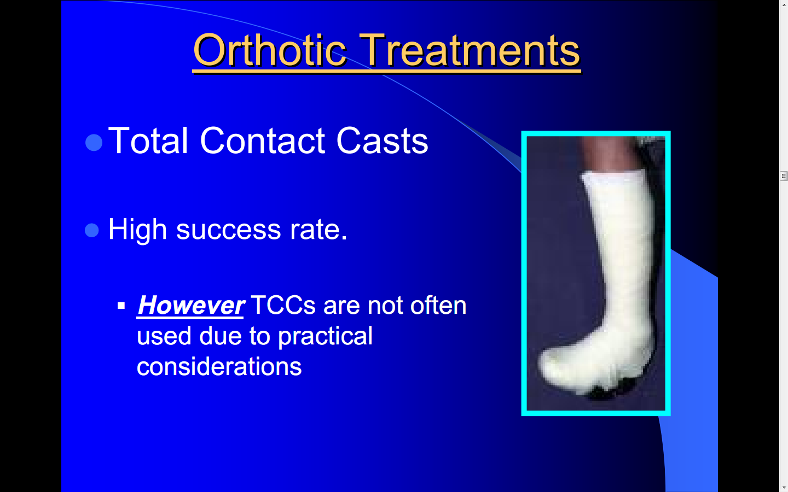

Slide 29
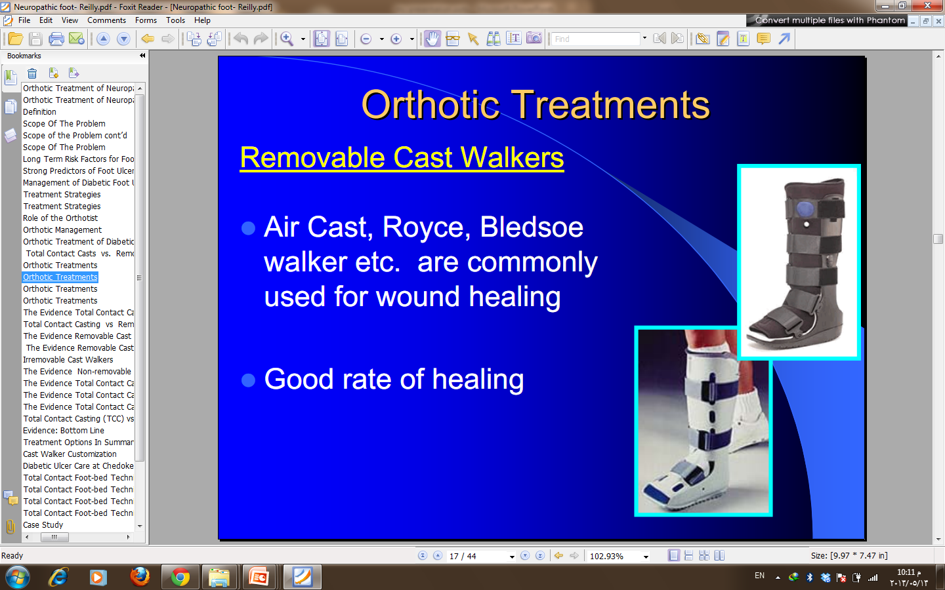

Slide 30
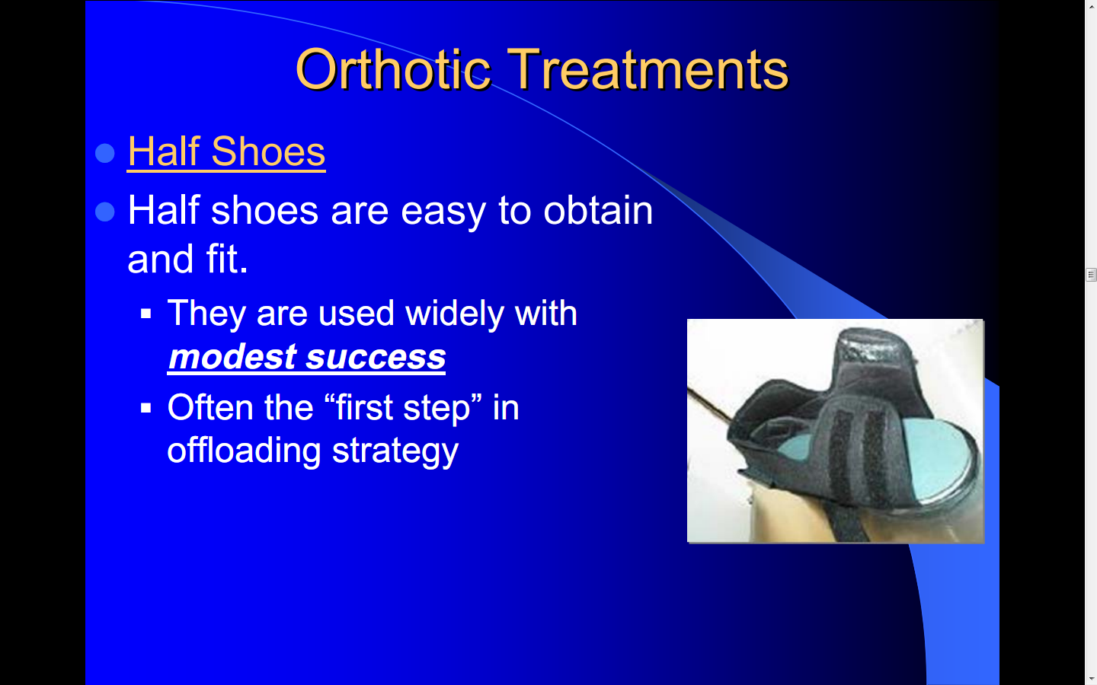

Slide 31
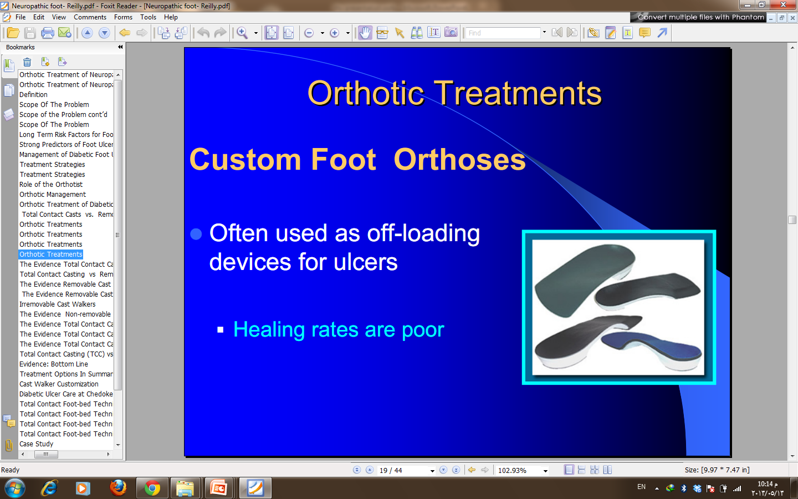

Slide 32
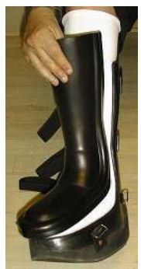
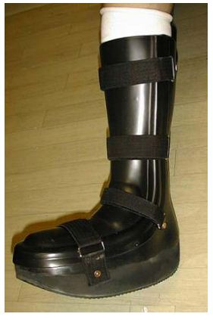
 CROW (Charcot Restraint Orthopedic Walker)
the CROW gives tremendous support
by preventing foot and ankle movement. It is fully padded on the inside. And give good healing rate

Slide 33
Surgical Treatment
Wagner 4-5
  Amputation
    ? level
OPERATIVE TREATMENT
the indications for urgent surgical intervention include necrotizing infections , wet gangrene or deep abscesses with systemic involvment.
Less urgent surgery may be required if
There is a substantially compromised soft tissue envelope,
Loss Of Mechanical Function Of The Foot, Or
Bone Involvement That Is Limb Threatening
Or if the patient prefers to avoid prolonged antibiotic therapy.
Surgical débridement of osteomyelitis is not always required.

Slide 34
Indications for Amputation
Uncontrollable infection or sepsis
Inability to obtain a plantar grade, dry foot that can tolerate weight bearing
Non-ambulatory patient
Decision not always straightforward

Slide 35
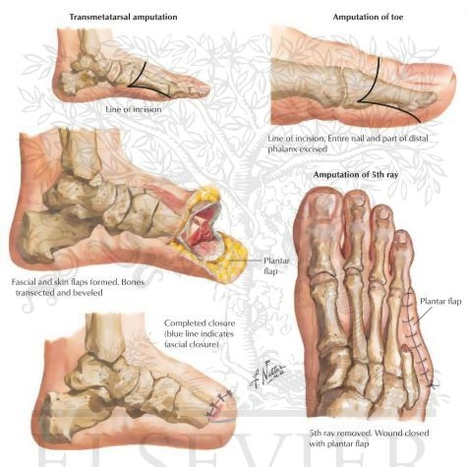
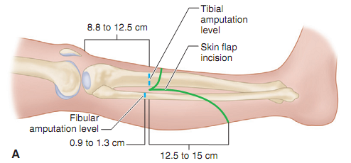
Site of predilection
Partial Foot Amputations
vs
BKA
vs
AKA

Slide 36
Site of predilection
More proximal ,,,less complication, more functional loss
More distal ,,,,less functional loss , more surgical complication
The patient’s overall well­being, general medical condition, and rehabilitation all are important factors.
Ambulation of the patient ,
Level of tissue necrosis
Level of infected planes of tissues
Distal pulses
A vascular surgery consultation is almost always appropriate. Even if revascularization would not allow for salvage of the entire limb

Slide 37
Site of predilection
Determining the most distal level for amputation with a reasonable chance of healing can be challenging.
Preoperatively, clinical assessment of skin color, hair growth, and
skin temperature provides valuable initial information.
Preoperative arteriograms,, are of little help in determining
potential for wound healing.
Segmental systolic blood pressures likewise offer little useful information because they are often falsely elevated owing to the noncompliant walls of arteriosclerotic vessels.
Measurements of skin perfusion pressures may be of some benefit,
thermography or laser Doppler flowmetry as methods to test skin flap perfusion.
tissue uptake of intravenously injected fluorescein or the tissue clearance of intradermally injected

Slide 38
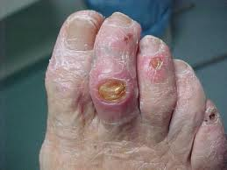
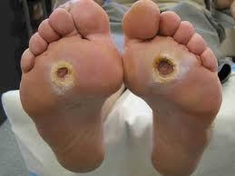
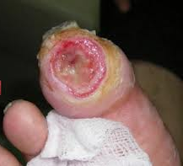

Slide 39
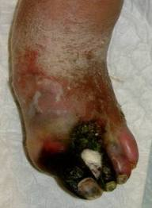
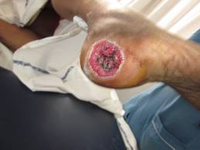

Slide 40
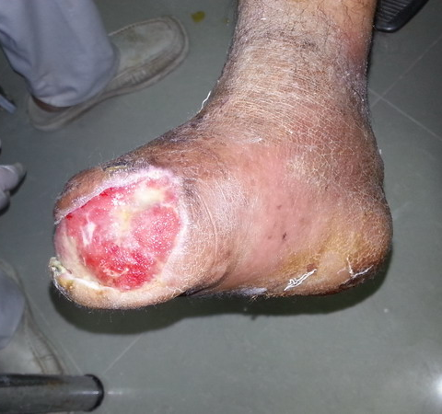
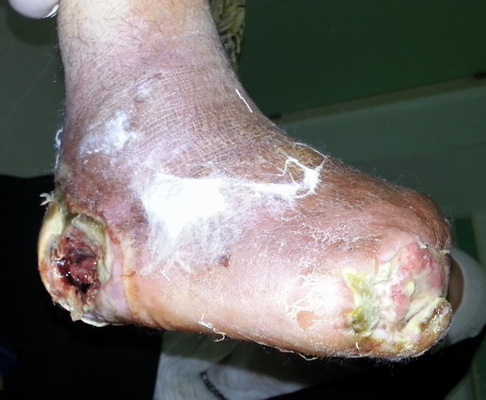

Slide 41
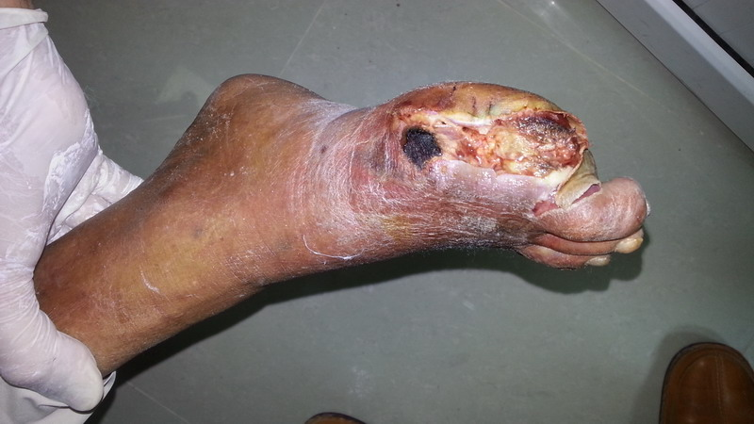

Slide 42
THANK YOU

