Slide 1
Neuromuscular disorders:
1-Cerebral palsy
2-Neural tube defects
3-Poliomylitis
4-Peripheral neuropathy
5-Muscular dystrophy
6- Compressive lesion of the spinal cord

Slide 2
-Clinical assessment
-Examination
1-Types of gait
2-Deformity
3-Muscle weakness
4-Sensory changes

Slide 3
Cerebral palsy : -Causative factors: -Diagnosis: -Types -Treatment:

Slide 4
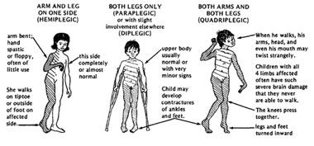

Slide 5
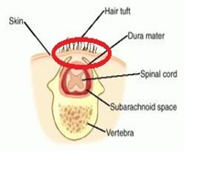
Spina Bifida: -Types : -Treatment :

Slide 6
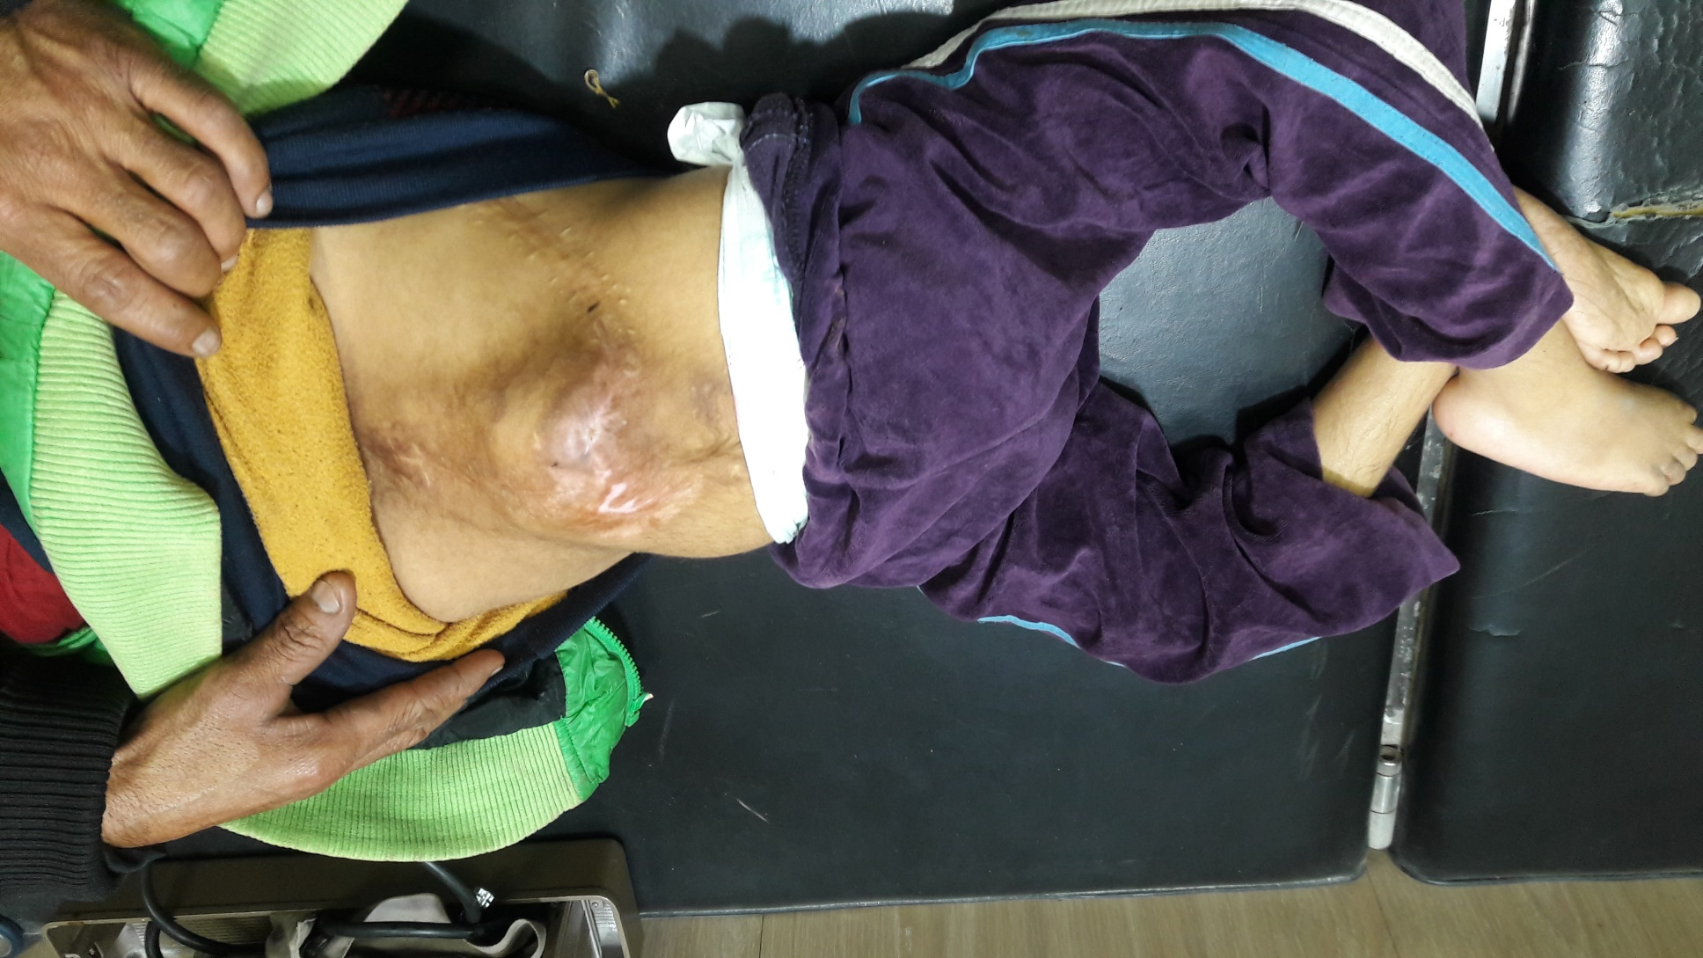

Slide 7
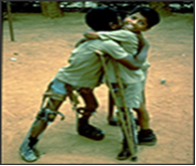
Poliomyelitis : -Clinical features : -Stages & Treatment:

