Slide 1
BLS,Cardiac Arrest,and Dysrrhythmia Management ACLS overview

Slide 2
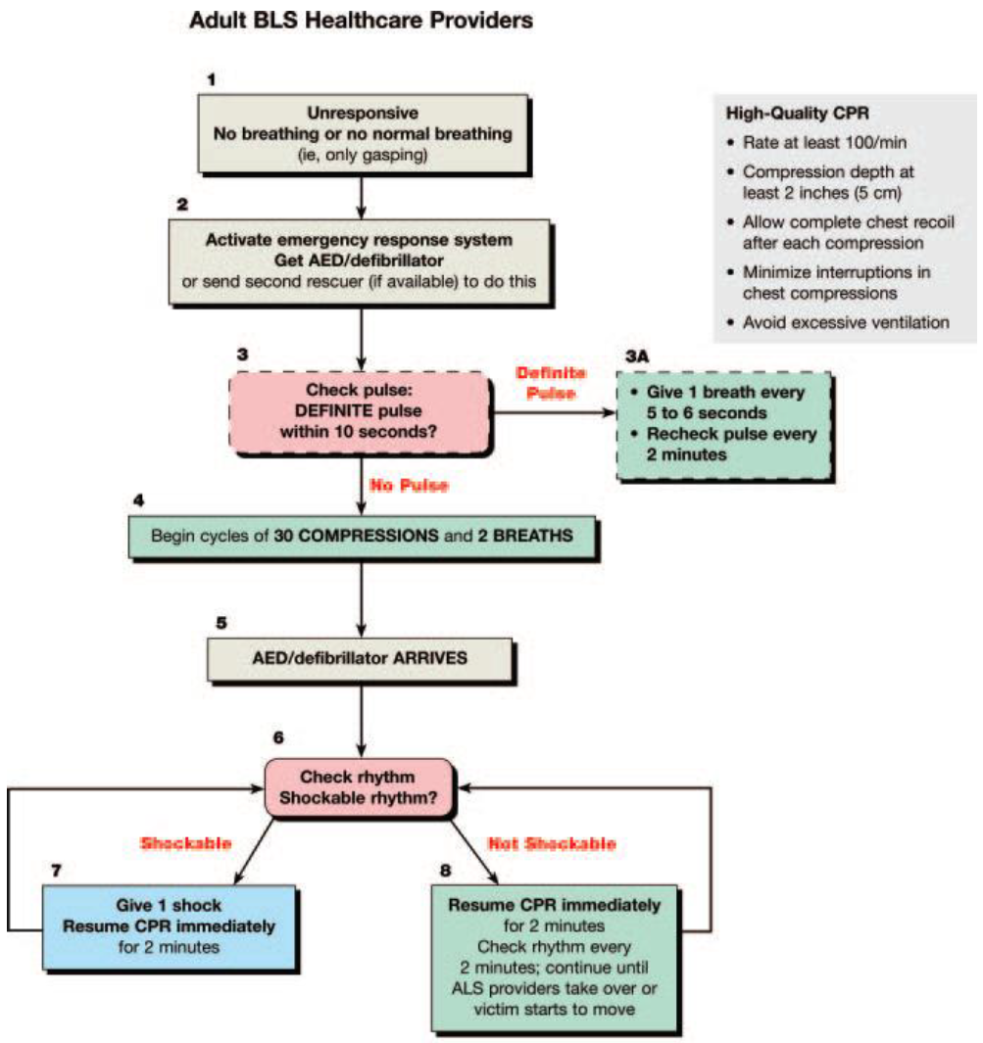

Slide 3
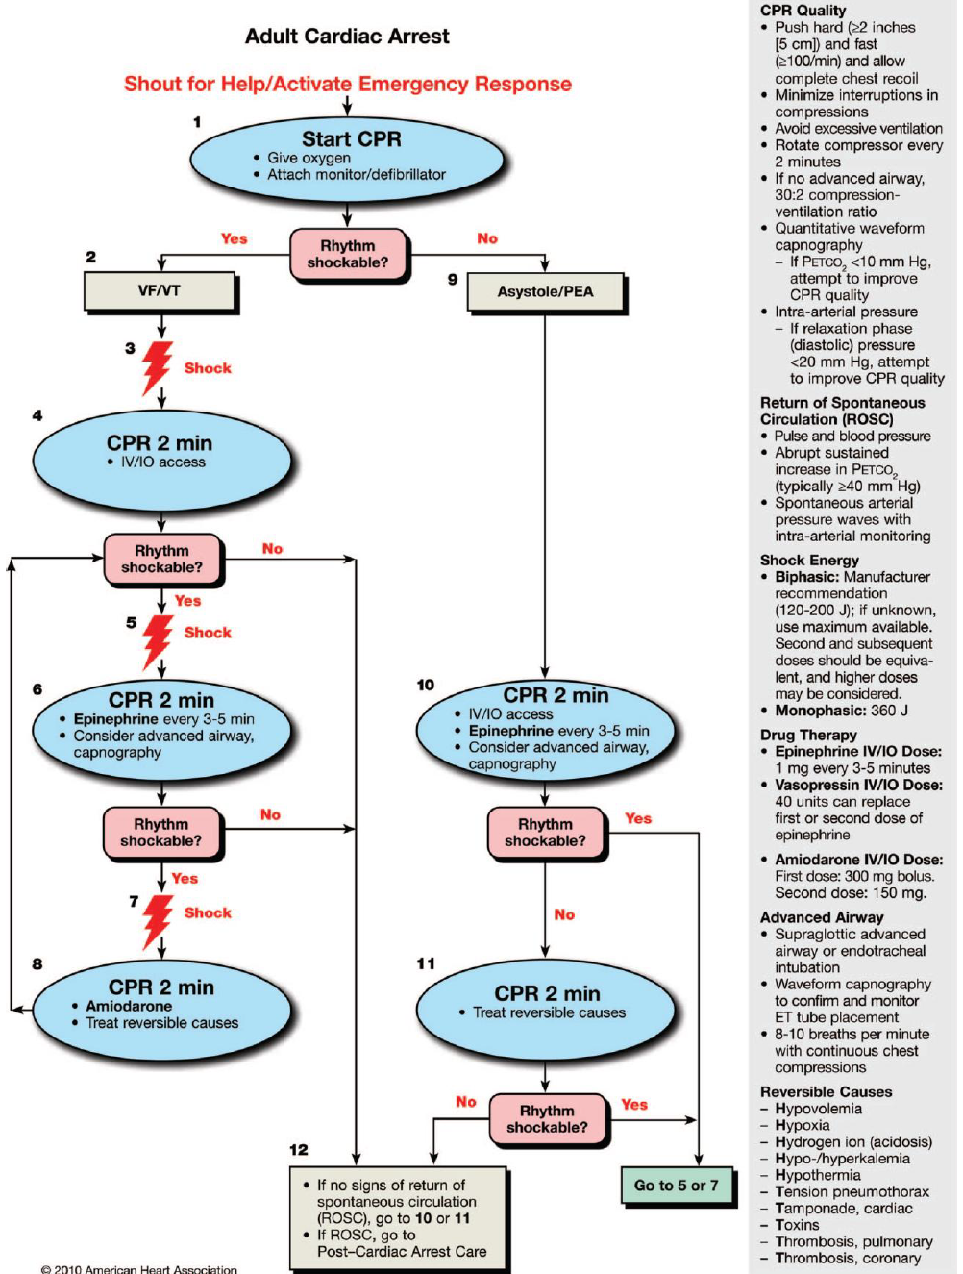

Slide 4
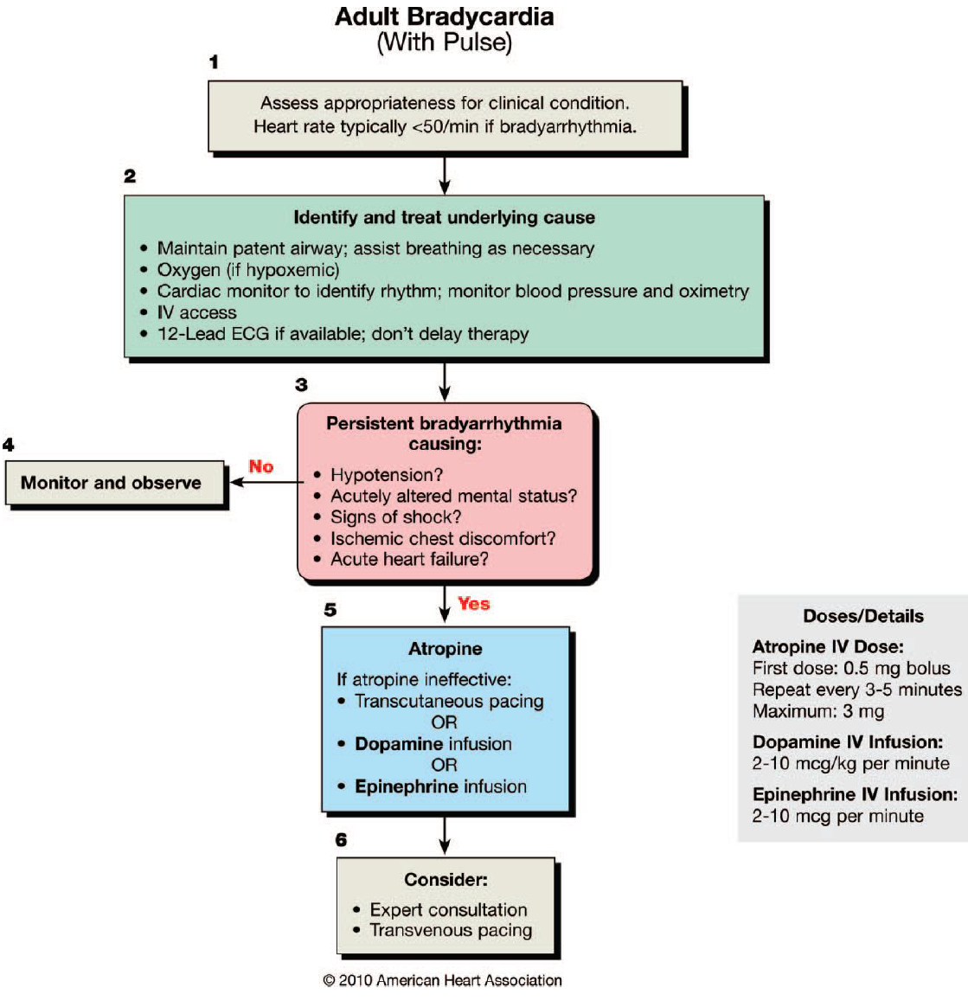

Slide 5
Bradycardia
Evaluation
Bradycardia is defined as a heart rate of <60 beats/ min. However, when bradycardia is the cause of symptoms,the rate is generally <50 beats per minute, which is the working definition of bradycardia used here.
Bradycardia may be physiologically normal for some patients.
Because hypoxemia is a common cause of bradycardia,initial evaluation of any patient with bradycardia should focus on signs of increased work of breathing tachypnea,intercostal retractions, suprasternal retractions) and SPO2.
If oxygenation is inadequate or the patient shows signs of increased work of breathing, provide oxygen.

Slide 6
Attach a monitor to the patient, evaluate BP, and establish IV access.
If possible, obtain a 12-lead ECG to better define the rhythm
Remember that signs and symptoms of bradycardia may be mild; asymptomatic or minimally symptomatic patients do not necessarily require treatment unless there is suspicion that the rhythm is likely to progress to symptoms or become life-threatening (eg, Mobitz type II 2nd AV block in the setting of AMI,or 3rd AVB).
If the bradycardia is suspected to be the cause of acute altered mental status, ischemic chest discomfort, acute heart failure, hypotension, or other signs of shock, the patient should receive immediate treatment.
.

Slide 7
Therapy
Atropine➔
1.First-line drug for acute symptomatic bradycardia 2.Temporizing RX while awaiting a TC or TV pacemaker for symptomatic sinus bradycardia, conduction block at the level of theAV node, or sinus arrest.
The recommended atropine dose for bradycardia is 0.5 mg IV every 3 to 5 minutes to a maximum total dose of 3 mg.
Atropine administration should not delay external pacing for patients with poor perfusion
Use atropine cautiously in the presence of acute coronary ischemia or MI; increased heart rate may worsen ischemia or increase infarction size.
Atropine will likely be ineffective inpatients who have undergone cardiac transplantation because the transplanted heart lacks vagal innervation.

Slide 8
Avoid relying on atropine in type II 2nd AVB or 3rd AV block where the location of block is infranodal(such as in His bundle).These bradyarrhythmias are not likely to respond to atropine and are preferably treated with TCP or Alpha-adrenergic support as temporizing measures while the patient is prepared for TVP
Pacing➔
1.Initiate TCP in unstable patients who do not respond to atropine
2.Immediate pacing might be considered in unstable patients with high-degree AV block when IV access is not available
TCP is a temporizing measure.
TCP is painful in conscious patients, and, whether effective or not (achieving inconsistent capture), the patient should be prepared for transvenous pacing

Slide 9
Alternative Drugs➔
1.Dopamine, epinephrine, and isoproterenol are alternatives when a bradyarrhythmia is unresponsive to atropine, or as a temporizing measure while awaiting the availability of a pacemaker.
2.May be appropriate in overdose of a -blocker or calcium
channel blocker.
Dopamine.infusion may be used for symptomatic bradycardia, particularly if associated with hypotension, in whom atropine may be inappropriate or after atropine fails Begin dopamine infusion at 2 to 10 mcg/kg /min. and titrate to response.

Slide 10
Epinephrine may be used for patients with symptomatic bradycardia, particularly if associated with hypotension, for whom atropine may be inappropriate or after atropine fails Begin the infusion at 2 to 10 mcg/min and titrate to effect.

Slide 11
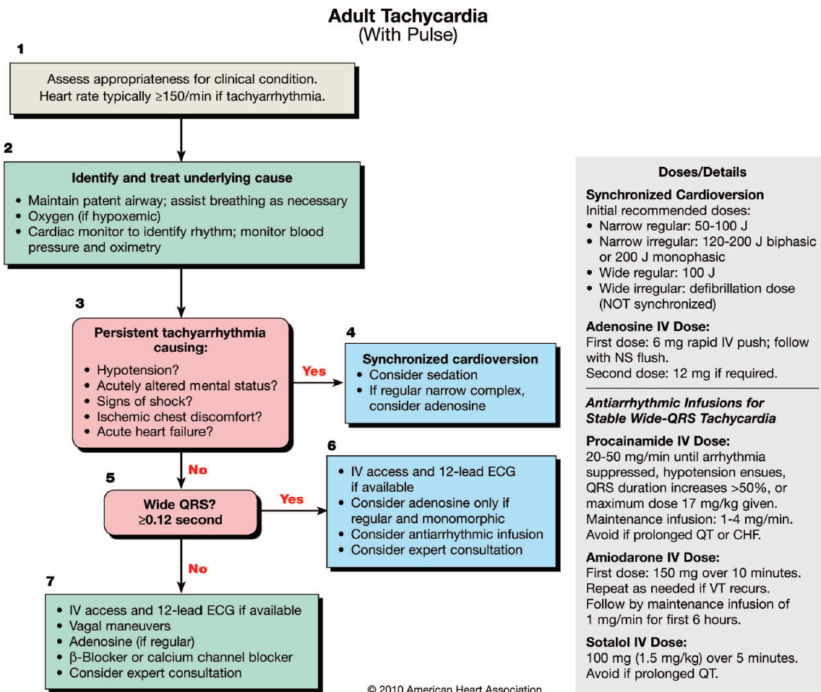

Slide 12
Tachycardia
Classification of Tachyarrhythmias
Narrow–QRS-complex (SVT) tachycardias (QRS <0.12sec)
In order of frequency
● Sinus tachycardia-regular
● Atrial fibrillation-irregular
● Atrial flutter-irregular
● AV nodal reentry(SVT)-regular
● Multifocal atrial tachycardia (MAT)-may be irregular
Wide–QRS-complex tachycardias (QRS >=0.12 second)
● VT and VF
● SVT with aberrancy
● Pre-excited tachycardias (Wolff-Parkinson-White
[WPW] syndrome)
● Ventricular paced rhythms

Slide 13
Tachycardia is defined as an arrhythmia with a rate of >100
beats per minute.
Tachycardia is an appropriate response to a physiologic stress
(eg, fever, dehydration) or other underlying conditions.
When encountering patients with tachycardia, efforts should be made to determine whether the tachycardia is the primary
cause or secondary to other pathologies.
Many experts suggest that when HR is 150 bpm, it is unlikely that instability is caused primarily by the tachycardia unless there is impaired ventricular function
Because hypoxemia is a common cause of tachycardia,
initial evaluation of tachycardia should focus on signs of increased work of breathing,and SPO2
If oxygenation is inadequate or the patient shows signs of increased work of breathing, provide oxygen.

Slide 14
Attach a monitor to the patient, evaluate blood pressure, and establish IV access.
Obtain a 12-lead ECG to better define the rhythm, but this should not delay immediate cardioversion if the patient is unstable.
If the patient demonstrates rate-related cardiovascular compromise with S/S such as acute altered mental status, ischemic chest discomfort, acute heart failure, hypotension, or other signs of shock suspected to be due to a tachyarrhythmia, proceed to immediate synchronized cardioversion

Slide 15
Cardioversion
If possible, establish IV access before cardioversion and
administer sedation if the patient is conscious.
Synchronized cardioversion is shock delivery that is timed
(synchronized) with the QRS complex. This synchronization
avoids shock delivery during the refractory period of
the cardiac cycle when a shock could produce VF.
Synchronized cardioversion is recommended to treat
(1)unstable SVT, (2) unstable AF, (3) unstable atrial flutter, and (4)unstable monomorphic (regular) VT

Slide 16
Cardioversion Waveform and Energy
1. Biphasic cardioversion of AF is 120 to 200 J.If the initial shock fails, providers should increase in a stepwise fashion.
2. Biphasic Cardioversion of atrial flutter and other SVTs is 50 to 100 J
3. Cardioversion with monophasic waveforms should begin at 200 J and increase in stepwise fashion if not successful
4. Monomorphic VT (regular form and rate) with a pulse responds well to monophasic or biphasic synchronized cardioversion at initial energies of 100 J.
5. if a patient has polymorphic VT, treat the rhythm as VF and deliver high-energy unsynchronized shocks (ie,DC)
6. If there is any doubt whether mono-or polymorphic VT is present in the unstable patient, do not delay shock to perform rhythm analysis:provide high-energy unsynchronized shocks (ie,DC).

Slide 17
Regular Narrow-Complex Tachycardia
A-Sinus Tachycardia➔
Usually results from a physiologic stimulus, such as fever, anemia, or hypotension/shock.
Sinus tachycardia is defined as a heart rate 100 beats per minute.
The upper rate of sinus tachycardia is calculated as 220 bpm minus the patient’s age in years)
If judged to be sinus tachycardia, no specific treatment is required. Instead, therapy is directed toward identification and treatment of the underlying cause.
B-Supraventricular Tachycardia (Reentry SVT)➔
Regular, narrow complex tachycardia(QRS<0.12 sec.)

Slide 18
Therapy for SVT➔
1.Vagal Maneuvers
Vagal maneuvers alone(Valsalva maneuver or carotid sinus massage) will terminate up to 25% of SVTs
2.Adenosine
If PSVT does not respond to vagal maneuvers, give 6 mg of IV adenosine as a rapid IV push through a large vein followed by a 20 mL saline flush
If the rhythm does not convert within 1 to 2 min., give a 12 mg rapid IV push using the method above.
Adenosine will transiently slow ventricular rate but not afford their termination
Amiodarone can be useful in RX of PSVT, but the onset of action of is slower than that of adenosine,and proarrhythmic risks favor the use of safer treatment alternatives.

Slide 19
Adenosine is safe and effective in pregnancy.
Side effects with adenosine are common but transient; flushing, dyspnea, and chest discomfort are the most frequently observed.
Adenosine should not be given to patients with asthma.
3.Calcium Channel Blockers and Beta-Blockers.
If adenosine or vagal maneuvers fail to convert PSVT,PSVT
recurs after RX,it is reasonable to use longer-acting AV nodal blocking agents, suchas calcium channel blockers (verapamil
and diltiazem) or Beta-blockers

Slide 20
Verapamil
2.5 mg to 5 mg IV bolus over 2-5 minutes. If no response, repeated doses of 5 mg to 10 mg may be administered every 15 to 30 minutes to a total dose of 20 mg.
An alternative dosing regimen is to give a 5 mg bolus every 15 minutes to a total dose of 30 mg.
Verapamil should not be given to==➔
1.Patients with wide-complex tachycardias.
2.Impaired ventricular function or heart failure
Diltiazem
15 mg to 20 mg (0.25 mg/kg) IV over 2 minutes; if needed, in 15 minutes give an additional IV dose of 20 mg to 25 mg (0.35 mg/kg). The maintenance infusion dose is 5 mg/hour to 15 mg/hour, titrated to heart rate

Slide 21
Metoprolol, Atenolol, Propranolol, Esmolol, and Labetolol
Like calcium channel blockers, they also have –ve inotropic effects and further reduce cardiac output in patients with heart failure.
Side effects of B-blockers can include bradycardias, AV Block, and hypotension.
B-blockers should be used with caution in patients with COPD, Asthma,Heart Block,DM
In patients with pre-excited atrial arrhythmias; the typical AV nodal blocking drugs are contraindicated and rate control may be achieved with (Amiodarone, Procainamide)

Slide 22
Wide-Complex Tachycardia
An unstable patient with a WCxT should be presumed to have VT and immediate cardioversion performed
If the patient is stable, the 2nd step is to obtain a 12-lead ECG to evaluate the rhythm.
Wide-complex tachycardias are defined as those with a
QRS >=0.12 second.
Causes➔
● VT or VF
● SVT with aberrancy
● Pre-excited tachycardias (associated with or mediated by
an accessory pathway)
● Ventricular paced rhythms

Slide 23
The 3rd step in management of a tachycardia is to
determine if the rhythm is regular or irregular??
A regular wide-complex tachycardia =➔
VT or SVT with aberrancy.
An irregular wide-complex tachycardia➔
AF with aberrancy
Polymorphic VT/torsades de pointes.
Therapy for Regular Wide-Complex Tachycardias
For patients who are stable with likely VT, IV antiarrhythmic
Procainamide ,amiodarone , or sotalol can be considered.
If one of these agents is given, a second agent should not be
given without expert consultation.
If antiarrhythmic RX is unsuccessful, cardioversion or expert consultation should be considered

Slide 24
Procainamide
Administered at a rate of 20 to 50 mg/min until the arrhythmia is suppressed, hypotension ensues, QRS duration increases 50%, or the maximum dose of 17 mg/kg is given.
Procainamide should be avoided in patients with prolonged QT and congestive heart failure.
IV sotalol (100 mg IV over 5 minutes) was found to be more
effective than lidocaine (100 mg IV over 5 minutes) when
administered to patients with stable monomorphic VT
Sotalol should be avoided in patients with a prolonged QT

Slide 25
Amiodarone
Effective in preventing recurrent monomorphic VT or treating refractory ventricular arrhythmias in patients with coronary artery disease and poor ventricular function.
It is given 150 mg IV over 10 minutes; dosing should be repeated as needed to a max. dose of 2.2 g IV per 24 hours.
By comparison, lidocaine is less effective in terminating VT
than procainamide, sotalol, and amiodarone, and should be considered second-line RX for monomorphic VT.
Lidocaine can be administered at a dose of 1 to 1.5 mg/kg IV bolus. Maintenance infusion is 1 to 4 mg/min

Slide 26
Irregular Tachycardias
Atrial Fibrillation and Flutter➔
An irregular narrow-complex or wide-complex tachycardia is
most likely atrial fibrillation with an uncontrolled ventricular response.
Therapy
General MX of AF should focus on➔
1.Control of the rapid ventricular rate (rate control) 2.conversion of hemodynamically unstable AF to sinus rhythm(rhythm control), or both.
Patients with an AF duration of>= 48 hours are at increased risk for cardioembolic events.
Electric or pharmacologic cardioversion (conversion to normal sinus rhythm) should not be attempted in these patients unless the patient is unstable.

Slide 27
An alternative strategy is to perform cardioversion(mech. or chemical)following anticoagulation with heparin and performance of transesophageal echocardiography to ensure the absence of a left atrial thrombus
Rate Control(AF with HR>120bpm)
Patients who are hemodynamically unstable should receive
prompt electric cardioversion.
Stable patients require ventricular rate control.
IV B-blockers and calcium channel blockers such as diltiazem are the drugs of choice for acute rate control in most individuals with AF and rapid ventricular response
Digoxin and amiodarone may be used for rate control in patients with congestive heart failure

Slide 28
A wide-complex irregular rhythm should be considered preexcited AF(WPW with AF).
Avoid AV nodal blocking agents such as adenosine, calcium channel blockers, digoxin, and possibly B-blockers in patients with pre-excitation AF because these drugs may cause a paradoxical increase in the ventricular response.
Patients with pre-excited atrial fibrillation present with very
rapid heart rates and require emergent electric cardioversion.
When electric cardioversion is not feasible or effective, or AF is recurrent, use of rhythm control agents may be useful for both rate control and stabilization of the rhythm

Slide 29
Rhythm Control
Polymorphic (Irregular) VT
Polymorphic (irregular) VT requires immediate defibrillation with the same strategy used for VF.
-If a long QT interval is observed during sinus rhythm (ie, the VT is torsades de pointes), the first step is to stop medications known to prolong the QT interval, correct electrolyte imbalance
Magnesium is commonly used to treat torsades de pointes VT (polymorphic VT associated with long QT interval)
-In the absence of a prolonged QT , the most common cause of polymorphic VT is myocardial ischemia.
In this situation IV amiodarone may reduce the frequency of arrhythmia recurrence

