Slide 1
Lab. 1:
Introduction +
Enterobius vermicularis

Slide 2
Credit hours: 45 theoretical hours (2 hours in 1st Course & 1hour in the 2nd Course) + 30 laboratories (2 hours for each lab.)

Slide 3
The following elements will determine the learner s final grade:
weight | Element
20 5 5 10 | First Course: 40% Theory Quizzes (3) Lab. Copybook Attendance Practical exam
60% (50 Th+ 10 P) | Final exam
100% | Total
21 4 3 10 2 | Second Course: 40% Theory Quizzes (3) Lab. Copybook Attendance Practical exam Small group learning
60% (50 Th+ 10 P) | Final exam
100% | Total

Slide 4
Nematode
The intestinal nematodes
Ascaris
Hook worms
Pin worm
Whip worm
The blood- and tissue dwelling nematodes
The filaria
Trichinella

Slide 5
General life cycle of Nematodes
Adult
♂ + ♀
Egg
L 4
L1
L 3
L 2

Slide 6
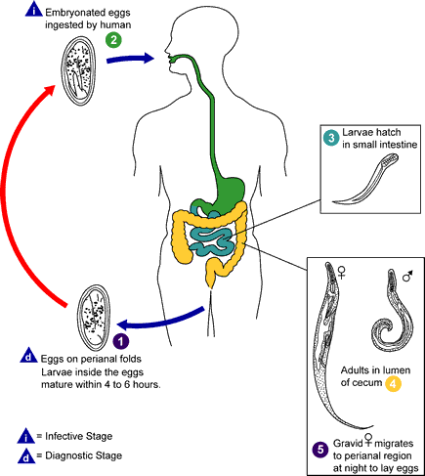

Slide 7
Enterobius vermicularis :

Slide 8
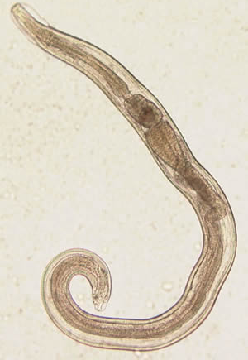
1. Enterobiusvermicularis :
A. Male:
Anterior cuticular
inflations,
Esophageal &
esophageal bulb,
Curved posterior end
(like an inverted
question mark).

Slide 9
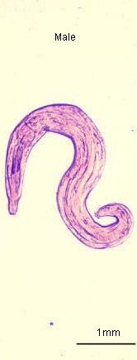
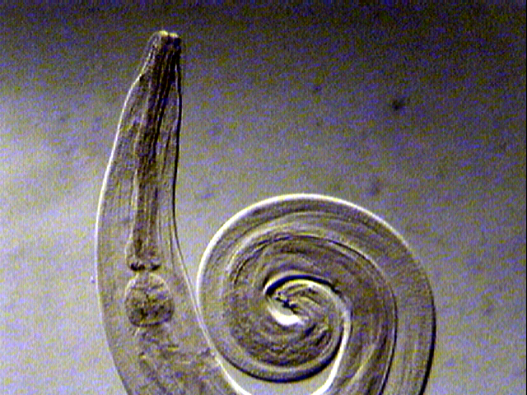
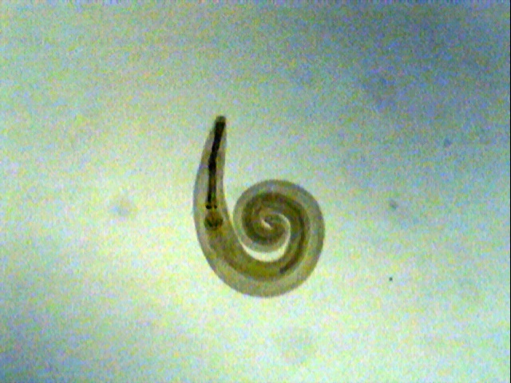
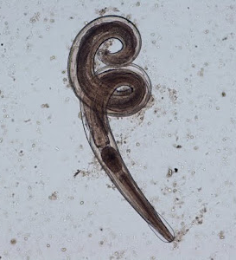
Enterobius vermicularis Adult Male posterior end is curved with one spicule, rarely seen in stool

Slide 10
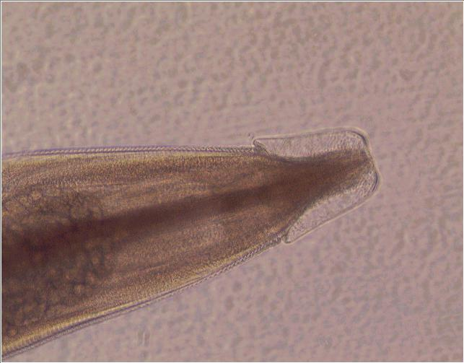
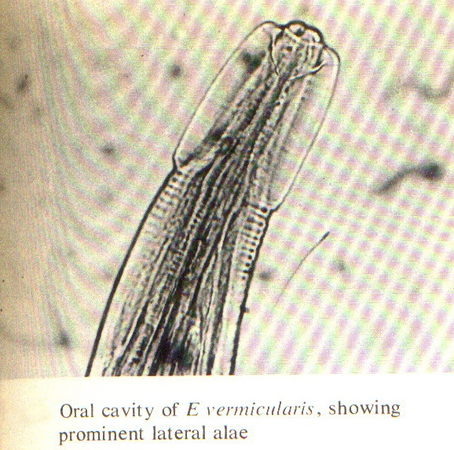
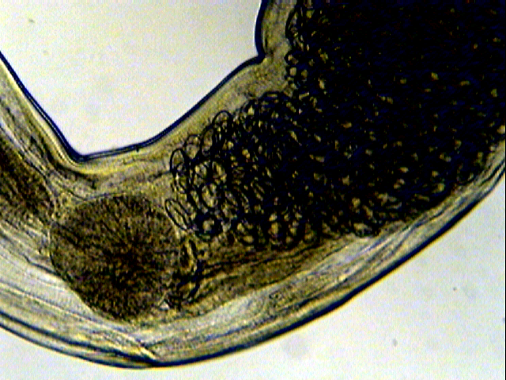
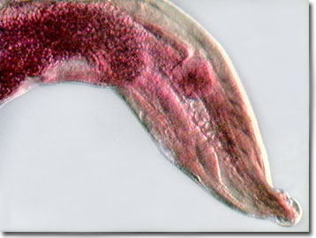
Cervical alae
Oesophagus
Bulb
Globular bulb
Enterobius vermicularis Adult Anterior end
Note : the cuticular cervical expansions ( alae ) and the double – bulb muscular oesophagus ( similar in both sexes )

Slide 11
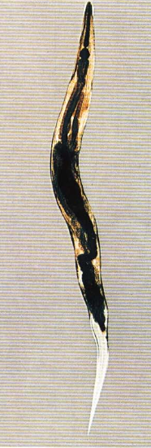
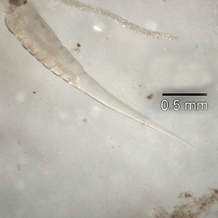
Enterobius vermicularis
B.Female:
Anterior cuticular inflations,
Esophageal &esophageal bulb,
Paired gonads,
Long pointed posterior end .

Slide 12
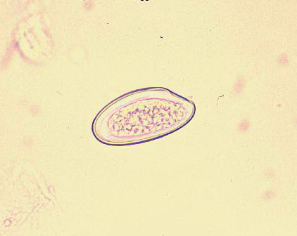
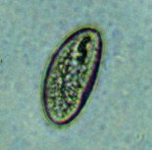
D. Ova:
D-shaped eggs,
with or without enclosed larva.

Slide 13
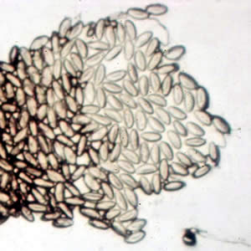
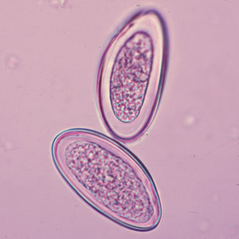
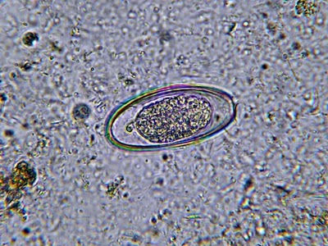
Eggs of E. vermicularis in a cellulose-tape preparation.
Eggs of E. vermicularis in a wet mount.
Egg in Fecal Concentrate X400

Slide 14
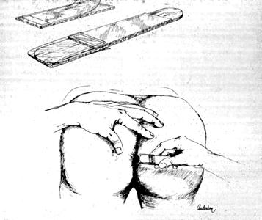
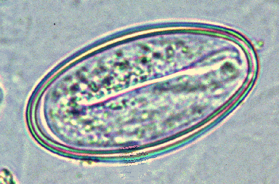
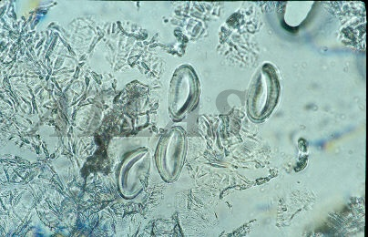
Tape test for pinworms
Flashlight Test: At night, the female adult worms deposit their eggs outside the rectum or anal area.

Slide 15
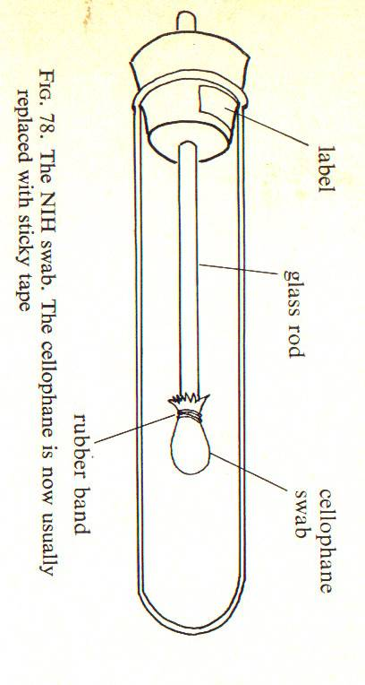
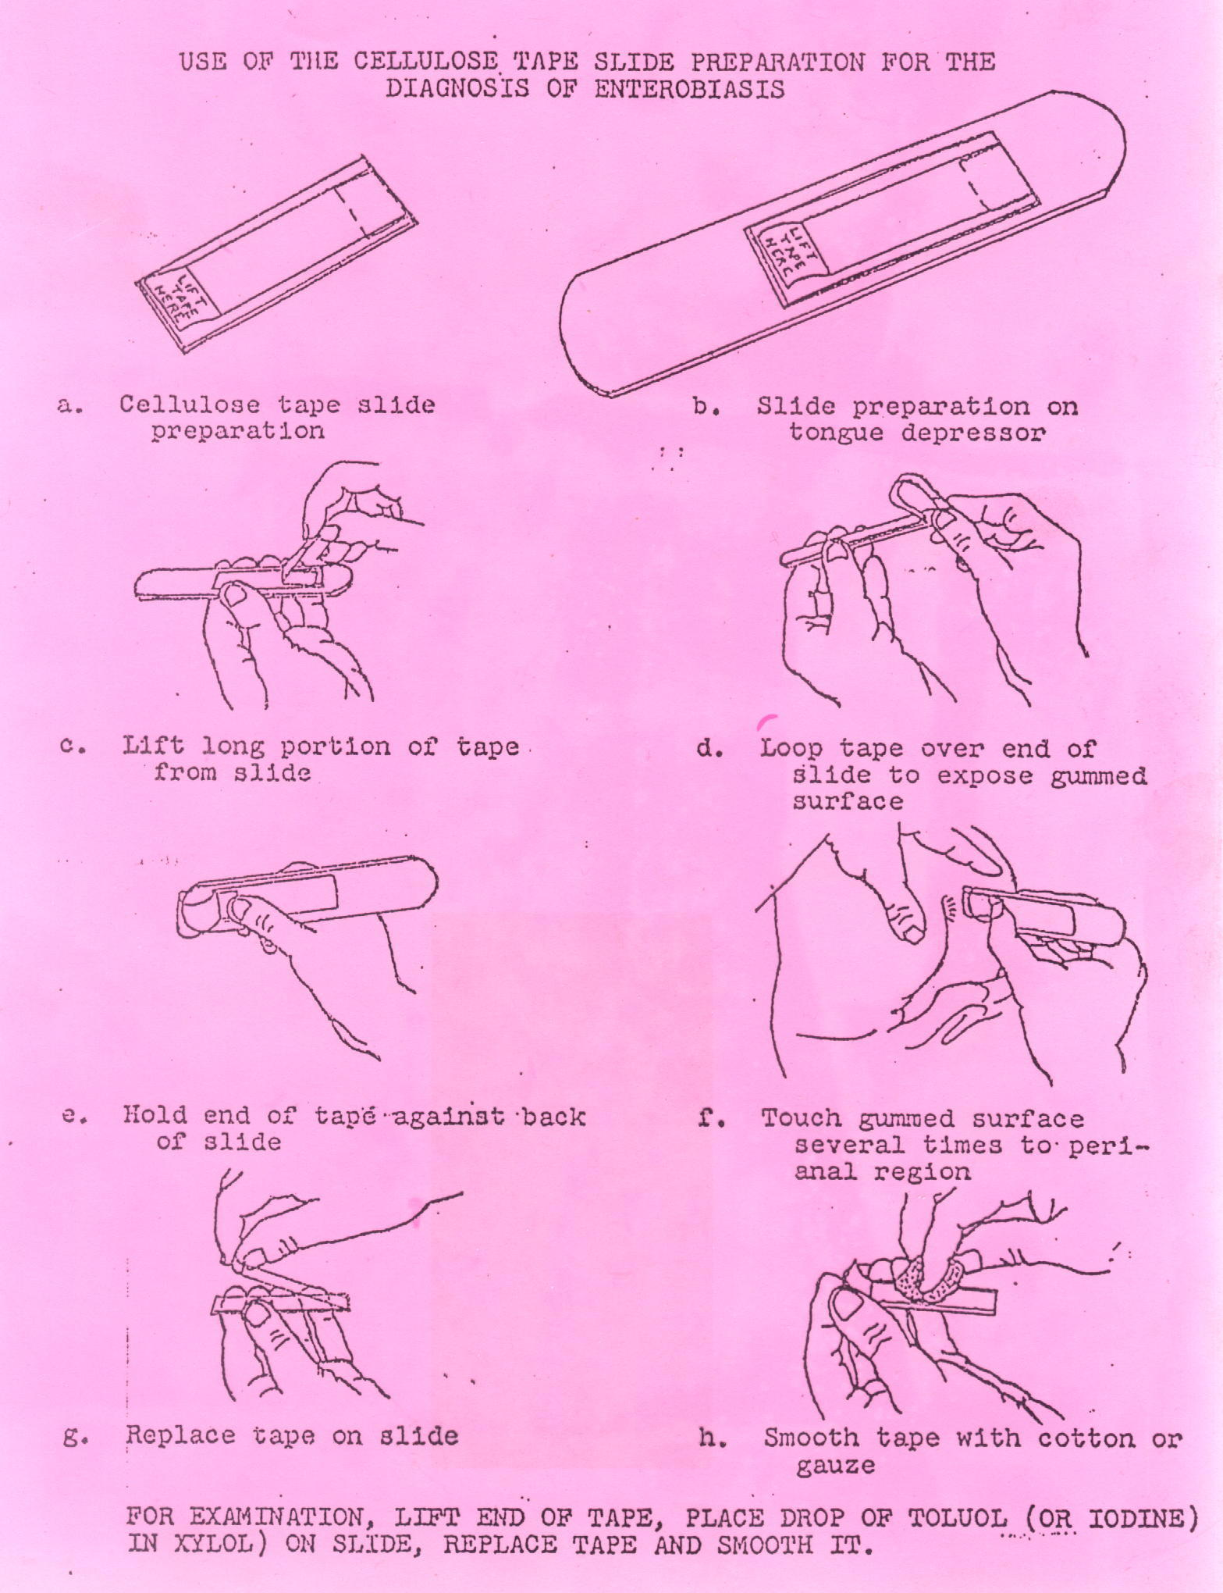
Scotch tape technique ( graham swab )
The NIH swab. The cellophane is now usually replaced with sticky tape
The techniques which used for detected the eggs of E. vermicularis from perianal skin, eggs are rarely recovered in stool
Note : eggs can also be recovered from under the finger nails

Slide 16
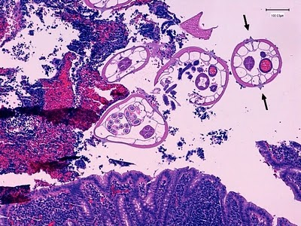
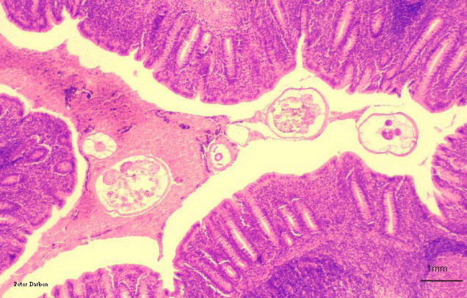
C. Section in appendix:
section of worms in lumen of appendix
lateral alae.

Slide 17
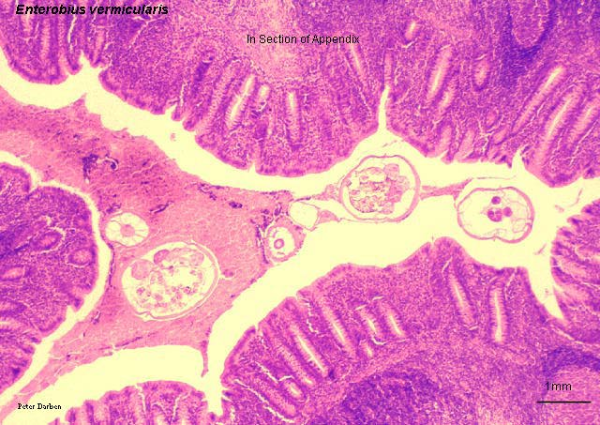
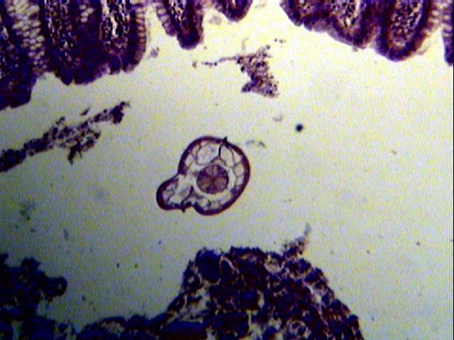
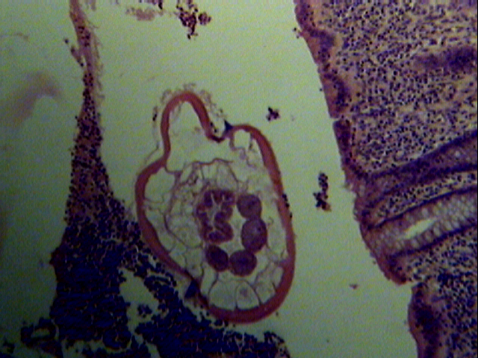
Section of adult worm
Lateral alae
Enterobius vermicularis Adult in Appendix Section
Note : cuticular lateral alae like spine in cross section of adult worm

