Slide 1
Medical/Image Processing
And
MATLAB for Image Processing
Medicine School – Al-Mustansiriyah University Dr. Ammar Kamel

Slide 2
Lecture outline
Applications of Image Processing
Demonstration of Basic Image Processing Tools
Image Formation and Perception
Image Representation

Slide 3
Application Areas of Image Processing
Purpose of image processing
– Improvement of pictorial information for human interpretation
– Compression of image data for storage and transmission
– Preprocessing to enable object detection, classification, and tracking
• Typical application areas
– Television Signal Processing
– Satellite Image Processing
– Medical Image Processing
– Law Enforcement
And much more

Slide 4
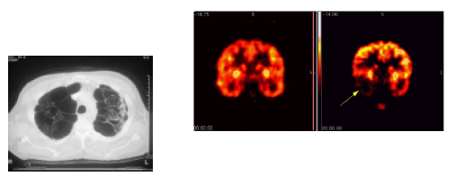
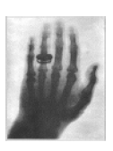
Medical Image Processing
Images are acquired to get information about Anatomy and Physiology of a patient
• How to reconstruct the image from captured data
• How to process/analyze the image to help diagnosis/treatment
– Ultra Sound (US)
– Magnetic resonance Imaging
– Positron Emission Tomography (PET)
– Computer Tomography (CT)

Slide 5
Basic Image Processing Operations
• Simple point processing
• Noise reduction
• Image enhancement
• Image restoration
• Image segmentation

Slide 6
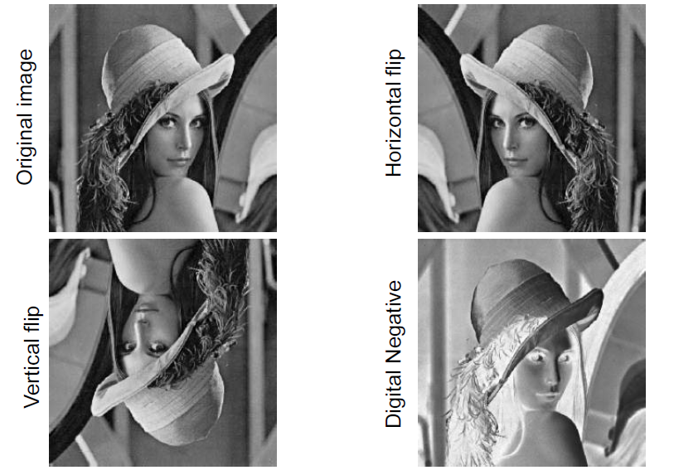
Simple point processing

Slide 7
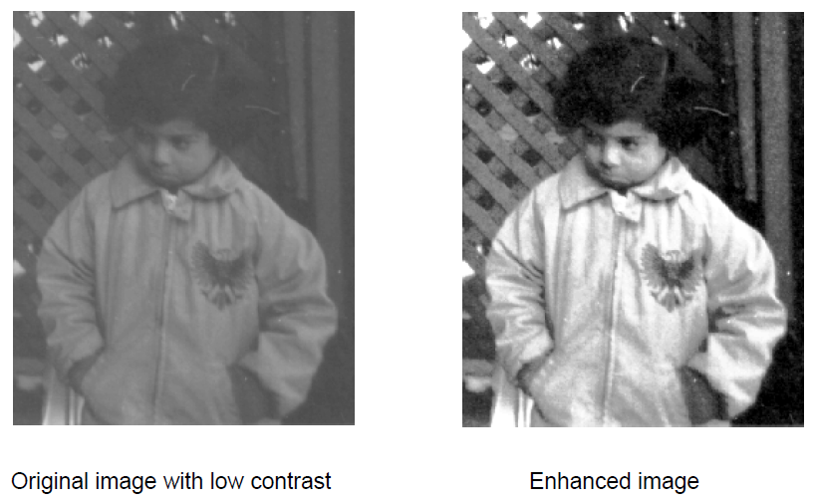
Contrast Enhancement

Slide 8
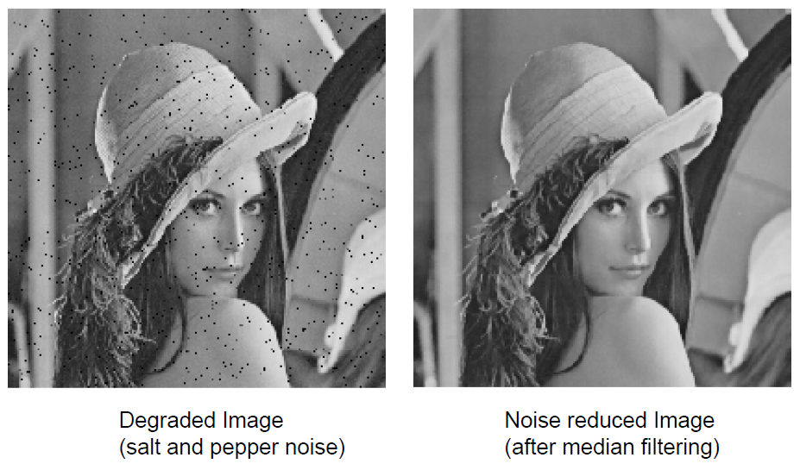
Noise Reduction

Slide 9
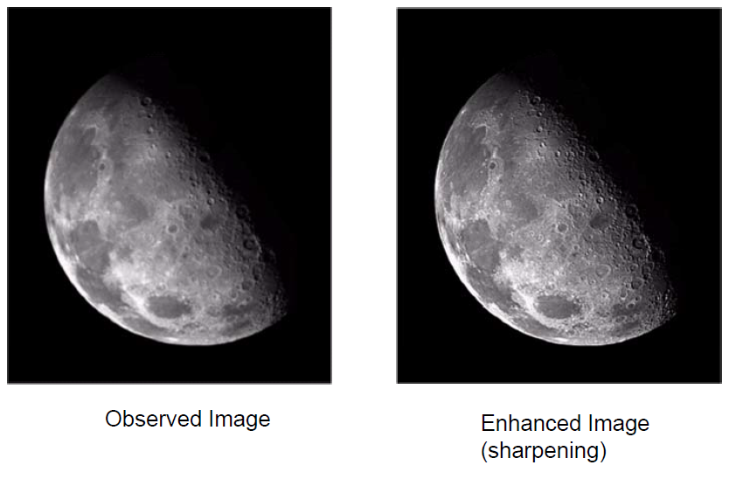
Image Sharpening

Slide 10
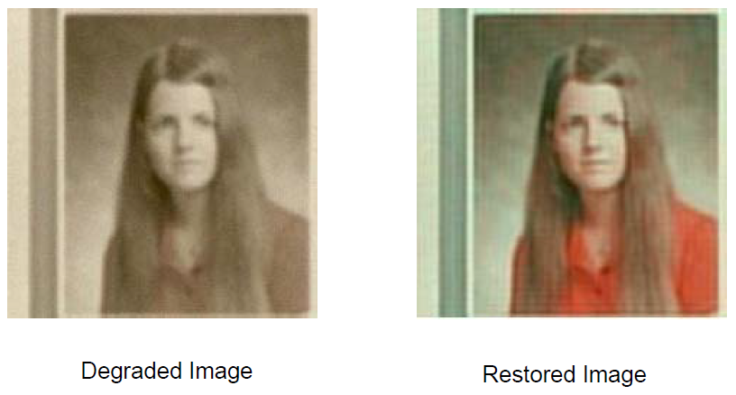
Image Restoration

Slide 11
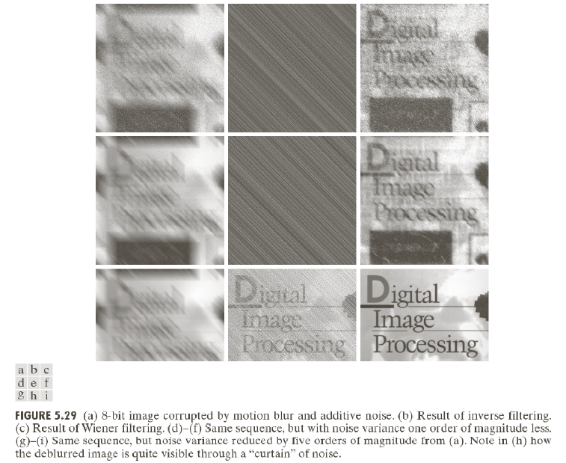
Image debluring

Slide 12
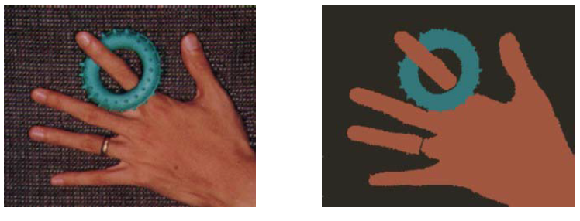
Image Segmentation
Segmentation of different object in the scene

Slide 13
Image Formation and Representation
• What Is an Image? And Digital Image
• What Is Digital Image Processing?
• Grayscale image capture
• Color image capture
• Digital image representation
• Common image file formats

Slide 14
What Is an Image?
An image is a visual representation of an object, a person, or a scene produced by an optical device such as a mirror, a lens, or a camera. This representation is two dimensional (2D), although it corresponds to one of the infinitely many projections of a real-world, three-dimensional (3D) object or scene.

Slide 15
What Is a Digital Image?
A digital image is a representation of a two-dimensional image using a finite number of points, usually referred to as picture elements, pels, or pixels.
Each pixel is represented by one or more numerical values: for monochrome (grayscale) images, a single value representing the intensity of the pixel (usually in a [0, 255] range) is enough;
for color images, three values (e.g., representing the amount of red (R), green (G), and blue (B)) are usually required.

Slide 16
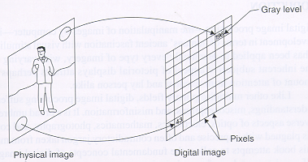
Image digitization
Sampling means measuring the value of an image at a finite number of points.
Quantization is the representation of the measured value at the sampled point by an integer.

Slide 17
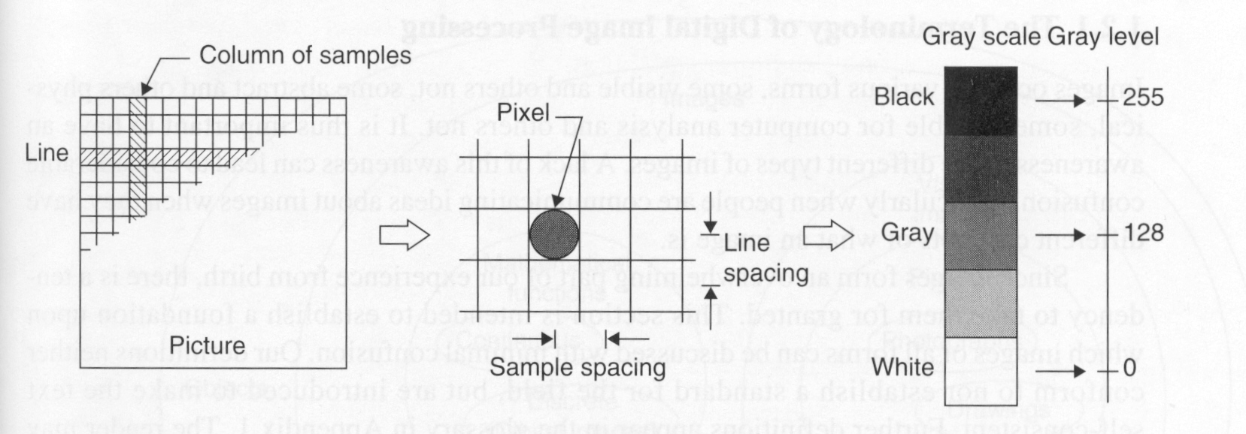
Image digitization (cont’d)
0
128
255

Slide 18
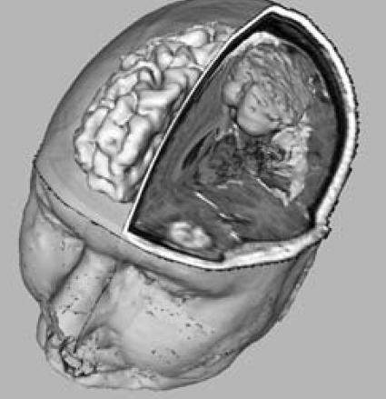
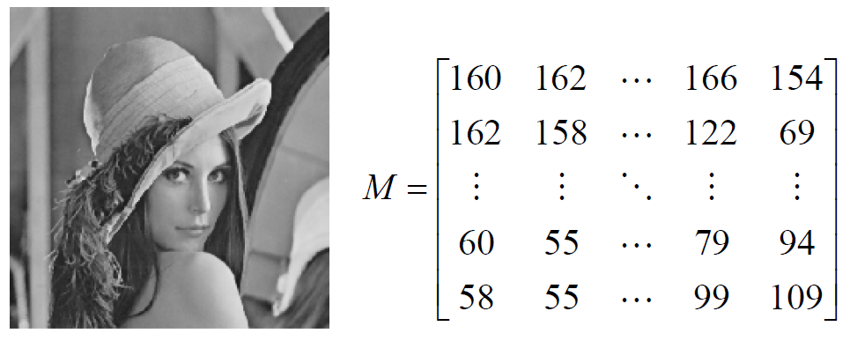
Grayscale Image Specification
• Each pixel value represents the brightness of the pixel. With 8-bit image, the pixel value of each pixel is 0 ~ 255
• Matrix representation: An image of MxN pixels is represented by an MxN array, each element being an unsigned integer of 8 bits

Slide 19
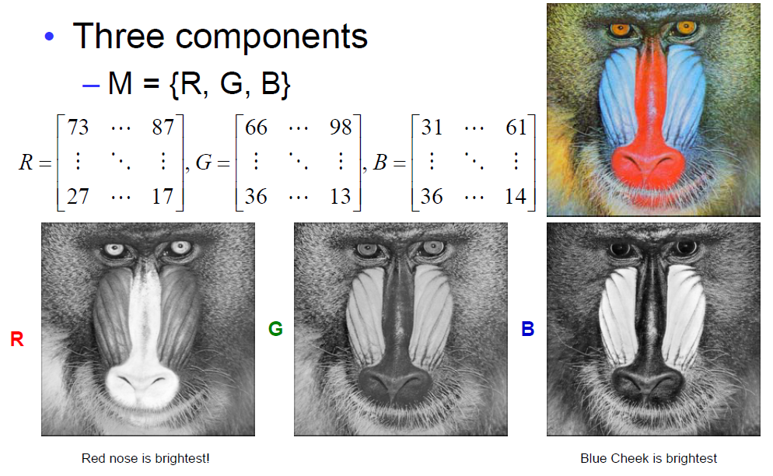
Color Image Specification

Slide 20
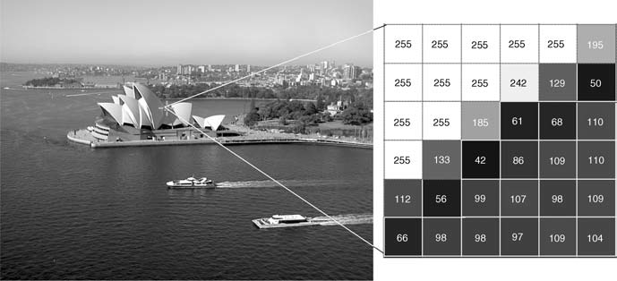
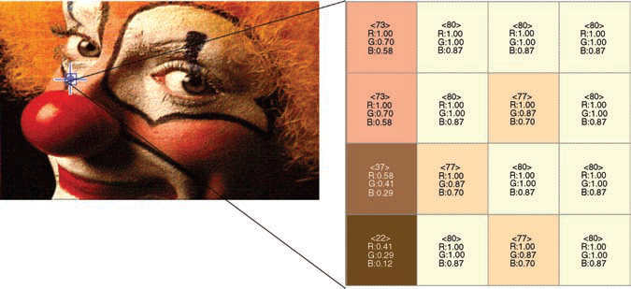
A grayscale image and the pixel values in a 6 × 6 neighborhood
An indexed color image and the indices in a 4 × 4 neighborhood

Slide 21
What Is Digital Image Processing?
Digital image processing can be defined as the science of modifying digital images by means of a digital computer.
The changes that take place in the images are usually performed automatically and rely on carefully designed algorithms. This is in clear contrast with another
scenario, such as touching up a photo using an airbrush tool in a photo editing software, in which images are processed manually and the success of the task depends on human ability and dexterity.

Slide 22
Common image file formats
GIF (Graphic Interchange Format) -
PNG (Portable Network Graphics)
JPEG (Joint Photographic Experts Group)
TIFF (Tagged Image File Format)
PGM (Portable Gray Map)
FITS (Flexible Image Transport System)

