Slide 2
ECZEMA
What is Eczema ?
Who can affected by Eczema?
How many types of Eczema?
What are the stages of it ?
What is the etiology and pathophysiology ?
How can diagnose and treat it ?
What is the prognosis of it ?

Slide 3
Eczema
Eczema is common inflammatory disease specific to the skin, characterized by intense pruritus with erythematous macules, vesicles, papules, plaques with or with out distinct borders .
Eczema is dermatitis.(Is the dermatitis eczema?) .
Dermatitis ; inflammation of skin .

Slide 4
Eczema
Classification of eczema: generally eczema is classified as endogenous and exogenous eczema .
Endogenous eczema: Atopic dermatitis, Seborrheic dermatitis, Xerotic eczema, pompholyx, Nummular eczema, Stasis dermatitis and id reaction .
Exogenous eczema: Contact dermatitis (Irritant CD and Allergic CD ), Photodermatitis, Radiation dermatitis .

Slide 5
Eczema
Stages of Eczema; acute, sub acute and chronic .
Histopathology | Clinical | Stage
Spongiosis (intraepidermal vesicles) | Erythema, vesication, itching< burning , oozing and crust. | Acute Eczema
Mild spongiosis,acanthosis,hyperkeratosis. | Erythema , itching and scale | Subacute Eczema
Hyperkeratosis & parakeratosis,mark acanthosis. | Itching,dryness,hyperpigmentation,lichenification and fissure | Chronic Eczema

Slide 6
Atopic dermatitis
Atopy is derived from the Greek word atopos, meaning out -of- place, and refer to predisposition to dermatitis ,asthma and allergic rhinitis (the surface of the body contact to the external environment are overactive) .
Atopy is not an allergic disease ,but skin disease with allergies .
Who come first itch or rash ?
ITCH THAT RASH OR RASH THAT ITCH ?

Slide 7
Atopic dermatitis
AD Onset ;is common inflammatory skin disease that affects 10 -25% of children and 2-10% of adult.
Age ;about 50%-60% less than 1 year(infant) and up to 90% by fifth year age .
AD types by age of disease onset;
Infantile AD; from 6weeks -2 years .
Childhood AD ;age 2-12 years .
Adolescent/Adult AD ; age >12-20 years .
Senile AD ;age > 60 years .

Slide 8
AD

Slide 9
AD
Aetiology of AD : multifactorial
Genetic : up to 50% of AD patients have defect in filaggrin gene on 1q21.
Epidermal barrier dysfunction; increase epidermal water loss and xerosis .
Immunological abnormalities: increase serum level of IgE(adaptive and innate immunity) .

Slide 10
NORMAL EPIDERMAL LAYER
Keratinocytes with their lipid envelop
Cross section of epidermis

Slide 11
AD

Slide 12
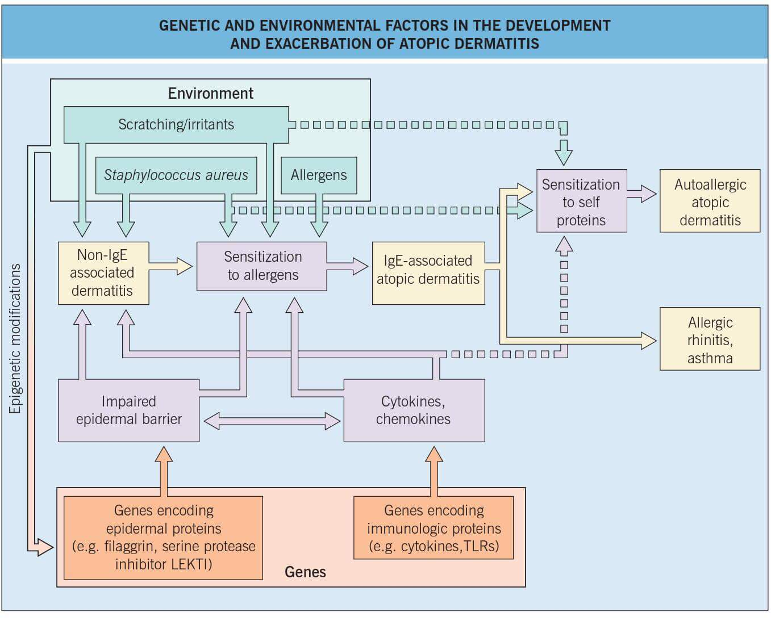
Pathogenesis

Slide 13
Comparison of normal to atopic skin

Slide 14
AD
Clinical features :
Essential features; must be present and sufficient for diagnosis:
Pruritus; rubbing or scratching .
Typical eczematous morphology and age –specific distribution pattern .
Chronic or relapsing course.
Other important features are :

Slide 15
Pattern of distribution

Slide 16
Infantile AD

Slide 17
AD
Onset during infancy or early childhood .
Personal or family history of Atopy ,asthma or allergic rhinitis(atopic march) .
Xerosis; dry skin with fine scales in absence of inflammation .
Diagnosis of AD ;need three out of six upper features.

Slide 18
AD
Physical finding associated with AD :
Dry skin . Why ?
Keratosis pilaris in 40% of AD (keratotic follicular papules with rim of erythema) 0n lateral aspect of arms and thighs .
PitryIasis alba ;hypo pigmented patches with fine scales particularly on the face of dark children .
Abnormal vascular responses; e.g.. Mild facial pallor, white dermoghraphism, delayed blanching .
Hyperlinear palm and soles .
Ocular finding; recurrent conjunctivitis ,per orbital darkness ,Dennie-Morgan fold.

Slide 19
Physical signs of AD
Pitryiasis alba
Keratosis pilaris

Slide 20
AD
Triggers factors:
Climate ;winter or summer ,low humidity .
Irritants :wool/rough fabrics, detergents and perspiration, prolong bath with water and soap .
Environmental allergies : dust mite, pollen ,contact allergies .
Food allergies :egg >milk, peanuts &fish .
Infection : cutaneous or systemic infection (mostly staph. Bacterial infection) .
Psychological stress .

Slide 21
AD
DDx of AD:
Seborrheic dermatitis .
Contact dermatitis .
Psoriasis .
Scabies .
Dermatophytes infections.
Impetigo .

Slide 22
AD
Complication of AD :
Cutaneous infection ;about 90% of AD patient are colonialized by staphylococcus bacteria so impetiganization is common .
Other infection e.g. herpes virus and molluscum contagiosum .
Food allergies and drug allergies ; increase in AD .
Psychological distress due to sever pruritus and chronicity .

Slide 23
AD
Management of AD:
general line of management of AD are ;
General measurements; patient education, avoidance of triggers and regular use of emollients .
Topical treatment : corticosteroid , calcinuriens inhibitors and antibiotic .
Systemic : anti-inflammatory drug e.g.. Steroids and immunosuppressive drugs e.g.. Cyclosporine ,azathioprine or methotrexate , antipruritic e.g.. Antihistamines and antibiotic.

Slide 24
AD
Treatment of AD
Avoid provoking factors e.g. wool clothes, excessive washing with harsh soap, prolonged bath ,extreme climate and infection .
Regular use of emollients specially contain glycerin and ceramids e.g. Vaseline cream.
Topical corticosteroid : cream or otimments once or twice daily with or without topical antibiotic .
Systemic antibiotic to treat infections.
Short course of systemic steroids in sever cases.
Antipruritic drug e.g. antihistamine ( sedative and non sedative ) .
Phototherapy with PUVA or UVB .
Systemic immunosuppressive : cyclosporine in chronic relapsing cases .
Biological treatment: updated treatment .

Slide 25
Seborrheic Dermatitis
SD : is common type of endogenous eczema characterized by itchy red inflammatory patches with greasy yellow scale affected Seborrheic areas(scalp, eyebrow, eyelids, nasolabial area, beard, moustache, EOC, retrouricuar fold , sternal, shoulder, interscapular region, axillae & groin).
There are two type of SD:
Infantile SD .
Adult SD.

Slide 26
SD
Aetiology : is unknown however possible causes are ;
Abnormal increase in colonization of Malasezia spp (pityrosprum ovale: yeast flora) on affected sites.
Hormonal :seborrhea due to increase of androgen level.
Sever SD may related to HIV infection or neurological disease e.g. Parkinsons disease.
Abnormal compositions of the skin lipids increase in TGs & cholesterol and reduced in squalene & free fatty acid due decrease in P. acne.

Slide 27
SD
C/F :
Infantile SD: occurred in the first 2 months of life ,affected scalp with thick greasy yellow scale called cradle cap, central part of face, asymptomatic rash of red patches with yellow scales symmetrically distributed on body flexures ,spontaneously resolve within sixth month of age or 1st year of life.

Slide 28
SD
Cradle cap
ISD

Slide 29
SD
Adult SD : symmetrical erythromateous patches or plaques covered with yellow greasy scales with slight itching on scalp and body flexures.
SD usually chronic course with remission and relapse.
Diagnosis : clinical .
Ddx: psoriasis ,infective eczema, atopic dermatitis.

Slide 30
Sites of involvement

Slide 31
SD
Treatment :
Topical corticosteroids ( moderate to potent) with topical antifungal cream e.g. betamethasone cream & Cotrimazole cream).
Scalp; antifungal shampoo e.g. selinium sulfide or ketoconazole .
Sever cases need systemic treatment with steroid, fluoconazoe,reteniods,MTX OR PUVA.

Slide 32
Pompholyx
Dyshidrotic eczema: is acute endogenous eczema, presented with recurrent attacks of crops of deeply seated vesicles‘ with clear fluid on the sides of hand and fingers in 80% and soles in10% ,may associated with heat &Bricking sensation with intense pruritus .
Causes; part of Atopy ,palmar hyperhidrosis and usually exacerbated by stress.
Treatment: topical or systemic steroid, soaking hand with warm water for 15 min or use aluminum chloride .

Slide 33
pompholyx

Slide 34
Nummular Eczema
Discoid dermatitis ; is common type of endogenous eczema ,affected adult(typically old age male 55-65y), with intensely pruritic rounded shape well demarcated patches measure about 2-3 cm(1-10 cm) on extensor surface of extremities.
A etiology: unknown, associated with Atopy, hypersensitive reaction to the bacterial infection &exacerbated by stress.
C/F: dull red discoid patches seated with vesicles or dry sharply demarcated scale on leg in men and arm of women ( bilateral, symmetrical on extensor surface) on background of dry skin..
Prognosis :Chronic relapsing course ,resistant to the treatment.

Slide 35
Nummular eczema
Treatment of discoid dermatitis :
Potent topical CS creams twice daily with occlusion .
Oral antihistamines, nonsedative at day time& sedative at night e.g. desloratidin and citrizine tab .
Systemic antibiotic :up to 95% of patient have colonizing with staph or infected lesions.
Short course of systemic steroid or IM injection.
Phototherapy .

Slide 36
Nummular eczema

Slide 37
Stasis dermatitis
Gravitational dermatitis : is type of eczema that associated with varicosities (venous hypertension) ,affected elderly patient on lower part of legs.
Pruritus, dryness with edema ,redness ,scale crust and oozing& signs of venous insufficiency e.g. Ulceration on medial malleolus .
Treatment of eczema and varicosities .

Slide 38
Stasis dermatitis

