Slide 1


Direct ophthalmoscope
By Mohammed Suhail AlSalam

Slide 2
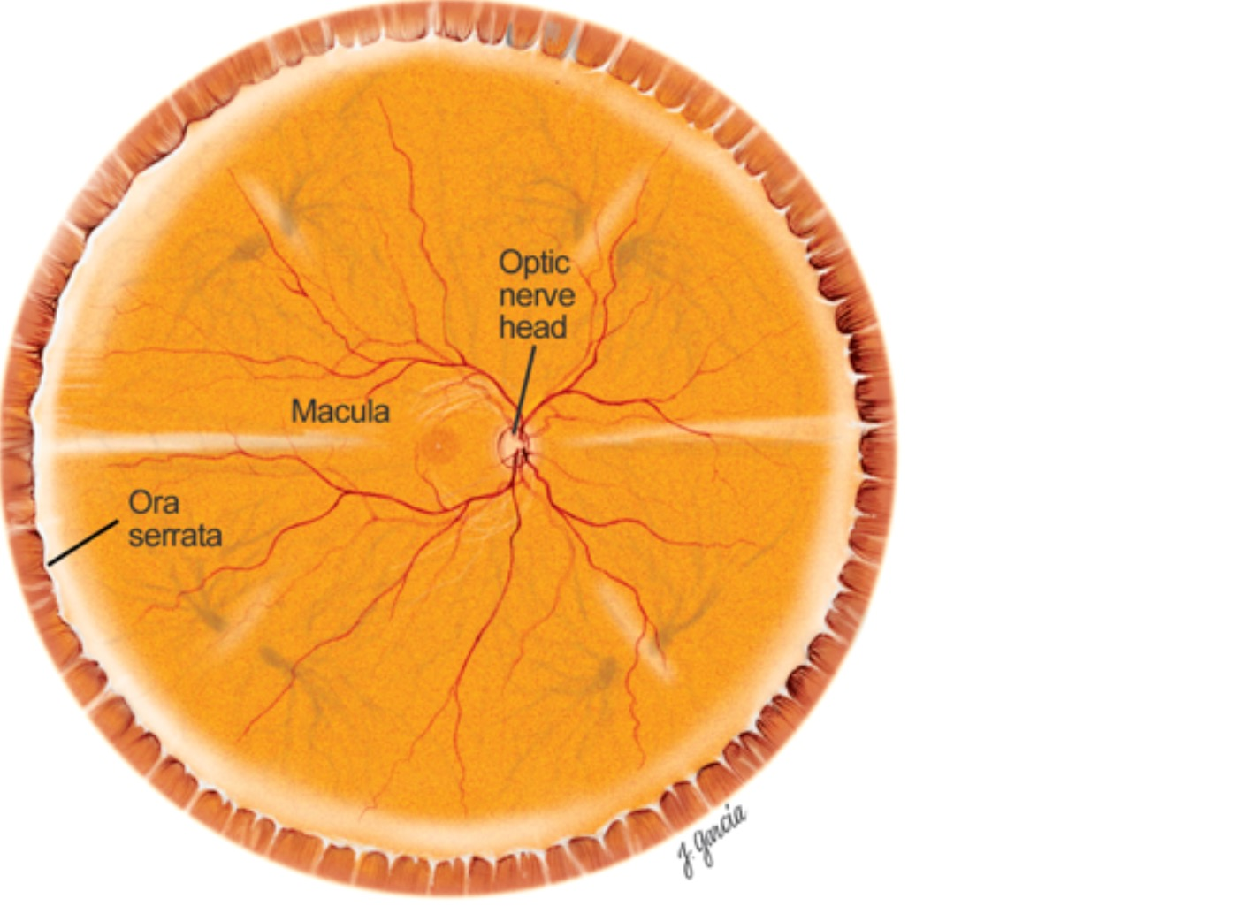

Learning Objectives
1 Understand the utility of the direct ophthalmoscope
2 Identify key anatomical structures visible with the direct ophthalmoscope
3 Learn the parts and settings of the direct ophthalmoscope
4 Learn the exam technique of the direct ophthalmoscope

Slide 3

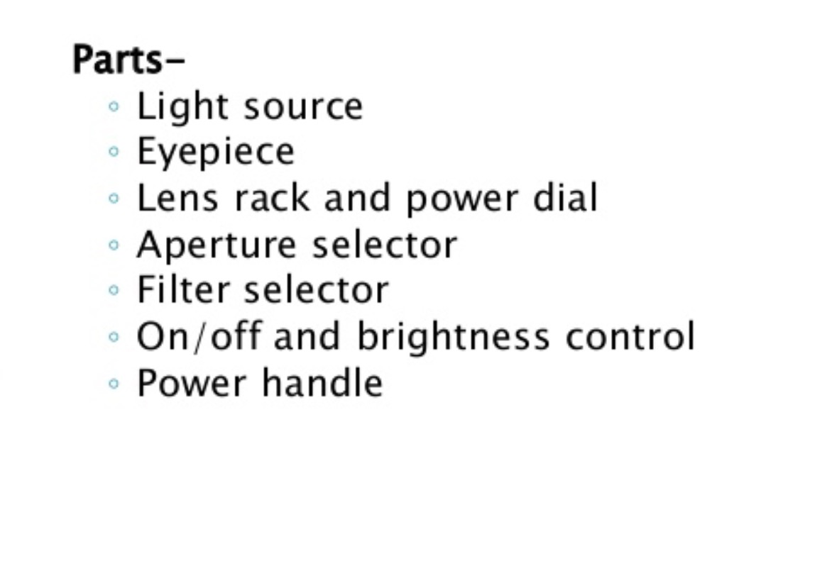
Direct ophthalmoscope parts
“Type a quote here.”
–Johnny Appleseed

Slide 4
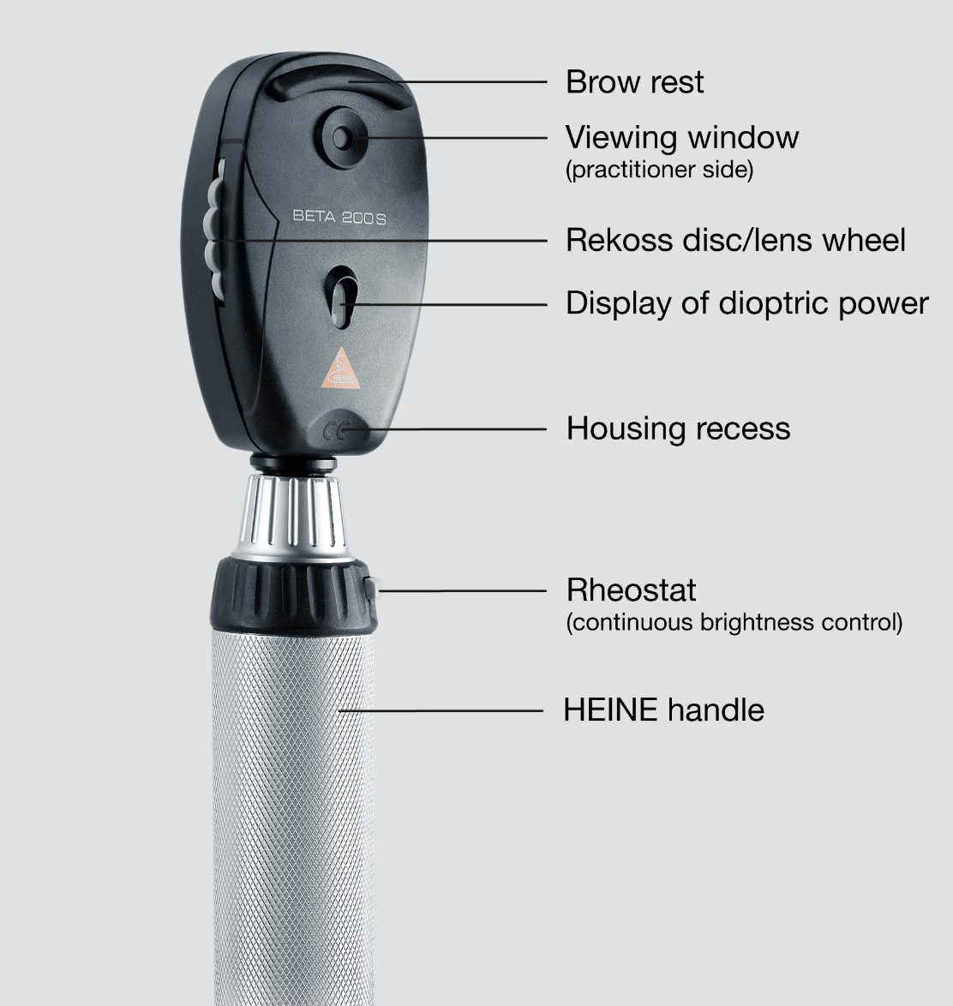
Direct ophthalmoscope parts
“Type a quote here.”
Examiner side
–Johnny Appleseed

Slide 5
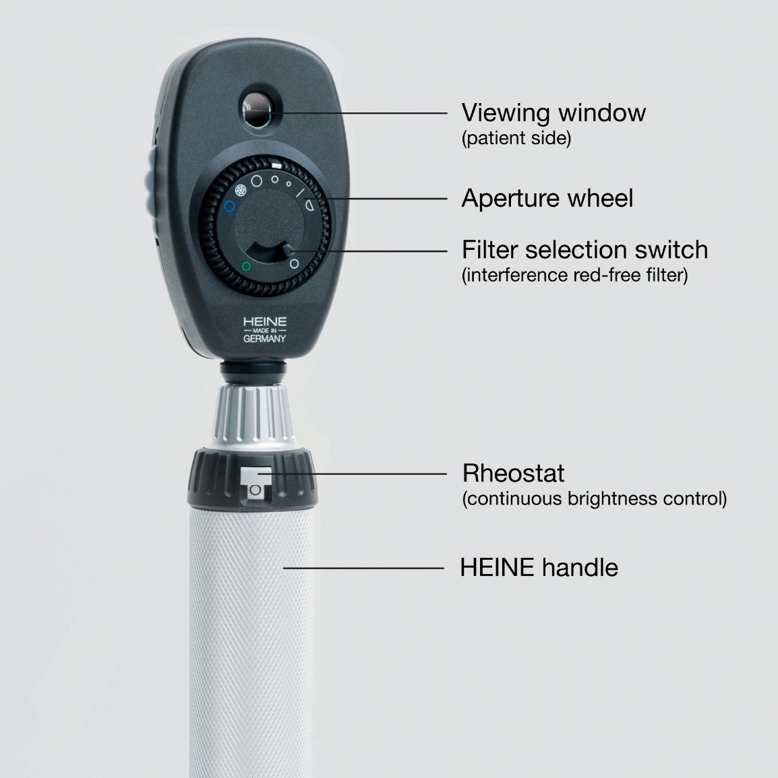
Direct ophthalmoscope parts
“Type a quote here.”
Patient side
–Johnny Appleseed

Slide 6
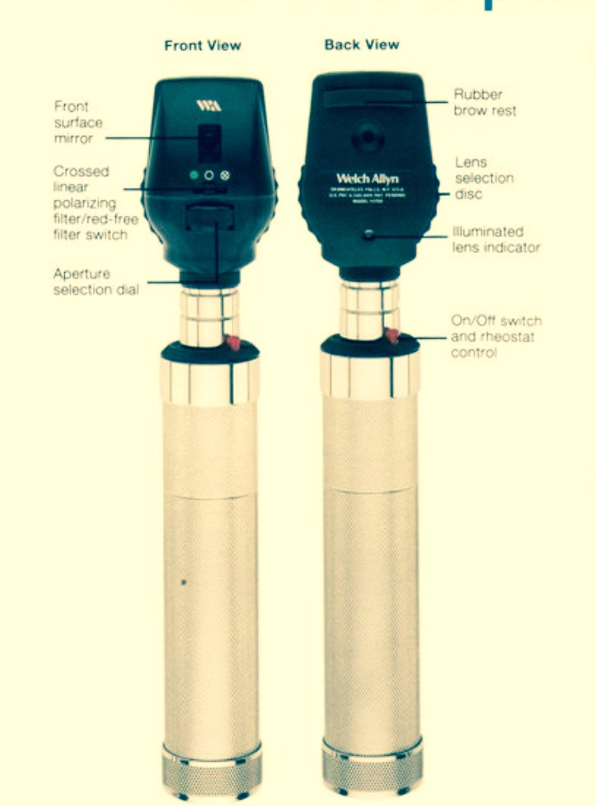

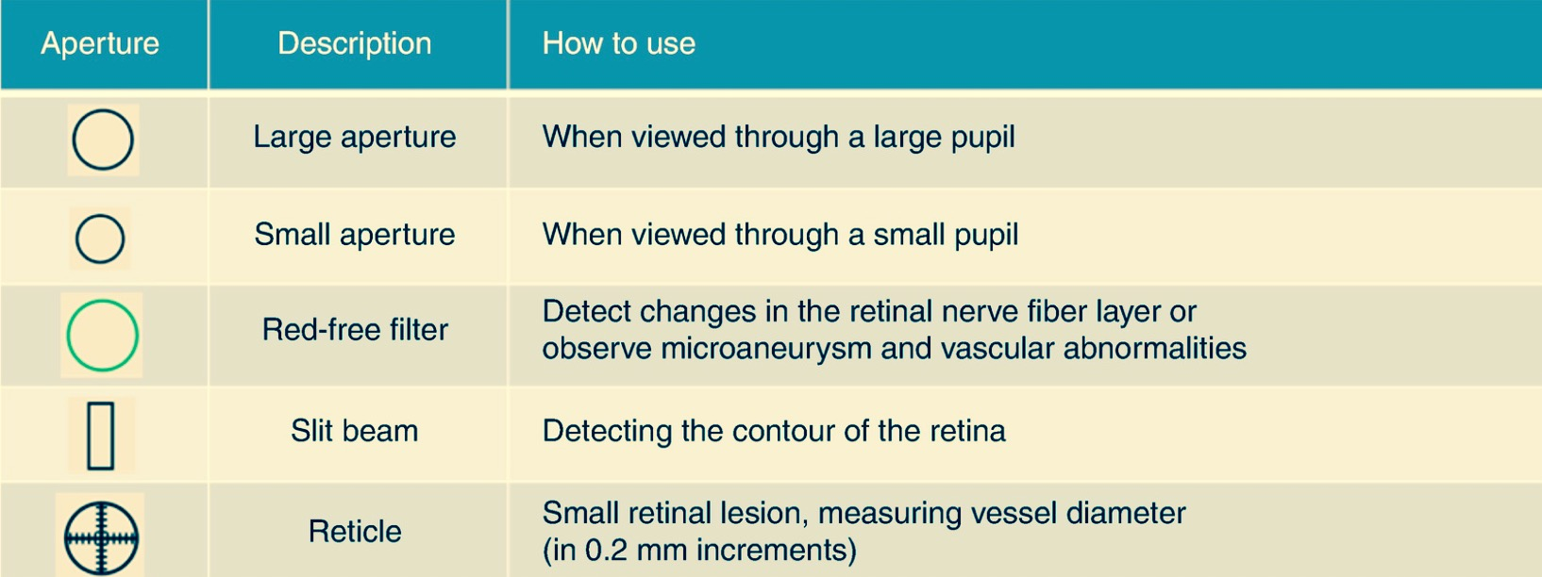
Direct ophthalmoscope
“Type a quote here.”

Slide 7

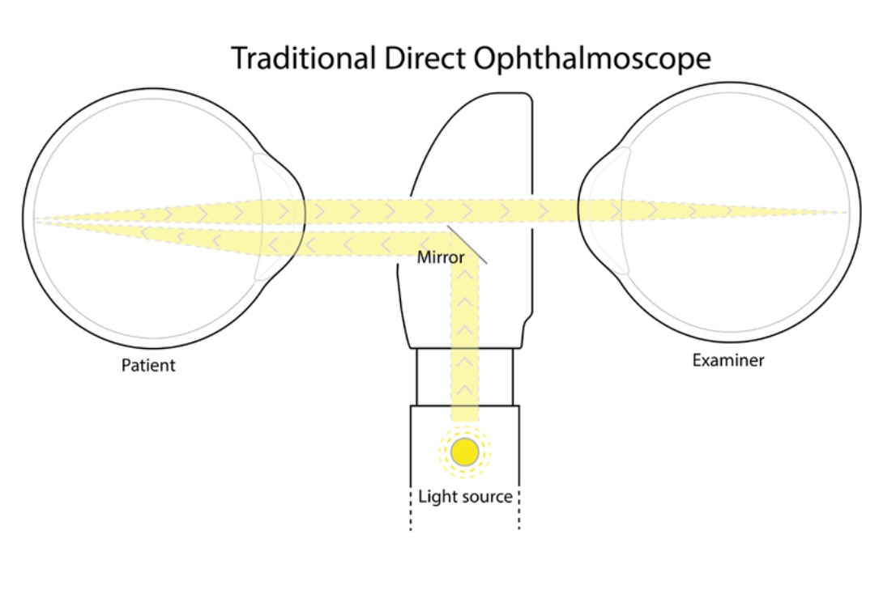
Direct ophthalmoscope principle
“Type a quote here.”
–Johnny Appleseed

Slide 8
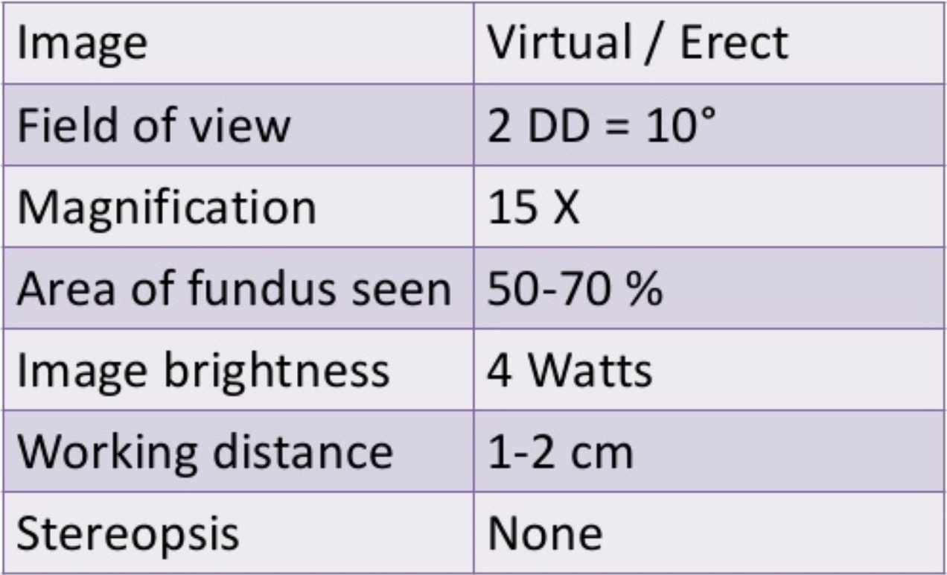
Direct ophthalmoscope
“Type a quote here.”
Image characteristics
–Johnny Appleseed

Slide 9
Exam Technique
1 Wash your hands.
2 Introduce yourself to the patient and explain what you are going to do.
3 Position the patient so that the ophthalmoscope is held directly at the level of the patient’s eye.
4 Turn on the ophthalmoscope and set the light to the correct aperture.
5 Dim the lights.
6 Instruct the patient to focus on an object straight ahead on the wall.
7 To exam the patient’s RIGHT eye, hold the ophthalmoscope in your RIGHT hand and use your RIGHT eye to look through the instrument.
8 Place your left hand on the patient’s head and place your thumb on their eyebrow.

Slide 10
Exam Technique
9 Hold the ophthalmoscope about 6 inches from the eye and 15 degrees to the right of the patient.
10 Find the red reflex.
11 Move in closer, staying nasally until you see the optic nerve.
12 Rotate the diopter lens until the optic nerve comes into focus.
• The farsighted eye requires more plus/green number lenses.
• The nearsighted eye requires more minus/red number lenses.
13 Measure the cup to disc ratio.
14 Scan slightly up, down, right and left to look at the vessels.
15 Move out temporally to find the macula and fovea.
16 Repeat the same technique on the other eye.

Slide 11
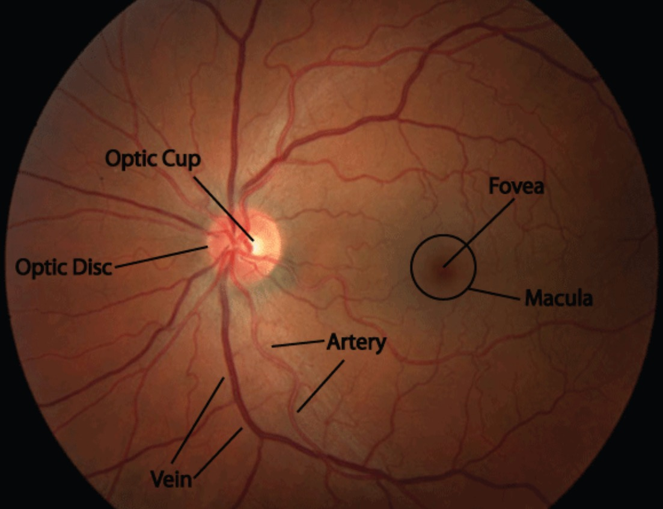
Normal Fundus appearance

Slide 12
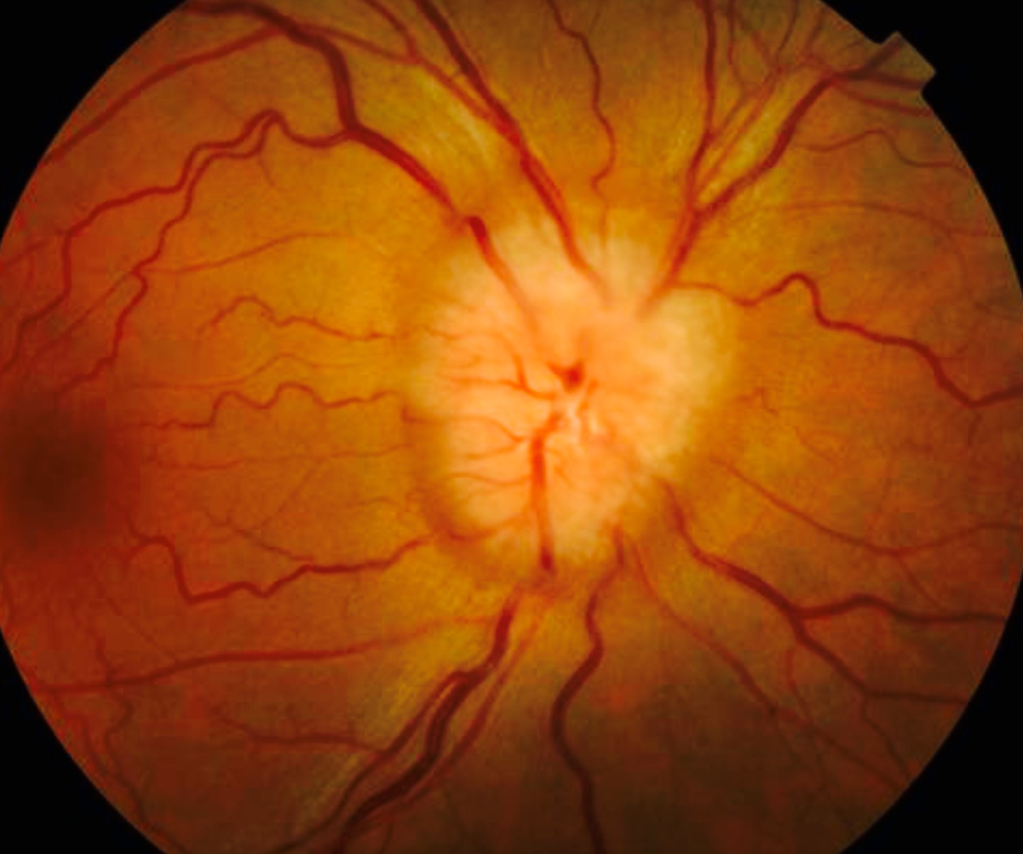
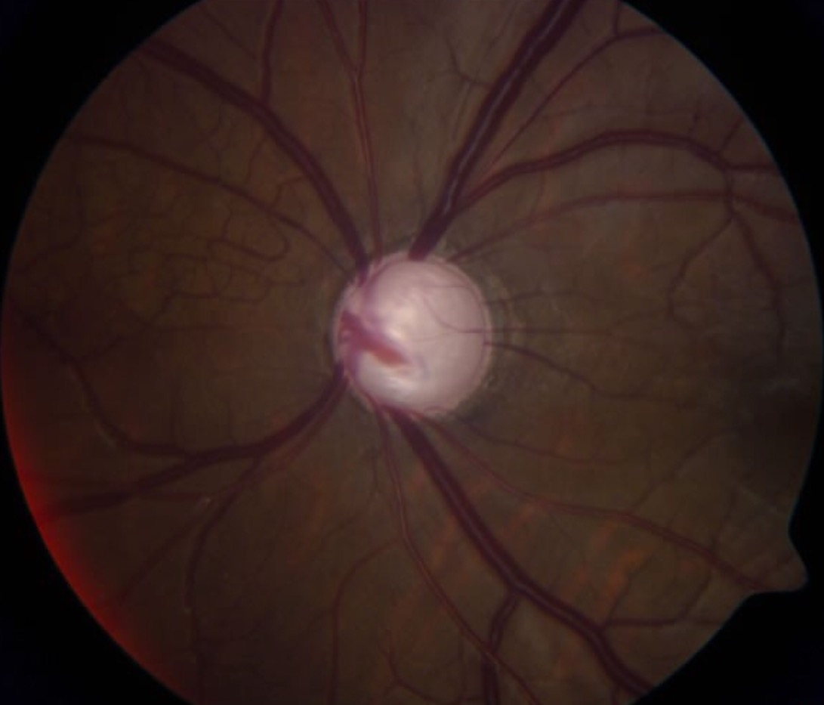
Fundus abnormalities
disc swelling
advanced disc cupping

Slide 13
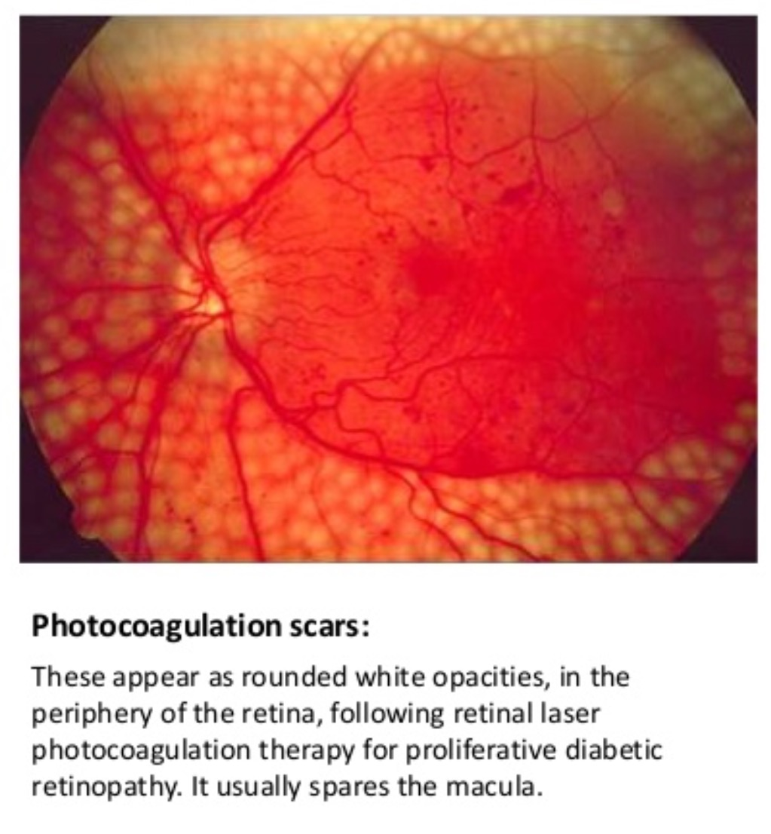
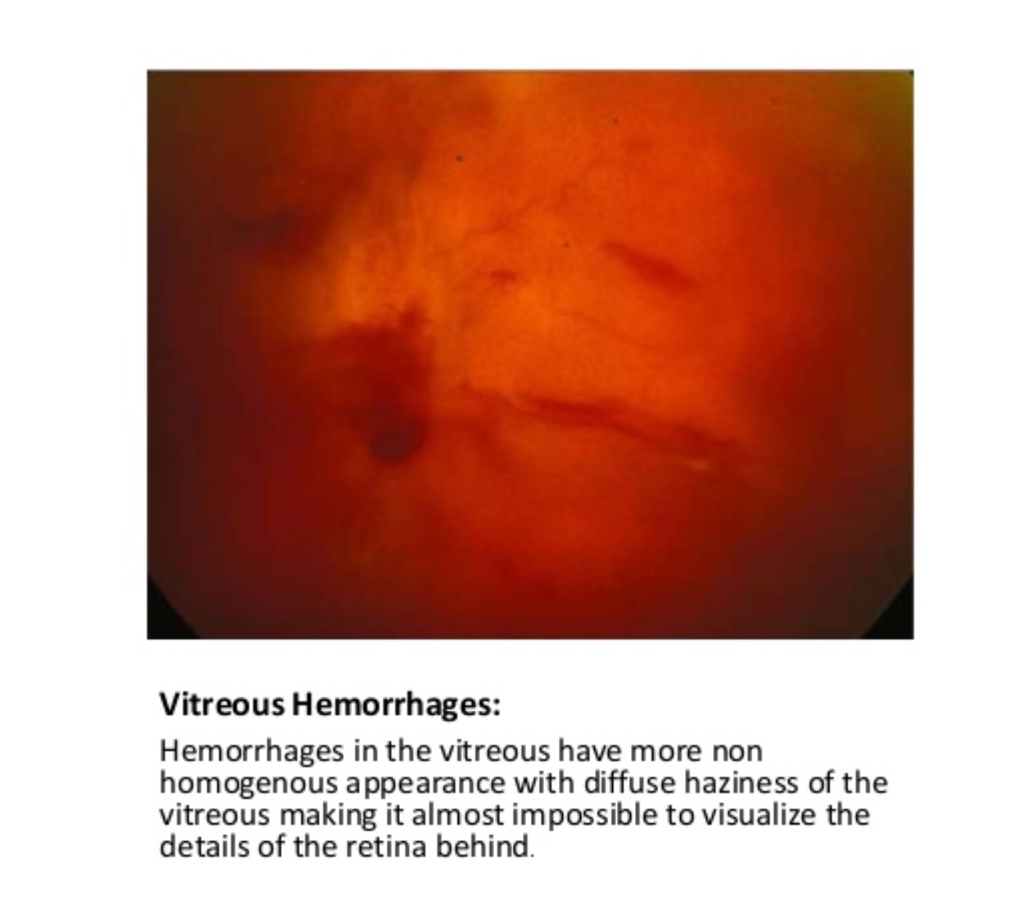
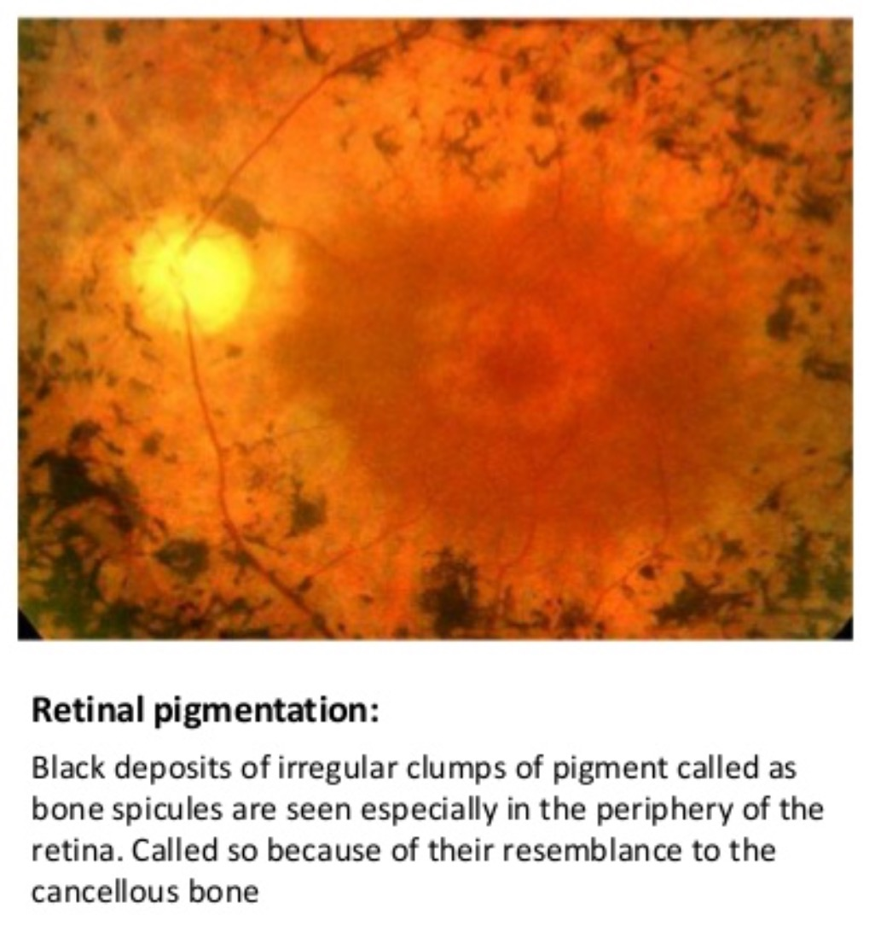
Fundus abnormalities

Slide 14

Direct Ophthalmoscope
Advantages
Dis-Advantages
Portable
Easy to use
Small field of view
Magnification around 15 times
No stereopsis
Can be used without dilatation
Media opacity can largely degrade image

Slide 15
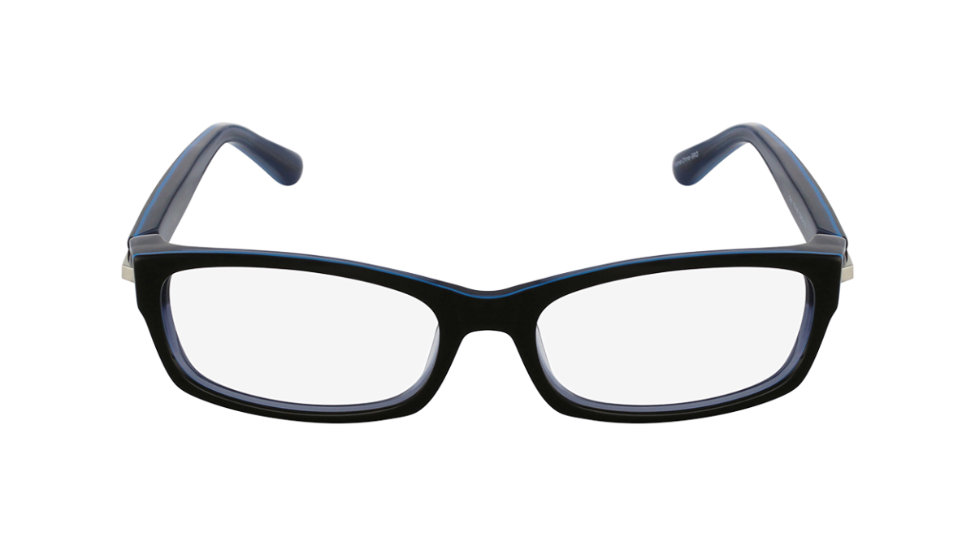

THANK YOU

