Slide 1
Intrauterine fetal death
Dr Hanan Dh Skheel
Department of obst and gyn

Slide 2
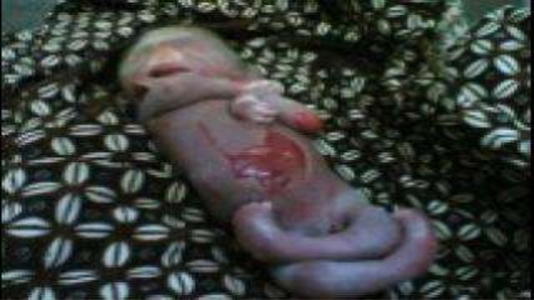
Still Birth
stillbirth ‘a baby delivered with no signs of life known to have died after 20 completed weeks of pregnancy’.
Intrauterine fetal death
Refers to babies with no signs of life in utero. Incidence 1 in 200
In addition to any physical effects, stillbirth often has profound emotional, psychiatric and social effects on parents, their relatives and friends

Slide 3
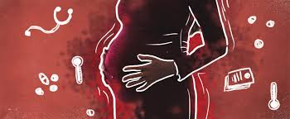
ETIOLOGY
Unexplained 50%
Fetal causes
25-40%
Placental causes
20-35%
Maternal
5-10%

Slide 4
)
MATERNAL CAUSES(RISK FACTORS)
• Obesity (>30kg/m2): proven, modifiable, highest ranking • Maternal (>35yrs)/paternal age
• Smoking/Alcohol/Drug abuse
• Infections (malaria, hepatitis, influenza, syphilis, Toxoplasma, sepsis)
• Medical ds –DM,HT,Thyroid Diseases
• Pre-existing diseases (HD, Anemia, Epilepsy) • Autoimmune Disorders (APS, SLE)
• RH incompatibility
• Hyperpyrexia
• Thrombophilias
• Trauma
• Cholestasis of pregnancy
• Obs cx – Abruption,PPROM,multifetal gestation
• Labour related (preterm, dystocia, uterine rupture)

Slide 5
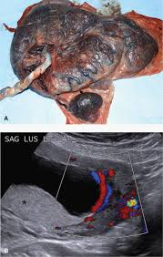
PLACENTAL CAUSES
.
• Abruption
• Cord accidents
• Placental insufficiency
• Placenta previa
• TTTS
• Chorioamnionitis
• PROM
• Feto-maternal hemorrhage
Iatrogenic- ECV, Drug overdoses

Slide 6
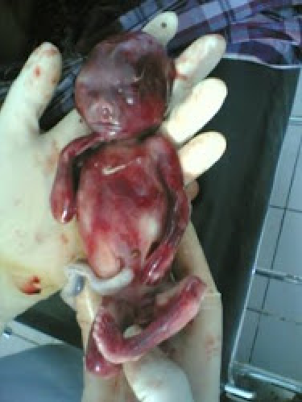
FOETAL CAUSES
• Multiple gestation
• IUGR
• Congenital anomalies
• Infections
• Hydrops (immune & non-immune)
• G6PD deficiency •

Slide 7
DIAGNOSIS
Symptoms: Absence of fetal movements
Signs: Regression of the positive breast changes Per abdomen • Gradual regression of the height of the uterus • Uterine tone is diminished • Fetal movement are not felt during palpation • Fetal heart sound is not audible
INVESTIGATIONS
• USG (100%)
Associated features can be noted (oligo, hydrops)
Robert’s sign : Appearance of gas shadow (in 12 hours) Spalding sign: Collapse skull bones (usually appears 7 days) Ball sign : Hyperflexion of the spine
Helix sign : Gas in umbilical arteries
Crowding of the ribs shadow

Slide 8
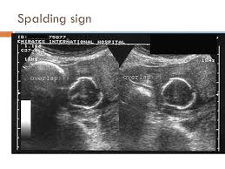
Auscultation and cardiotocography should not be used to investigate suspected IUFD.
Real-time ultrasonography is essential for the accurate diagnosis of IUFD.
Ideally, real-time ultrasonography should be available at all times.
A second opinion should be obtained whenever practically possible.
Mothers should be prepared for the possibility of passive fetal movement. If the mother reports passive fetal movement after the scan to diagnose IUFD, a repeat scan should be offered.
Auscultation of the fetal heart by Pinard stethoscope or Doppler ultrasound is insufficiently accurate for diagnosis

Slide 9
Breaking bad news
If the woman is unaccompanied, an immediate offer should be made to call her partner, relatives or
friends.
Discussions should aim to support maternal/parental choice.
Parents should be offered written information to supplement discussions

Slide 10
Clinical assessment and laboratory tests should be recommended
To assess maternal wellbeing (including coagulopathy)
To determine the cause of death, the chance of recurrence
Possible means of avoiding further pregnancy complications
Parents should be advised that no specific cause is found in almost half of stillbirths.
Parents should be advised that when a cause is found it can crucially influence care in a future pregnancy

Slide 11
Another important purpose of investigation is to assess maternal wellbeing and ensure prompt
management of any potentially life-threatening maternal disease. This includes a detailed history of
events during pregnancy and clinical examination for pre-eclampsia, chorioamnionitis and placental abruption. There is also a moderate risk of maternal disseminated intravascular coagulation (DIC): 10% within 4 weeks after the date of late IUFD, rising to 30% thereafter. This can
be tested for by clotting studies, blood platelet count and fibrinogen measurement.
Obvious cause - No further testing or limited testing
(cord accidents, anencephaly)

Slide 12
History
Recurrent abortions
• Congenital anomalies
• Abnormal karyotype
• Hereditary conditions
• Developmental dela
Maternal
• DM
• HPT
• Thrombophilias
• Autoimmune disease
• Severe Anemia
• Epilepsy
• Consanguinity
• Heart disease
Past Obstetrical
Baby with congenital anomaly /
hereditary condition
• IUGR
• Gestational HPT with adverse
sequele
• Placental abruption
• IUFD
• Recurrent abortions
I.
Past Obstetrical
• Baby with congenital anomaly /
hereditary condition
• IUGR
• Gestational HPT with adverse
sequele
• Placental abruption
• IUFD
• Recurrent abortions

Slide 13
Examination
Gross description
Infant description • Malformation • Skin staining • Degree of maceration • Color-pale , plethoric
Umbilical cord • Prolapse • Entanglement-neck, arms, legs • Hematoma or stricture • Number of vessels • Length
Amniotic fluid • Color-meconium, blood • Volume Placenta • Weight • Staining • Adherent clots • Structural abnormality • Velamentous insertion • Edema/ hydropic changes Membranes • Stained • Thickening
Fetal Autopsy & Karyotyping
These 2 are important tests in SB evaluation • Crucial for future pregnancy
• Appropriate consent req to take fetal tissue,Autopsy
• Ideally should be done by perinatal pathologist
• If denied, post mortem MRI should be considered
• Radiographs if indicated for skeletal abnormalities
• Photographs

Slide 14
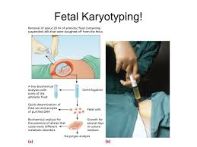
Fetal karyotyping
Fetal karyotyping (recomeded in all cases) esp- - Dysmorphic fetus, FGR - Hydropic - Signs of chromosomal anomaly Samples- Parents with multiple pregnancy losses (second or third trimester) • For aneuploidy- FISH, For small deletions-
• Amniocentesis –highest yield • 3ml fetal blood from umbilical vs and or cardiac puncture-heparinized bulb
• If blood not obtained at least 1 of the follwing samples - 1) Placental block 1x1cm 2) cord 1.5cm
3) costocondral junction or patellar
(skin not . recommended)

Slide 15
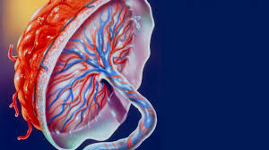
Placental investigations
• Chorionicity
• Cord knot, vessels, thrombosis
• Infarcts, thrombosis, abruption
• Vascular malformations
• Signs of infection
• Placental block(1x1 cm) below cord insertion
• Umbilical segment (1.5 cm)
• Placental swabs for infections
• Bacterial cultures for E. Coli, Listeria .

Slide 16
Maternal evaluation
CBC • Hb electrophoresis • Diabetes testing (HbA1c, FBS)
• Additional Tests • Kleihauer (for all women, beforebirth), in Rh- D negative second test after antidote
• Serological Tests (TORCH, Syphilis, Parvovirus) ?? in all cases, opinion varies, rarely helpful If clinical findings suggest intrauterine infection (i.e., those with IUGR, microcephaly) • Antiphospholipid (LA,ACA), Antiplatelet Ab if ICH detected • ?? Thrombophilias screening (6 weeks postpartum) - factor V leiden mutations & deficiencies, antithombin III, protein C & S Current • Bile acids (Cholestasis of preg)- important cause, recurrence in 80% cases • High vaginal & cervical swab for C & S•Urine toxicology screening (cocaine, amphetamines ,associated with abruption)

Slide 17
Management
Depends on:
• Single or multiple gestation
• Gestation age at death
• Parents wish (varied response)
– Expectant approach –More than 85% of women with an IUFD labour spontaneously within three weeks of diagnosis. If the woman is physically well, her membranes are intact and there is no evidence of pre-eclampsia, infection or bleeding, the risk of expectant management for 48 hours is low.
There is a 10% chance of maternal DIC within 4 weeks from the date of fetal death and an increasing chance thereafter, emotional burden, and risk of Chorioamnionitis
Active approach
• Fetal death <28weeks
• Mifepristone 200 mg followed by Misoprostol 400 µg 4 - 6 hourly most effective with shortest I-D interval
• Fetal death >28weeks • Cervical ripening (mechanical or chemical) followed by Oxytocin induction Induction of Labour

Slide 18
Vaginal birth can be achieved within 24 hours of induction of labour for IUFD in about 90% of women
. Vaginal birth carries the potential advantages of immediate recovery and quicker return to home
. Caesarean birth might occasionally be clinically indicated by virtue of maternal condition. The woman herself might request caesarean section because of previous experiences or a wish to avoid vaginal birth of a dead baby.Vaginal birth was described as emotionally distressing

Slide 19
WHO regimen of Misoprostol in IUD cases
• IUFD at term – 25 µg 6 hourly 2doses, if no response increase to 50 µg 6 hourly, do not exceed 4 doses.
• Do not use Oxytocin in 8hrs of using Misoprostol
• Contraindicated in previous CS cases (WHO)
• RCOG & NICE Regimen
• <26 weeks - 100 µg 6hrly (max 4 doses)
• >27 weeks - 25-50 µg 4hrly (max 6 doses)
• Use of PGs is associated with increase risk of uterine rupture in cases of previous scar
• Membranes should not be ruptured as long as possible
• Pain management should be offered
• Keep watch on CBC, coagulation profile, signs of infection • Active management of III stage of labour
• Keep blood and blood products ready

Slide 20
Pain management
Diamorphine should be used in preference to pethidine.
Regional anaesthesia should be available for women with an IUFD.
Assessment for DIC and sepsis should be undertaken before administering regional anaesthesia. Women should be offered an opportunity to meet with an obstetric anaesthetist.

Slide 21
Complicatyions
Complications
– Infection
– PPH – Retained placenta
– Abruption – DIC – Shock,
renal failure – Sepsis – Maternal death
Post delivery
Emotional support & Counseling as they r at increased risk of (PPD) • Keep in non maternity ward • Suppression of lactation (tight breast support, dopamine agonists,) • Counsel for future pregnancy, early ANC visit, preconceptional testing • Assurance in cases of non recurring causes • Contraceptive counseling

Slide 22
Management of future pregnaqncy
Preconception or initial prenatal visit
• Detailed medical and obstetric history
• Evaluation and workup of previous stillbirth
• Determination of recurrence risk • Smoking cessation • Weight loss in obese women (
• Genetic counselling if family genetic condition exists • Medical problem like Diabetes should be managed prior to [pregnancy
• Thrombophilia workup: antiphospholipid antibodies (only if specifically indicated)
• Risk of recurrence is 7-10 / 1000 birth
• Support and reassurance

Slide 23
First trimester • Dating sonography • First-tri screen: pregnancy-associated plasma protein A, b HCG, and nuchal translucency* • Folic acid
Second trimester • Fetal ultrasonographic anatomic survey at 18–20wks • Maternal serum screening (Quadruple) marker • Blood investigations
Third trimester • Sonographic screening for fetal growth restriction after 28 weeks of gestation • Admission at critical period in high risk cases
• Kick counts starting at 28 weeks of gestation
• Antipartum fetal surveillance starting at 32 wks or 1–2 wks earlier than prior stillbirth
• Weekly FHR , BPP, Doppler • Support and reassurance

Slide 24
STRATEGIES FOR PREVENTION
• No sure method to prevent
• Loosing weight, life style modifications
• Women should try to optimize their health prior to pregnancy
• Enough Folic acid before they get pregnant
• Good preconception and prenatal care
• Women with DM –tight control before and during pregnancy • Educate women not to delay pregnancy

Slide 25
special recommendations for women with an IUFD who are rhesus D-negative
Women who are rhesus D (RhD)-negative should be advised to have a Kleihauer test undertaken urgently to detect large feto–maternal haemorrhage (FMH) that might have occurred a few days earlier. Anti-RhD gammaglobulin should be administered as soon as possible after presentation.
If there has been a large FMH, the dose of anti-RhD gammaglobulin should be adjusted upwards and the Kleihauer test should be repeated at 48 hours to ensure the fetal red cells have cleared.
If it is important to know the baby’s blood group; if no blood sample can be obtained from the baby or cord, RhD typing should be undertaken using free fetal DNA (ffDNA) from maternal blood taken shortly after birth.

Slide 26
Major FMH is a silent cause of IUFD and a Kleihauer test is recommended for all women to diagnose the cause of death
.
In those women who are RhD-negative, the potentially sensitising bleed might have occurred days before the death is recognised,threatening the window for optimal timing of anti-RhD gammaglobulin administration (72 hours). Anti-RhD gammaglobulin provides reduced benefit when given beyond 72 hours, up to 10 days after the sensitising event.

