Slide 1
أ. د. سامية عباس عليوي

Slide 2
The cardiovascular development
Before the 3rd week of development, the embryo has its nutrition by diffusion, later on blood & blood vessels develop in mesoderm in the form of clusters

Slide 3
These clusters then are canalized forming blood vessels; & form primitive blood cells that undergo gradual programmed cell death to be replaced by fetal blood cells .

Slide 4
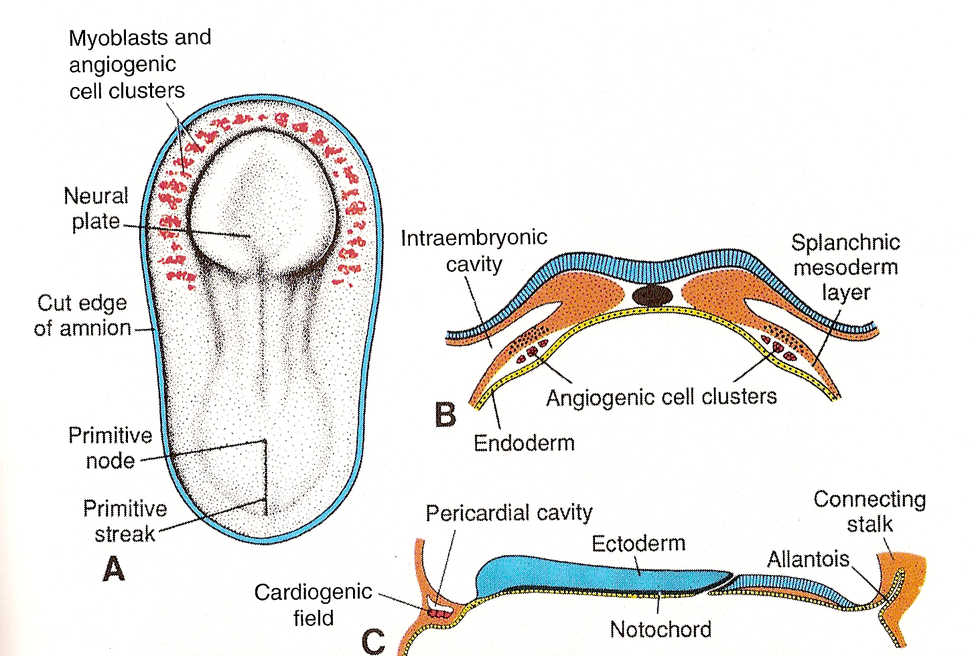

Slide 5
The fetal blood cell then migrate to form major haemopoitic system of the embryo inside the liver & then the adult in the bone marrow.

Slide 6
The angiogenetic clusters are canalized also to form the horse shoe- shaped plexus to form U-shaped endocardial heart tube

Slide 8
The anterior central portion of this tube is called the cardiogenic field that is located anterior to buccopharangeal membrane & neural tube.

Slide 9
The intra embryonic cavity near this field is primordium of the pericardial cavity.
The heart beating begins in the 4th wK of development

Slide 11
Formation and position of the endocadiac heart tube:
The cardiogenic field deviated ventrally & caudally by the passive effect of the cephalocaudal folding of the embryo,thus, the cardiac field become ventral & caudal to the buccopharyngeal membrane after 180 degree ventral deviation reaching the cervical region of the embryo and then the thoracic region.

Slide 12
Also, the transverse folding of the embryo results in approximation of the lateral limb of the U shaped heart tube & then fusion of these limbs forming the single heart tube.

