Slide 1
huda hameed
Department of chemistry
collage of medicine al- mustansiriyah university.
Lecture No. 1
Organic Chemistry And Stereochemistry
Chirality, Isomerism, & Stereoisomerism

Slide 2
List of contents:
Organic Chemistry.
Hydrocarbons.
Molecular Structure of Hydrocarbon.
Stereochemistry of tetrahedral.
Molecular Structure of Hydrocarbon
Functional group.
Classification
Types of Some Aliphatic Hydrocarbons
Stereochemistry and molecular representation of hydrocarbons.
Superposable and non superposable objects.
Isomerism.
Chiral molecules.
Enantiomers.
Application of Enantiomers and chirality in Pharmacology.
Optical Activity.

Slide 3
The Aim of Lecture:
To Know Aldehyde, Ketone, and carboxylic acids structures as a type of organic Compounds, & their presence.
To Know the carbonyl group and carbonyl Compounds.
To Know the Organic Chemistry, Hydrocarbons and their Molecular Structure, Functional group, and classification of Hydrocarbons.
To Know the Stereochemistry of tetrahedral, Isomerism, Chiral molecules, Enantiomers, Diastereoisomers, and Optical Activity of organic Chemistry.

Slide 4
Organic Chemistry
Organic chemistry is the study of carbon compounds. Animals, plants, and other forms of life consist of organic compounds.
Nucleic acids, proteins, fats, carbohydrates, enzymes, vitamins, and hormones are all organic compounds. Biochemistry was developed later as the study of the chemical compounds, and reactions in living cells.
Hydrocarbons
Hydrocarbons are the most simple organic compounds. Hydrocarbons contain only carbon (C) and hydrogen (H) Figure (1&2).
Hydrocarbon derivatives: Some of organic compound also contain non metals ( referred to as heteroatoms) such as oxygen ,nitrogen, halogens , Sulphur, and phosphorus. All C atoms in an alkane are surrounded by four groups, making them sp3 hybridized and tetrahedral, and all bond angles are 109.5°.
Figure (1): A is the tetrahedral structure of Methane and its distribution in space by 3 dimensional structure its chemical formula is CH₄ ,while B represent the measured angels between carbon atom and the four Hydrogen atoms of the Methane CH_{4.} https://encrypted-tbn0.gstatic.com/images?q=tbn%3AANd9GcRDguu0ewr9tfleYCFwuD4OdkXX4uzIsM6jww&usqp=CAU

Slide 5
Figure (2): A is the tetrahedral structure

Slide 6
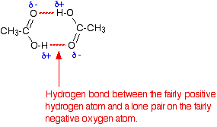
Molecular Structure of Hydrocarbon:-
Carbon atoms form four bonds in molecular structures, while hydrogen has one bond. For a saturated hydrocarbon molecule there is no double or triple carbon-to-carbon bonds and will have a maximum number of hydrogen atoms.
The unsaturated molecule will have double or triple carbon-to-carbon bonds Figure (3).
Figure (3): The saturated molecule Ethane, and unsaturated molecules Ethylene have double & Acetylene have triple carbon-to-carbon bonds.
Organic Chemistry & Hydrocarbons Groups.October 2018,DOI: 10.13140/RG.2.2.11527.85926Project: Fuel system design and operation
Functional group
Organic compounds are characterized by their type of bonds the double (> C = C <) of alkenes, or triple (- C = C -) of, the hydroxyl group of alcohols, or double bond of carbon-to-carbon atoms of aromatic hydrocarbons, or Cl ⁻ , F ⁻ , Br ⁻ , I ⁻ ions of halides, carbonyl group of aldehydes and ketones and / or heteroatom groups (such as O, N, S, or P) in their structure, this group of atoms or heteroatoms within the molecule called functional group. So that functional group is a good indicator for naming hydrocarbons, and for classification of all organic compounds and derivatives of hydrocarbons. In most organic compounds, the functional group gives a compound new chemical, and physical properties. Figure (4) show you the functional groups of Alcohol, Aldehyde, Alkene, carboxylic acid, and Ketone. Carbonyl group (>C=O) is a functional group of (Aldehyde, Ketone), Alkene double bond, and in Carboxylic acid carboxyl group, carbonyl group, and hydroxyl group (-OH) are the functional groups.
-
Functional group of Hydrocarbon | Hydrocarbon Chemical Formula
Hydroxyl group (-OH ) | Alcohol ( R- CH2 – OH )
Carbonyl group ( -C H =O ) | Aldehyde RCHO
Double Bond (> C = C <) | Alkene ( R2 C = C R2 )
Carboxyl group(-COOH), & Hydroxyl(-OH). | Carboxylic acid RCOOH
Carbonyl group (>C=O ) | Ketone R₂CO
Figure (4):
Carbonyl Compounds are consist of carbon- oxygen double bounded (>C=O). Its polar or water soluble due to ability to form Hydrogen bonding, respectively as in, figure(5) bellow. Aldehyde, Ketone, and carboxylic acids are all containing of carbonyl group, so they called Carbonyl Compounds.
The functional groups of Alcohol, Aldehyde, Alkene, carboxylic acid, and Ketone. Carbonyl group (>C=O) is a functional group of (Aldehyde, Ketone), Double Bond, and in Carboxylic acid carboxyl group, carbonyl group, and hydroxyl group (-OH) are the functional groups.
Figure(5): carbonyl group, and hydrogen bonding

Slide 7
Classification of Hydrocarbons
Division of the Family of Hydrocarbons depending on their functional group, for that hydrocarbons are divided into two main groups:
1- Aliphatic hydrocarbons. 2- Aromatic hydrocarbons.
1- Aliphatic hydrocarbons:
The aliphatic hydrocarbons may be present as saturated or unsaturated compounds Figure (6,7) . The saturated aliphatic hydrocarbons are known as alkanes or paraffins. They have general formula. CnH2n+2 , n is any number.
Figure (6): The saturated and unsaturated aliphatic hydrocarbons.https://cdn1.byjus.com/cbse/2017/09/15151739/BYJUS-LOGO-Purple-3kb.pn
a- Aliphatic saturated hydrocarbons:
The alkane molecules which have no double bonds in their structure are called saturated. This simply means that there are as many hydrogen atoms as possible in the molecule, and no more can be added. Alkane show only covalent single bonds, its strong as a single bond.
b- Aliphatic unsaturated hydrocarbons:
Unsaturated hydrocarbons are alkenes and alkynes which have one carbon-carbon double bond and one carbon-carbon triple bond respectively. Unsaturated hydrocarbons are more reactive than saturated hydrocarbons, and they usually fewer hydrogen atoms can be seen in bond with carbon atoms.
The unsaturated aliphatic hydrocarbons may be further classified as alkenes (olefins) and alkyne double bond is less than twice as strong as a single bond. making it easier to break one part of the double bond apart than it would be to break a single bond. The alkenes are hydrocarbons with general formula CnH2n. They show at least one carbon – carbon double bond. The alkynes are hydrocarbons with general formula CnH2n-2. They show at least one carbon – carbon triple bond.
Figure (7):Classification of Hydrocarbons into Aliphatic hydrocarbons and Aromatic hydrocarbon.
http://www.questtutorials.com/media/static/xi/chemistry/01_Classification%20
of%20Hydrocarbons_files/image001.gif

Slide 8
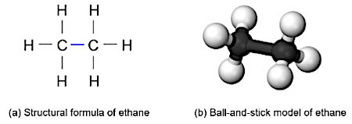
Types Of Some Aliphatic Hydrocarbons
Alkanes: Alkanes are hydrocarbons that contain only single bonds. Alkanes are said to be saturated hydrocarbons. Their hydrogen content is at a maximum. Their carbon-hydrogen combination of CnH2n+2. Figure (8). Alkenes ( Olefins): Carbon-hydrogen combination of CnH2n. Alkene family consists of chain molecules that contain double carbon-to-carbon bond, and are therefore unsaturated.
Alkane Methane. Alkene Ethene.
Figure (8): Alkane, and Alkene.1-https://upload.wikimedia.org/wikipedia/commons/5/58/Methane-3D-balls.png. 2-https://study.com/cimages/videopreview/videopreview-full/5.43_101780.jpg3-https://cdn1.byjus.com/wp-content/uploads/2018/12/physical-properties-of-alkenes.png
How can you Visualize an Alkane’s Structure
Ethan conformation is indicated by first Structural formula = CH₃CH₃ a graphical representation of the way atoms are connected, This condensed structural formula is help to save time /space, and the other model indicates convenient Ball-and-Stick model – 3D models figure(9) represent both models for Ethan conformation.
Figure(9): Ethan conformation, Structural formula = CH₃CH₃ a graphical representation convenient Ball-and-Stick, 3D model.
1-https://ars.els-cdn.com/content/image/3-s2.0-B9780126639711500075-f03-07-9780126639711.gif?_2-https://wp-media.tellibrary.org/2019/03/Screen-Shot-2019-03-08-at-9.40.18-AM.jpg
3-https://upload.wikimedia.org/wikipedia/commons/thumb/1/18/Conformations-of-1%2C2-dihaloethanes-from-xtal-compared-F-vs-I-Mercury-3D-balls.png/600px-Conformations-of-1%2C2-dihaloethanes-from-xtal-compared-F-vs-I-Mercury-3D-balls.png

Slide 9
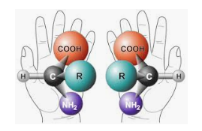
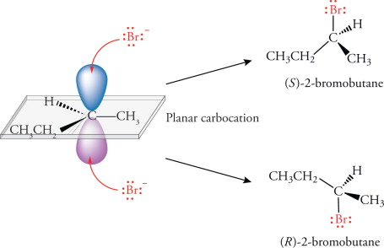
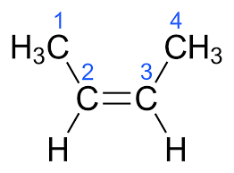
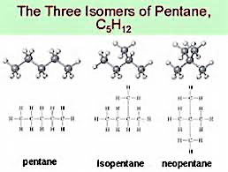
Stereochemistry
Stereochemistry:
Is the study of the different spatial arrangements of toms in our space. The stereo chemical configuration of any stereo center is the using of naming 'R ' (from the Latin rectus, meaning right-handed) or ' S ' (from the Latin sinister, meaning left-handed).
These two structures are not identical. The following structures indicate that designations in Figure(10) 1 A & B.
The Figure B indicates the – Br ⁻ group which bound carbon atom below the page gives is (R) structure, whereas (S) structure in this case group – Br which bound carbon atom above the page. The positions of the – Br ⁻ group are reversed for each structure.
1 A. 1 B.
Figure( 10): 1 A Designations of 'R ' &' S '. 1 B Indicate the way of binding of Bromine ion with Carbon atom (stereo center ), to give 'R ' &' S ' Isomers.
source:
Stereochemistry and molecular representation of hydrocarbons.
Isomers of hydrocarbons:
Isomers are compounds with identical chemical formulae, but different structures. These compounds are contain exactly the same number of atoms, i.e., they have exactly the same chemical formula, but differ from each other by the way in which the atoms are arranged. Examples of isomers with the same chemical formula C₄H₈ called 2- butene named cis and trans 2 butene .The difference in structure leading for significant chemical and physical differences. For example, the boiling points for n-pentane, isopentane, and neopentane which differ by the arrangement at one carbon atom only Figure (11) are 36.1°C, 27.8°C, and 9.5°C, respectively. Thus, neopentane's lower boiling point means that this isomer has a lower vapor pressure, which makes it is more likely to enter the atmosphere than the other two isomers under the same environmental conditions.
Figure (11) : Hydrocarbon isomers with identical chemical formulae with significant chemical and physical differences.

Slide 10
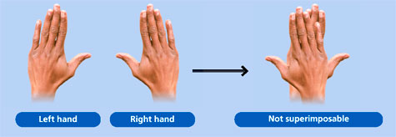
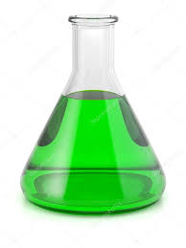
Superposable and non superposable objects:-
Every object has a mirror image. Many objects are Achiral. By this we mean Achiral, that the object and its mirror image are identical, that is, the object and its mirror image are superposable one on the other. Superposable means that one can, place one object on the other so that all parts of each coincide. But Chiral object is one that cannot be superposable on its mirror image Figure (14 ).
Figure ( 14): Superposable and non superposable objects.
mirror.
Left hand
Right hand
Non superposable
Two Flasks(Superposable)
Flask
Isomerism
Isomerism:
The branch of chemistry that deals with the special arrangement of atoms in molecules, and the effects of such arrangements, on the chemical and physical properties of the molecules, especially where asymmetric centers, of substitution lead, to optical rotation, as shown in Figure ( 15).
Figure(15 ) : A diagram of the two isomeric crystals were non-superimposable mirror images of each other, they had the same physical properties, but differed in their ability to rotate plane polarized light. This property was termed as optical activity.
REFERENCE: https://chem.libretexts.org/Bookshelves/Organic_Chemistry/Book%3A_Organic_Chemistry_with_a_Biological_Emphasis_v2.0_(Soderberg)/03%3A_Conformations_and_Stereochemistry/3.06%3A_Optical_Activity

Slide 11
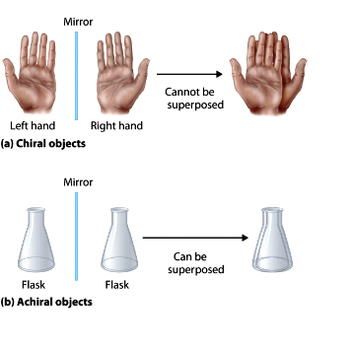
Chiral molecules
Chiral Sample: Chiral from Greek word meaning hand. A sample have Chiral or an asymmetric carbon atom in its structures, and this atom is a carbon atom attached to four different groups, and its optically active.
Chiral: any molecule that is non superposable with its mirror image. A compound is chiral if it contains one or more central atom bounded with four different groups of atoms called chiral compound Figure (16 ).
Figure (16 ): Chiral compound and Achiral compound.
but the Glycine, 2- amino ethanoic acid is a kind of Achiral compound due to absence of central carbon atom bounded to four different atom as shown bellow:
Achiral molecule Glycine.
In all the other amino acids , the ⍶ carbon atoms of amino acids are centers of chirality. Knowing that proteins are derived from L - amino acids. Figure( 17) showing different of chiral center of amino acids compounds.
Figure( 17 ): Achiral compound .http://www.chemeddl.org/

Slide 12
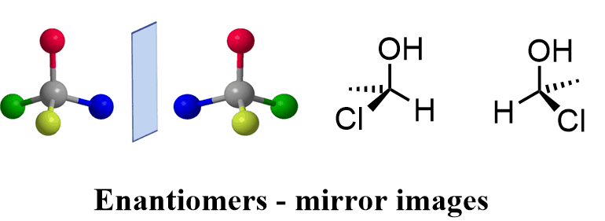
Also, the activity of drugs containing chirality centers can similarly vary between enantiomers. For several years the drug thalidomide was used to alleviate the symptoms of morning sickness in pregnant women. But it was discovered that thalidomide was the cause of horrible birth defects in many children born subsequent to the use of the drug.
Enantiomers
Enantiomers are chiral molecules that are mirror images of one another. Furthermore, the molecules are non-superimposable on one another. This means that the molecules cannot be placed on top of one another and give the same molecule. Chiral molecules with one or more stereocenters can be enantiomers. Fig.(20 )
Fig.(20 ): Enantiomers chemical structures.
Application of Enantiomers and chirality in Pharmacology:
The importance of stereochemistry of enantiomers in drug action is gaining greater attention in medical practice, and a basic knowledge of the subject will be necessary for clinicians to make informed decisions regarding the use of single-enantiomer drugs.
For some therapeutics, single-enantiomer formulations can provide greater selectivities for their biological targets, and improved therapeutic better than a mixture of enantiomers. For describing stereochemistry and enantiomers to be used depend on the potential of biological and pharmacologic differences between the 2 enantiomers of a drug, and highlights the clinical experience with single enantiomers of the selective one to aid the practicing physician to provide optimal pharmacotherapy to his or her patients.

Slide 13
The Biochemical Importance of CHIRALITY:
The human body is structurally chiral, with the heart lying to the left of center and the liver to the right. Chirality in molecules, Carbohydrates, nucleotides, phospholipids and proteins have chirality. Protein building unit is amino acid. All but one (except Glycine) of the 20, L - amino acids that make up naturally occurring proteins are chiral, and all of these are classified as being left - handed. The molecules of natural sugars are almost all classified as being right-handed. In fact, most of the molecules of life are chiral, and most are found in only one mirror image form. Our senses of taste and smell also depend on chirality. As we shall see, one mirror-image form of a chiral molecule may have a certain odor or taste while its mirror image smells and tastes completely different. The food we eat is made of molecules of one mirror image form, we would likely starve because the enzymes in our bodies are chiral and react with the natural mirror-image form of their substrates fig.( 18).
Most pharmaceuticals are chiral. Usually only one mirror-image form of a drug provides the desired effect. The other mirror image form is often inactive or, at best, less active. In some cases the other mirror-image form of a drug actually has severe side effects or toxicity.
Fig.(18 ): Enantiomers of drug to bind specific Enzyme.
Epinephrine is a hormone bind cell enzymes to regulate activity of the cell metabolism for glycolysis process in opposite activity direction with Insulin hormone inside the hepatic cells.
The enzyme- Epinephrine has three binding sites, one specific for A site, another for B site, and a third for Z site interactions. The binding sites are arranged on the surface as shown Fig.(19 ). To form an enzyme-substrate complex, all three sites on the enzyme must bind with the corresponding groups or atoms of the substrate. Only the D-enantiomer can bind to the surface with all three groups attached to the correct binding sites. The L-enantiomer can bind to a maximum of two sites. In this way the enzyme can distinguish between the two enantiomers in response to cell metabolism.
Fig.(19): Enantiomers of Epinephrine binds specific position of Enzyme. of Enzyme to Epinephren,

Slide 14
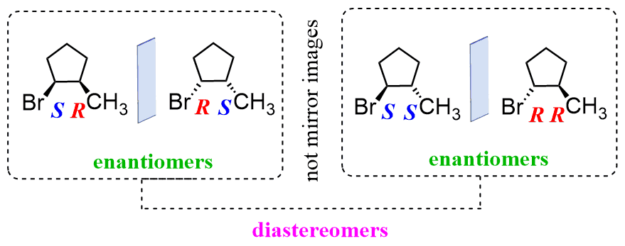
Diastereomers
Diastereomers are defined as compounds which have the same molecular formula and sequence of bonded elements but which are nonsuperimposable, non-mirror images. Enantiomers and diastereomers commonly called stereoisomers fall under the broader concept of isomerism which always involves the comparison of at least two species. The enantiomers which are a type of stereoisomers are also diastereomers. Diastereomers may be cyclic compounds contain non-superimposable chiral centers, but are not mirror images. Figure ( 21).
What is the difference between an enantiomer and a diastereomer?
Enantiomers and diastereomers are two types of stereoisomers. Enantiomers include mirror images and non-superimposable chiral centers. Diastereomers contain non-superimposable chiral centers, but are not mirror images. Depending on the number of stereocenters, there could be far more than 2 compounds.
Figure ( 21): Diastereomers are stereoisomers (enantiomers) that are not mirror images. For example, compare these two molecules.
Optical Activity:
Optical Activity is the ability of some substances to rotate plane polarized light, rotates plane-polarized light to the right is called Dextrorotatory (+), while to lift is called Levorotatory (-). When ordinary light is passed through a polarizing filter, all planes of oscillation are filtered out except one, resulting in plane-polarized light. A beam of plane-polarized light passed through a sample of a chiral compound, interacts with the compound in such a way that the angle of oscillation will rotate polarized light. This property is called optical activity. Racemic mixture: its 1:1 {equimolar of Dextrorotatory (+), & Levorotatory (-) } mixture of two enantiomers, its optical activity is zero. Optical activity is useful in choosing the appropriate drugs or choosing the effective enantiomer. See Figure (23).
Figure (23 ): Optical activity : A beam of plane-polarized light passed through a sample of a chiral compound, interacts with the compound in such a way that the angle of oscillation will rotate polarized light.

Slide 15
Reference:
P. Kostecki, J. Dragun, in Encyclopedia of Soils in the Environment, 2005]
https://encrypted-tbn0.gstatic.com/images?q=tbn%3AANd9GcRDguu0ewr9tfleYCFwuD4OdkXX4uzIsM6jww&usqp=CAU
October 2018,DOI: 10.13140/RG.2.2.11527.85926Project: Fuel system design and operation
https://ars.els-cdn.com/content/image/3-s2.0-B9780126639711500075-f03-07-9780126639711.gif?_
2-https://wp-media.tellibrary.org/2019/03/Screen-Shot-2019-03-08-at-9.40.18-AM.jpg
3-https://upload.wikimedia.org/wikipedia/commons/thumb/1/18/Conformations-of-1%2C2-dihaloethanes-from-xtal-compared-F-vs-I-Mercury-3D-balls.png/600px-Conformations-of-1%2C2-dihaloethanes-from-xtal-compared-F-vs-I-Mercury-3D-balls.png

