Slide 1
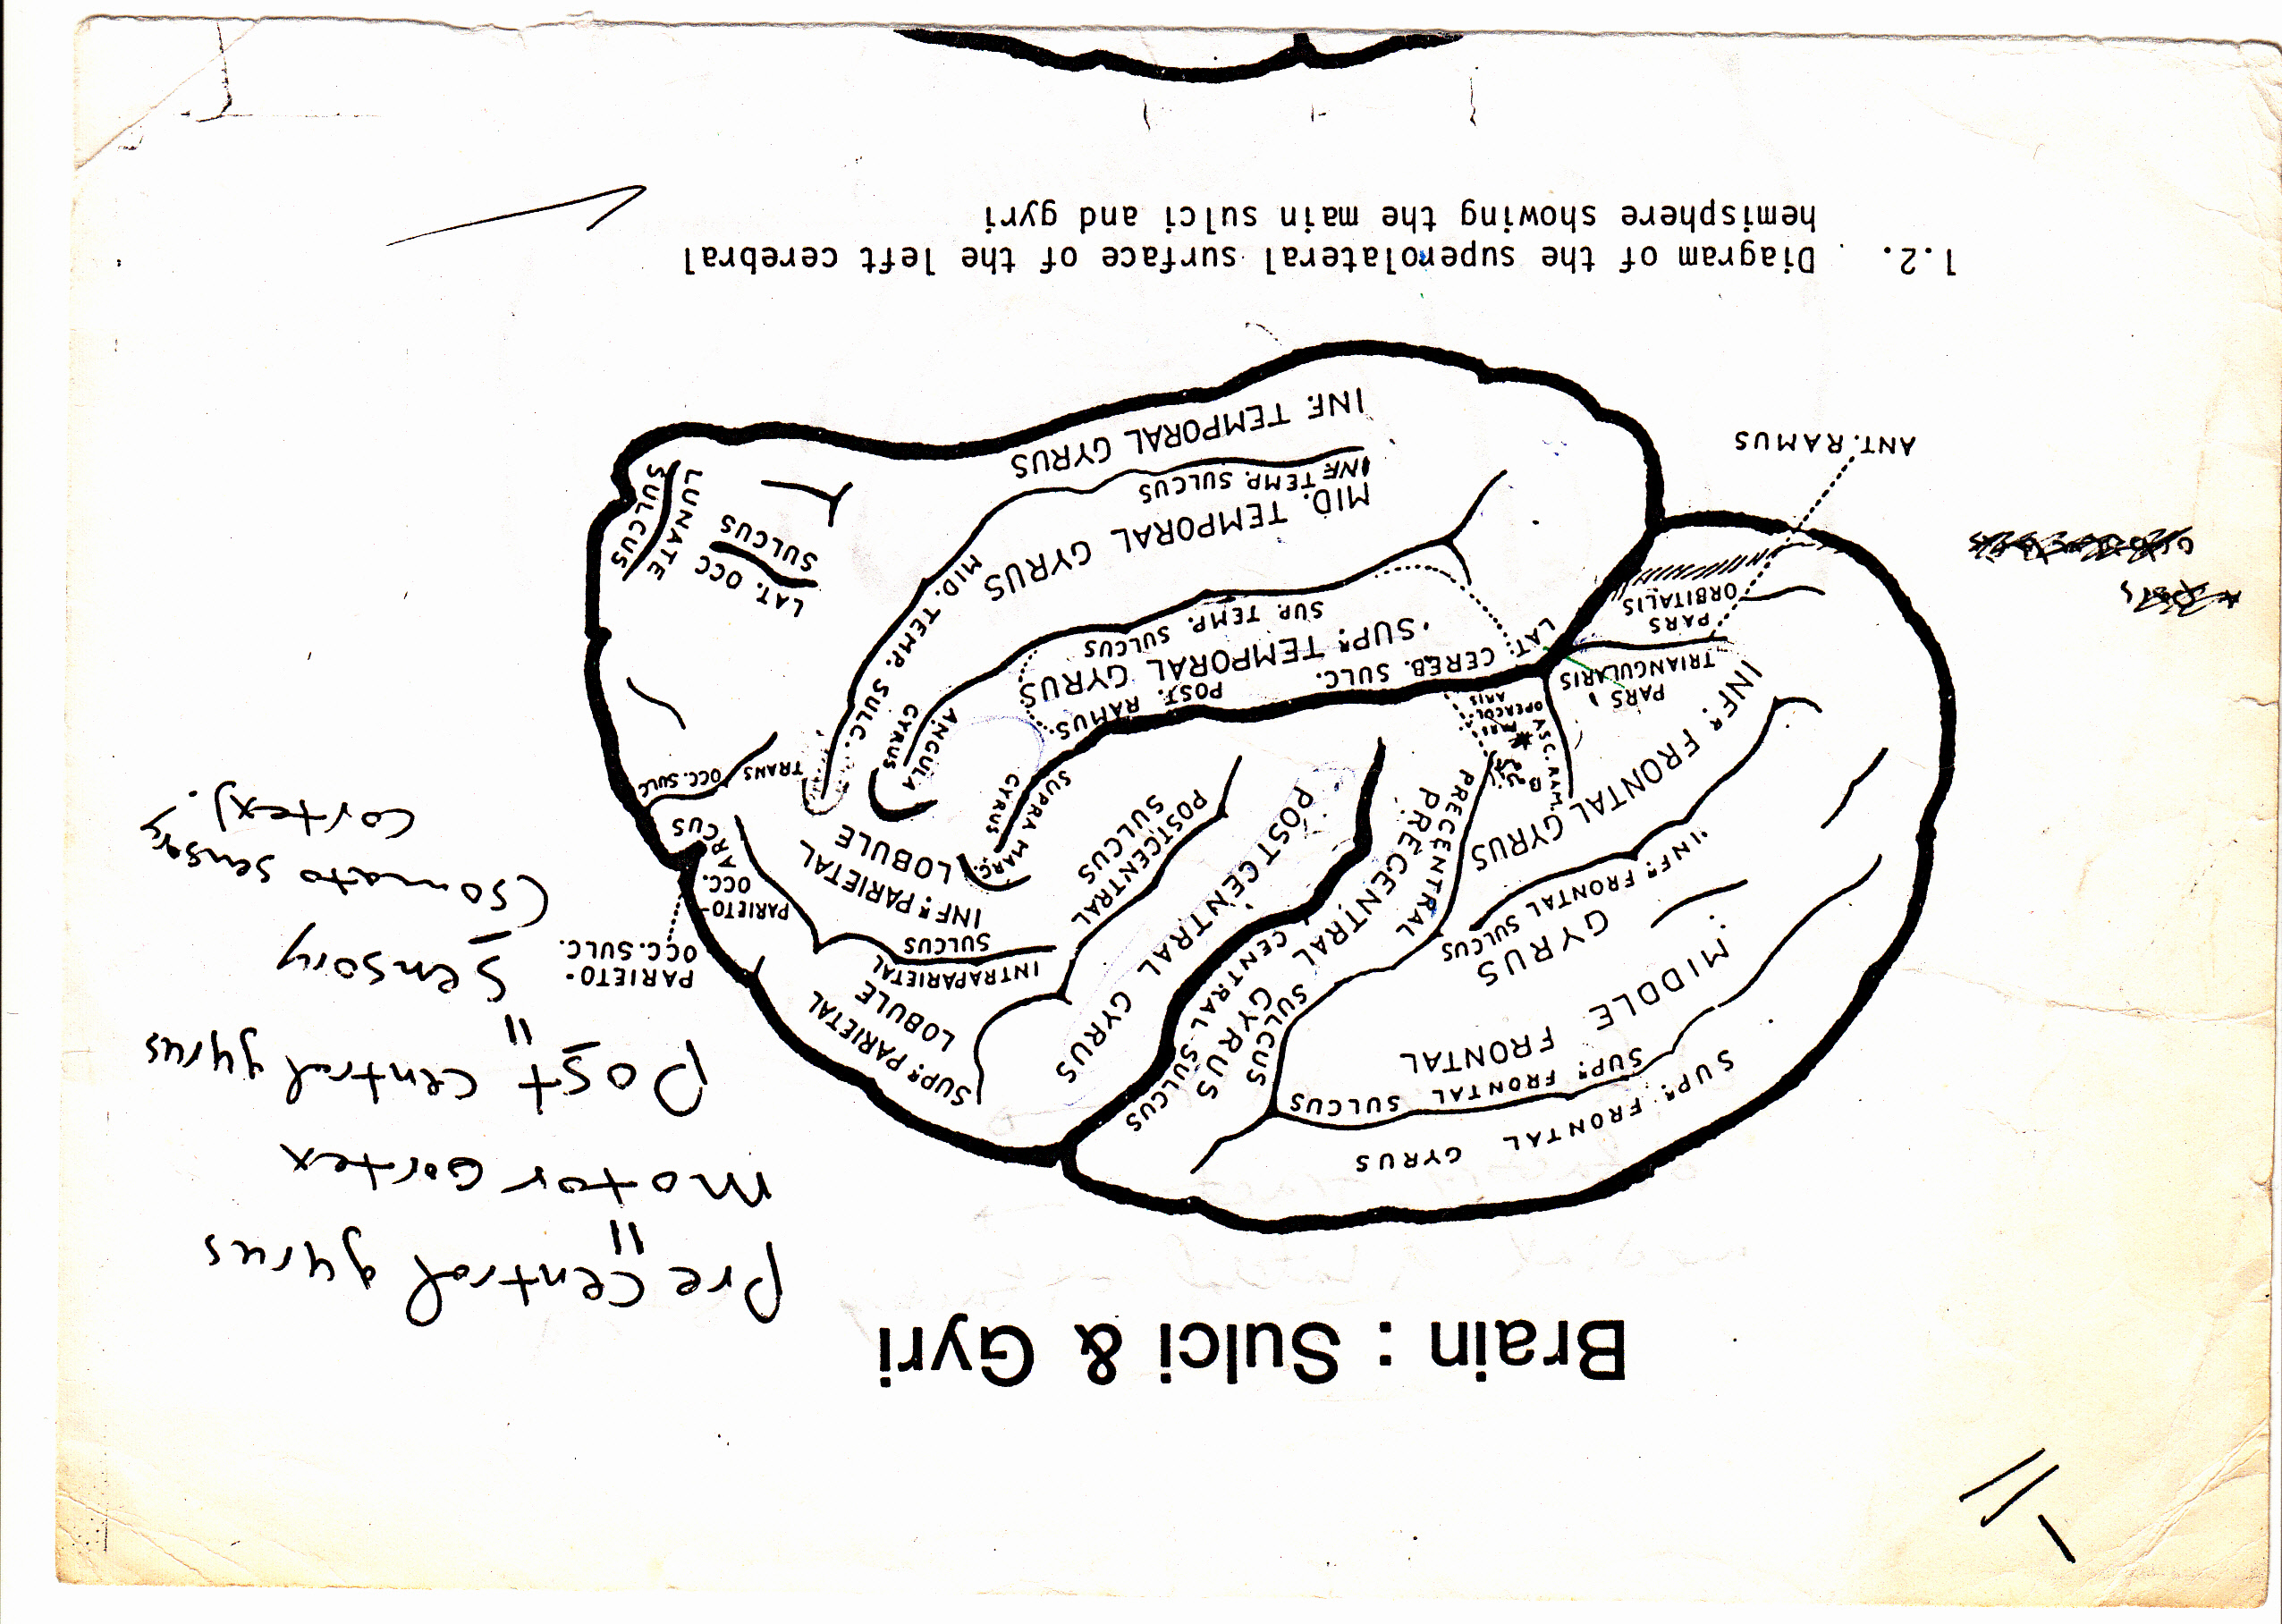

Slide 2
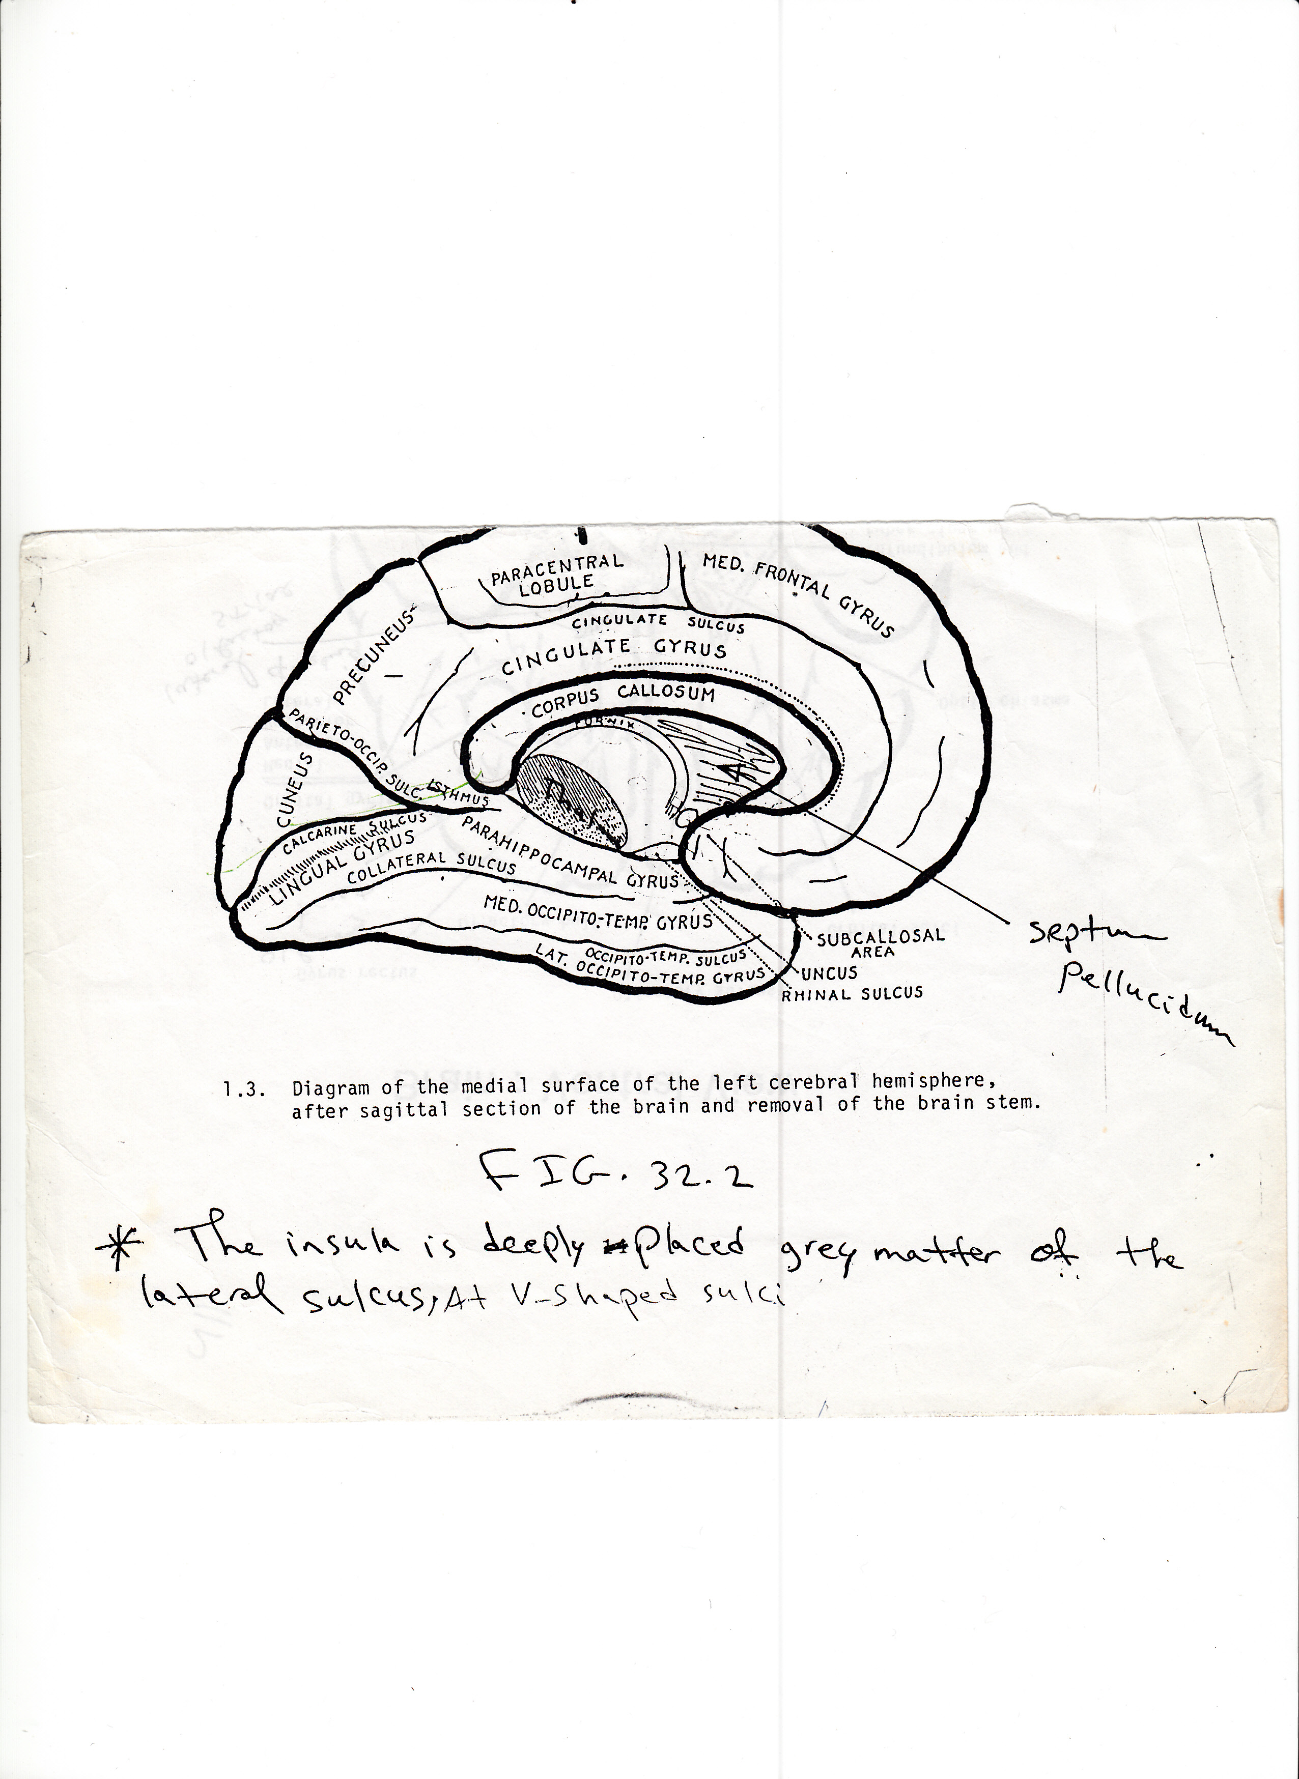

Slide 3
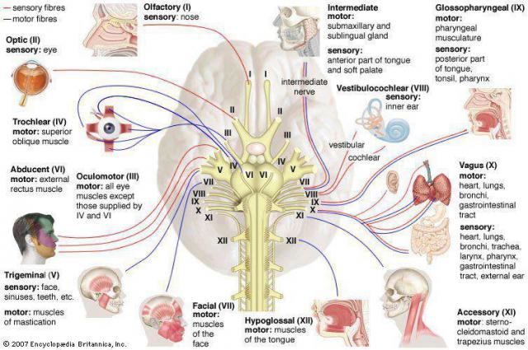

Slide 4
Cranial nerves attachment:
The main features of inferior surface (base) of the brain are the presence of the cranial nerves attachment.

Slide 5
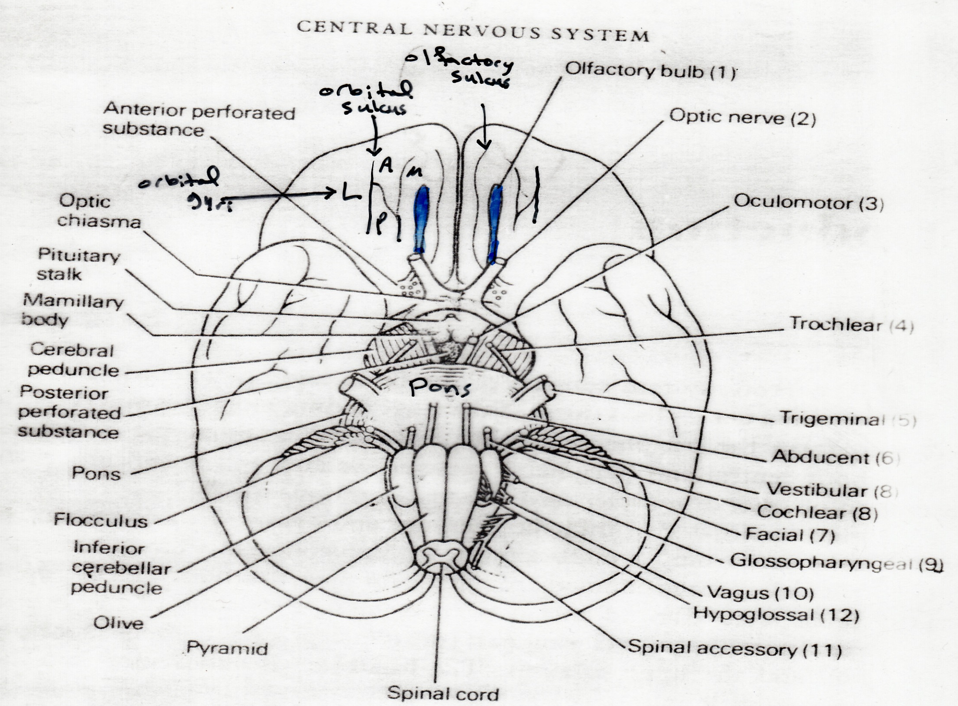

Slide 6
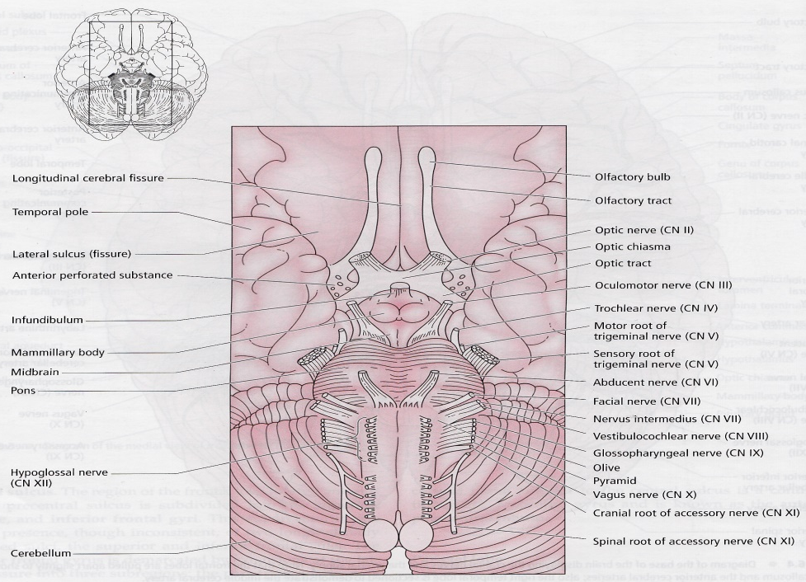

Slide 7
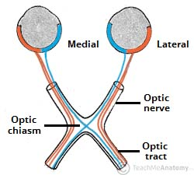

Slide 8
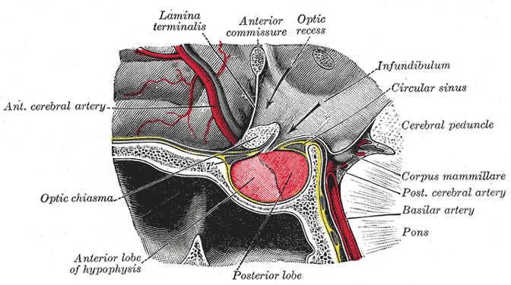


Slide 9
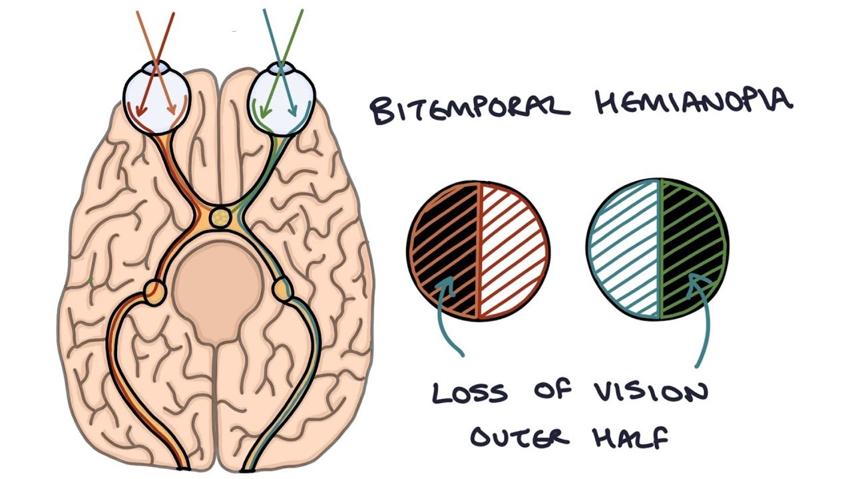

Slide 10
Cytoarchitecture of the cerebral cortex:
from superficial to deep layers:
I -Molecular layer.
II-External granular layer.
III-External pyramidal layer.
IV-Internal granular layer.
V-Internal pyramidal layer.
VI-Multiform layer.

Slide 11
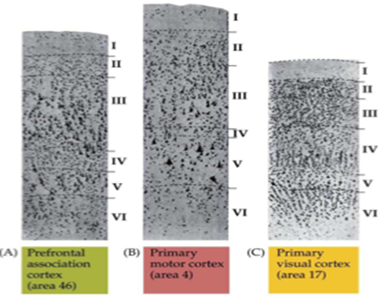
Depending on the cytohistological features, Broadman in 1909 had made cytoarchitectural map of the cerebral cortex which are called Broadman areas and they are (47) areas.

Slide 12
