Slide 1
NEOPLASIA (New growth) DR.AYSER HAMEED LEC.1

Slide 2
Abnormal mass of tissue, characterized by followings:-
Its growth is uncoordinated & exceeded with that of the normal tissues.
Neoplasm persist its growth after the cessation of stimuli which cause the change.
Loss of responsiveness to normal growth controls (Autonomous).
Tumors increase local size regardless of their local environmental & nutritional status of the host.

Slide 3
Neoplasia mean tumors
Oncology: is the science that studies the tumors.
Oncology divided tumors according to their behavior into (Benign & Malignant).

Slide 4
Nomenclature of Tumors:
All tumors (benign & malignant) have two basic parts:
Parenchymal Part: Formed by neoplastic cells.
Supporting part: Made up of blood vessels & connective tissue.
Parenchymal Part:-
Determine the clinical behavior of tumors.
Derived the name of tumors.
Naming of Benign tumors: (Cell of origin of tumor + Suffix Oma), like:-
Fibroma (benign tumor of fibrous tissue).
Chondroma (benign tumor of cartilage).

Slide 5
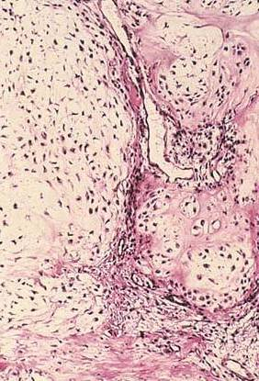
Chondroma
The tumor has lobules of benign-looking chondrocytes

Slide 6
Certain Benign Tumors or lesions
1. Adenoma: benign epithelial neoplasm producing glandular pattern or benign neoplasm derived from glands e.g. Renal Adenoma, follicular adenoma of thyroid.
2. Papilloma: Any benign neoplasm growing on any surface that produce microscopic or macroscopic finger like fronds, as in the skin.
3. Polyp: is a mass that projects above a mucosal surface, as in the gut.
Some malignant tumors appear as Polyp (mainly in the colon).
4. Cystadenoma: are hollow cystic masses, typically seen in the ovary.

Slide 7
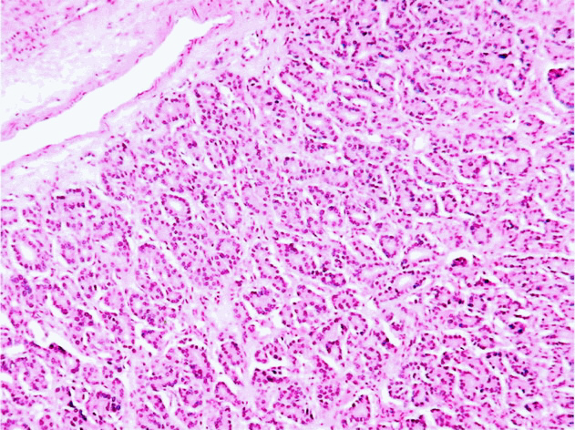
Follicular adenoma thyroid
A portion of another follicular adenoma consisting of small (micro) follicles.

Slide 8
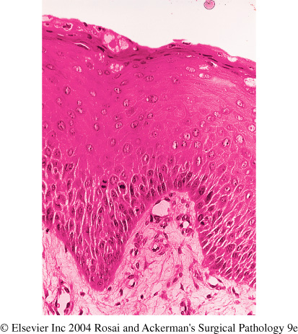
Squamous cell papilloma larynx
This multilayered benign-looking squamous epithelium is arranged in a finger-like projections, each having a core of vascularized connective tissue. The Rt. Photo is a higher power showing the squamous epithelium cover of one of the papillae.

Slide 9
Ovarian cystadenoma and papillary cystadenoma
Lt, a cystadenoma seen as a unilocular, thin-walled cyst with smooth inner & outer surfaces.
Rt, papillary cystadenoma having similar gross features to cystadenoma except for the presence of multiple yellowish, warty projections sprouting from the inner surface.

Slide 10
Naming of Malignant Tumors
Malignant neoplasm arising in mesenchymal tissue or its derivatives are called Sarcoma, e.g.
Fibrosarcoma (malignant neoplasms of fibrous tissue).
Chondrosarcoma (malignant neoplasm of cartilage).
Osteosarcoma (malignant neoplasm of bone).
2. Malignant neoplasms of epithelial cells origin are called Carcinoma.
These epithelia are derived from germ layers, e.g. renal cell carcinoma (Mesoderm), Squamous cell carcinoma (ectoderm).

Slide 11
So mesoderm can give rise to carcinoma as well as Sarcoma.
Sometime the type of malignant epithelia gives the name of malignant tumor, like
Squamous cell carcinoma: tumor cells resemble stratified squamous epithelium.
Adenocarcinoma: tumor cells grow in glandular pattern.
Sometime the tissue of origin can identify by the name of tumor, like
Renal cell carcinoma.
Hepatocellular carcinoma.

Slide 12
Tumors can be divided according to their origin:
Monoclonal tumor: Malignant tumor in which the cells are derived from single progenitor cells (single germ layer).
Mixed tumors: tumors in which the stem cells may undergo divergent differentiation, like pleomorphic adenoma of parotid gland which contain two parts (epithelial part & fibromyxoid part).
Another example of mixed tumor is fibroadenoma of breast which consist of two parts (Adenoma & fibroma).

Slide 13
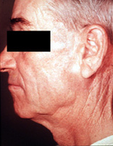
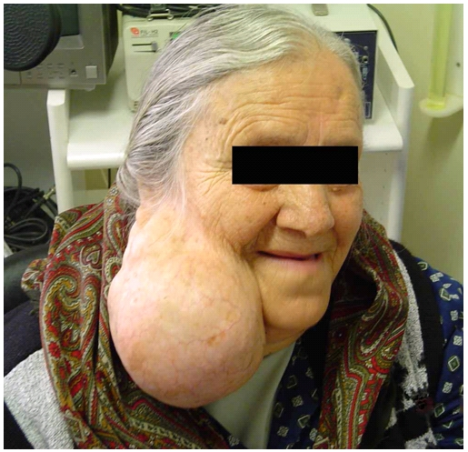
MIXED PAROTID TUMOR (Pleomorphic Adenoma)
Two clinical examples of parotid pleomorphic adenomas. These tumors classically present as preauricular swelling. In the early stages the tumor is small but it may progressively increase in size if left untreated. The Rt. Photo is an usually large pleomorphic adenoma. The only way of establishing the diagnosis & excluding malignancy is through microscopic examination of sections from the excised tumor. This has revealed features of pleomorphic adenoma in these two examples.

Slide 14
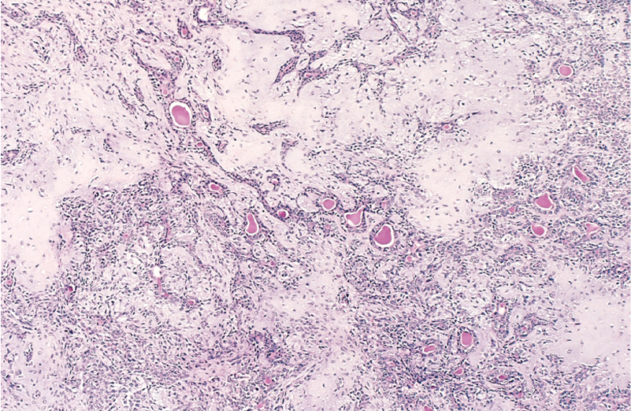
Mixed salivary gland tumor (Pleomorphic adenoma)
Sheets of epithelial/myoepithelial cells with glandular arrangement. There are several nodules of cartilaginous tissue composed of chrondrocytes within a bluish background. The capsule of the tumor is to the Lt.

Slide 15
3. Teratoma:
A tumor contains recognizable mature or immature cells or tissues, which are derived from more than one germ layer (sometime from three germ layers).
These teratomas are arising from totipotential cells mainly in the ovary & testis.
May contain:- Bone, muscle, fat, hair (these are mesoderm derivatives).
Epithelia (respiratory, intestinal), this is endoderm derivative.
Nerve (ectoderm derivatives).

Slide 16
If all components of teratoma are benign, is called mature teratoma typically seen in ovary.
If these components are immature, this is called immature teratoma (Malignant potential), typically seen in testis.

Slide 17
Ovarian Cystic Teratoma (Dermoid cyst)
Well-developed teeth in ovarian mature cystic teratoma.

Slide 18
Tumor like lesions
1. Hamartoma: is a malformation that present as a mass of disorganized tissue indigenous to the particular site.
e.g. Hamartoma of lung.
2. Choristoma: is a congenital anomaly, it is heterotopic rest of cells.
e.g. small nodule of pancreatic tissue may be found in the submucosa of stomach, duodenum & small intestine.

Slide 19
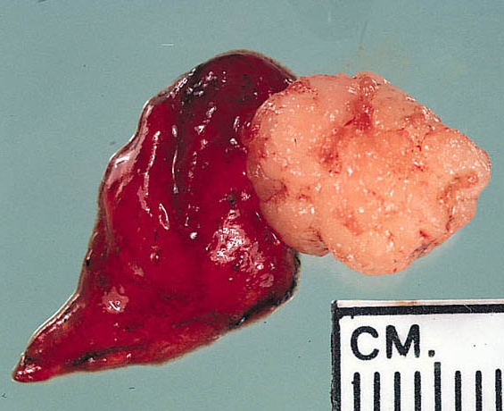
PULMONARY HAMARTOMA
Pulmonary hamartoma. The lesion is subpleural, is well circumscribed, and has a glistening cut surface.
A mixture of cartilage, respiratory epithelium and fat

Slide 20
Ectopic pancreas wall of jejunum (arrow)

Slide 21
Important note:
Lymphoma, melanoma, mesothelioma & meningioma, although they are end with suffix oma, they are malignant tumors.
Characteristics of Benign & Malignant tumors:
Characteristics of differentiation between benign & malignant tumors are:-
Differentiation & anaplasia.
Rate of growth.
Local invasion.
4.Metastasis.

Slide 22
I. Differentiation & anaplasia:
Parenchymal part of tumor is responsible for differentiation & anaplasia of tumors, while the stromal part of tumors is important for growth of tumor because it contains blood supply of tumors.
Differentiation of Parenchymal cells refers to the extent to which the tumor cells resemble their normal original tissue morphologically & functionally.

Slide 23
Leiomyoma
Sections from a leiomyoma show interlacing bundles of benign smooth muscle cells that simulate very closely their native counterparts.

Slide 24
Benign tumors composed of well differentiated cells (closely resemble their normal counterpart),
e.g. Lipoma (consist of mature adipose cells).
Chondroma (consist of mature chondrocytes).
Mitosis is extremely rare in number in benign tumors.
Malignant tumors characterized by wide range of parenchymal cell differentiation (from well differentiated to undifferentiated & anaplasia).

Slide 25
Lipoma (small intestine)

Slide 26
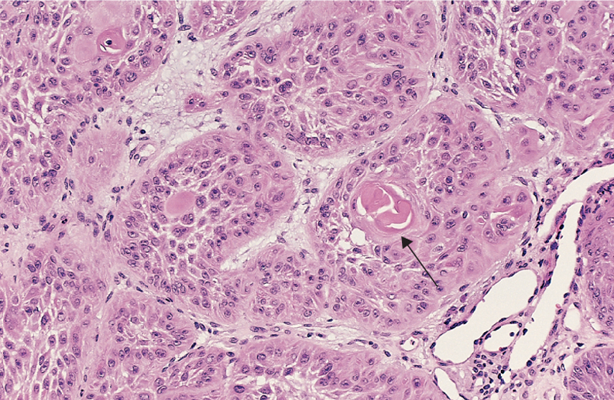
Well-differentiated squamous cell carcinoma of the skin
The tumor cells are strikingly similar to normal squamous epithelial cells, with intercellular bridges and nests of keratin pearls (arrow).

Slide 27
Anaplasia: means loss of structural & functional differentiation of normal cells.
Characteristics of anaplastic cells:
Pleomorphism (variation in the size & shape of cells).
Large hyperchromatic nuclei.
Increase Nucleus/ Cytoplasm (N/C) ratio (1:1), normally it is (1:4 or 1:6).
Anisonucleosis (variation in the size of nucleus) & poikilonucleosis (variation in the shape of nucleus).

Slide 28
5. Chromatin is coarse, large prominent nucleolus.
6. Numerous, atypical mitosis.
7. Loss of normal orientation of cells (loss of gland formation).
According to degree of differentiation: three grade of differentiation of malignant tumors,
Well differentiated malignancy (like normal tissue).
Moderately differentiated malignancy.
Poor differentiated, undifferentiated, anaplastic malignancy.

Slide 29
Important notes:
Usually benign & well differentiated cancer have functional capacity e.g. like well differentiated malignancy of endocrine glands secrete hormones resemble the normal endocrine cells

Slide 30
Degrees of differentiation
Normal
adenoma
carcinoma

Slide 31
Undifferentiated (Anaplastic) Cancer
Complete loss of differentiation (primitive cells).
Frequent mitoses including abnormal ones
Cells/nuclei show marked pleomorphism/sometimes multinucleated tumor giant cells
Extreme nuclear hyperchromasia
Marked nuclear enlargement N:C may reach 1:1 (instead of 1:4 or 1:6)
The chromatin is coarsely clumped and irregularly distributed
Usually large, prominent nucleoli

Slide 32
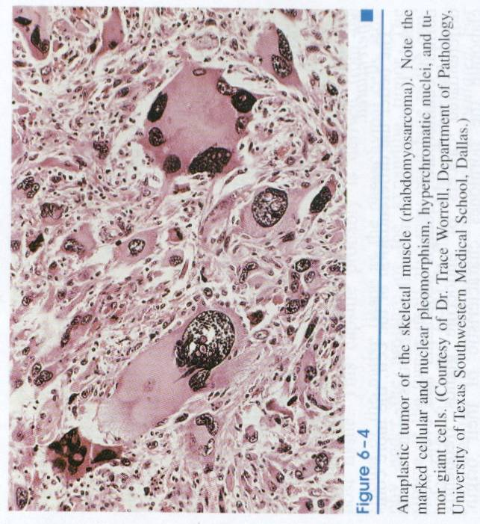
Rhabdomyosarcoma
Pleomorphic rhabdomyosarcoma showing prominent pleomorphism, frankly malignant nuclei & malignant multinucleated giant cells.

Slide 33
Dysplasia:
It is non-neoplastic growth disorder; mainly occur in epithelia (not stroma).
It is a loss of uniformity of the individual cells & a loss in their architectural orientation.
Characteristics of dysplastic cells:
Pleomophism.
Large, hyper chromatic cells.
Mitosis more than normal (mitosis not restricted to the basal layer, it involves the all layers).
Loss of normal maturation of cells e.g. loss of maturation of squamous epithelium.

Slide 34
When dysplastic changes involve the entire thickness of the epithelium, they are called Carcinoma in Situ or preinvasive stage of cancer.
However; foci of carcinoma in situ can present adjacent to area of cancer.
Dysplasia does not necessarily progress to cancer & dysplasia not involve full thickness may be reversible.

Slide 35
Cervix uteri severe dysplasia amounting to carcinoma in situ
There is failure of normal differentiation, marked nuclear and cellular pleomorphism, and numerous mitotic figures extending toward the surface. The intact basement membrane (below) is not seen in this section.

Slide 36
THANKS

