Slide 1
Acute myeloid leukaemia
Ass.Prof.Abeer Anwer Ahmed

Slide 2
The leukaemias are a group of disorders characterized by the accumulation of malignant white cells in the bone marrow and
blood.
These abnormal cells cause symptoms because of:
(i) bone marrow failure (e.g. anaemia, neutropenia, thrombocytopenia);
and (ii) infiltration of organs (e.g. liver, spleen, lymph nodes, meninges, brain, skin or testes).

Slide 3
Classification of leukaemia
The main classification is into four types: acute and chronic
leukaemias, which are further subdivided into lymphoid or
myeloid.
Acute leukaemias are usually aggressive diseases in which
malignant transformation occurs in the haemopoietic stem
cell or early progenitors.
Genetic damage is believed to involve several key biochemical steps resulting in:
(i) an increased rate of proliferation, (ii) reduced apoptosis and (iii) a block in cellular differentiation.
these events cause accumulation in the bone marrow of early haemopoietic cells known as blast cells.
The dominant clinical feature of acute leukaemia is usually bone
marrow failure caused by accumulation of blast cells, although
organ infiltration also occurs. If untreated, acute leukaemias are
usually rapidly fatal, although with modern treatments most
younger patients are ultimately cured of their disease

Slide 4
Diagnosis of acute leukaemia
Acute leukaemia is normally defined as the presence of
over 20% of blast cells in the bone marrow at clinical
presentation. However, it can be diagnosed with less than
20% blasts if specific leukaemia‐associated cytogenetic or
molecular genetic abnormalities are present
The lineage of the blast cells is defined by microscopic
examination (morphology)
Immunophenotypic (flow cytometry) ,cytogenetic and molecular analysis

Slide 5
Immunophenotypic analysis define whether the blasts are of myeloid or lymphoid lineage
and also localize the stage of cellular differentiation The typical ‘myeloid immunophenotype’ is CD13,
CD33+ and TdT− .
Special antibodies are helpful in the diagnosis of the rare undifferentiated, erythroid or megakaryoblastic subtypes

Slide 6
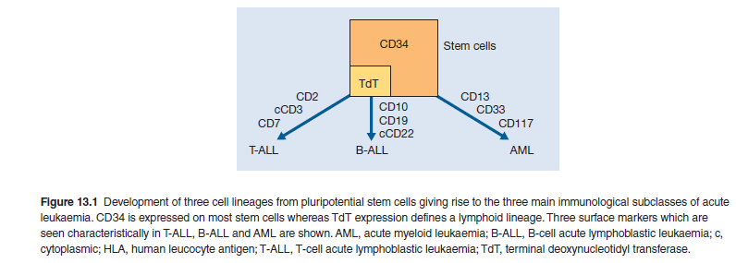

Slide 7
Cytogenetic and molecular analysis is essential and is
usually performed on marrow cells, although blood may be used if the blast cell count is particularly high.
Cytochemistry can be useful in determining the blast cell lineage. but is no longer performed in centres where the newer and more definitive tests are available.

Slide 8
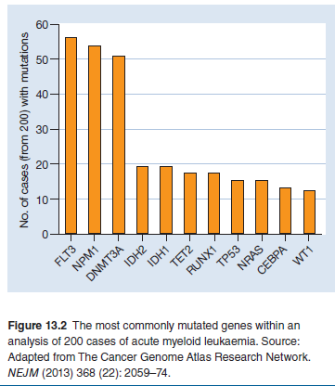

Slide 9
Acute myeloid leukaemia Pathogenesis
The AML genome contains an average of about 10 mutations
within protein‐coding genes, amongst the smallest number of
any adult cancer .
Many AML ‘driver mutations’ have been identified, with the most common being within FLT3, NPM1 and DNMT3A .
Some other mutations,
e.g. of ASXL1, are frequent in myelodysplasia and when found in AML suggest that it is secondary to myelodysplasia.
The mutations usually occur on only one of the two alleles for the gene and may be ‘loss of function’ or ‘gain of function’.
The average AML at presentation contains less than one gene fusion
event, which usually arise from translocations, with the most common being PML‐RARA, CBFB‐MYH11, RUNX1- RUNX1T1 which are found in around 15%, 12% and 8% of cases respectively.
The wide variety of cytogenetic abnormalities and molecular mutations are such that each case usually has a unique pattern of mutations.

Slide 10
Incidence
Acute myeloid leukaemia (AML) is the most common form of acute leukaemia in adults and becomes increasingly common
with age, with a median onset of 65 years. It forms only a minor fraction (10–15%) of the leukaemias in childhood.
Cytogenetic abnormalities and response to initial treatment have a major influence on prognosis

Slide 11
AML is classified according to the World Health Organization (2008) scheme.
There is an increasing focus on the genetics abnormalities within the malignant cells and it is likely that ultimately almost all AML cases will be classified by specific genetic subtype.
Currently this is not possible but many genetic subtypes have been determined. Approximately 60% of tumours exhibit karyotypic abnormalities on cytogenetic
analysis and many cases with a normal karyotype carry mutations in genes such as nucleophosmin FLT3, (NPM1), CEBPA, DNMT3A detected only by molecular methods and which have prognostic significance

Slide 12
Six main groups of AML are recognized
1 AML with recurrent genetic abnormalities encompasses
subtypes with specific chromosomal translocations or gene
mutations. The detection of these abnormalities defines the
tumour as AML and so the diagnostic criteria for this subgroup
are relaxed in that the bone marrow blast cell count
does not need to exceed 20% in order to make a diagnosis.
In general these disorders have a good prognosis.
2 AML with myelodysplasia‐related changes. In this group
the AML is associated with microscopic features of dysplasia
in at least 50% of cells in at least two lineages. The clinical
outcome of these patients is impaired in relation to the
first subgroup.

Slide 13
3 Therapy‐related myeloid neoplasms(t‐AML) arise in patients
who have been previously treated with drugs such
as etoposide or alkylating agents. They commonly exhibit mutations in the MLL gene and the clinical response is usually poor.
4 AML, not otherwise specified. This group is defined
by the absence of cytogenetic abnormalities and comprises around 30% of all cases. Mutations in the NPM1and FLT3 genes are more frequent in those with normal cytogenetics

Slide 14
5 Myeloid sarcoma is rare but refers to a disease that resembles a solid tumour but is composed of myeloid blast cells
6 Myeloid proliferations related to Down’s syndrome. Children with Down’s syndrome have a greatly increased risk of acute leukaemia.
Two myeloid variants are recognized:
(i) transient abnormal myelopoiesis in which there is a selflimiting leucocytosis; and (ii) AML.

Slide 15
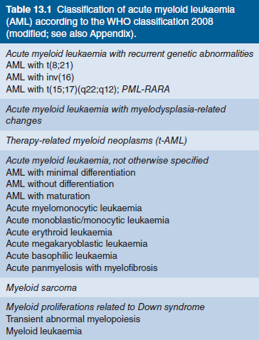

Slide 16
Mixed phenotype acute leukaemia
These rare cases express two markers for both myeloid and lymphoid differentiation either on the same blast cells or on two different cell populations.
They usually have a poorprognosis.

Slide 17
Clinical features
The clinical features of AML are dominated by the pattern of bone marrow failure caused by the accumulation of malignant
Infections are frequent, and anaemia and thrombocytopenia are often profound.
A bleeding tendency caused by thrombocytopenia and disseminated intravascular coagulation (DIC) is characteristic of the promyelocytic variant of AML. Tumour cells can infiltrate a variety of tissues. Gum hypertrophy and infiltration ,skin involvement and CNS disease are characteristic of the myelomonocytic and monocytic subtypes

Slide 18
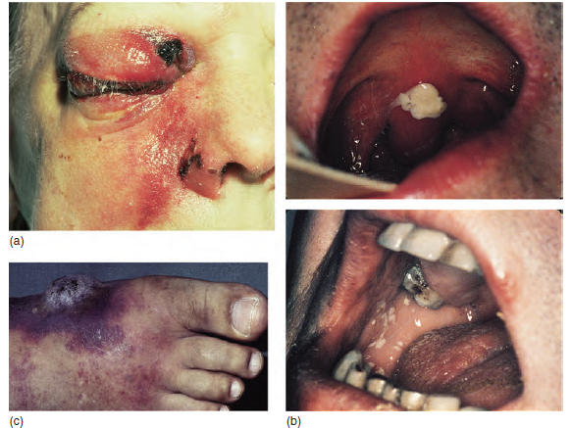

Slide 19
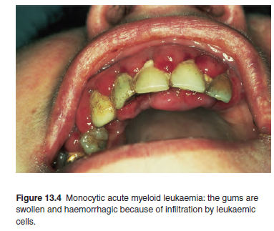

Slide 20
Investigations
Haematological investigations reveal a normochromic
normocytic anaemia with thrombocytopenia in most cases.
The total white cell count is usually increased and blood film
examination typically shows a variable numbers of blast cells.
The bone marrow is hypercellular and typically contains many
leukaemic blasts .
Blast cells are characterized by morphology, immunological (flow cytometric) cytogenetic and molecular genetic determining prognosis and developing a treatment plan analysis for confirming the diagnosis,

Slide 21
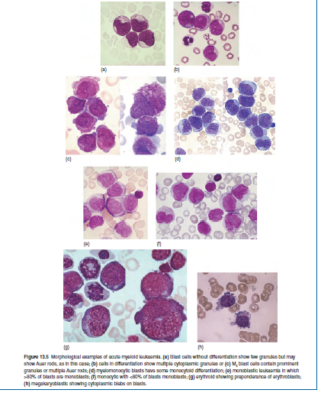

Slide 22
Cytochemistry is no longer used in most centres.
Tests for DIC are often positive in patients with the promyelocytic variant of AML .
Biochemical tests are performed as a baseline before treatment begins and may reveal
raised uric acid or lactate dehydrogenase.

Slide 23
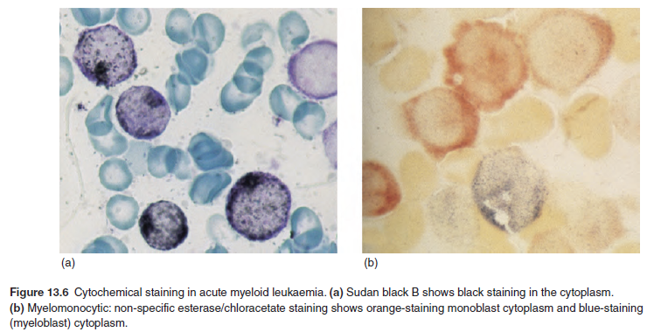

Slide 24
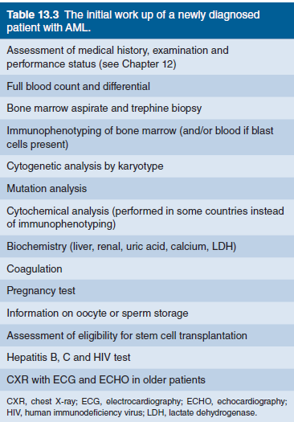

Slide 25
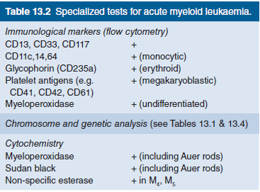

Slide 26
Cytogenetics and molecular genetics
Two of the most common t(8;21) and inv(16) are associated with a good prognosis.
Acute promyelocytic leukaemia is a variant of AML that contains the
t(15;17) translocation in which the gene PML on chromosome
15 is fused to the retinoic acid receptor α gene, RARα, on chromosome 17 .
The resultant PML‐RARα fusion protein functions as a transcriptional repressor whereas normal (wild‐type) RARα is an activator. Normally, the PMLprotein forms homodimers with itself, whereas the RARα
protein forms heterodimers with the retinoid X receptor protein, RXR. The PML‐RARα fusion protein binds to PML and RXR, preventing them from linking with their natural partners. This results in the cellular phenotype of arrested differentiation.

Slide 27
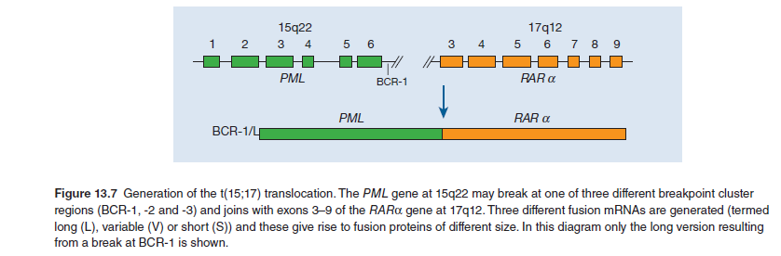

Slide 28
Point mutations affecting the genes FLT3, NPM1,
DNMT3A, CEBPA, TET2, WT1, IDH1, RUNX1, and others
are frequent in AML, especially in those cases without a
cytogenetic abnormality .
They may be used to subclassify the disease and have prognostic significance .
Some of these genes are involved in DNA methylation or acetylation and are also mutated in cases of myelodysplasia and myeloproliferative diseases .
The presence in de novo AML of a myelodyplasia ‘specific’ mutation, e.g. of ASXL1 or SF3B1 is unfavourable.

Slide 29
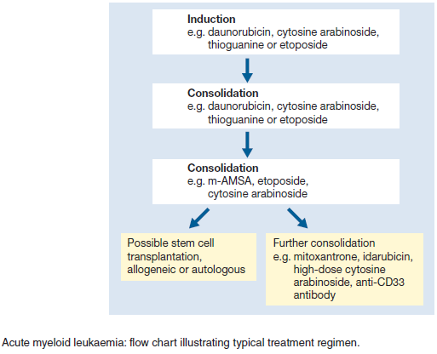

Slide 30
