Slide 1
Myeloproliferative disorders are closely related to each
other and transitional forms can occur with evolution from
one entity into another during the course of the disease
These diseases are associated with acquired mutations of
the genes that encode the tyrosine kinase proteins, Janus‐associated
kinase 2 (JAK2), MPL (the receptor for thrombopoietin),
or calreticulin (CALR) (Table 15.1). Mutation of JAK2
(JAK2V617F) occurs in a heterozygous or homozogous state,
in the marrow and blood of almost all patients with PV and in approximately 60% of those with ET and primary myelofibrosis,showing the common aetiology of these three diseases

Slide 2
The mutation occurs in a highly conserved region of
the pseudokinase domain, which is believed to negatively regulate
JAK2 signalling. JAK2 has a major role in normal myeloid
development by transducing signals from cytokines and
growth factors including erythropoietin and thrombopoietin

Slide 3
Why the same mutation is associated with different
myeloproliferative diseases is unclear but depends partly
on the dosage of the mutant allele, this being usually higher in PV than ET. A minority of PV patients show a variant JAK2 mutation in exon 12. In those patients who do not demonstrate a JAK2 mutation a mutation in the calreticulin (CALR) is observed in most cases. CALR is a multifunction protein
involved in signal transduction and gene transcription. Mutations in the MPL gene are found in 5–10% of ET and MF cases.
A mutation in one of these three genes is seen in 99% of cases of PV and around 85–90% of cases of ET or MF

Slide 4
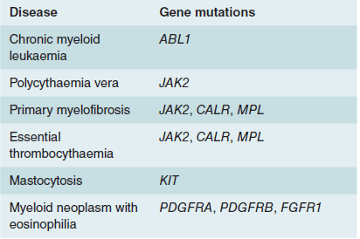
Genetic mutations in myeloproliferative diseases and other myeloid neoplasms.

Slide 5
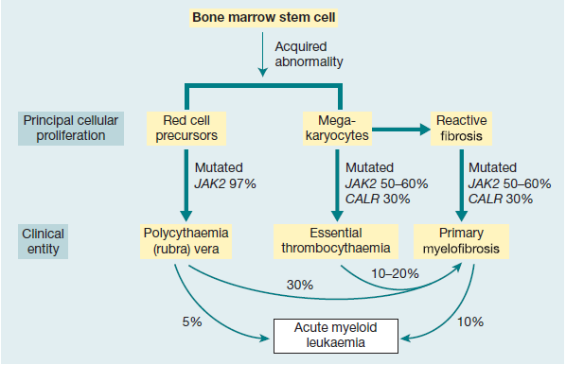
Relationship between the three myeloproliferative diseases. They may all arise by somatic mutation in the pluripotential stem and progenitor cells. Many transitional cases occur showing features of two conditions and, in other cases, the disease transforms during its course from one of these diseases to another or to acute myeloid leukaemia. The three diseases, polycythaemia rubra vera, essential thrombocythaemia and primary myelofibrosis, are characterized by JAK2 or CALR mutation in a varying proportion of cases.

Slide 6
The role of JAK2 mutation in the generation of myeloproliferative diseases
. (a) (i) Most haemopoietic growth factor
receptors do not have intrinsic kinase activity but associate with a protein kinase such as JAK2 in the cytoplasm.
(ii) When the receptor binds a growth factor (e.g. erythropoietin) the cytoplasmic domains move closer together and the JAK2 molecules can activate each
other by phosphorylation and phosphorylate downstream poteins e.g. STATS (Fig. 1.7). (iii) The V617F JAK2 mutation allows the JAK
protein to become activated even when no growth factor is bound.
(b) A model for the development of myeloproliferative disease
following JAK2 mutation. The primary event appears to predispose to an acquired heterozygous mutation of JAK2 (V617F). This leads
to a survival advantage. In some patients, a mitotic recombination event leads to a homozygous JAK2 mutation state.

Slide 7
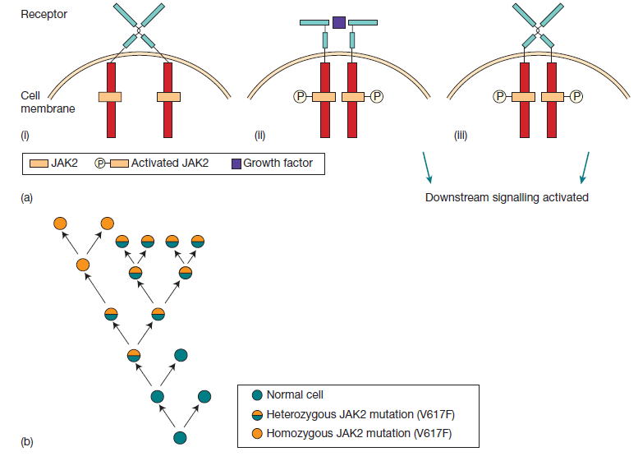

Slide 8
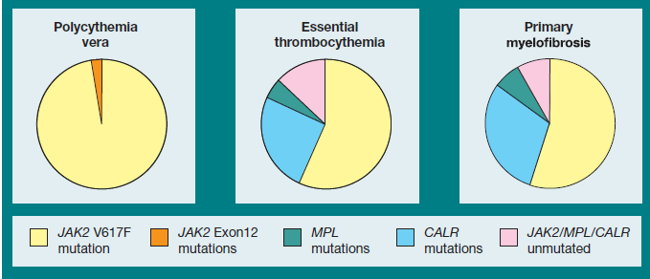
Frequency of JAK2, CALR and MPL mutations in the three subtypes of myeloproliferative neoplasm. Source

Slide 9
Polycythaemia
Polycythaemia is defined as an increase in the haemoglobin concentration above the upper limit of normal for the patient’s age and sex.

Slide 10
Polycythaemia vera (PV)
In PV the increase in red cell volume is caused by a clonal malignancy of a marrow stem cell. The disease results from somatic mutation of a single haemopoietic stem cell which gives its progeny a proliferative advantage.
The JAK2V617F mutation
is present in haemopoietic cells in about 97% of patients
and a mutation in exon 12 is seen in some of the remainder.
Although the increase in red cells is the diagnostic finding, in
many patients there is also an overproduction of granulocytes
and platelets. Some families have an inherited predisposition
to myeloproliferative disease but JAK2 or CALR mutations are
not present in the germline

Slide 11
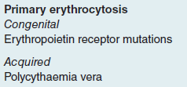
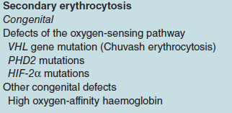
Classification of polycythaemia

Slide 12
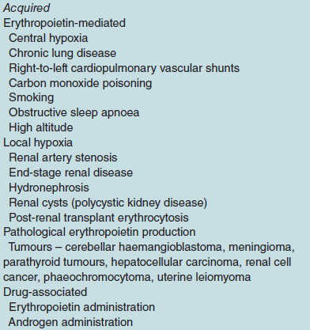

Slide 13
Clinical features
PV is usually a disease of older people and has an equal sex
incidence. Clinical features result from hyperviscosity, hypervolaemia,
hypermetabolism or thrombosis.
1 Headaches, dyspnoea, blurred vision and night sweats.
Pruritus, characteristically after a hot bath, can be a severe
problem.
2 Plethoric appearance: ruddy cyanosis conjunctival
suffusion and retinal venous engorgement.
3 Splenomegaly in 75% of patients
4 Haemorrhage or thrombosis, either arterial or venous, may
be seen.
5 Gout (as a result of raised uric acid production)

Slide 14
Laboratory findings
1 The haemoglobin, haematocrit and red cell count are increased.
The total red cell volume is increased.
2 A neutrophil leucocytosis is seen in >50% and some have
increased basophils.
3 A raised platelet count is present in about half of patients.
4 The JAK2 mutation is present in the bone marrow and peripheral
blood granulocytes in over 95% of patients.
5 The bone marrow is hypercellular with trilineage growth,
as assessed by trephine biopsy

Slide 15
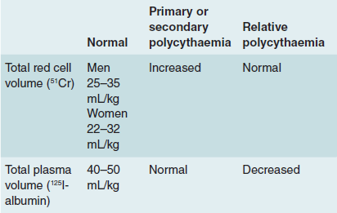
Radiodilution methods for measuring red cell and plasma volume.

Slide 16
6 Serum erythropoietin is low.
7 Plasma urate is often increased; the serum lactate dehydrogenase (LDH) is normal or slightly raised.
8 Circulating erythroid progenitors (erythroid colony‐forming
unit, CFUE, and erythroid burst‐forming unit, BFUE;
are increased compared to normal and grow in
vitro independently of added erythropoietin (endogenous
erythroid colonies).
9 Chromosome abnormalities (e.g. deletions of 9p or 20q)
are found in a minority of subjects and mutations in TET‐2
or other epigenetic genes occur in 10–20%.

Slide 17
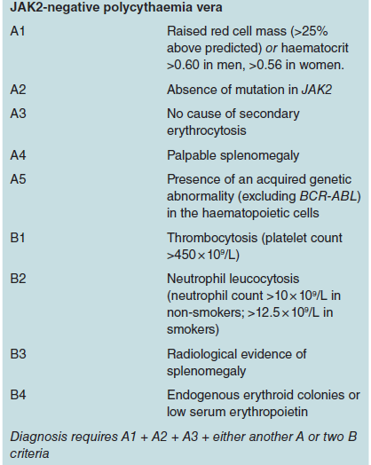
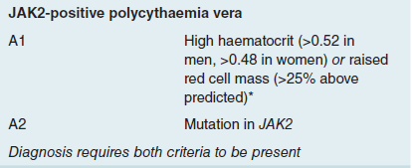
Diagnosis

Slide 18
Congenital causes of primary polycythaemia
Congenital causes are relatively rare and include cases caused
by mutations in the genes that regulate oxygen sensing (VHL,
PHD2 or HIF2A) (see Chapter 2) as well as mutation of the
erythropoietin receptor and haemoglobin mutations that lead
to high oxygen‐affinity variants with subsequent tissue hypoxia.
These patients often have a family history of polycythaemia
and present at a young age.

Slide 19
Secondary polycythaemia
The causes of secondary polycythaemia are listed in Table
Acquired causes are due to an increase in the erythropoietin
level. Hypoxia caused by smoking or chronic obstructive
airways disease is a common cause, and measurement of arterial
oxygen saturation is a valuable test. Renal and tumour
causes of inappropriate erythropoietin secretion are less
common.
There is little evidence on which to guide a treatment
plan but one approach is to advise venesection if the haematocrit
is above 0.54 with the aim of reducing to a target
around 0.5. A lower target for venesection may be used if
there is hypertension, diabetes, dyspnoea, angina or a previous
thrombotic episode. Low‐dose aspirin may be of benefit
for many patients

Slide 20
Apparent polycythaemia
Apparent polycythaemia, also known as pseudopolycythaemia,
is the result of plasma volume contraction. By definition,
the red cell mass is normal. The cause is uncertain but it is
far more common than PV. It occurs particularly in young or
middle‐aged men and may be associated with cardiovascular
problems such as hypertension or cerebral transient ischaemic
attacks. Diuretic therapy, heavy smoking, obesity and alcohol
consumption are frequent associations. Venesection is recommended
for patients with a recent history of thrombosis or
with cardiovascular risk factors, with the aim of maintaining a
haematocrit around 0.45–0.47.

Slide 21
Essential thrombocythaemia
In this condition there is a sustained increase in the platelet
count due to megakaryocyte proliferation and overproduction
of platelets. The haematocrit is normal and the Philadelphia
chromosome or BCR‐ABL1 rearrangement are absent. The
bone marrow shows no collagen fibrosis. A persisting platelet
count of greater than 450 × 109/L is the central diagnostic
feature, but other causes of a raised platelet count (particularly
iron deficiency, inflammatory or malignant disorder and myelodysplasia)
need to be fully excluded before the diagnosis can
be made.

Slide 22
Fifty to 60% of patients show the JAK2 (V617F) mutation
and these cases tend to resemble more closely PV with higher
haemoglobin and white cell counts than JAK2‐negative cases
The JAK2 mutation also affects platelet function
leading to a pro‐thrombotic state. Mutations in the CALR gene
are seen in around 75% of JAK2‐negative ET patients, in total
representing about a third of all patients. These patients tend
to be younger and have higher platelet counts but a lower incidence of thrombosis
Mutations within the MPL
gene are seen in 4% of cases. Rare primary familial cases in
children have been associated with mutations in the genes for
thrombopoietin or its receptor MPL

Slide 23
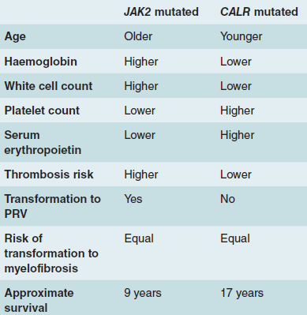
Typical clinical and laboratory features of essential thrombocythaemia associated with JAK2 or CALR mutation

Slide 24
Diagnosis
This used to be based on the exclusion of other causes of chronic thrombocytosis but now that specific genetic lesions have been
identified a positive diagnosis can be made in most cases.

Slide 25
The suggested diagnostic criteria for essential thrombocythaemia
A1 Sustained platelet count above 450 × 109/L.
A2 Presence of an acquired pathogenetic mutation (e.g. in
JAK2 or CALR).
A3 No other myeloid malignancy, PV, primary myelofibrosis,
chronic myeloid leukaemia (CML) or myelodysplastic syndrome.
A4 No reactive cause for thrombocytosis and normal iron
stores.
A5 Bone marrow trephine histology showing increased megakaryocytes
with prominent large hyperlobulated forms;
reticulin is generally not increased.
Diagnosis requires A1–A3 or A1 + A3–A5

Slide 26
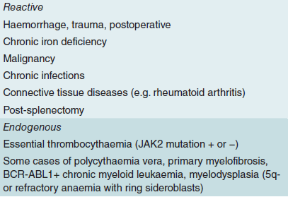
Causes of a raised platelet count

Slide 27
Clinical and laboratory findings
The dominant clinical features are thrombosis and haemorrhage.
Most cases are asymptomatic and diagnosed on a
routine blood count. Thrombosis may occur in the venous
or arterial systems ,whereas haemorrhage, as a
result of abnormal platelet function, may cause either chronic
or acute bleeding. Some patients, particularly those with the
JAK2 mutation, present with Budd–Chiari syndrome when
the platelet count may be normal because of splenomegaly. A
characteristic symptom is erythromelalgia, a burning sensation
felt in the hands or feet and promptly relieved by aspirin. Up
to 40% of patients will have palpable splenomegaly, whereas
in others there may be splenic atrophy because of infarction.

Slide 28
Abnormal large platelets and megakaryocyte fragments
may be seen on the blood film .
The bone marrow
is similar to that in PV but an excess of abnormal megakaryocytes is typical. Cytogenetics and molecular analysis are performed to exclude BCR‐ABL1+ CML.
The condition must be distinguished from other causes of a raised platelet count
Platelet function tests are rarely needed, but are
consistently abnormal, with failure of aggregation with adrenaline
being particularly characteristic

Slide 29
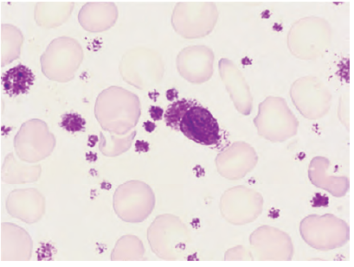
Peripheral blood film in essential thrombocythaemia showing increased numbers of platelets and a nucleated megakaryocytic fragment

Slide 30
Prognosis and treatment
The principle is to reduce the risk of the major clinical problems
of thrombosis or haemorrhage. Standard cardiovascular
risk factors, such as cholesterol, smoking, diabetes, obesity
and hypertension, should be identified and treated. Low‐dose
aspirin at 75 mg/day is generally recommended in all cases.

Slide 31
Patients at high risk include those over 60 years of age, and/
or with previous thrombosis and/or with platelet count over
1500 × 109/L, and this group should be treated with hydroxycarbamide
or anagrelide to reduce the platelet count. Low‐risk
patients are those aged below 40 years and here aspirin alone
is sufficient. Optimum control of the medium‐risk group (age
40–60 years) is uncertain.

Slide 32
Hydroxycarbamide is the most widely used treatment and is
well tolerated, although after prolonged therapy some patients
develop skin keratosis, epitheliomas, ulceration or pigmentation.
Anagrelide is a good second‐line treatment but has cardiovascular
side‐effects, and a possible increased risk of myelofibrosis is also of
concern. These two drugs can be combined at low doses to reduce
side‐effects. α‐Interferon is also effective and is often used in
younger patients or during pregnancy. A long‐acting PEGylated
preparation is preferred. JAK2 inhibitors are also being assessed

Slide 33
Course
Often the disease is stationary for 10–20 years or more.
The disease may transform after a number of years to myelofibrosis but
the risk of transformation to AML is relatively low (less than 5%).

Slide 34
Primary myelofibrosis
The predominant feature of primary myelofibrosis is a progressive
generalized reactive fibrosis of the bone marrow in association
with the development of haemopoiesis in the spleen
and liver (known as myeloid metaplasia). Clinically this leads
to anaemia and massive splenomegaly. In some patients there is osteosclerosis

Slide 35
The fibrosis of the bone marrow is secondary to hyperplasia of abnormal megakaryocytes.
Fibroblasts are stimulated by platelet‐derived growth factor
and other cytokines secreted by megakaryocytes and platelets.
The JAK2, CALR and MPL mutations occur in approximately
55%, 25% and 10% of patients respectively (Fig. 15.2).
One‐third of patients with similar features have a previous
history of PV or ET and some patients present with clinical
and laboratory features of both disorders

Slide 36
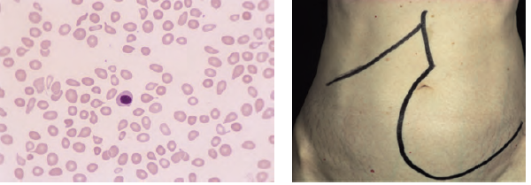
(a) Peripheral blood film in primary myelofibrosis. Leucoerythroblastic change with ‘tear‐drop’ cells and an erythroblast. (b) Massive splenomegaly in a patient with myelofibrosis

Slide 37
Clinical features
1 An insidious onset in older people is usual with symptoms
of anaemia.
2 Symptoms resulting from massive splenomegaly are frequent
and include abdominal discomfort, pain or indigestion.
Splenomegaly is the main physical finding
(Fig. 15.5b).
3 Hypermetabolic symptoms such as loss of weight, anorexia,
fever and night sweats are common.
4 Bleeding problems, bone pain or gout occur in a minority
of patients.

Slide 38
Laboratory findings
1 Anaemia is usual but a normal or increased haemoglobin
level may be found in some patients.
2 The white cell and platelet counts are frequently high at the
time of presentation. Later in the disease leucopenia and
thrombocytopenia are common.
3 A leucoerythroblastic blood film is found. The red cells
show characteristic ‘tear‐drop’ poikilocytes (Fig. 15.10).
4 Bone marrow is usually unobtainable by aspiration. Trephine
biopsy (Fig. 15.7b) shows a fibrotic, hypercellular
marrow. Increased megakaryocytes are frequently seen. In
10% of cases there is increased bone formation with increased
bone density on X‐ray.
5 JAK2 is mutated in approximately 55% of cases and CALR
mutations occur in 25%. The CALR‐mutated patients have
lower white cell and higher platelet counts and longer survival

Slide 39
6 High serum urate and LDH levels reflect increased, although ineffective, haemopoiesis.
7 Transformation to AML occurs in 10–20% of patients.

Slide 40
Treatment
This is aimed at reducing the effects of anaemia and splenomegaly.
Useful prognostic information may be obtained by
analysis of the IPSS score
Blood transfusions and regular folic acid therapy are useful in severely anaemic patients.
Ruxolitinib is an oral JAK2 inhibitor that can reducespleen size, improve constitutional symptoms and quality of life and increase survival. Hydroxycarbamide may also reduce splenomegaly and hypermetabolic symptoms

Slide 41
Splenectomy is considered for patients with severe symptomatic splenomegaly: mechanical discomfort, thrombocytopenia, portal hypertension, excessive transfusion requirements.
Allopurinol may be indicated to prevent gout and urate nephropathy from hyperuricaemia. Allogeneic stem cell transplantation may be curative for young patients.
The median survival is around 5 years and causes of death include heart failure, infection and leukaemic transformation

Slide 42
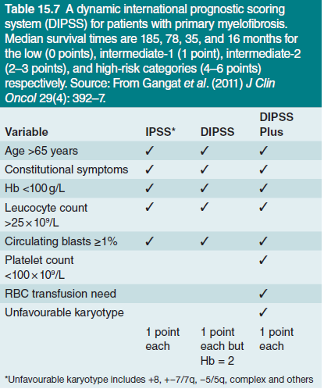

Slide 43
Mastocytosis
Mastocytosis is a clonal neoplastic proliferation of mast cells
that accumulate in one or more organ systems. Mast cells are
similar to basophils and survive for months or years in vascular
tissues and most organs. Systemic mastocytosis is a clonal
myeloproliferative disorder involving usually the bone marrow,
heart, spleen, lymph nodes and skin.
The somatic KIT mutation Asp816Val is detected in the
majority of patients and may be partly responsible for autonomous
growth and enhanced survival of the neoplastic mast
cells.

Slide 44
Symptoms are related to histamine and prostaglandin
release and include flushing, pruritus, abdominal pain and
bronchospasm.
The skin usually shows urticaria pigmentosa. Serum tryptase is increased and can be used to
monitor treatment.
Antihistamine drugs are valuable and interferon,
chlorodeoxyadenosine and tyrosine kinase inhibitors can
be helpful.
In many patients the disease runs a chronic indolent
course.
In others an aggressive course may be associated with
AML, mast cell leukaemia or other haemopoietic conditions

