Slide 1
Anemia 3ed year
Ass. Prof. Abeer Anwer Ahmed

Slide 2
Objectives
Explain background, definition and etiology of hypochromic anemias
Outline diagnostic algorithm of hypochromic anemias
Identify key laboratory findings to diagnose hypochromic anemias

Slide 3
Anemia
This is defined as a reduction in the haemoglobin concentration of the blood below normal for age and sex.
typical values would be :
-less than 135 g/L in adult males and
-less than 115 g/L in adult females .
-From the age of 2 years to puberty, less than 110 g/L
-newborn infants have a high haemoglobin level, 140 g/L is
taken as the lower limit at birth

Slide 4
Clinical features of anaemia
The presence or absence of clinical features can be considered under four major headings:
1. Speed of onset Rapidly progressive anaemia causes more
Symptoms
2. Severity Mild anaemia often produces no symptoms or
Signs
3. Age The elderly tolerate anaemia less well than the young
because normal cardiovascular compensation is impaired.
4. Haemoglobin O2dissociation curve :rise in 2,3‐DPG in the red cells and a shift in the O2 dissociation curve to the right so that oxygen is give up more readily to tissues.

Slide 5
Symptoms
shortness of breath, particularly on exertion, weakness, lethargy, palpitation and headaches.
In older subjects, symptoms of cardiac failure,
angina pectoris or intermittent claudication or confusion may be present.
Visual disturbances because of retinal haemorrhages
may complicate very severe anaemia, particularly of rapid onset

Slide 6
Signs
These may be divided into:
general and specific.
General signs
include pallor of mucous membranes or nail beds, which occurs if the haemoglobin level is less than 90 g/L
A hyperdynamic circulation may be present with tachycardia, a bounding pulse, cardiomegaly and
a systolic flow murmur especially at the apex. Particularly in the elderly, features of congestive heart failure may be present

Slide 7
Specific signs
are associated with particular types of anaemia, e.g.
koilonychia (spoon nails) with iron deficiency
jaundice with haemolytic or megaloblastic anaemias.
leg ulcers with sickle cell and other haemolytic anaemias.
bone deformities with thalassaemia major.
The association of features of anaemia with excess infections
or spontaneous bruising suggest that neutropenia or
thrombocytopenia may be present, possibly as a result of bone
marrow failure.

Slide 8
Pallor of the conjunctival mucosa in patient with severe anaemia

Slide 9
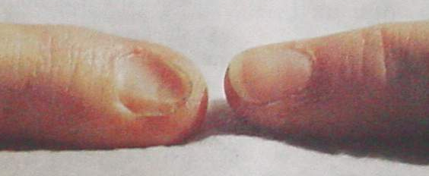
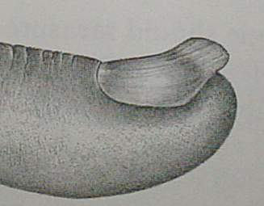
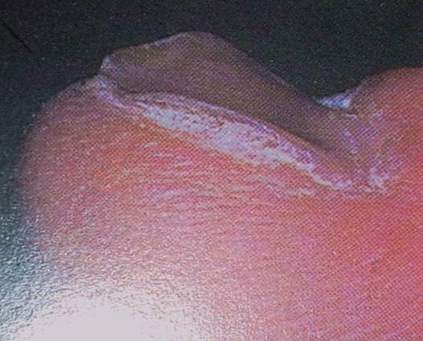
Koilonychia - spoon shaped nail

Slide 10
Classification and laboratory findings in anaemia
The most useful classification is that based on red cell indices(MCH, mean corpuscular haemoglobin; MCV, mean corpuscular volume.)
and divides the anaemia into:
- microcytic
-normocytic
-and macrocytic

Slide 11
Morphological Classification
Anemia
Macrocytic
Normocytic
Microcytic
Megaloblastic
Non-megaloblastic
IDA
Genetic
Anomaly
Vitamin B12 deficiency
Folic acid deficiency
Hepatic disease
Drug-induced anemia
Hypothyroidism
Reticulocytosis
Recent blood loss
Hemolysis
Bone marrow failure
Anemia of chronic disease
Sickle cell
Thalassemia
Notes:
- Anemia can be classified on the basis of the morphology of the RBCs, etiology, or pathophysiology
- This scheme of classification is based on the size of RBC which is measured by Mean cell volume (MCV). As per MCV, cells are considered macrocytic if they are larger than normal, microcytic if hey are smaller than normal, and normocytic if their size falls within normal limits

Slide 13
Iron deficiency anemia
Clinical features
When iron deficiency is developing, the reticuloendothelial stores (haemosiderin and ferritin) become completely depleted before anaemia occurs (
the patient may show the general symptoms and signs of anaemia
and also :
a painless glossitis,
angular stomatitis,
brittle, ridged or spoon nails (koilonychia)
and unusual dietary cravings (pica).
In children, iron deficiency is particularly significant as it can cause irritability, poor cognitive function and a decline in psychomotor development.

Slide 14
Causes of iron deficiency
Chronic blood loss
Uterine
Gastrointestinal, e.g. peptic ulcer, oesophageal varices,
aspirin (or other non‐steroidal anti‐inflammatory drugs)
ingestion, gastrectomy, carcinoma of the stomach, caecum,
colon or rectum, hookworm, schistosomiasis, angiodysplasia,
inflammatory bowel disease, piles, diverticulosis
Rarely, haematuria, haemoglobinuria, pulmonary
haemosiderosis, self‐inflicted blood loss
Increased demands
Prematurity
Growth
Pregnancy
Erythropoietin therapy
Malabsorption
Gluten‐induced enteropathy, gastrectomy, autoimmune
gastritis
Poor diet
A major factor in many developing countries but rarely the
sole cause in developed countries

Slide 15
Laboratory diagnosis of IDA

Slide 16
Blood film of IDA: Hypochromic microcytic RBCs with occational target cells and pencil shape poikelocyte

Slide 18
Anaemia of chronic disorders
One of the most common anaemias occurs in patients with
a variety of chronic inflammatory and malignant diseases
The characteristic features are:
1 Normochromic, normocytic or mildly hypochromic (MCV
rarely <75 fL) indices and red cell morphology.
2 Mild and non‐progressive anaemia (haemoglobin rarely
<90 g/L) – the severity being related to the severity of the
disease.
3 Both the serum iron and TIBC are reduced.
4 The serum ferritin is normal or raised.
5 Bone marrow storage (reticuloendothelial) iron is normal
but erythroblast iron is reduced

Slide 19
Causes of the anaemia of chronic disorders
Chronic inflammatory diseases
Infections (e.g. pulmonary abscess, tuberculosis,
osteomyelitis, pneumonia, bacterial endocarditis)
Non‐infectious (e.g. rheumatoid arthritis, systemic lupus
erythematosus and other connective tissue diseases,
sarcoidosis, inflammatory bowel disease, liver disease)
Malignant diseases
Carcinoma, lymphoma, sarcoma

Slide 20
The pathogenesis of ACD
appears to be related to:
-decreased release of iron from macrophages to plasma because of raised serum hepcidin levels.
- reduced red cell lifespan .
-an inadequate erythropoietin response to anaemia caused by the effects of cytokines such as IL‐1 and tumour necrosis factor (TNF) on erythropoiesis

Slide 21
Laboratory diagnosis of IDA Vs ACD

Slide 22
Sideroblastic anaemia
This is a refractory anaemia defined by the presence of
many pathological ring sideroblasts in the bone marrow
ring sideroblasts: are abnormal erythroblasts containing
numerous iron granules arranged in a ring or collar around
the nucleus instead of the few randomly distributed iron
granules
There is also usually erythroid hyperplasia with ineffective
erythropoiesis.
Sideroblastic anaemia is diagnosed when 15% or more of marrow erythroblasts are ring sideroblasts.

Slide 23
Ring sideroblasts with a perinuclear ring of iron granules in sideroblastic anaemia.

Slide 24
Classification of sideroblastic anaemia
Hereditary
X chromosome linked ALA‐S mutation or rarely with spinocerebellar degeneration and ataxia
Usually occurs in males, transmitted by females; also occurs rarely in females
Other rare types
Acquired
Primary
Myelodysplasia (refractory anaemia with ring sideroblasts)
ALA‐S, δ‐aminolaevulinic acid synthase.

Slide 25
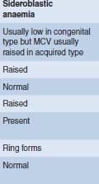
Lab. diagnosis in sidroblastic anemia

