Slide 1
Megaloblastic anaemias and other macrocytic anaemias
Ass.Prof. Abeer Anwer Ahmed

Slide 2
Introduction to macrocytic anaemia
In macrocytic anaemia the red cells are abnormally large (mean corpuscular volume, MCV >98 fL).
There are several causes but they can be broadly subdivided into:
megaloblastic
and non‐megaloblastic
based on the appearance of developing erythroblasts in the bone marrow.

Slide 3
Megaloblastic anaemias
This is a group of anaemias in which the erythroblasts in the bone marrow show a characteristic abnormality .
Maturation of the nucleus being delayed relative to that of the cytoplasm.
The underlying defect accounting for the asynchronous maturation of the nucleus is defective DNA synthesis .

Slide 4
Causes of megaloblastic anaemia
-Vitamin B12 deficiency
-Folate deficiency
-Abnormalities of vitamin B12 or folate metabolism (e.g.
transcobalamin deficiency, nitrous oxide, antifolate drugs)
-Other defects of DNA synthesis
Congenital enzyme deficiencies (e.g. orotic aciduria)
Acquired enzyme deficiencies (e.g. alcohol, therapy with
hydroxyurea, cytosine arabinoside)

Slide 5
Vitamin B12 and folate: nutritional aspects.

Slide 7
Causes of B12 deficiency

Slide 8
Causes of Folate deficiency

Slide 9
Effects of vitamin B12 or folate deficiency

Slide 10
A baby with neural tube defect (spina bifida).

Slide 11
Clinical features of megaloblastic anaemia
The onset is usually insidious with gradually progressive symptoms and signs of anaemia .
The patient may be mildly jaundiced (lemon yellow) because of the excess breakdown of haemoglobin resulting from increased ineffective erythropoiesis in the bone marrow.
Glossitis (a beefy‐red sore tongue)
angular cheilosis
and mild symptoms of malabsorption with loss of weight may be present because of the epithelial abnormality. Purpura as a result of thrombocytopenia and widespread melanin pigmentation (the cause of which is unclear) are less frequent presenting features
Many asymptomatic patients are diagnosed when a blood count that has been performed for another reason reveals macrocytosis.

Slide 12
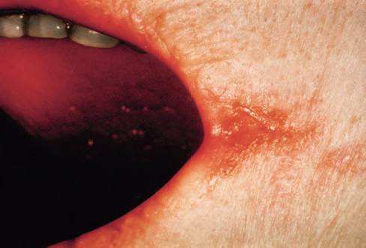
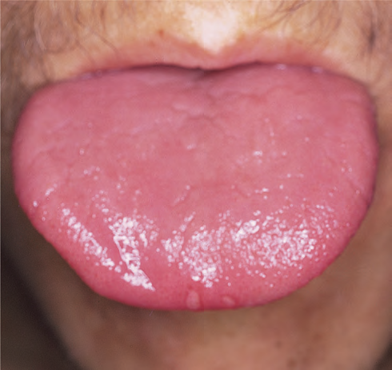

Slide 13
Cross‐section of the spinal cord in a patient who died with subacute combined degeneration of the cord (Weigert–Pal stain). There is demyelination of the dorsal and dorsolateral columns.

Slide 14
Laboratory findings
-The anaemia is macrocytic (MCV >98 fL and often as high as
120–140 fL in severe cases) and the macrocytes are typically oval .
If iron deficiency is also present the MCV maybe normal.
-The reticulocyte count is low .
-the total white cell and platelet counts may be moderately reduced, especially in severely anaemic patients.
-A proportion of the neutrophils show hypersegmented nuclei (with six or more lobes).
- The bone marrow is usually hypercellular and the erythroblasts are large and show an open, fine, lacy primitive chromatin pattern but normal cytoplasmic haemoglobinization .
Giant and abnormally shaped metamyelocytes are characteristic.
-The serum unconjugated bilirubin and lactate dehydrogenase
are raised as a result of marrow cell breakdown.

Slide 15
Megaloblastic anaemia: peripheral blood film showing oval macrocytes

Slide 16
Megaloblastic changes in the bone marrow in a patient with severe megaloblastic anaemia. (a–c) Erythroblasts showing fine, open stippled (primitive) appearance of the nuclear chromatin even in late cells (pale cytoplasm with some haemoglobin formation). (d) Abnormal giant metamyelocytes and band forms.

Slide 17
Tests for cause of vitamin B12 or folate deficiency.

Slide 18
Treatment of megaloblastic anemia

Slide 19
Pernicious anaemia (PA)
This is caused by autoimmune attack on the gastric mucosa leading to atrophy of the stomach.
The wall of the stomach becomes :
-Thin
-with a plasma cell and lymphoid infiltrate of the lamina propria.
-Intestinal metaplasia may occur.
-There is achlorhydria and secretion of IF is absent or
almost absent.
-Serum gastrin levels are raised.
-Helicobaterpylori infection may initiate an autoimmune gastritis which presents in younger subjects as iron deficiency and in the elderly as PA.

Slide 20
Antibodies
Ninety per cent of patients show parietal cell antibody in the serum directed against gastric
H+/K+‐ATPase.
The more common parietal cell antibody is less specific as it occurs quite commonly in older subjects
PA is distinguished from simple atrophic or autoimmune gastritis by the presence of antibodies to IF.

Slide 21
Fifty per cent of PA patients show in serum an antibody to IF which inhibits IF binding to B12.
IF antibodies also occur in PA in gastric juice.
IF antibodies are virtually specific for PA but as they occur in the serum of only half of patients, their absence from serum
does not exclude the diagnosis.

Slide 22
second antibody blocking IF attachment to its ileal binding site is less frequent.

Slide 23
Pernicious anaemia: associations.
Female Vitiligo
Blue eyes Myxoedema
Early greying Hashimoto’s disease
Northern European Thyrotoxicosis
Familial Addison’s disease
Blood group A Hypoparathyroidism
Hypogammaglobulinaemia
Carcinoma of the stomach

Slide 24
Other macrocytic anemia
There are many non‐megaloblastic causes of macrocytic anaemia .
The exact mechanisms creating large red cells in each of these conditions is not clear although
-Increased lipid deposition on the red cell membrane
- alterations of erythroblast maturation time in the marrow.

Slide 25
Causes of macrocytosis other than megaloblastic anaemia.

