Slide 1
CYTOPATHOLOGY
DR. RAGHAD HANOON

Slide 2
Principles in cytopathology
CYTOPATHOLOGY:
Is the study of the normal and diseased altered cells obtained from various sites of the body (i.e., through the detection of abnormal morphologic characteristics of the examined cells).

Slide 3
TYPES OF CYTOPATHOLOGY:
1. Exfoliative cytopathology:
Spontaneously shed cells in the body fluids e.g. serous effusion, urine & CSF and sputum cytopathology.
2. Abrasive cytopathology:
Dislodges cells from body surfaces e.g. Pap smear (cervical smear), bronchial washing & brushing.
3. Fine Needle Aspiration (FNA):
e.g. FNA of breast, FNA of thyroid, lymph node.

Slide 4
Stains used in cytopathology:
1. Papnicolaou stain:
Mainly used in Exfoliative cytopathology.
Good & better demonstration of nuclear details.
2. Hematoxyline & Eosin (H& E):
Mainly used in FNA.
3. Leishman & Giemsa stains:
Mainly in FNA.

Slide 5
Characteristics of ideal stain in cytopathology:
Evaluation of architectural pattern of tissue fragments.
Proper evaluation of nuclear morphology (most important characteristic).
Proper evaluation of cytoplasmic morphology.
Evaluation of background (blood, secretions, mucin…….)

Slide 6
Fixatives used in Cytopathology:
95% ethyl alcohol (for Pap smear & FNA).
Spray fixatives (does not result in lysis of RBC & better reserved of nuclear details).
Carnoy’s fixative (lysis of RBC).
Other (Formaline, Glutarldehyde).

Slide 7
Staining methods in Cytopathology:
1.Air – dried Giemsa staining:
Air drying follows by staining with Giemsa.
Well demonstrated cytoplasmic details.
Exaggerated cells & nuclear size.
Poorly seen individual cells.
2. Wet –fixed Pap staining:
Alcohol fixation follows by staining with Pap or H & E.
Excellent demonstration of nuclear details.
Normal size of cell & nucleus.
Clearly seen individual cells.

Slide 8
Cytopathology can be further subdivided into:
Gynecological Cytopathology, include cervicovaginal cytopathology………..etc.
Non gynecological Cytopathology include cytopathology of all other organs.
Fine Needle Aspiration (FNA): include FNA of breast, FNA of thyroid…….etc.

Slide 9
Gynecological cytopathology:
Two types of epithelial cells are present in female genital organs
Columnar epithelium: lined uterus, fallopian tubes & endocervix.
Squamous epithelium: lined ectocervix & vagina.
Squamous Metaplasia of endocervical epithelium (columnar) into Squamous epithelium is usual process occurring in all women, as a result of hormonal effects. (Changes more in cytoplasm of cells more than nuclei).
For reporting of cervico- vaginal cytology, Bethesda system (2014) is currently used.

Slide 10
characteristics | Normal Squamous cells | Metaplatic Squamous cells | Malignant Squamous cells
Cell arrangement | Exfoliated singly | Cohesive sheets or groups | Singly or dyscohesive sheets. Variable size & shape of cells.
Cytoplasmic characteristics | Abundant cytoplasm Well defined cell borders | Either pale to dense cytoplasm. Cytoplasmic processes. Poor defined cell borders. | Scant cytoplasm
Nuclear characteristics | Centrally located nucleus. Absent nucleoli. Low N/C ratio. | Larger nuclei than normal. With or without nucleoli. | Variable size & shape. High N/c ratio. Prominent nucleoli.

Slide 11
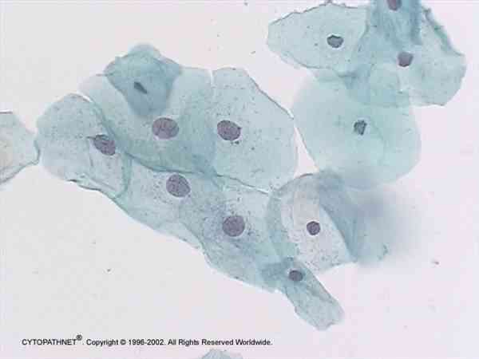
Normal squamous cells

Slide 12
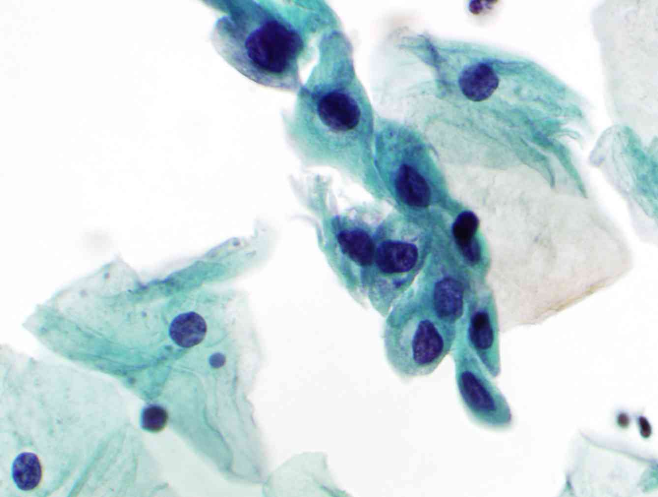
Squamous metaplastic cells

Slide 13
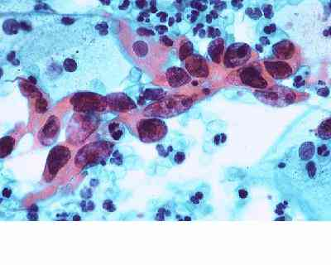
Squamous cell carcinoma

Slide 14
Non-Gynecological cytopathology
Non-Gynecological cytopathology:
Include cytological examination of all other organs (e.g. respiratory system cytopathology, urine cytopathology……….)
1. Serous effusions cytology:
Accumulation of fluid in serous cavities (pleura, peritoneum…) is abnormal & can results from many causes (inflammation, cancers….).
Cytological examination of serous effusions is performed mainly for establish the presence or absence of malignancy (either primary mesothelioma or metastatic carcinoma to these sites).
Metastatic carcinomas to the serous surfaces are from lung, breast, colon, stomach & ovary.
Better to differentiate between mesothelioma & metastatic carcinoma by using special stains & immunohistochemistry.

Slide 15
Characteristic | reactive mesothelial cells | Malignant mesothelioma | Adenocarcinomas (metastatic)
Fluid characteristics | Clear, turbid | Always hemorrhagic | Hemorrhagic
Cells arrangement | Singly mainly, less as tissue fragments. Ill-defined cell borders. | Small to large complex sheets of cells. Well defined cell borders. | Acinar (gland like formation). Well defined cell borders.
Cytoplasmic characteristics | Moderate to abundant cytoplasm. | Scant to moderate amount. | Scant to moderate amount. Presence of cytoplasmic vacuoles & signet ring cells.
Nuclear characteristics | Variable in number & shape. Normal N/C ratio Multiple micronucleoli. | Same Increase N/C ratio | Single, macronucleoli, coarse chromatin. Increase N/C ratio

Slide 16
Reactive mesothelial cells

Slide 17
Malignant mesothelial cells

Slide 18
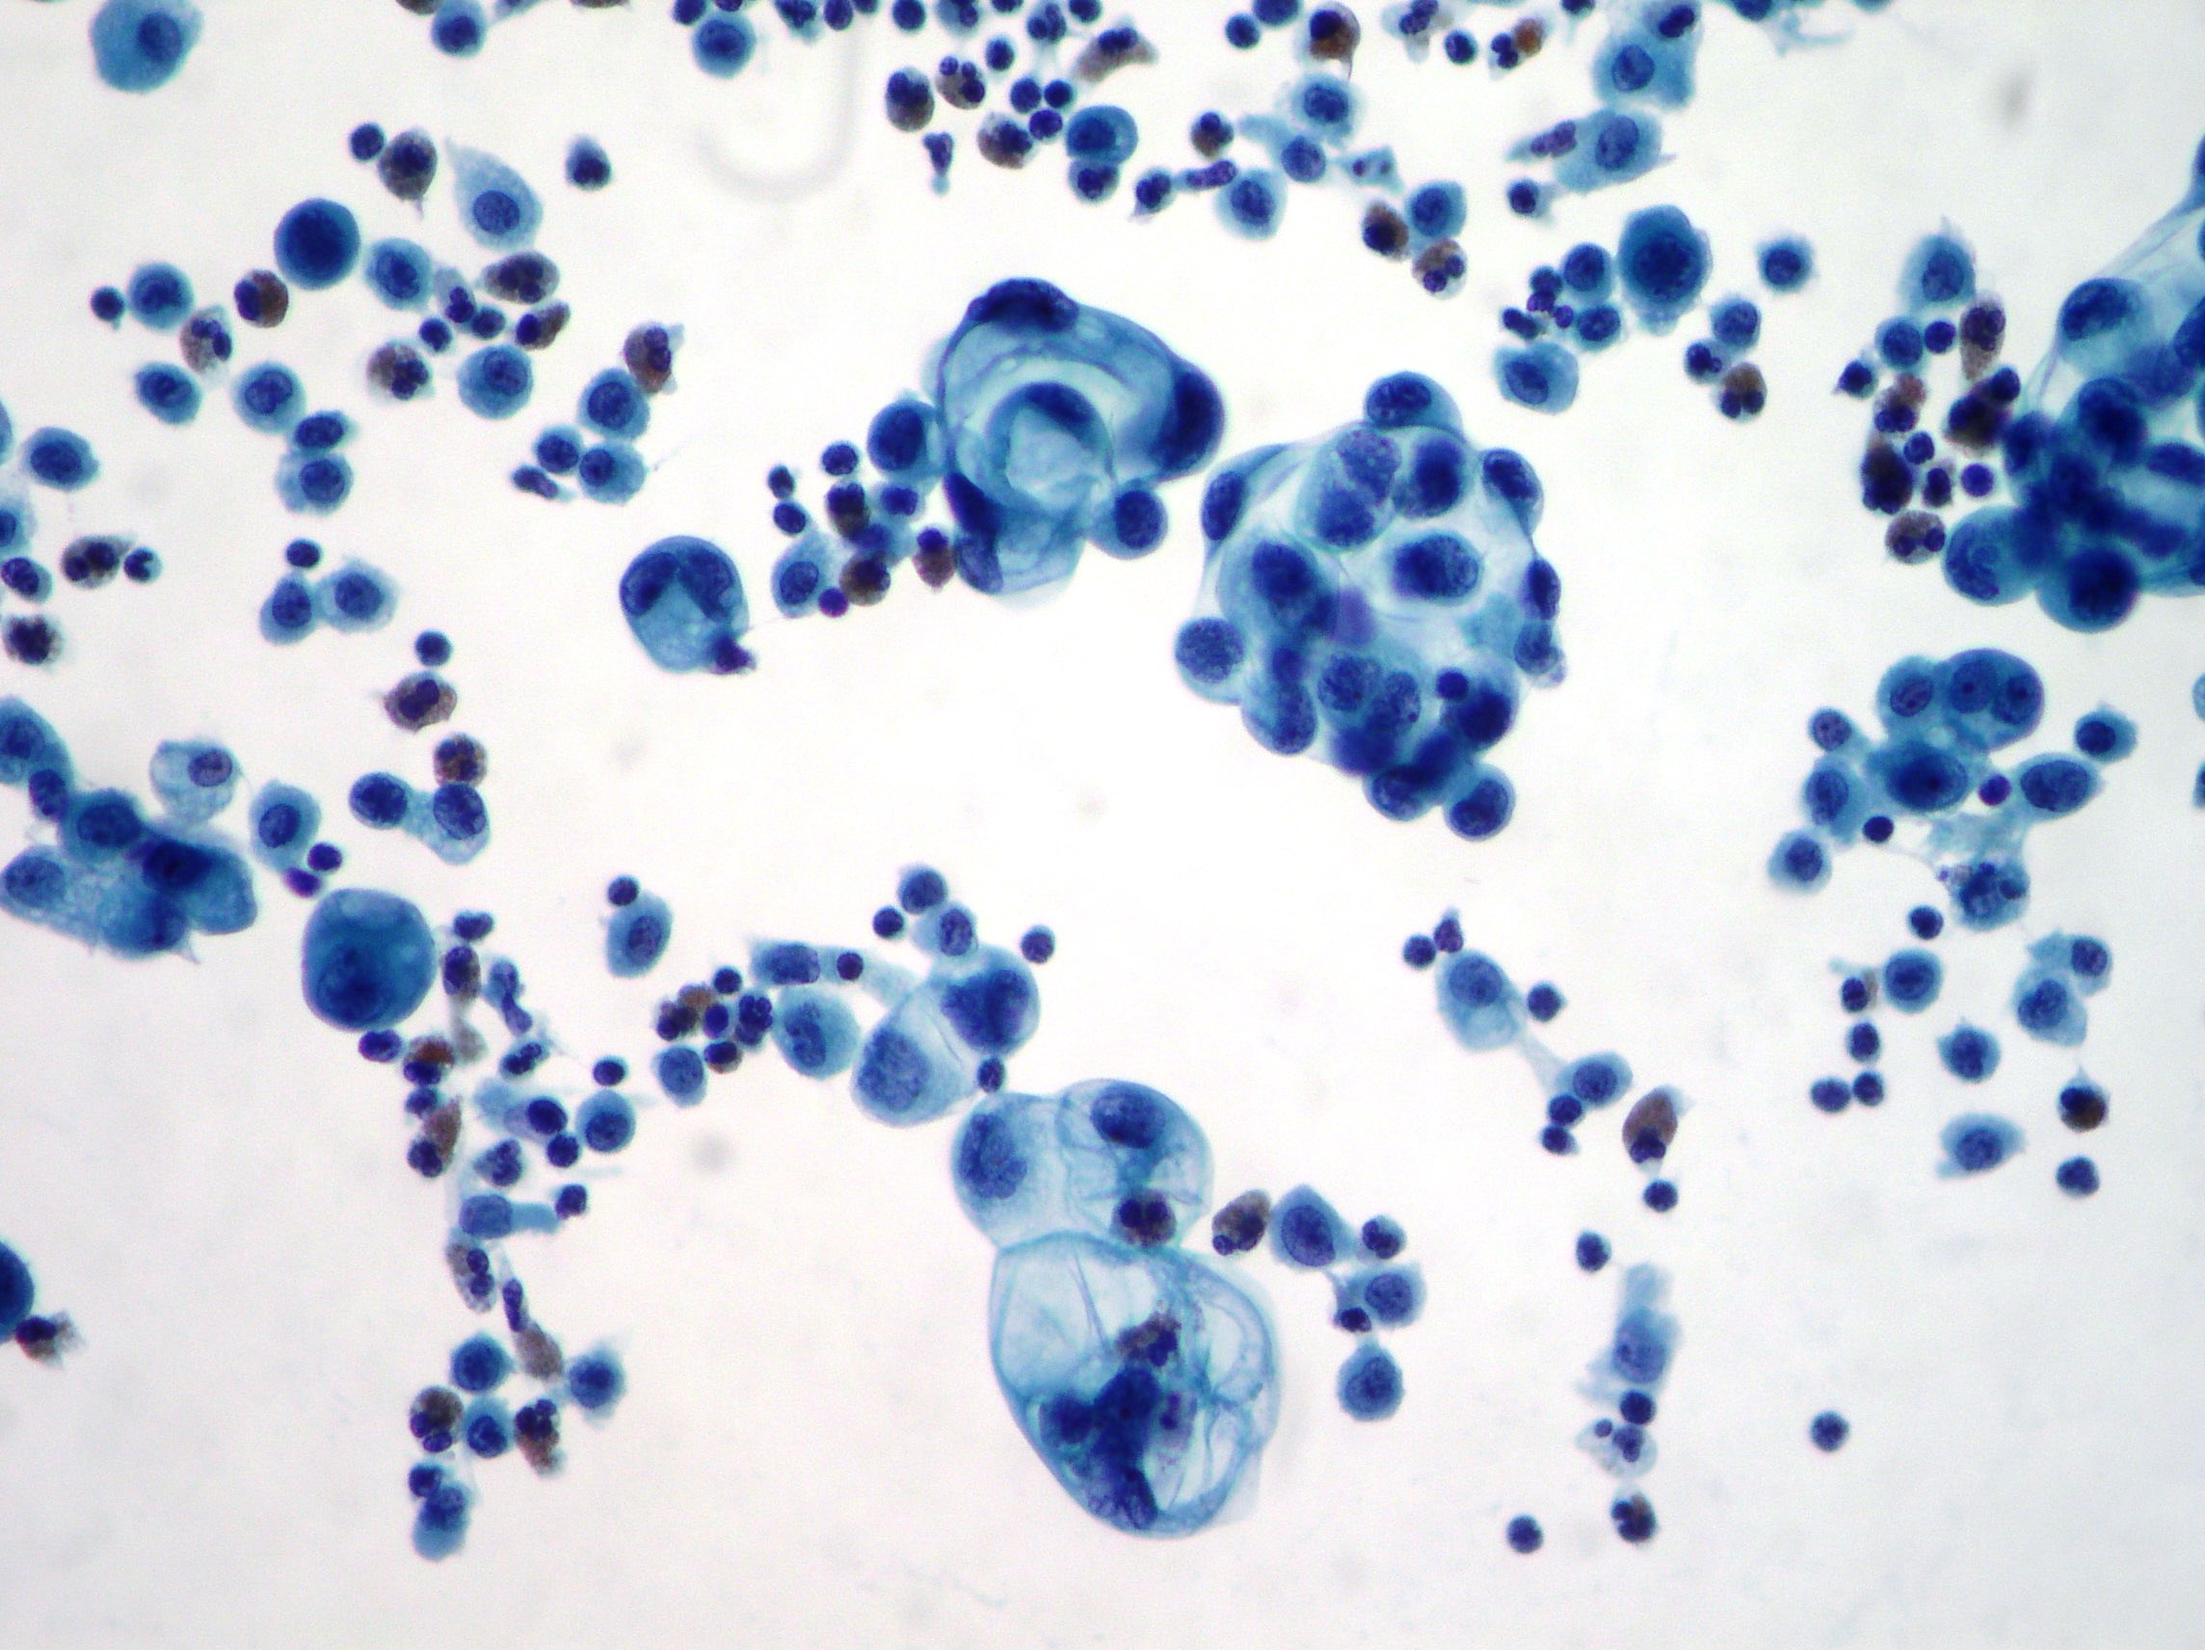
Metastatic malignant cells

Slide 19
2. Sputum Cytology:
Offers highly diagnostic values for diagnosis of centrally located lung cancer (Squamous, small cell cancers of lung).
Three to five consecutive daily sputum examinations is advisable to increase the rate of detection of cancers.
Sputum may spontaneously coughed or induced.
Sputum sample is fixed with Saccomanno fixative (2% polyethylene glycol With 50% ethyl alcohol).
Sputum sample is considered satisfactory when it contains alveolar macrophages.

Slide 20
Alveolar macrophages

Slide 21
FNA of Breast:
FNA is by far the most popular , simple, cost effective, reliable & diagnostic procedure in cytological diagnosis of breast lesions.
FNA is important part in triple screening for early detection of breast carcinoma (physical examination, mammography & FNA).

Slide 22
Characteristics | Benign pattern | Malignant pattern
Cellularity | Almost low cellularity | High cellularity
Cells arrangements | Sheets of uniform ductal cells (cohesive) | Single, variable size malignant cells. (poorly cohesive)
Single bare nuclei | FREQUENT | ABSENT
Nuclear characteristics | Uniform size | Enlarged, atypical nuclei.

Slide 23
Fibroadenoma of breast

Slide 24
Malignant cells of breast aspirate

Slide 25
Thank you

