Slide 1
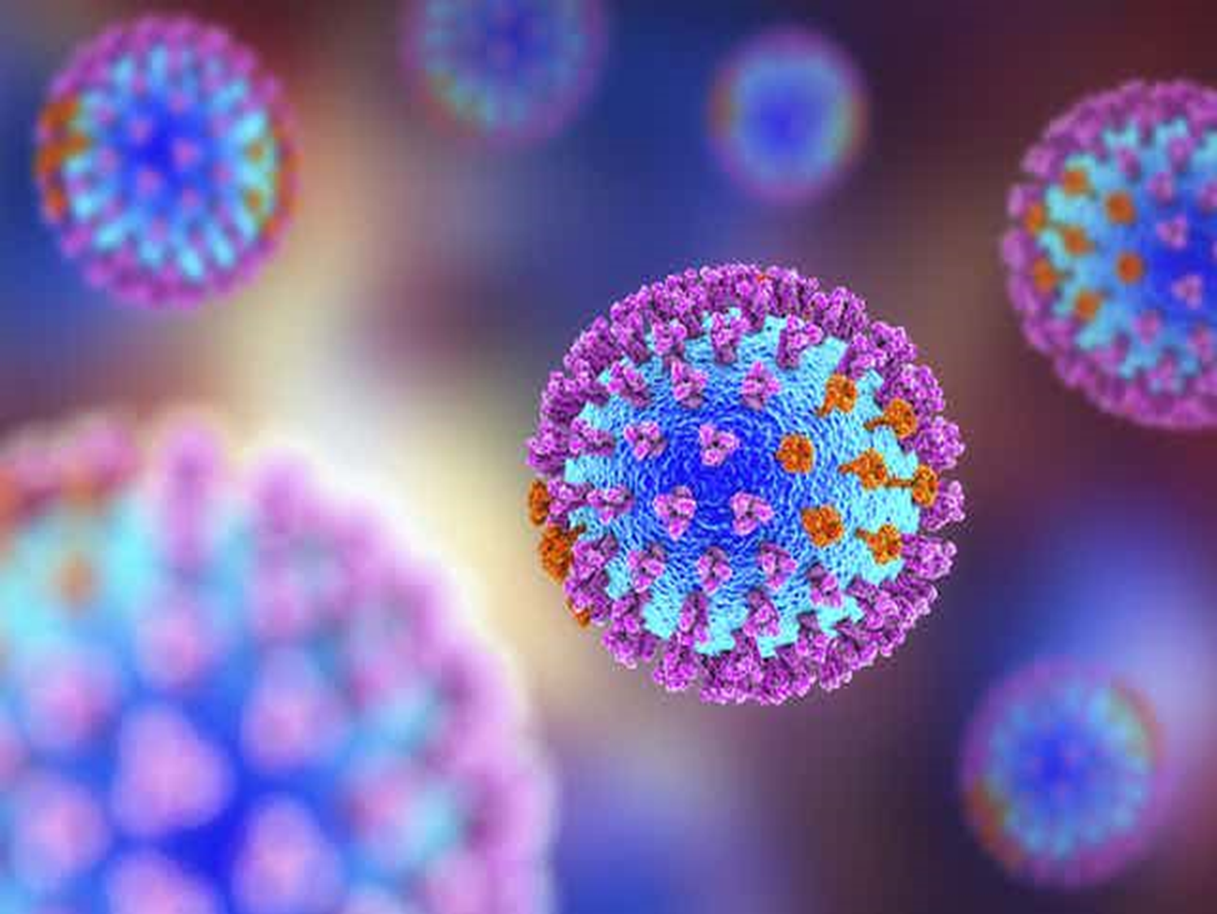
Viral Vaccines
Dr. Luma Amer

Slide 2
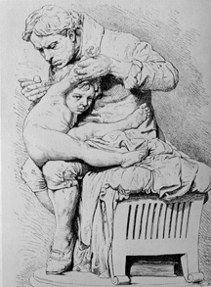
Virus Vaccines
First vaccine developed by Jenner in late 1700's against
smallpox virus

Slide 3
Vaccines
1796 Jenner: wild type animal-adapted virus
1800’s Pasteur: Attenuated virus
1996 DNA vaccines

Slide 4
Because few drugs are useful against viral infections, prevention of infection by the use of vaccines is very important.
Prevention of viral diseases can be achieved by the use of vaccines that induce active immunity or by the administration of preformed antibody that provides passive immunity.

Slide 5
Type of vaccine

Slide 6
Active Immunity
There are two types of vaccines that induce active immunity: those that contain:
Livevirus whose pathogenicity has been attenuated an
killed virus Some vaccines, such as the hepatitis B vaccine, contain purified viral proteins and are often called subunit vaccines. The features of subunit vaccines resemble those of killed vaccines because no viral replication occurs in these vaccines.

Slide 7
New Methods
Recombinant DNA
Single gene (subunit)
Hepatitis B vaccine
raised in yeast
S-antigen mRNA
cDNA
Express plasmid
S-antigen mRNA
protein

Slide 8
Killed vaccines (Inactivated, non-replicating (pathogens:
• Requires propagation of the pathogen.
Method of production - exposure to denaturing agent, heat, phenol , formalin, B-propriolactone
- results in loss of infectivity without loss of antigenicity.

Slide 9
In general, live vaccines are preferred to vaccines containing killed virus because their protection is greater and longer-lasting. With live vaccines, the virus multiplies in the host, producing a prolonged antigenic stimulus, and both IgA and IgG are elicited when the vaccine is administered by the natural route of infection, e.g., when polio vaccine is given orally.
Killed vaccines, which are usually given intramuscularly, do not stimulate a major IgA response. Killed vaccines typically do not stimulate a cytotoxic T-cell response, because the virus in the vaccine does not replicate. In the absence of replication, no viral epitopes are presented in association with class I MHC(Major histocompatibility complex) proteins and the cytotoxic T-cell response is not activated. Although live vaccines stimulate a long-lasting response, booster doses are now recommended with measles and polio vaccines.

Slide 10
There are three concerns about the use of live vaccines:
They are composed of attenuated viral mutants, which can revert to virulence either during vaccine production or in the immunized person. Of the commonly used live vaccines, only polio vaccine has had problems regarding revertants; measles, mumps, rubella, and varicella vaccines have not.
Even if the virus in the live vaccine does not revert, it can still cause disease because, although attenuated (weakened), it can still be pathogenic in a host with reduced immunity.

Slide 11
2-The live vaccine can be excreted by the immunized person.
It is advantageous if the spread of the virus successfully immunizes others, as occurs with the live polio vaccine. However, it could be a problem if, e.g., a virulent poliovirus revertant spreads to a susceptible person. Rare cases of paralytic polio occur each year by this route of infection.

Slide 12
3-A second virus could contaminate the vaccine if it was present in the cell cultures used to prepare the vaccine. This concern exists for both live and killed vaccines.

Slide 13
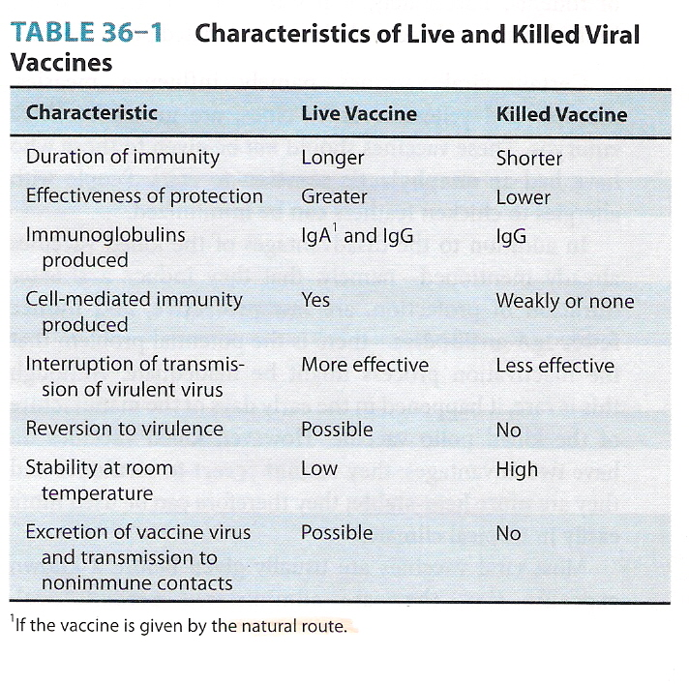

Slide 14
Certain viral vaccines, namely, influenza, measles, mumps, and yellow fever vaccines, are grown in chick embryos.
These vaccines should not be given to those who have had an anaphylactic reaction to eggs. People with allergies to chicken feathers can be immunized.

Slide 15
In addition to the disadvantages of the killed vaccines already mentioned—namely, that they induce a shorter duration of protection, are less protective, and induce fewer IgA antibodies—there is the potential problem that the inactivation process might be inadequate.

Slide 16
Most viral vaccines are usually given before a known exposure; i.e., they are administered preexposure. However, there are two vaccines, the vaccines against rabies and hepatitis B, that are also effective when given postexposure because the incubation period of these diseases is long enough that the vaccine-induced immunity can prevent the disease. Thus, the rabies vaccine is most often used in people after they have received a bite from a potentially rabid animal and the hepatitis B vaccine is used in people who have sustained a needle-stick injury

Slide 17
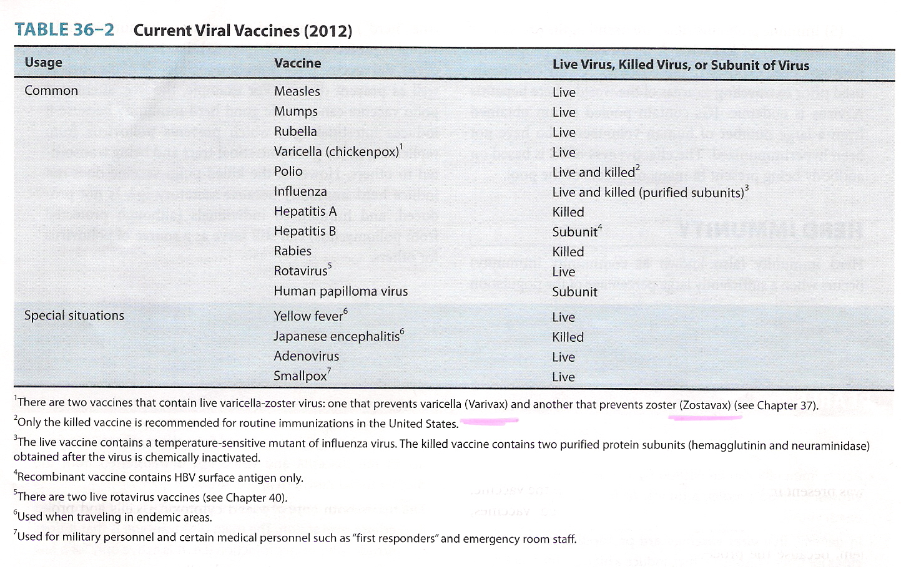

Slide 18
The prospect for the future is that some of the disadvantages of current vaccines will be bypassed by the use of purified viral antigens produced from genes cloned in either bacteria or yeasts.
The advantages of antigens produced by the cloning process are that they contain no viral nucleic acid and so cannot replicate or revert to virulence; they have no contaminating viruses from cell culture; and they can be produced in large amounts.
A disadvantage of these cloned vaccines is that they are unlikely to stimulate a cytotoxic T-cell response because no viral replication occurs

Slide 19
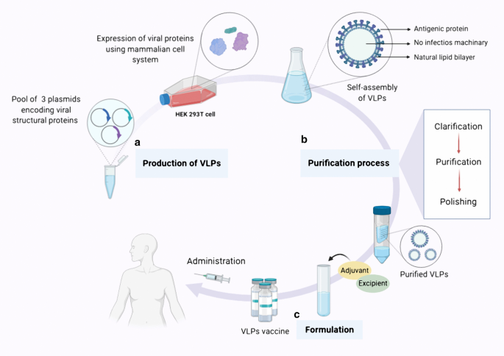

Slide 20
Another prospect for the future is the use of "DNA vaccines." These vaccines contain purified DNA encoding the appropriate viral proteins genetically engineered into a viral vector or plasmid.
Immunization with this composite DNA elicits both antibody and cytotoxic T cells and protects against disease in experimental animals.

Slide 21
Passive Immunity
Passive immunity is provided by the administration of preformed antibody in preparations called immune globulins.
Passive–active immunity is induced by giving both immune globulins to provide immediate protection and a vaccine to provide long-term protection.

Slide 22
Example:
Rabies immune globulin (RIG) is used in the prevention of rabies in people who may have been exposed to the virus. It is administered by injecting as much RIG as possible into the tissue at the bite site and the remainder is given intramuscularly.
Varicella-zoster immune globulin (VZIG) is used in the prevention of disseminated zoster in people who may have been exposed to the virus and who are immunocompromised.

Slide 23
Hepatitis B immune globulin (HBIG) is used in the prevention of hepatitis B in people who may have been exposed to the virus either by needle-stick or as a neonate born of a mother who is a carrier of HBV.
The preparation contains a high titer of antibody to hepatitis B virus and is obtained from humans to avoid hypersensitivity reactions. HBIG is often used in conjunction with hepatitis B vaccine, an example of passive–active immunization.

Slide 24
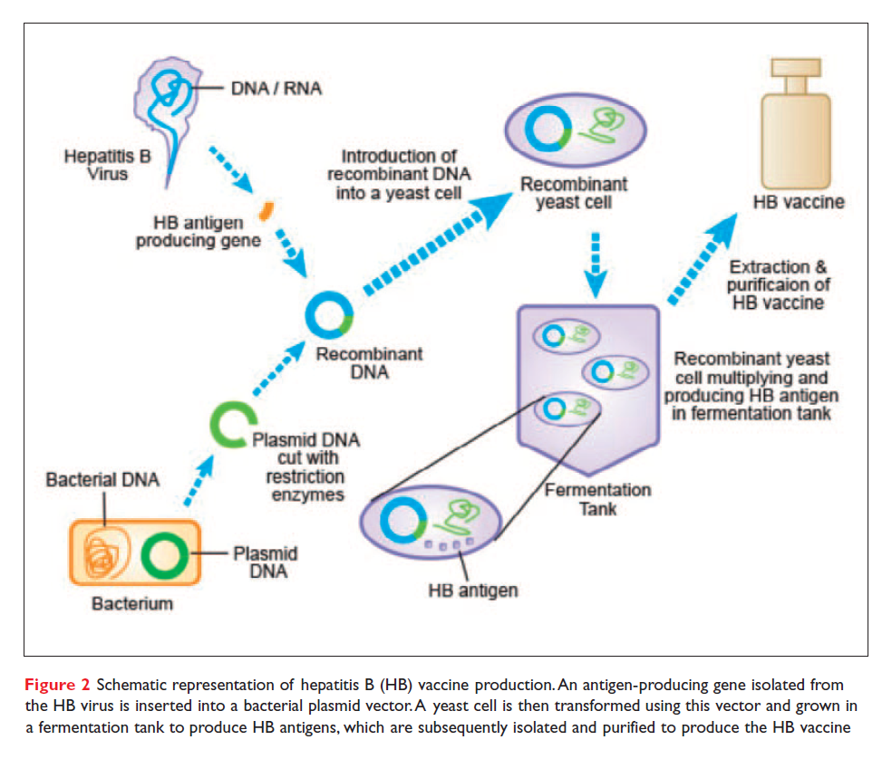

Slide 25
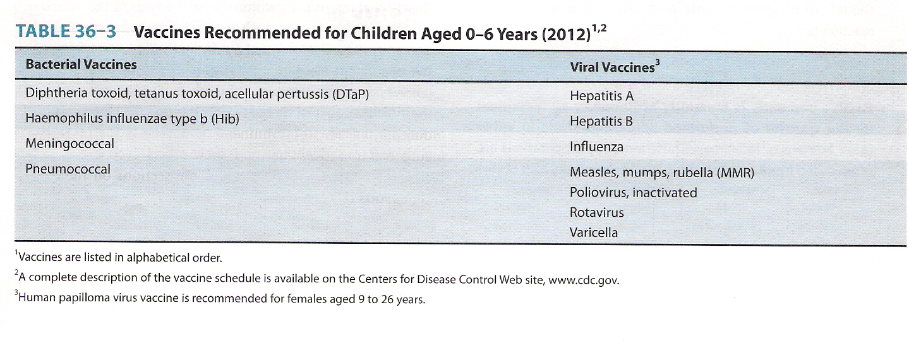

Slide 26
Herd Immunity
Herd immunity (also known as community immunity) occurs when a sufficiently large percentage of the population (the "herd") is immunized so that an unimmunized individual is protected . For herd immunity to occur, the vaccine must prevent transmission of the virus as well as prevent disease. For example, the live, attenuated polio vaccine can provide good herd immunity because it induces intestinal IgA, which prevents poliovirus from replicating in the gastrointestinal tract and being transmitted to others. However, the killed polio vaccine does not induce herd immunity because secretory IgA is not produced and immunized individuals (although protected from poliomyelitis) can still serve as a source of poliovirus for others.

Slide 27
TECHNOLOGIES
• Vaccine delivery technologies:
• Transcutaneous vaccines,
• Nasal sprays
• Transgenic edible plants containing genes for human vaccine, antigens.
•

Slide 28
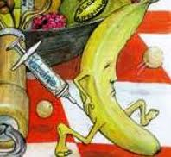

Slide 29
Thank you

Slide 30
Question
Differentiate between disadvantages of live attenuated and killed vaccines

