Slide 1
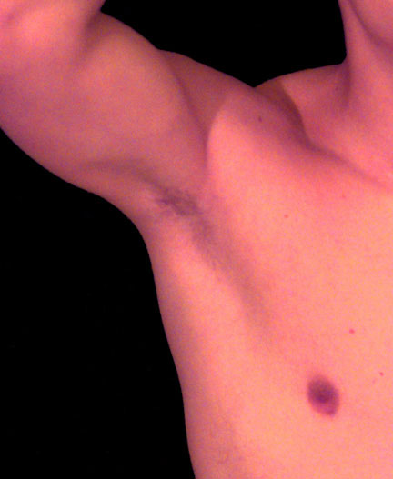
The Axilla: Part I
Gray’s anatomy for students pp: 710-726 + 737, 738

Slide 2
OBJECTIVES
Define & Identify the walls of the axilla and how structures traverse them
Study the course and branches of the axillary artery and recognize its important relations.
Understand the arterial anastomosis around the scapula & shoulder joint
Locate & study the groups of axillary lymph nodes

Slide 3
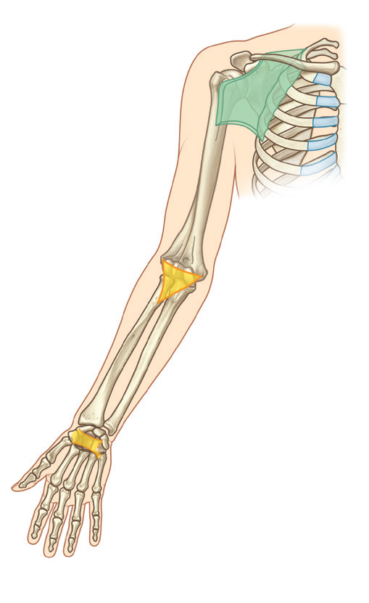
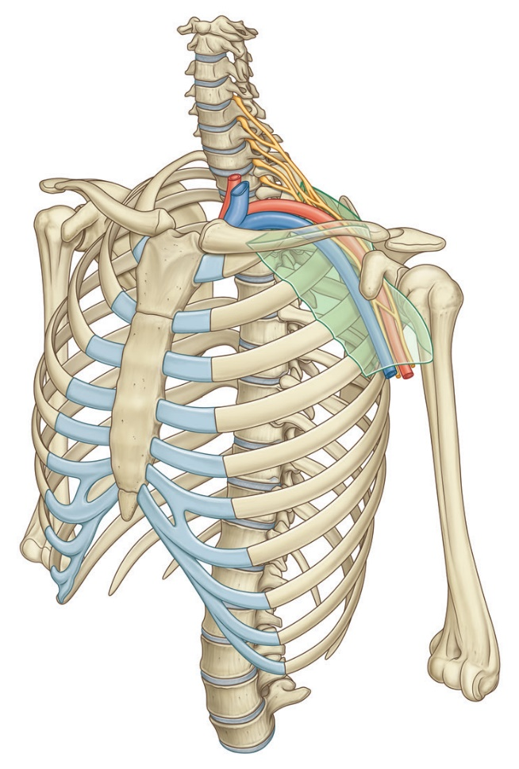
Transitions between the regions
Axilla (Neck & thorax→ Arm)
Cubital fossa (Arm → Forearm)
Carpal Tunnel (Forearm → Hand)

Slide 4
Surface anatomy

Slide 5
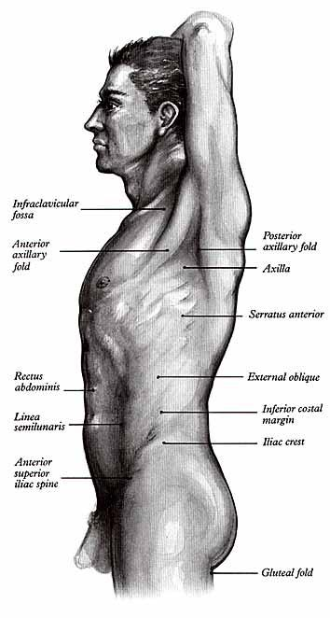
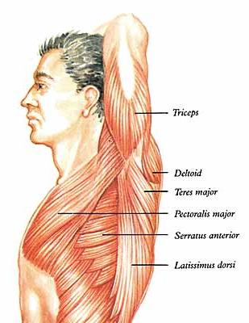

Slide 6
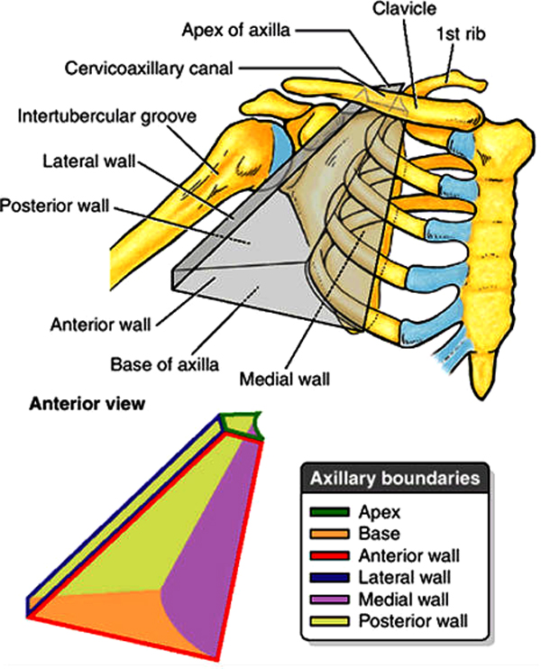
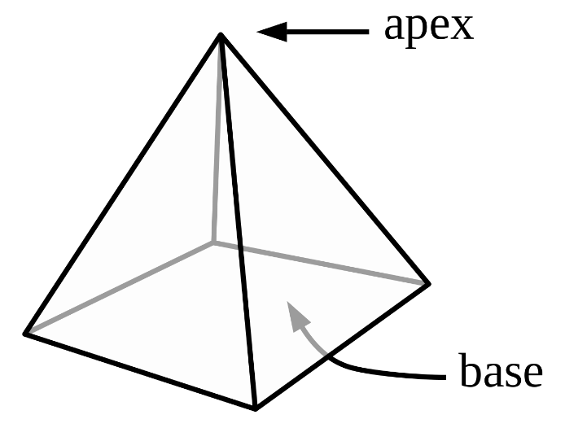
Walls

Slide 7
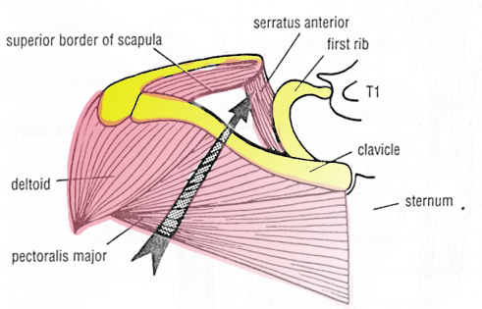
Apex (cervicoaxillary canal)= inlet

Slide 8
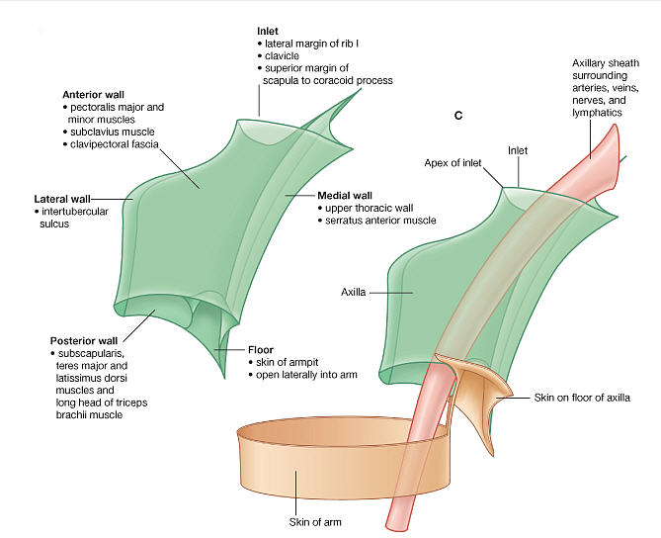
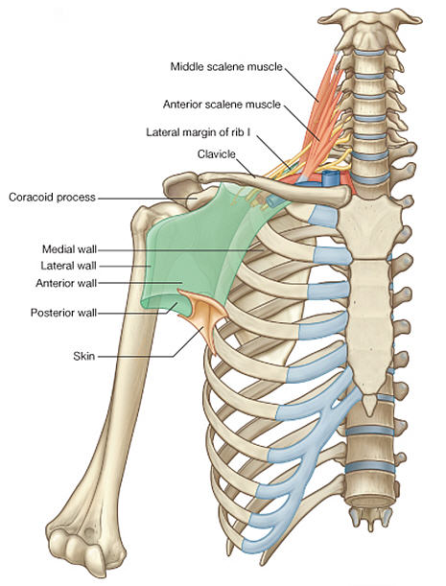

Slide 9
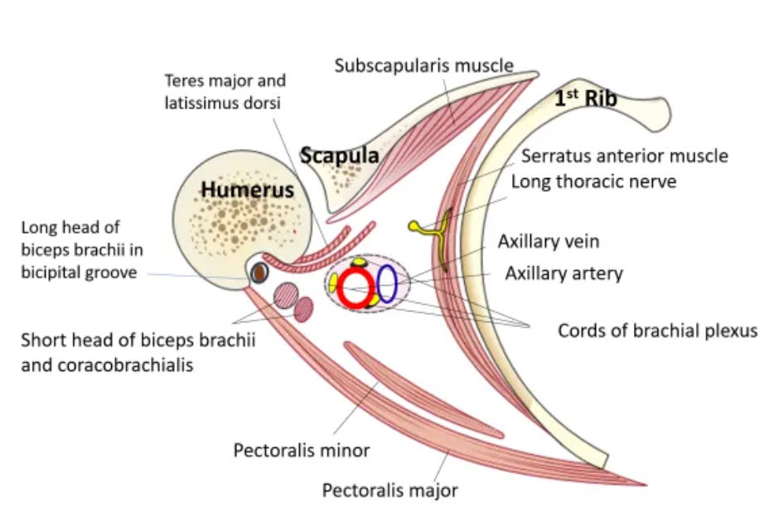
Axillary walls & Contents

Slide 10
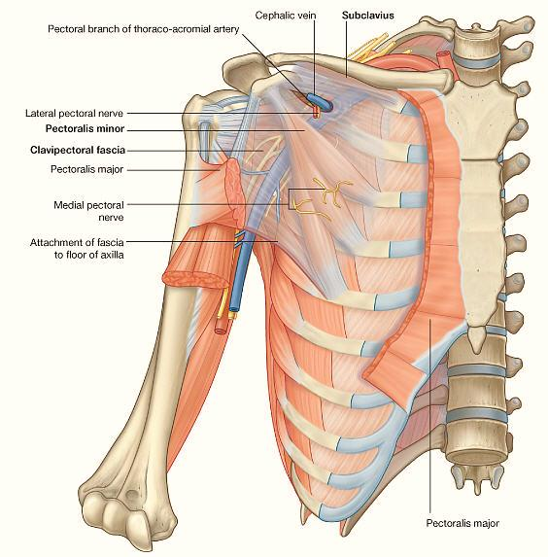
Anterior wall

Slide 11
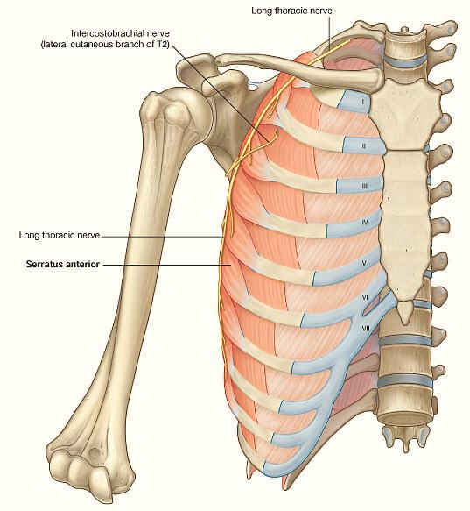
Medial wall

Slide 12
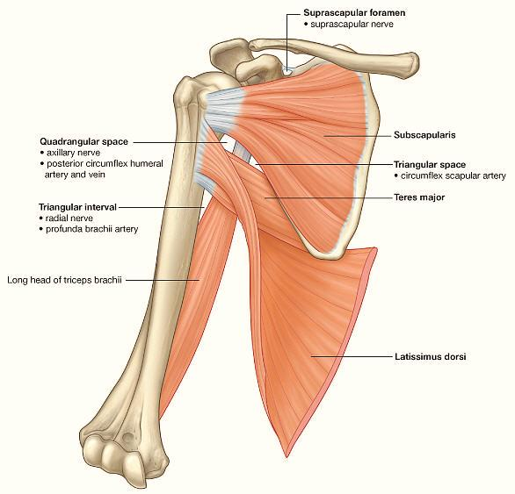
Posterior wall

Slide 13
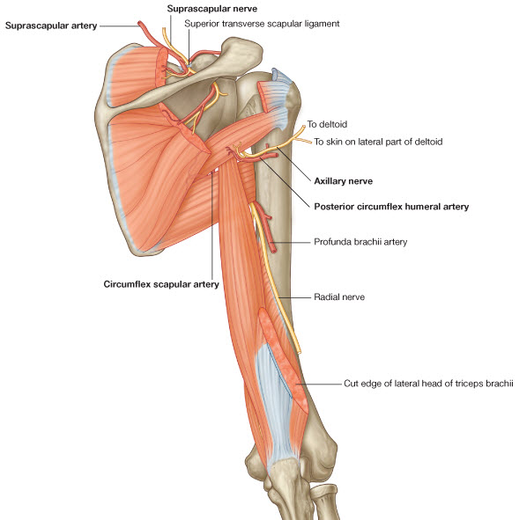
Gaps in the Posterior wall of the axilla

Slide 14
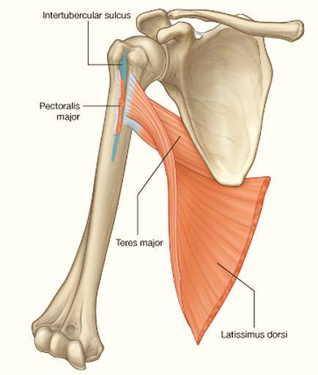
Lateral wall

Slide 15
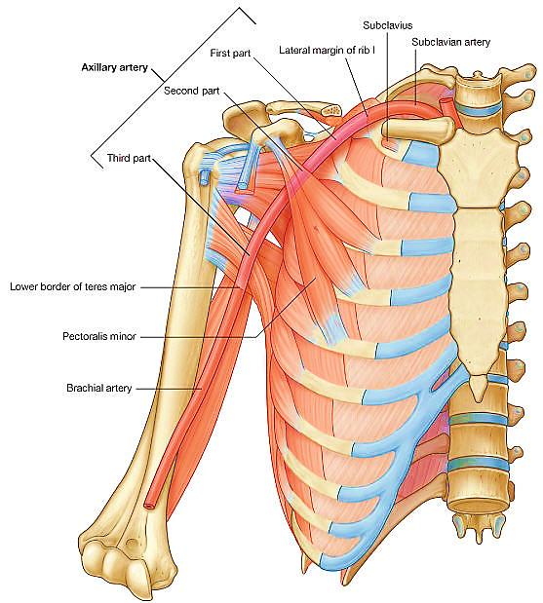
The Axillary artery

Slide 16
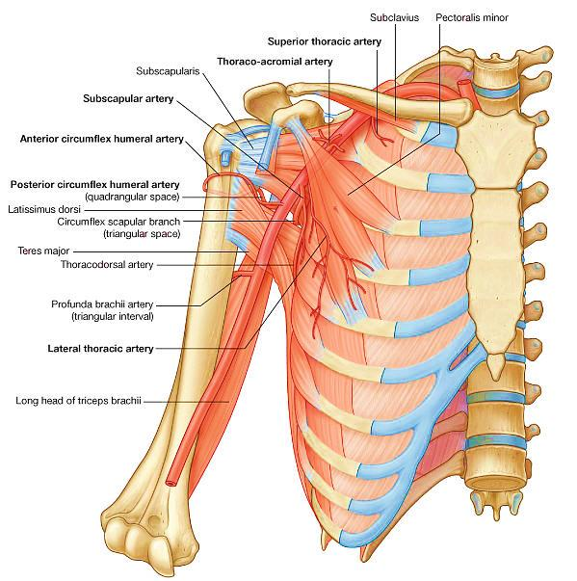

Slide 17
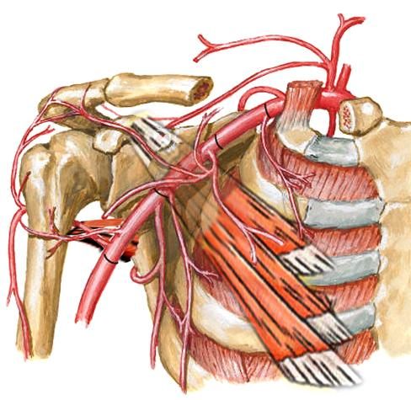
The Axillary artery
1-1Superior thoracic artery
2-1 Thoracoacromial artery
2-2 lateral thoracic artery
3-1 Subscapular artery
3-2 Ant. circumflex humeral artery
3-3 Post.circumflex humeral artery
1
2
3

Slide 18
The Axillary artery
Subscapular artery: largest branch. Subdivides into:
Circumflex scapular artery
Thoracodorsal artery
1
2
3

Slide 19
Humeral anastomosis
Anterior & posterior circumflex humeral arteries + Recurrent branch of profunda brachii artery

Slide 20
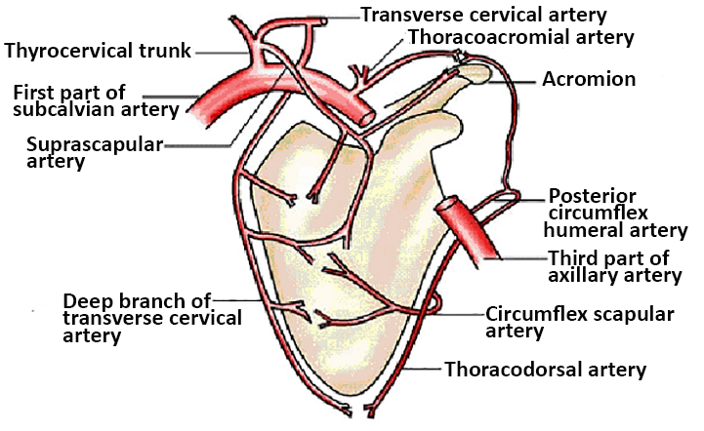
Anastomosis around the scapula

Slide 21
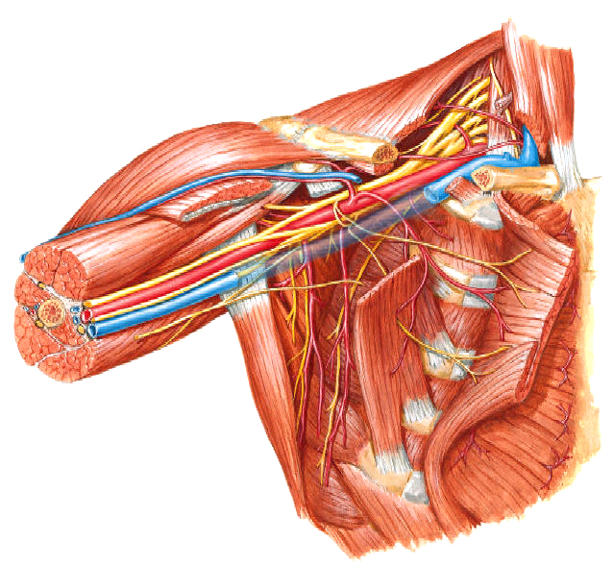
Important Relations
Axillary vein
Brachial plexus
P major
P minor
Subscapularis
L dorsi
T major
Biceps
Corachobrachialis

Slide 22
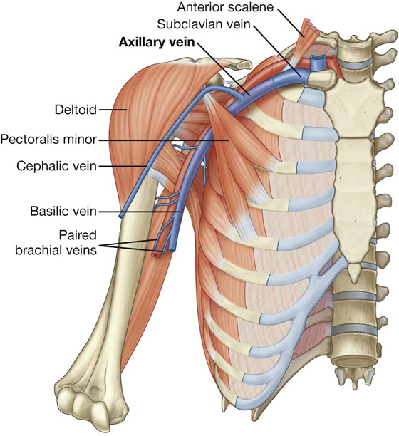
Axillary vein
Runs opposite course & receives same tributaries as the artery and its branches.
2. Differs from artery in:
Beginning: Basilic v. + Brachial vv.
Near the end receives cephalic v.

Slide 23
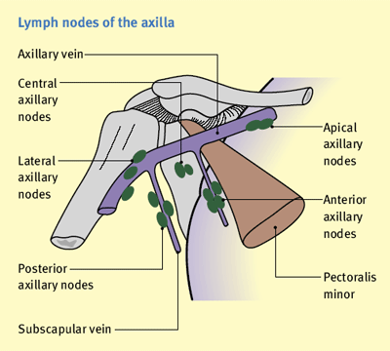
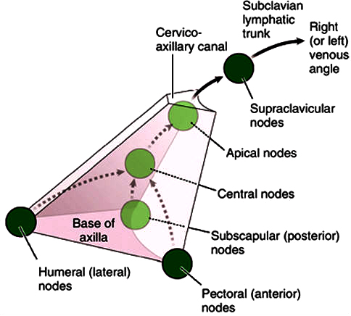
The axillary lymph nodes (groups)

Slide 24
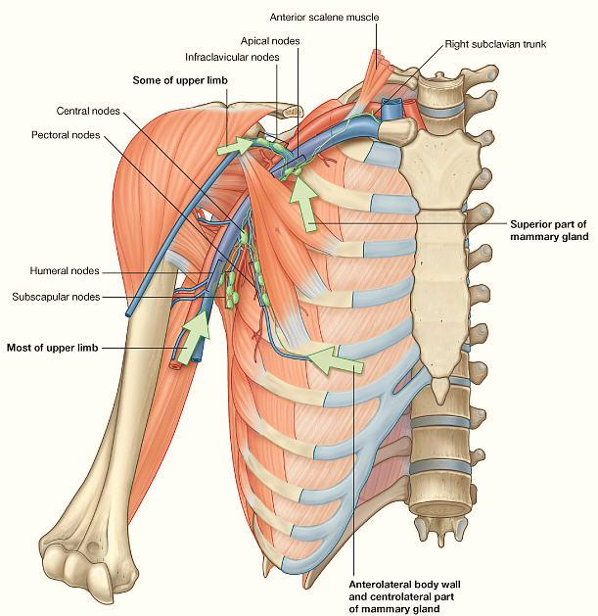
The axillary lymph nodes (location)

Slide 25
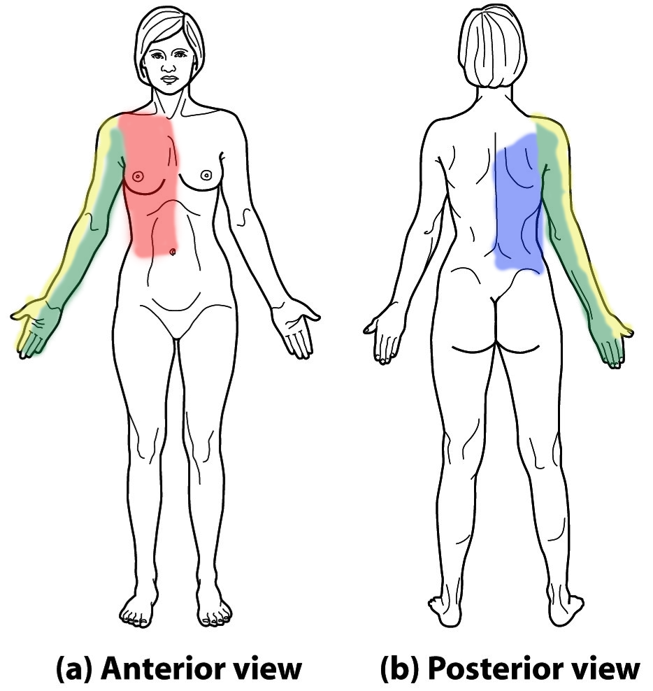
The axillary lymph nodes (Afferent & Efferent)
Anterior (Pectoral)
Posterior (Subscapular)
Lateral (Humeral)
Central
Apical
Infraclavicular
(Deltopectoral)
Subclavian Trunk

Slide 27
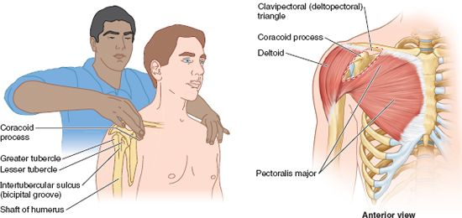
The deltopectoral (infraclavicular) nodes examination

