Slide 1
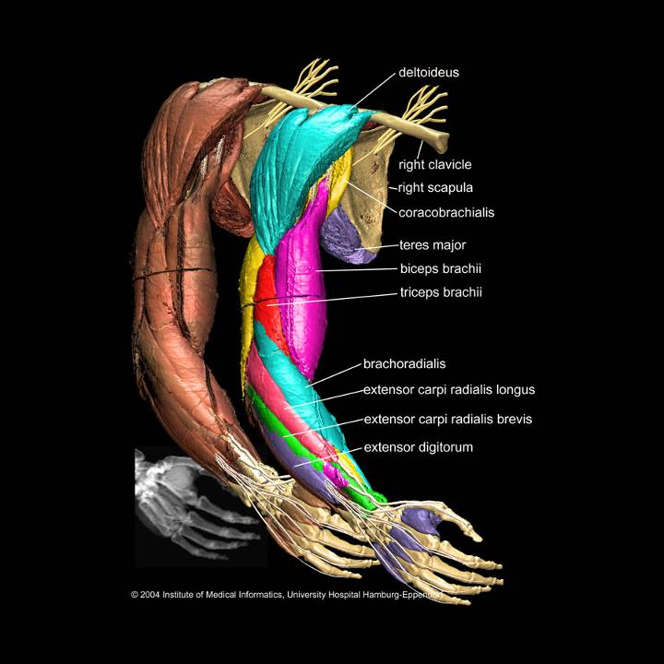
The Arm pp.739-752
Objectives: 1. Identify the skeletal framework of the region
2. Recognize the muscle compartmentalization
3. Study the course & branches of the neurovascular structures
4. Recap all info using cross sections

Slide 2
1. Humerus shaft & distal end
The bones

Slide 3
1. Humerus shaft & distal end
The bones

Slide 4
1. Humerus shaft & distal end
The bones

Slide 5
2. Proximal ulna
The bones

Slide 6
3. Proximal radius
The bones

Slide 7
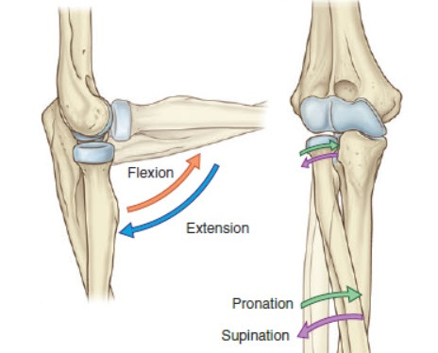
Articulations
The bones

Slide 8
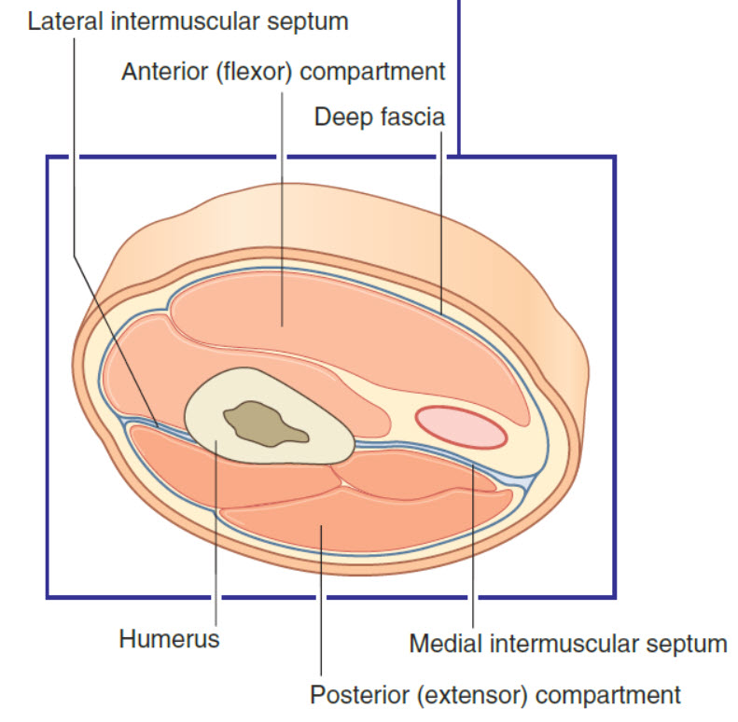
A. Anterior Compartment Coracobrachialis, Biceps,Brachialis, musculocutaneous nerve. B. Posterior Compartment: Triceps, Profunda Brachii vessels, Radial nerve
Compartments

Slide 9
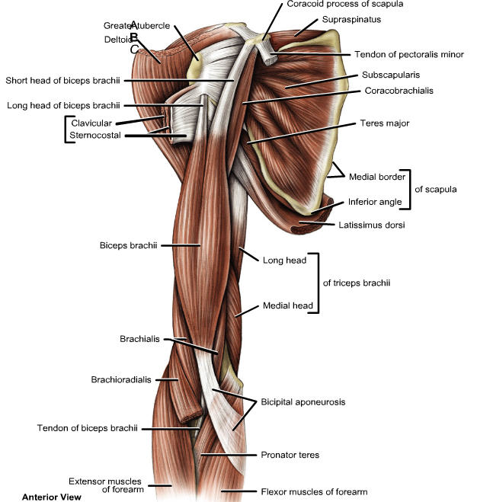
1.Coracobrachialis 2. Biceps brachii 3. Brachialis
Anterior compartment muscles

Slide 10
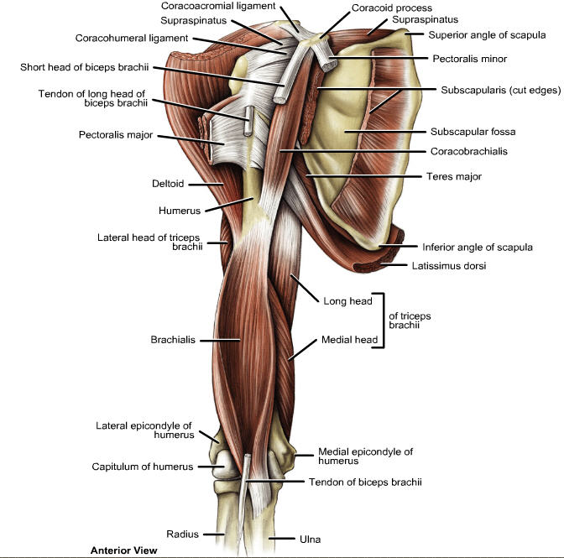
1.Coracobrachialis 2. Biceps brachii 3. Brachialis
Anterior compartment muscles

Slide 11
Nerve supply: Musculocutaneous nerve (C5, C6, C7) (except for the lateral part of brachialis→ from radial nerve)
Actions& nerve supply
Actions
Ant. Comp.
Coracobrachialis
Shoulder
Biceps brachii
Shoulder+Elbow
Brachialis
Elbow
Weak shoulder flexor
1. Flexion
2. RU Supination in elbow flexion
Elbow flexion

Slide 12
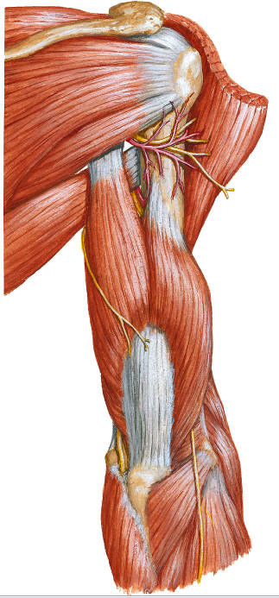
Triceps brachii: 1. Long head (S) 2. Lateral head (S)
Posterior compartment muscle

Slide 13
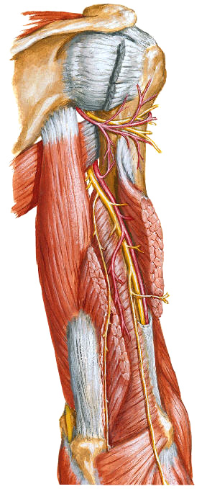
Triceps brachii: 1. Long head (S) 2. Lateral head (S) 3. Deep head Action: Elbow extension Nerve supply: Radial nerve
Posterior compartment muscle
Olecranon

Slide 14
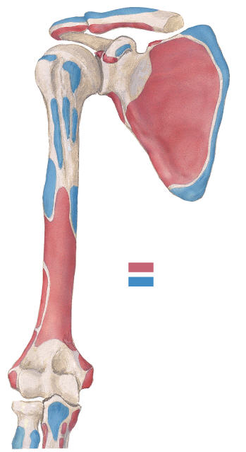
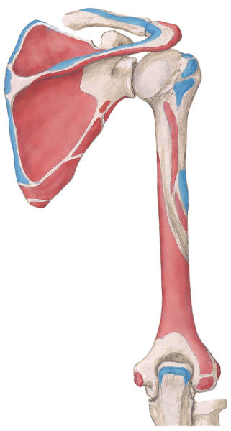
Anterior
Posterior
Long h. biceps
Long h. triceps
Coracobrachialis+ Short h. biceps
Lateral h. triceps
Brachialis
Brachioradialis
Medial h. triceps
Extensor carpi radialis longus

Slide 15
Coracobrachialis
Biceps
brachii
Triceps
brachii
Brachialis

Slide 16
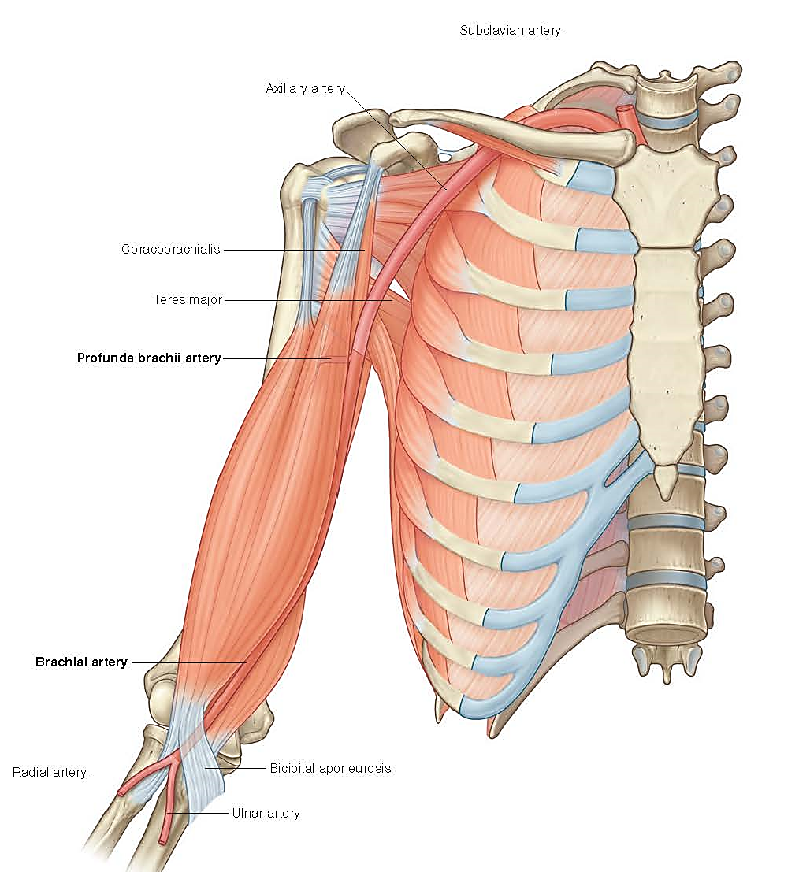
Subclavian a. Axillary a. Brachial a.
The Brachial Artery
1st rib
Teres major
Radial neck
Radial a.
Ulnar a.

Slide 17
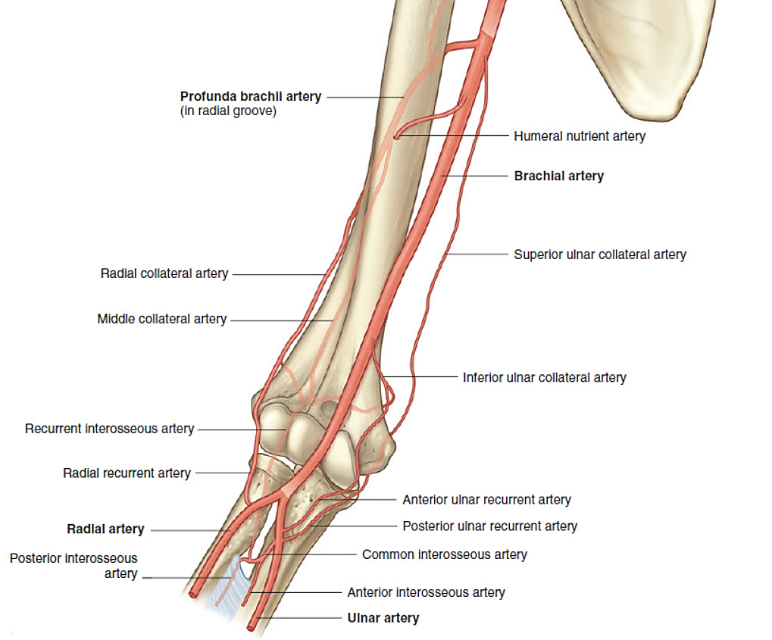
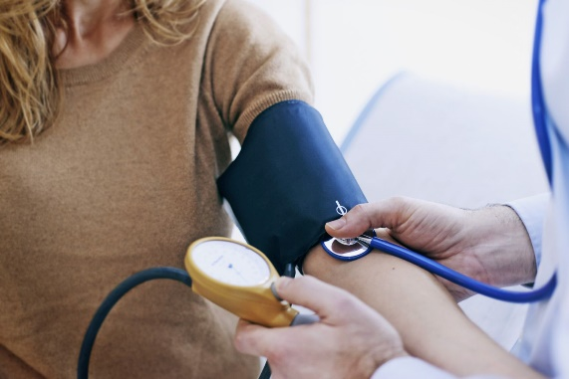
Clinical importance: 1. Blood pressure measurement 2. Arterial blood sampling
Branches of the brachial artery
+Muscular branches & recurrent branch to shoulder

Slide 18
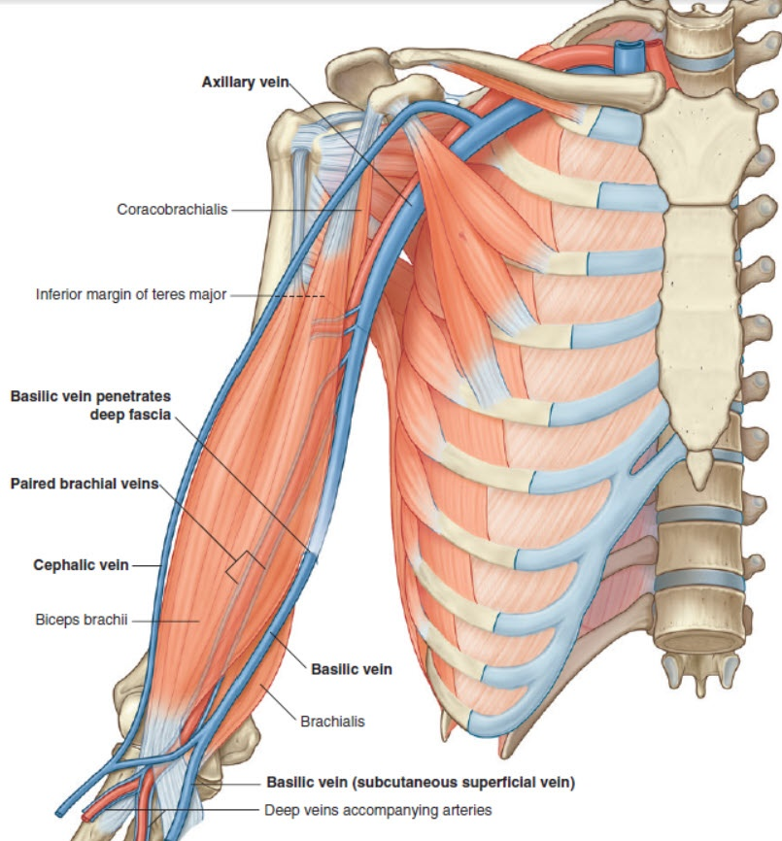
Subclavian v. Axillary v. Brachial vv.
Veins: venae comitans
1st rib
Cephalic v.
Teres major
Basilic v.
Radial neck
Radial vv.
Ulnar vv.

Slide 19
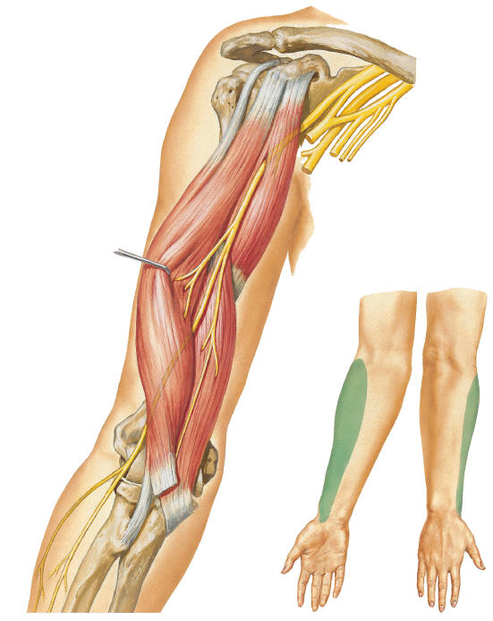
Musculo to: Coracobrachialis+ Biceps+Most of brachialis Cutaneous: Lateral cutaneous nerve of the forearm (lateral antebrachial nerve)
Musculocutaneous nerve
I’ll change my name now ☺

Slide 20
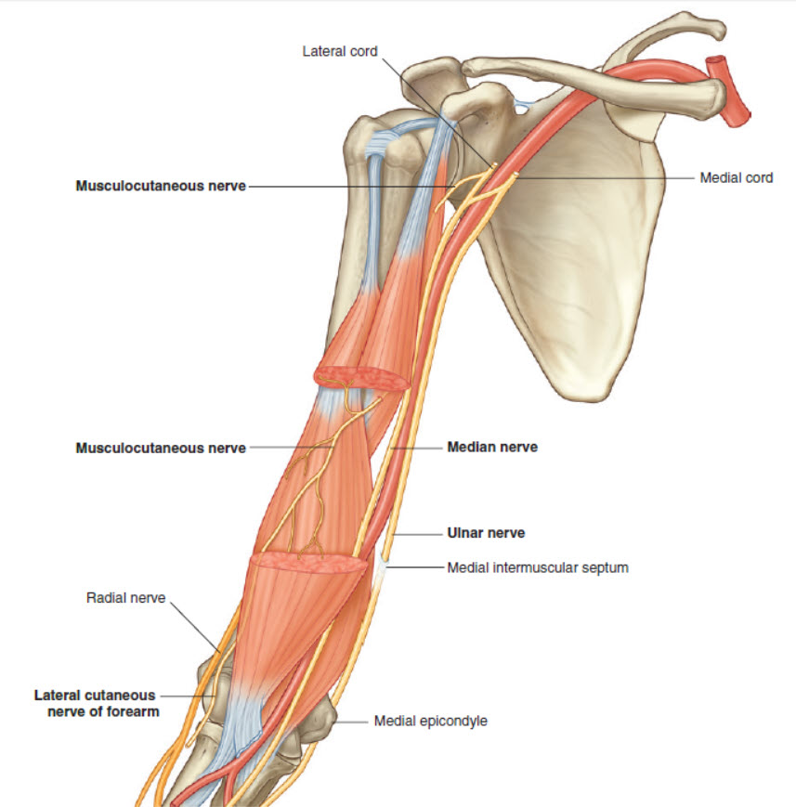
I’m just passing by. I have nothing to supply.
Ulnar nerve: Funny nerve
I’ll leave to the posterior compartment☺

Slide 21
Lateral Anterior Medial
Median nerve: play with brachial a.
I’m lateral ☺
I’m anterior ☺
I’m medial ☺

Slide 22
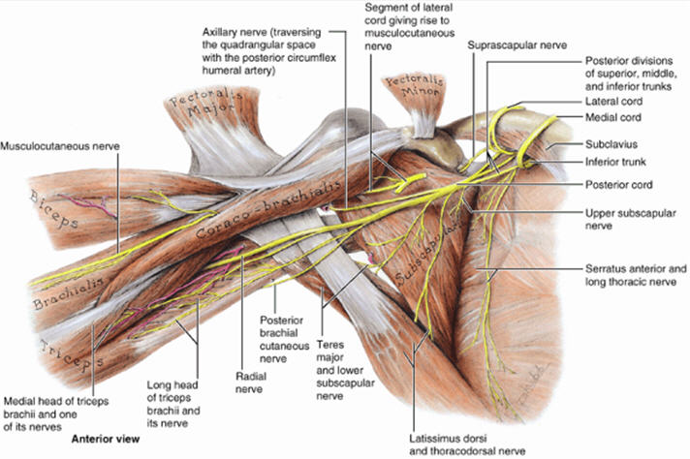
Axilla Radial groove Anterior compartment (cubital fossa)
Radial nerve: BIG BOSS in a HURRY

Slide 23
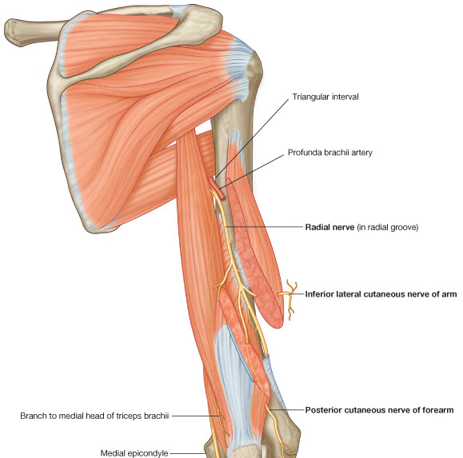
In the radial groove: A. Muscular: to lat. & med. Heads of triceps & to anconeus. B. Cutaneous: 1. Lower lateral cutaneous of a rm 2. Posterior cutaneous nerve of forearm
Radial nerve: BIG BOSS in a HURRY
I’ll go back to anterior compartment☺

Slide 24
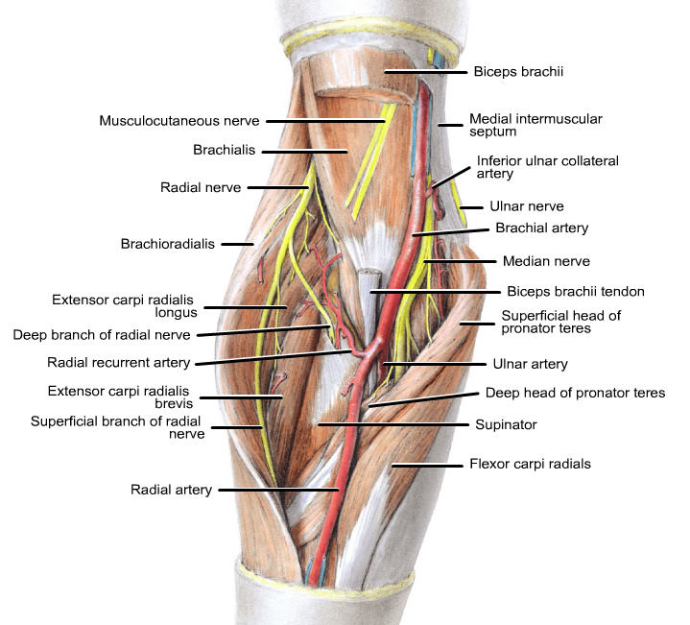
In anterior compartment: A. Muscular to brachioradialis, ECRL & small part of brachialis B. Articular to elbow C. Divides into deep & superficial branches
Radial nerve: BIG BOSS in a HURRY

Slide 25
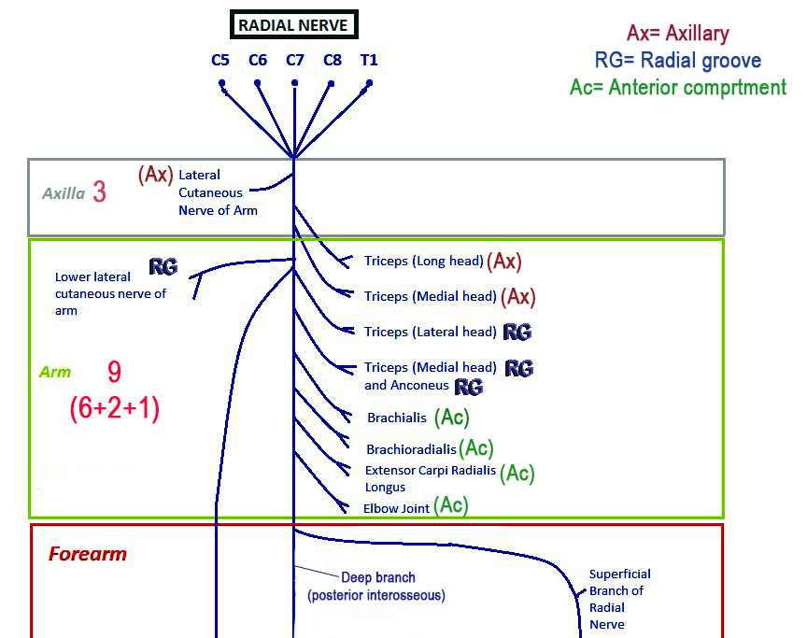
Posterior cutaneous nerve of the forearm

Slide 26
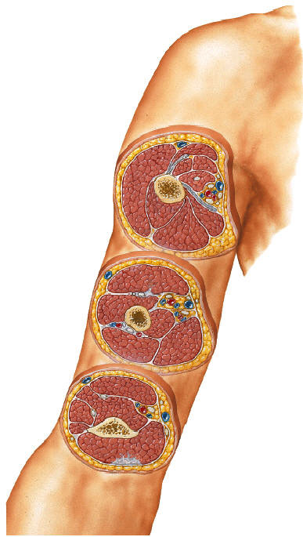
RECAP The arm in sections

Slide 27
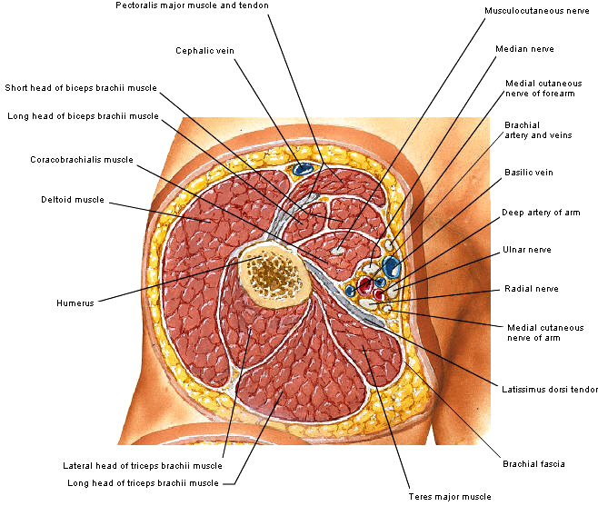
Proximal 1/3 section

Slide 28
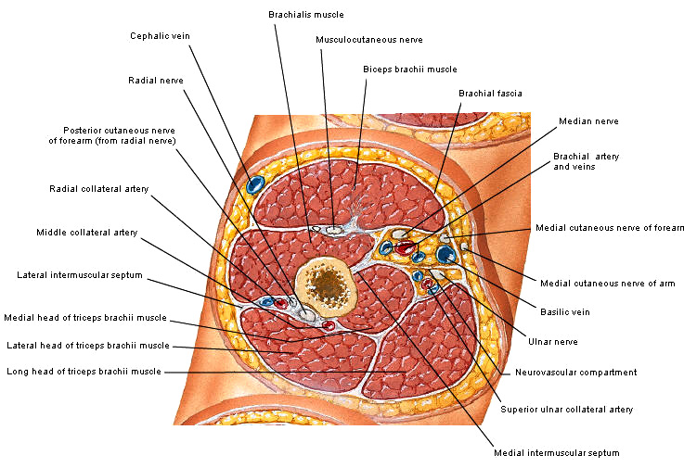
Mid-arm section

Slide 29
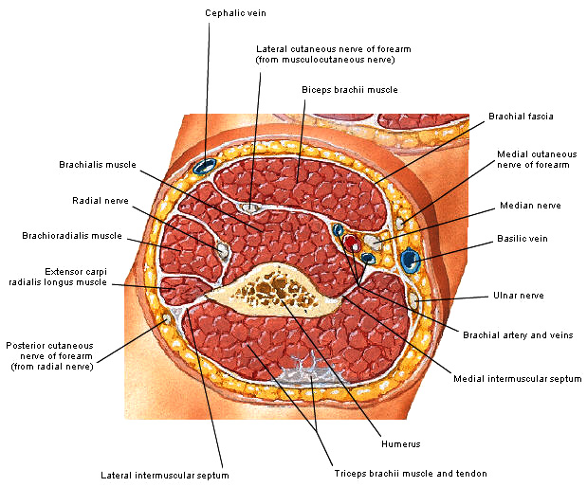
Distal arm section

