Slide 1
BREAST PATHOLOGY
Ductal carcinoma in situ
LEC. 2
DR. AYSER HAMEED

Slide 2
DCIS
  Has several of histologic appearances.
  Architectural patterns are often mixed and include solid, comedo, cribriform, papillary, etc.
  Nuclear appearance ranges from bland and monotonous (low nuclear grade) to pleomorphic (high nuclear grade).
  The comedo subtype is distinctive and is characterized by cells with high-grade nuclei distending spaces with extensive central necrosis. The name derives from the toothpaste-like necrotic tissue that can be extruded from transected ducts with gentle pressure.

Slide 3
DCIS only rarely presents as a palpable or radiologically detectable mass.
If detection is delayed, a palpable mass or nipple discharge may develop.
The cells in the better differentiated tumors express estrogen and, less often, progesterone receptors.
The prognosis for DCIS is excellent, with over 97% long-term survival after simple mastectomy.

Slide 4
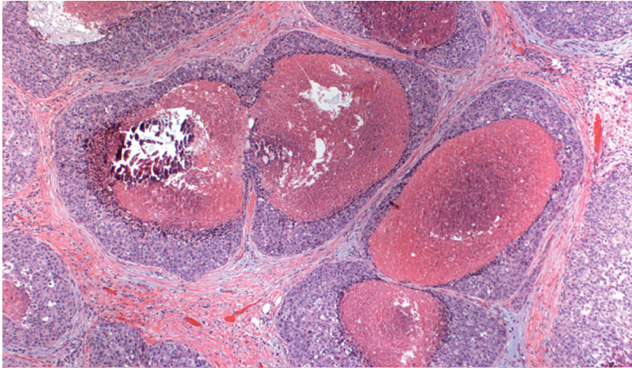
Comedo DCIS
Comedo DCIS fills several adjacent ducts and is characterized by large central zones of necrosis with calcified debris. This type of DCIS is most frequently detected as radiologic calcifications.

Slide 5
Paget disease of the nipple
Is caused by the extension of DCIS up to the lactiferous ducts and into the contiguous skin of the nipple.
The clinical appearance is usually of a unilateral crusting exudate over the nipple and areolar skin.
In about half of cases, an underlying invasive carcinoma will also be present.
Prognosis is based on the underlying carcinoma and is not worsened by the presence of Paget disease.

Slide 6
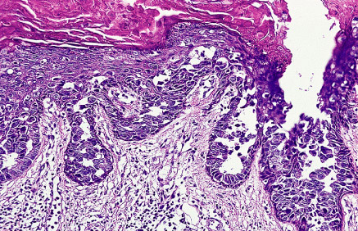
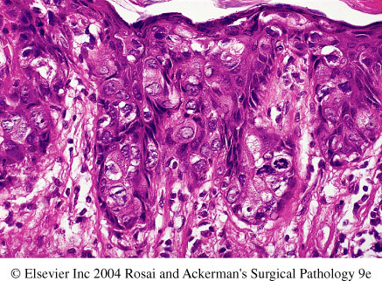
Paget disease nipple
LP views of Paget disease. The cleft-like separation between the tumor cells and the overlying squamous epithelium is characteristic.
HP views of Paget disease. The cleft-like separation between the tumor cells and the overlying squamous epithelium is characteristic.

Slide 7
In LCIS the cells are small & monomorphic with bland, round nuclei and occur in loosely cohesive clusters within distended lobular ductules & acini . Intracellular mucin vacuoles (signet ring cells) are common.
LCIS is virtually always an incidental finding, and, unlike DCIS, it does not form masses.

Slide 8
Approximately one-third of women with LCIS will eventually develop invasive carcinoma.
Unlike DCIS, subsequent invasive carcinomas arise in either breast at significant frequency.
Current treatment requires either close clinical and radiologic follow-up of both breasts or bilateral prophylactic mastectomy.

Slide 9
Approximately one-third of women with LCIS will eventually develop invasive carcinoma.
Unlike DCIS, subsequent invasive carcinomas arise in either breast at significant frequency.
Current treatment requires either close clinical and radiologic follow-up of both breasts or bilateral prophylactic mastectomy.

Slide 10
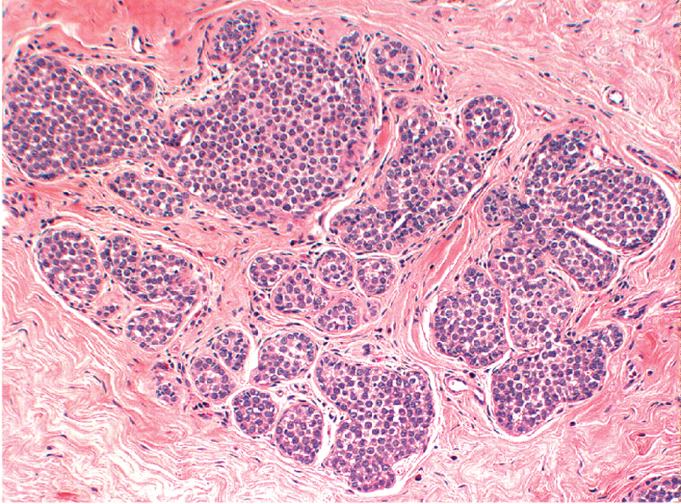
Lobular carcinoma in situ
A monomorphic population of small, rounded, loosely cohesive cells fills and expands the acini of a lobule. The underlying lobular architecture can still be recognized.

Slide 11
Invasive (Infiltrating) Carcinoma (IDC)

Slide 12
Invasive (Infiltrating) Carcinoma (IDC)
Is a term used for all carcinomas that cannot be subclassified into one of the specialized types described below; it does not indicate that this tumor specifically arises from the ductal system. Carcinomas of "no special type" or "not otherwise specified"(NOS) are synonyms for ductal carcinomas.
The majority (75%) of BRCA fall into this group.
This type of cancer is usually associated with DCIS. Most ductal carcinomas produce a desmoplastic response, which replaces normal breast fat and forms a hard, palpable mass.

Slide 13
The microscopic appearance is quite variable, ranging from tumors with well-developed tubule formation and low-grade nuclei to tumors consisting of sheets of anaplastic cells. The tumor margins are usually irregular . Advanced cancers may cause dimpling of the skin, retraction of the nipple, or fixation to the chest wall .
About two-thirds express estrogen or progestagen receptors, and about one-third overexpress HER2/NEU.

Slide 14
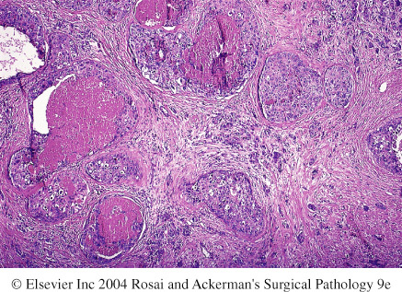
Invasive duct ca with its in situ component of comedo type

Slide 15
Invasive carcinoma breast
Carcinoma of the left breast. F/60. A small lump was palpable, and when the hands were raised above the head tethering to the skin was accentuated (arrow).

Slide 16
Inflammatory carcinoma
Is defined clinically by an enlarged, swollen, erythematous breast, usually without a palpable mass.
The underlying carcinoma is generally poorly differentiated and diffusely invades the breast parenchyma.
The blockage of numerous dermal lymphatic spaces by carcinoma results in the clinical appearance. True inflammation is minimal or absent.
Most of these tumors have distant metastases, and the prognosis is extremely poor.

Slide 17
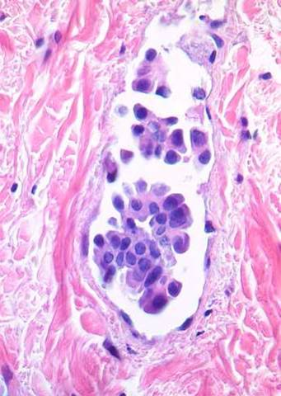
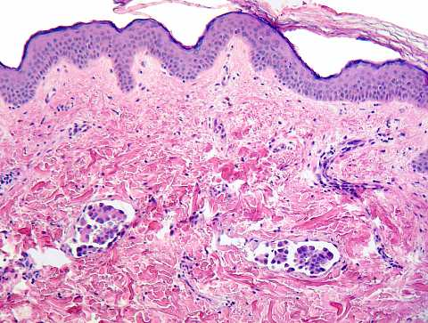
Inflammatory carcinoma
Inflammatory carcinoma with malignant cells in the dermal lymphatics, which are associated with lymphocytic infiltration and stromal edema

Slide 18
Invasive lobular carcinoma
Consists of cells morphologically identical to & is usually associated with LCIS.
The cells invade individually into stroma and are often aligned in strands (Indian file).
Occasionally they surround cancerous or normal-appearing acini or ducts, creating a so-called bull's-eye pattern.
Lobular carcinomas are also more frequently multicentric and bilateral (10% to 20%).
Almost all of these carcinomas express hormone receptors, but HER2/NEU overexpression is very rare or absent.
These tumors comprise fewer than 20% of all breast carcinomas.

Slide 19
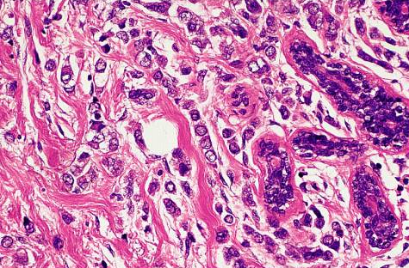
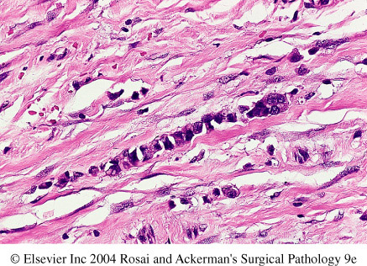
Invasive lobular Ca
The tumor cells are small and uniform with round nuclei and grow in an Indian file fashion.
Indian file pattern of growth of

Slide 20
Medullary carcinoma
Is a rare subtype, constituting 1% of cases.
These cancers consist of sheets of large anaplastic cells with pushing, well-circumscribed borders.
There is also a pronounced lymphoplasmacytic infiltrate.
These carcinomas uniformly lack hormone receptors and do not overexpress HER2/NEU.

Slide 21
Colloid (mucinous) carcinoma
Is also a rare subtype.
The tumor cells produce abundant quantities of extracellular mucin that dissects into the surrounding stroma.
Grossly the tumors are usually soft and gelatinous.
Tubular carcinoma
Rarely presents as palpable masses but account for 10% of invasive carcinomas smaller than 1 cm found with mammographic screening.
It consists of well-formed tubules with low-grade nuclei.
Lymph node metastases are rare, and prognosis is excellent.

Slide 22
Features Common to All Invasive Cancers:
In all forms of BRCA discussed previously, progression of the disease leads to certain local morphologic features.
These include a tendency to become adherent to the pectoral muscles or deep fascia of the chest wall, with consequent fixation of the lesion, as well as adherence to the overlying skin, with retraction or dimpling of the skin or nipple.

Slide 23
The latter is an important sign, because it may be the first indication of a lesion, observed by the woman herself during self-examination.
Involvement of the lymphatic pathways may cause localized lymphedema.
In these cases the skin becomes thickened around exaggerated hair follicles, a change known as peau d'orange (orange peel) .

Slide 24
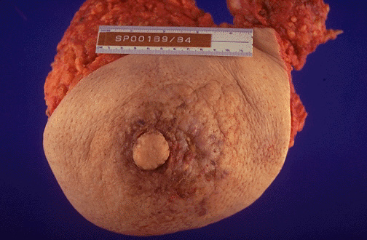
Inflammatory carcinoma
Note the gross cutaneous changes associated with an underlying carcinoma of breast. These are due to dermal lymphatic invasion by carcinoma that has resulted in the grossly thickened, erythematous, and rough skin surface with the appearance of an orange peel ("peau d'orange").

Slide 25
Spread of Breast Cancer
Spread eventually occurs through lymphatic and hematogenous channels.
Lymph node metastases are present in about 40% of cancers presenting as palpable masses but in fewer than 15% of cases found by mammography.
Outer quadrant and centrally located lesions typically spread first to the axillary nodes. Those in the inner quadrants often involve the lymph node along the internal mammary arteries.

Slide 26
The supraclavicular nodes are sometimes the primary site of spread, but they may become involved only after the axillary and internal mammary nodes are affected.
More distant dissemination eventually ensues, with metastatic involvement of almost any organ or tissue in the body.

Slide 27
Favored locations are the lungs, skeleton, liver, and adrenals and (less commonly) the brain.
However, no site is immune.
Metastases may appear many years after apparent therapeutic control of the primary lesion, sometimes 15 years later.

Slide 28
Clinical Course
When BRCA is discovered by the woman or her physician, it is felt as a deceptively discrete, solitary, painless, and movable mass.
At this time, the carcinoma is typically 2 to 3 cm in size, and involvement of the regional lymph nodes (most often axillary) is already present in about half of patients.

Slide 29
With mammographic screening, carcinomas are frequently detected before they become palpable.
The average invasive carcinoma found by screening is around 1 cm in size, and only 15% of these have nodal metastases.
In addition, in many women DCIS is detected before the development of invasive carcinoma.

Slide 30
Prognosis
This is influenced by the following (note that the first three are components of tumor stage):
1. The size of the primary carcinoma. Invasive carcinomas smaller than 1 cm have an excellent prognosis in the absence of lymph node metastases
2. Lymph node involvement and the number of lymph nodes involved by metastases.
With no axillary node involvement, the 5-year survival rate is close to 90%.
The survival rate decreases with each involved lymph node and is less than 50% with 16 or more involved nodes.

Slide 31
3. Distant metastases. At this stage the disease is rarely curable, although chemotherapy may prolong survival.
4. The grade; Well-differentiated carcinomas have a significantly better prognosis as compared with poorly differentiated carcinomas.
5. The histologic type; all specialized types of breast carcinoma (tubular, medullary, and mucinous) have a somewhat better prognosis than carcinomas NOS.

Slide 32
6. Estrogen or progesterone receptors status: determining the presence or absence of these receptos is to predict the response to therapy and thus indirectly the prognosis.
The highest rate of response is to anti-estrogen therapy (oophorectomy or tamoxifen) is seen in women whose tumors have both estrogen and progesterone receptors.
Lower rates of response are seen if only one of the receptors is present.
If both are absent, very few patients respond.
7. The proliferative rate of the cancer as measured by mitotic counts.
Mitotic counts are included as part of the grading system. High proliferative rates are associated with a poorer prognosis.

Slide 33
8. Aneuploidy i.e. carcinomas with an abnormal DNA content; these have a slightly worse prognosis.
9. Overexpression of HER2/NEU is caused by amplification of the gene.
Overexpression is associated with a poorer prognosis.
However, the importance of evaluating HER2/NEU is to predict response to a monoclonal antibody ("Herceptin") to the gene product.
This is one of the first examples whereby an antitumor antibody therapy has been developed on the basis of a specific gene abnormality present in the tumor.

Slide 34
MALE BREAST
Gynecomastia refers to enlargement of the male breast, which may occur in response to absolute or relative estrogen excesses.
The most important cause of such hyperestrinism in the male is cirrhosis of the liver, with consequent inability of the liver to metabolize estrogens.
Other causes include Klinefelter syndrome, estrogen-secreting tumors, estrogen therapy, and digitalis therapy.
Grossly, a button-like, subareolar swelling develops, usually in both breasts but occasionally in only one.

Slide 35
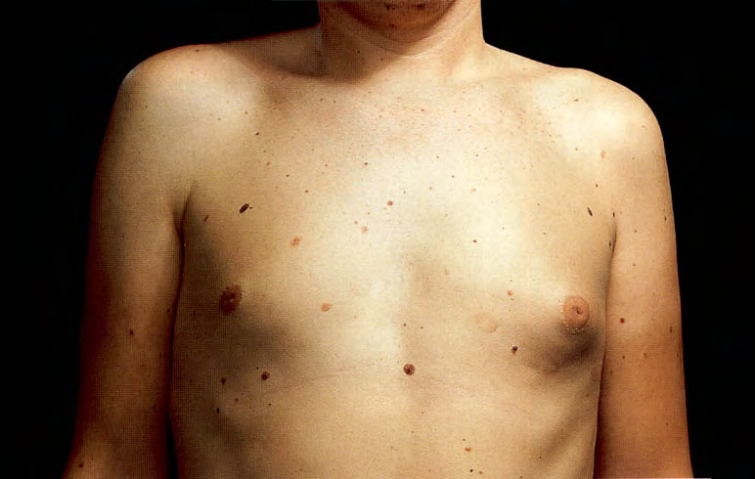
Gynaecomastia
This condition occurs most commonly at about puberty, presumably resulting from mild hormonal imbalance. It may occur also during adult life. Only very occasional cases of gynaecomastia are caused by an endocrine tumor.

Slide 36
Carcinoma
Is a rare, with a frequency ratio to breast cancer in the female of 1: 125.
It occurs in advanced age.
Because of the scant amount of breast substance in the male, the tumor rapidly infiltrates the overlying skin and underlying thoracic wall.
Both morphologically and biologically, these tumors resemble invasive carcinomas in the female.

