Slide 1
An Introduction to Neuroanatomy
Objectives:
Review the anatomical & functional divisions of the nervous system.
Study the embryological development of the CNS & the derivatives (parts)
Understand the special terms of orientation in relation to the nervous system.
Identify the lobes, poles & surfaces of the cerebral hemispheres

Slide 2
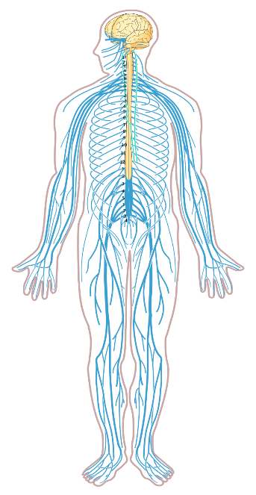
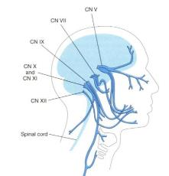
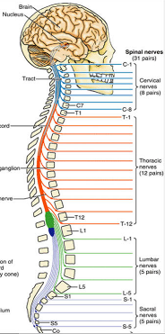
Anatomical divisions of the NS
Central (CNS)
Peripheral (PNS)
Brain
(in skull)
a. 12 pairs of cranial nerves (CN I-CN XII)
b. Spinal cord
(in vertebral column)
b. 31 pairs of spinal nerves

Slide 3
Functional divisions of the nervous system
SOMATIC
Sensory (afferent)
Motor (efferent)
1. General sensation (skin, joints & ligaments): Pain, Touch, Pressure, Vibration, Positions dense [proprioception])
2. Special senses (Hearing, Vision, Taste, Smell, Equilibrium)
Skeletal muscles
CNS
VISCERAL
Visceral receptors in internal organs (viscera) sensitive to stretch, distension, irritation…etc.
Smooth muscles
Cardiac muscles
Glands

Slide 4
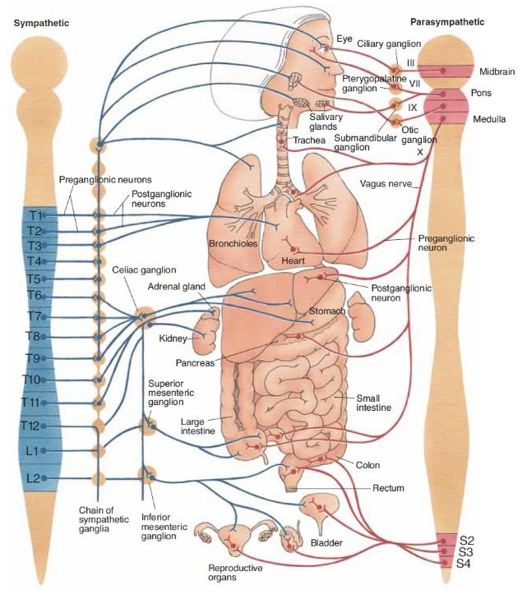
Visceral = Autonomic
Sympathetic = Thoracolumbar
[T1-L2 (L3)]
Sympathetic trunk
All Spinal nerves
CN IX, X, XII
Organs
Short pregagnglionic
Long postganglionic
Parasympathetic = Craniosacral
[CN III, VII, IX, X
+ S2, S3, S4]
Ganglia
Organs
Long pregagnglionic
Short postganglionic

Slide 5
Embryology: Neural tube

Slide 6
Neural tube defects

Slide 7
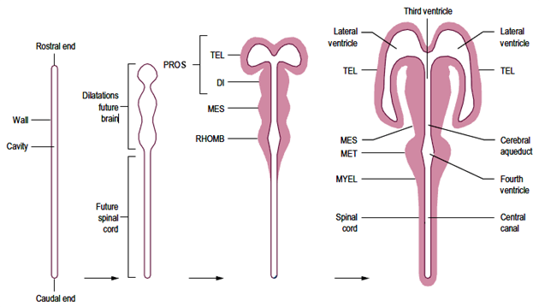
Embryology: Neural tube vesiculation

Slide 8
Derivatives
ORIGIN | DERIVATIVE | CAVITY
Prosencephalon (Forebrain) | 1. Paired telencephalon | Lateral ventricle
 | 2. Single diencephalon | 3rd ventricle
Mesencephalon | Midbrain* | Cerebral aqueduct
Rhombencephalon (Hindbrain) | 1. Metencephalon: | 4th ventricle
 | Pons* | 4th ventricle
 | b. Cerebellum
 | 2. Myelencephalon:
 | Medulla oblongata*
Spinal medulla | Spinal cord | Central canal
*Midbrain + * Pons + * Medulla oblongata= Brainstem

Slide 9
Mature Parts
Cerebrum
Diencephalon
Midbrain
Cerebellum
Pons
Medulla
Oblongata
Spinal cord

Slide 10
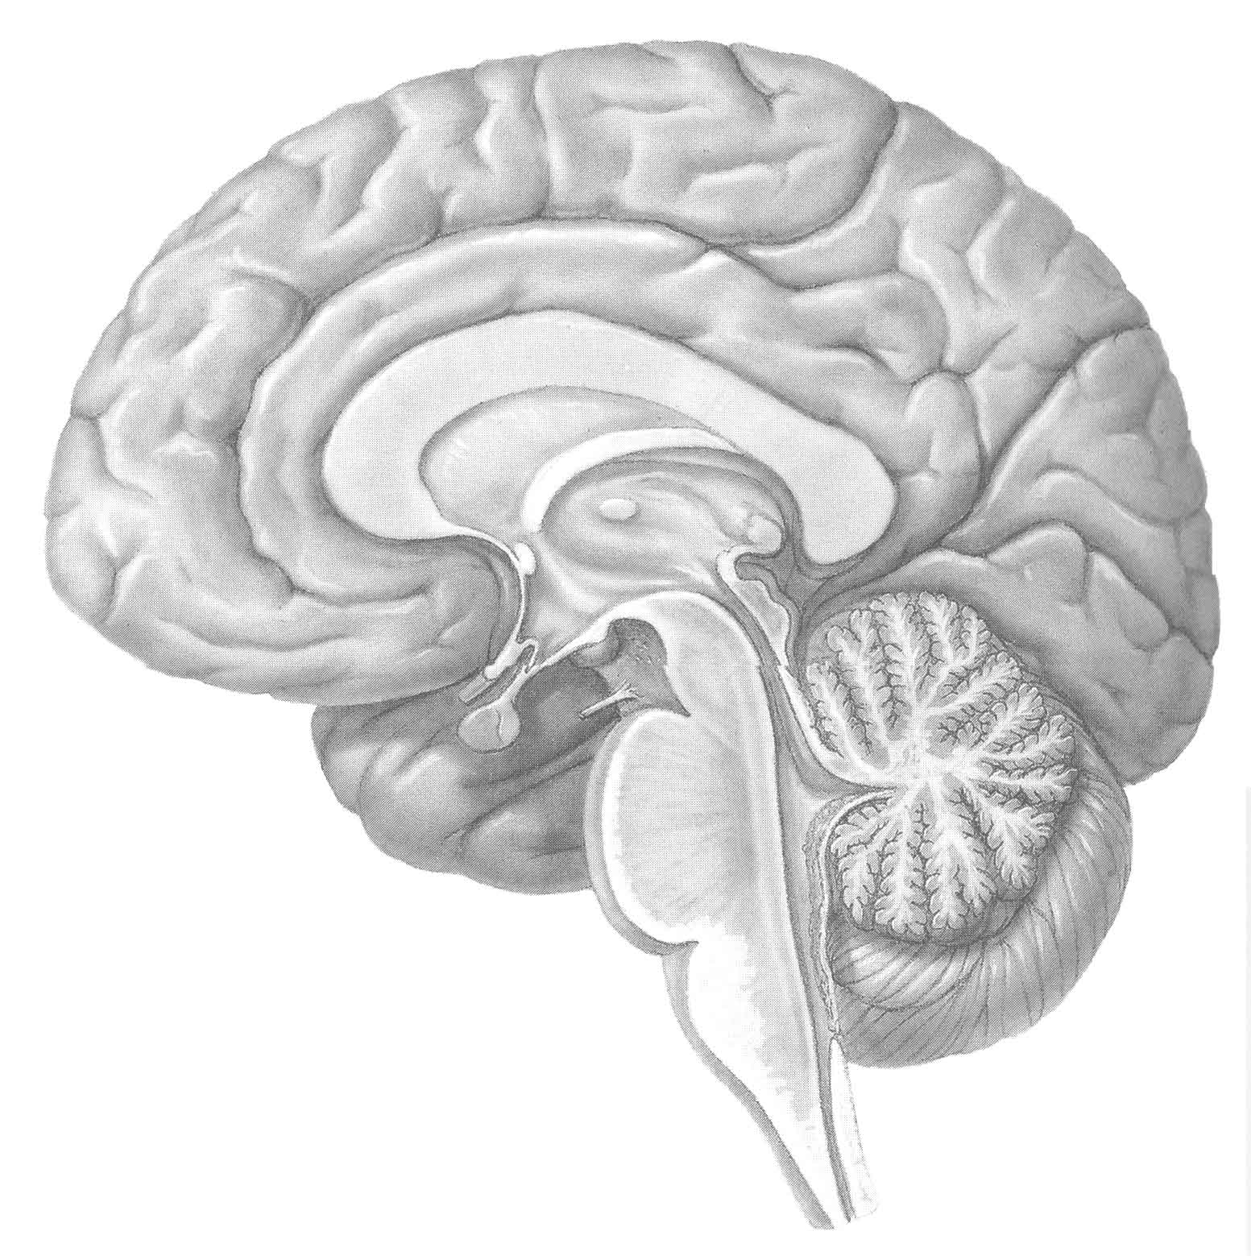
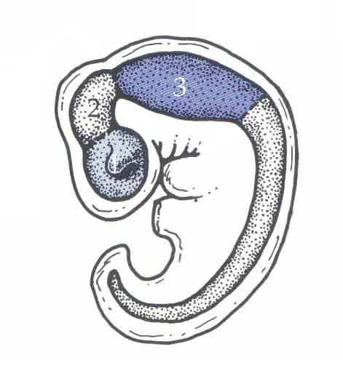
Embryology: Neural flexures
The cephalic flexure persists into maturity
Cephalic flexure
MidsagBrain

Slide 11
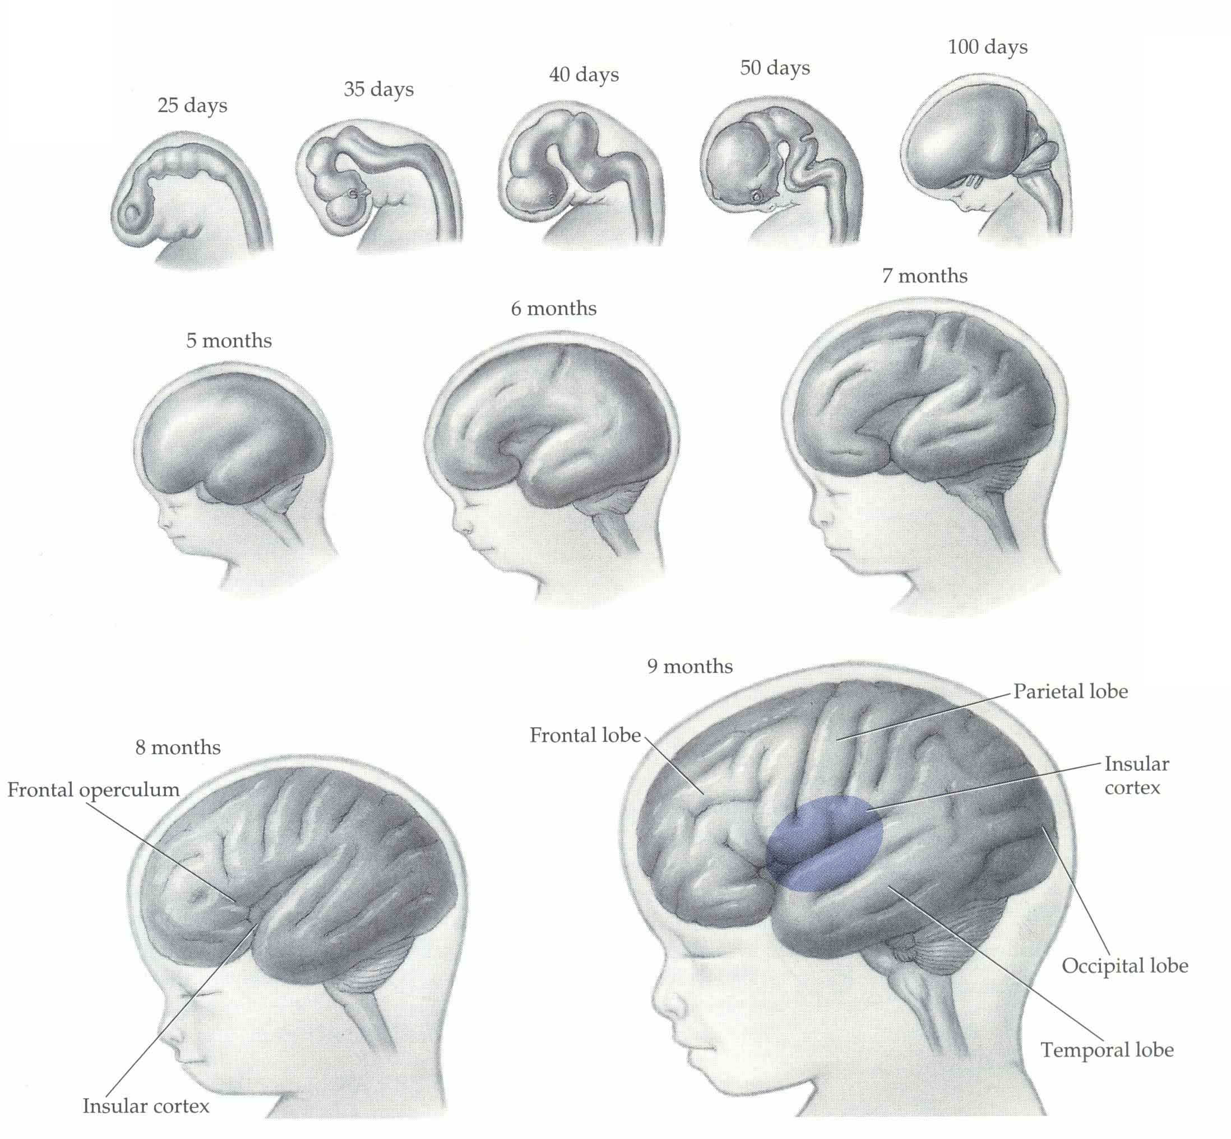
Orientation

Slide 12
The cerebral hemispheres: Poles

Slide 13
The cerebral hemispheres: Surfaces& Borders

Slide 14
The cerebral hemispheres: Surface features

Slide 15
The cerebral hemispheres: Lobes

