Slide 1
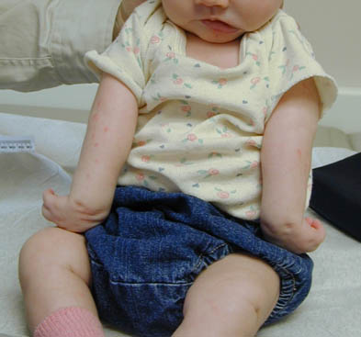
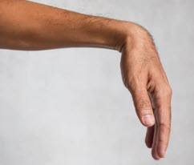
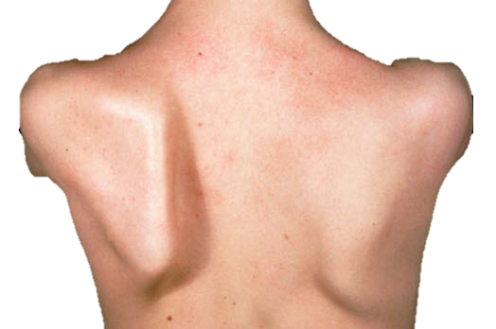
Nerve Injuries of the Upper Limb
Assist. Proff. Dr. Sameh S. Akkila
UOMCOM

Slide 2
Why? How?
1. Understand why nerve injuries of the upper limb are common & important.
2. Classify the types of nerve injuries & the different outcomes of each.
3. Review the course of the major nerves of the upper limb & how / where they can be injured with the
resulting outcome.
Objectives

Slide 3
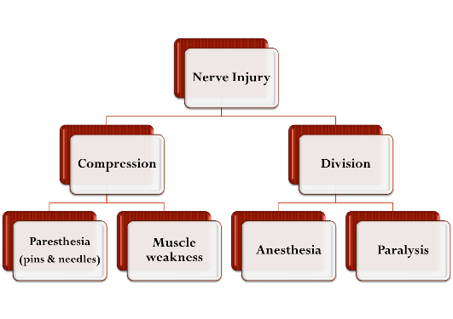
Types of nerve injuries
A nerve can be injured completely or partially. It can be compressed (e.g., by a tumor or an enlarged lymph node) or severed (e.g., by a stab wound, a bullet or a fractured bone).
A compressed nerve will have its fibers short-circuiting causing unreal sensation (paresthesia) and irregular
In Division: The nerve fibers (axons) shrink back and 'rest' for about a month; then they begin to grow again. Axons will regenerate about 1mm per day. The extent to which a nerve recovers is variable, and it will always be incomplete.
muscle movement or weakness.
A severed (cut) nerve will not transmit any impulses
leading to complete loss of sensation & complete loss
of muscle function. Overtime, paralyzed muscles
ATROPHY (shrink in size).
Summary
Why? How?

Slide 4
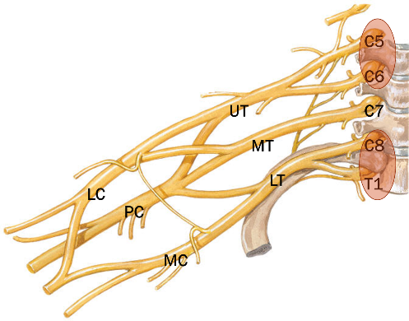
Brachial plexus injuries
Brachial plexus injuries = Radiculopathy (myotomes& dermatomes) affecting multiple nerves that share the root.
C5+C6= Upper trunk (UT)
C7 = Middle trunk (MT)
C8+T1= Lower trunk (LT)
Each trunk divides into ant. & post. divisions.
Ant. divisions of UT & MT form lateral cord (LC)
Ant. division of LT forms medial cord (MC)
All 3 post. divisions form posterior cord (PC)
Where?
Radiculopathy
The plexus is usually injured at the peripheries:
Upper = C5, C6
or
Lower = C8, T1

Slide 5
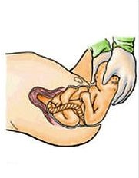
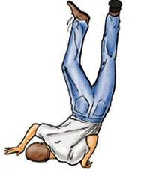
Upper Brachial plexus injuries
Traction injuries to the neck affecting the upper roots:
(C5 & C6) → Erb-Duchenne palsy.
- In Infants (Congenital): hasty head delivery.
- In adults (Acquired): stretching the head to one side & the shoulder to the opposite side (e.g., falling from a height).
It affects all nerves with C5, C6 root value.
Like this
How?

Slide 6
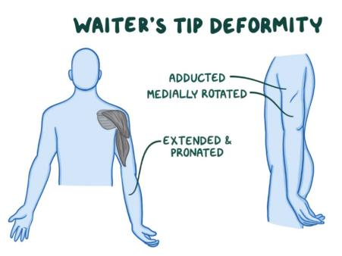
Upper Brachial plexus injuries
Affected nerves | Paralyzed | Result
Suprascapular (C5, C6) | Supraspinatus Infraspinatus | -No Shoulder Abduction -No Shoulder Lat. rotation
Axillary (C5, C6) | Deltoid Teres minor | -Weak all shoulder movements except adduction -No Shoulder Lat. rotation
Affected nerve | Paralyzed | Result
Long thoracic (C5, C6, C7) | - Most of Serratus anterior | - Winging of scapula
Musculocutaneous (C5,C6,C7) | - Elbow flexors myotome | - Greatly weakened elbow flexion
Radial branch to supinator C5 | - Supinator | - Forearm pronated
Wrist flexors (C6 myotome) | - Wrist flexion | -Weak wrist flexion
The shoulder is ADDUCTED & MEDIALLY ROTATED with the elbow EXTENDED and the palm facing backwards due to a PRONATED FOREARM (Supinator is paralyzed & biceps CANNOT supinate an extended elbow!).
Result
Main nerves affected

Slide 7
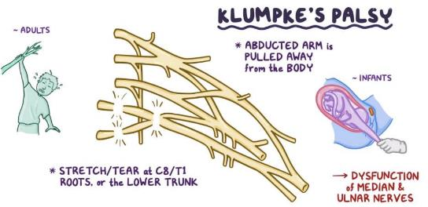
Lower Brachial plexus injuries = Klumpke’s Palsy
Affect the C8 & T1 root distributed to the small muscles
of the HAND via fibers that travel through the ULNAR
& MEDIAN nerves.
- In Infants (Congenital): hasty arm delivery.
- In adults (Acquired): commonly associated with
An abducted arm is pulled away from the body.
Like this
shoulder dislocation (i.e., abduction under weight).
How?

Slide 8
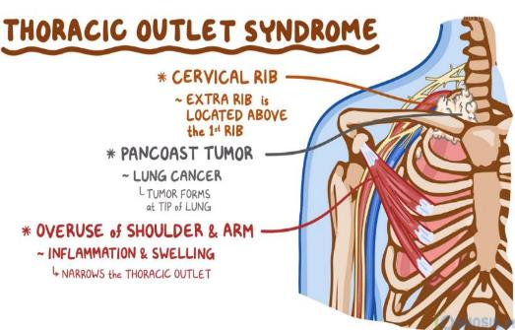
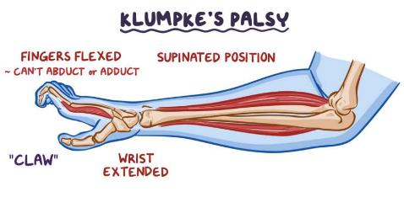
Forearm supinated + Wrist extended
with Thumb paralyzed & Fingers clawed
Nerve | Paralyzed
Median | - Wrist pronators - Wrist flexors - Thenar mm.
Ulnar | - Small muscles of the hand
Result
Causes & Affected nerves

Slide 9
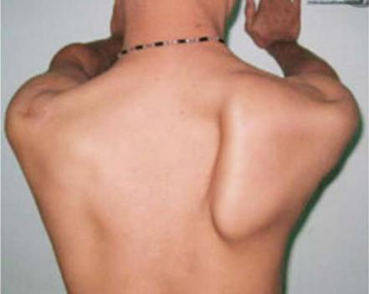
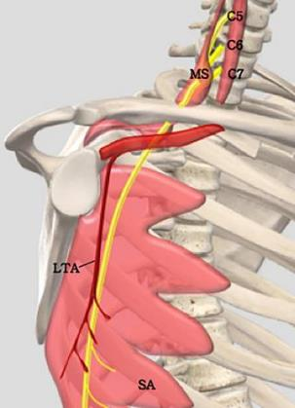
Long thoracic nerve injury
In addition to weakness in protraction, the scapula is no longer held against the thorax and when the patient pushes forwards, this leads to WINGING of the scapula = the medial border is pushed backwards,
Nerve review
The nerve arises from C5, C6, C7 roots & descends behind the 1st part of the axillary artery along the lateral thoracic wall running along & supplying serratus anterior muscle. It may be cut during radical mastectomy or by a stab wound along its course leading to paralysis of serratus anterior.
Result

Slide 10
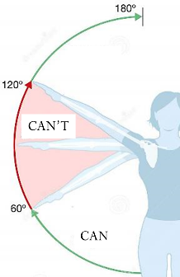
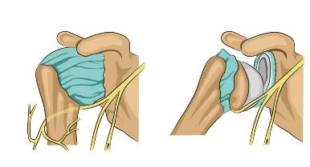
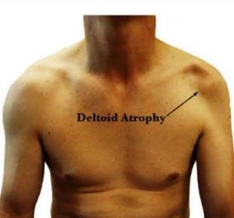
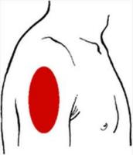
Axillary nerve injury
With deltoid paralyzed, shoulder abduction can only be initiated by SUPRASPINATUS but cannot be continued. Overtime, deltoid atrophies leading to loss of the shoulder round and prominent coracoid & acromion. There’s also small area of anesthesia of the skin over the lower ½ of deltoid.
The axillary nerve (C5, C6) arises from the post. cord of the brachial plexus & passes through the quadrangular space to run deep to deltoid around the surgical neck of the humerus. It supplies DELTOID, TERES MINOR & the skin over the lower ½ of deltoid (upper lateral cutaneous nerve of the arm).
It’s commonly injured by inferior shoulder dislocation, fracture of the surgical neck of the humerus or penetrating injuries to the axilla.
Nerve review
Result

Slide 11
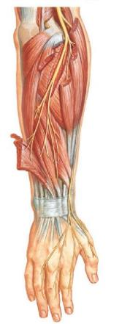
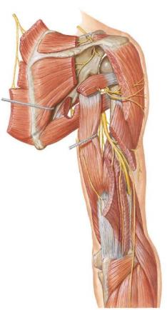
Radial nerve injury
Here it lies between & supplies ECRL, brachioradialis, & part of brachialis and then divides in deep & superficial branches. The deep branch passes to the muscles of the posterior compartment of the forearm between the two heads of supinator. The superficial branch runs the lateral side of the forearm and wrist to the skin of the lateral 2/3 of the dorsum of the hand.
The radial nerve (C5-T1) is the continuation of the pos. cord of the brachial plexus. In the axilla it gives muscular branches to triceps & the post. Cut. N. of the arm &
then passes through the triangular interval to run in the radial groove where it gives muscular branches to triceps & anconeus &
the lower lat. Cut. N. of the arm & post. Cut. N. of the forearm. After which, the radial groove leads it back to the anterior compartment of the distal arm.
Nerve review
The nerve may be injured in the AXILLA, RADIAL GROOVE or its deep branch may be compressed by supinator.
How? Where?

Slide 12
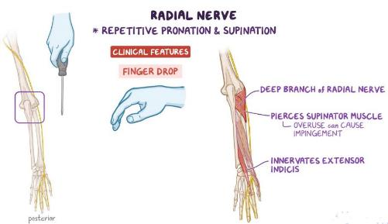
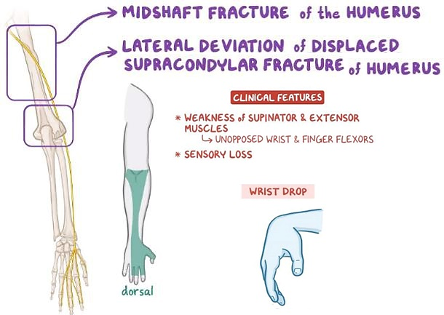
Supinator syndrome= Finger drop
Radial groove injury
Overuse of supinator can impinge the deep branch of the radial nerve leading to weakness of all posterior forearm extensor muscles EXCEPT ECRL. Wrist extension is still possible but always combined with abduction. Digital extension is greatly weakened leading to FINGER DROP. THERE IS NO SENSORY LOSS.
Finger Drop
With wrist drop the patient CANNOT MAKE A FIST. The sensory loss is limited to the back of the forearm & hand.
Wrist Drop

Slide 13
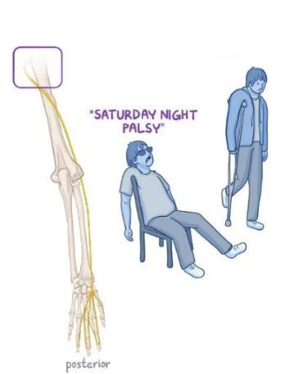
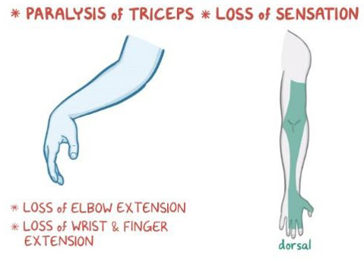
Extensive damage
Radial nerve injury in the axilla
The elbow, wrist & fingers are all unopposedly flexed. Paresthesia is extensive.
Mechanism
Result
More commonly a compression than a division.

Slide 14
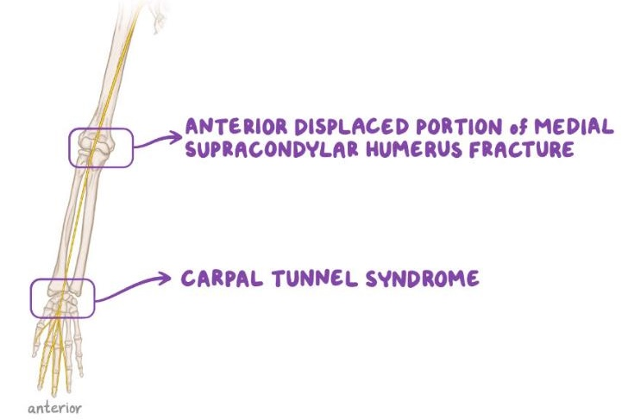
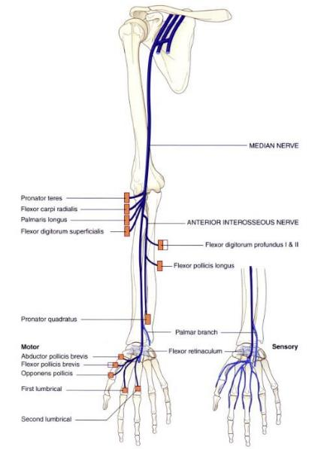
Median nerve injury
The nerve is most commonly COMPRESSED at the carpal tunnel → CARPAL TUNNEL SYNDROME.
Less commonly it can be divided at the wrist (Distal injury) → MEDIAN CLAW
It may be less commonly compressed by pronator teres → PRONATOR SYNDROME
It can also be divided by a fractured medial epicondyle.
Nerve review
Where? How?

Slide 15
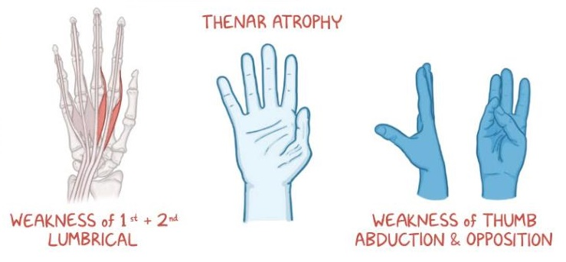
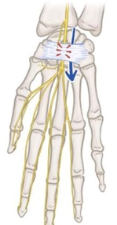
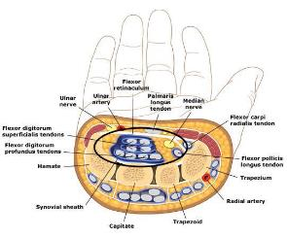
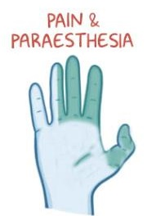
Carpal tunnel syndrome
Motor: great weakness in thumb opposition and less weakness in other movements EXCEPT ADDUCTION. If not treated, thenar muscles atrophy EXCEPT for ADDUCTOR POLLICIS.
Sensory: paresthesia in the lat. 3 ½ fingers but NOT THE PALM.
Causes
Result

Slide 16
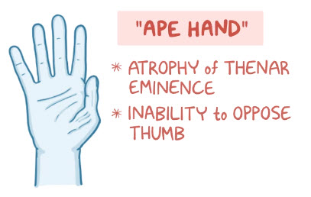
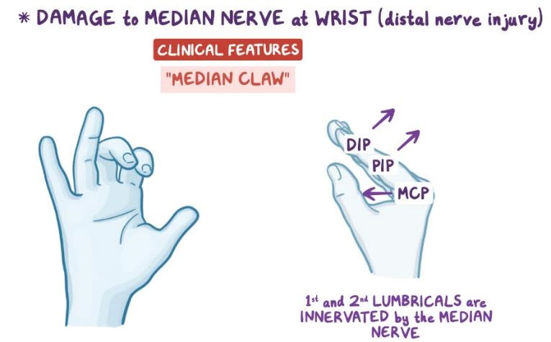
Median Claw
Recurrent branch damage
All the intrinsic thumb muscles (EXCEPT ADDUCTOR POLLICIS) are paralyzed & then atrophy. The thenar eminence is lost, the thumb is kept in adduction with slight lateral rotation due to pull from the abductor pollicis longus.
Paralysis of the lat. 2 lumbricals with preserved function of extrinsic flexors. This imbalance leads to permanent flexion of the index & middle fingers phalanges (aggravated when trying to extend the fingers).
Distal injury
Distal injury

Slide 17
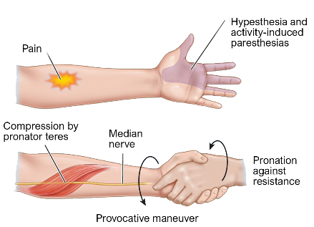
Pronator teres syndrome
Proximal cut
Repeated pronation compresses the nerve between the heads of the pronator teres. Patients complains of pain and tenderness in the proximal aspect of the anterior forearm aggravated by resisted pronation, and paresthesia of palmar aspects of the lat. 3 ½ fingers & lat. 2/3 of the palm.
SENSORY > MOTOR
With lumbricals I & II paralyzed, trying to make a fist leaves the index & middle fingers extended. The thumb is kept in an extended/adducted position. (MOTOR > SENSORY).
Proximal Compression
Proximal division
Benediction Sign

Slide 18
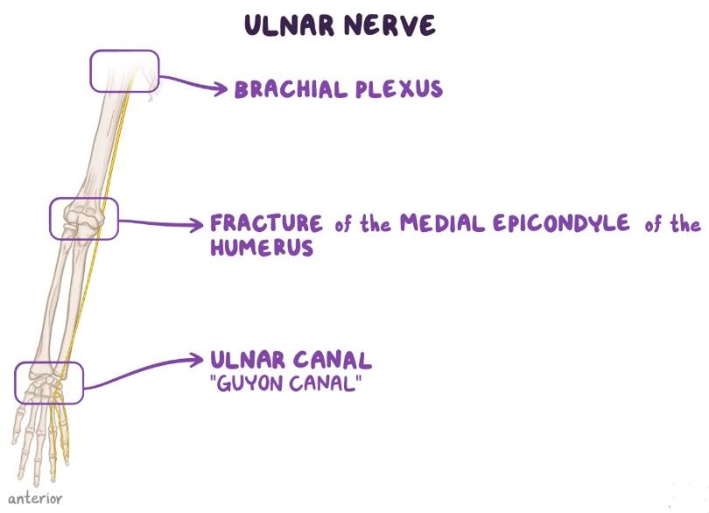
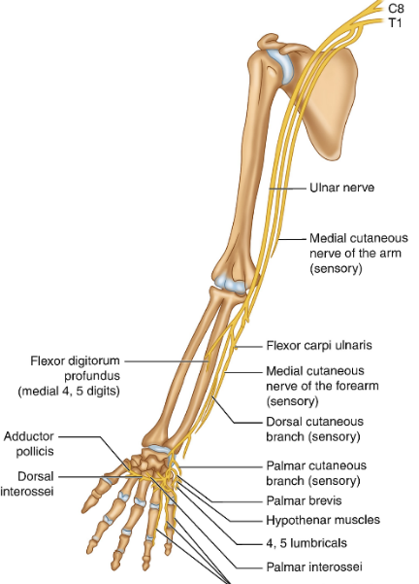
Ulnar nerve injury
The nerve is most commonly cut by a fracture of the medial epicondyle.
It may be less commonly compressed as it passes anterior to the flexor retinaculum.
Rarely, it is compressed at the axilla or by FCU.
Nerve review
Where? How?

Slide 19
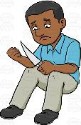
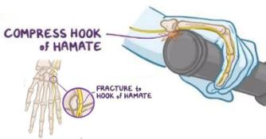
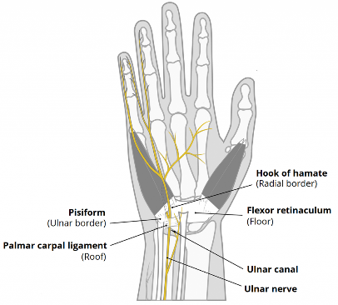
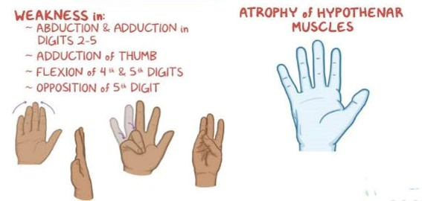
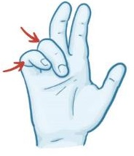
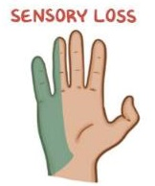
Distal ulnar nerve injury
>
Guyon’s (ulnar) canal
Cut >> Compression
Guyon’s (ulnar) tunnel houses the ulnar nerve & artery as they pass between the wrist ligaments, pisiform, hook of the hamate & abductor digiti minimi superficial to the flexor retinaculum.

Slide 20
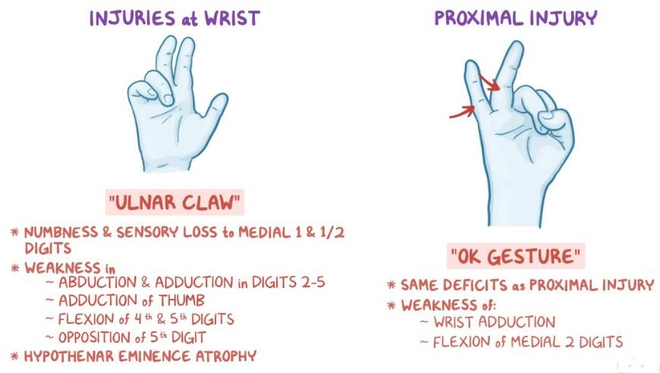
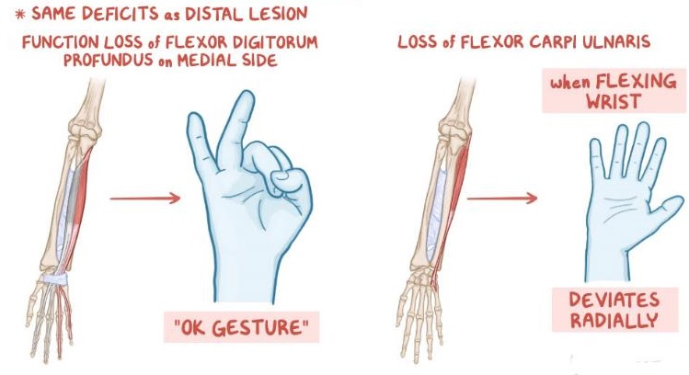
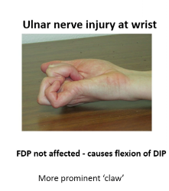
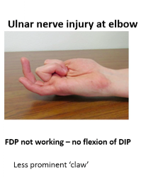
Proximal ulnar nerve injury
FCU & The medial 2 tendons of FDP are also paralyzed. So, flexing the wrsit is combined with abduction. When flexing the fingers the ring & little fingers remain extended fiving the OK SIGN.
Proximal cut
Ulnar paradox
Ulnar PRADOX = distal injury is more devastating than proximal injury. Related to the function of FDP.

Slide 21
The End

