Slide 1
The Gluteal Region pp. 566-575+658
Objectives:
Identify the boundaries & skeletal framework of the region
Recognize muscle groups of the region
Identify the main nerves & vessels
Relate the surface anatomy to important clinical notes

Slide 2
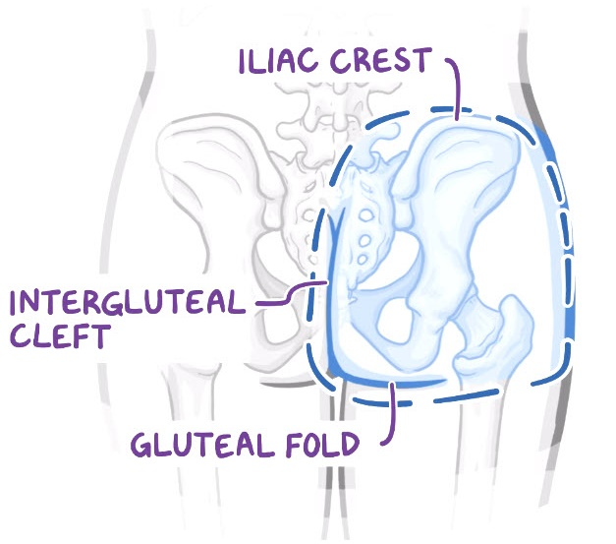
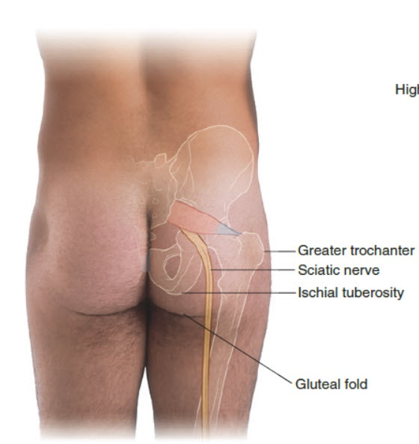
Boundaries
Superiorly: Iliac crest
Inferiorly: Gluteal fold
Medially: Intergluteal cleft
Laterally: Line joining the ASIS with greater femoral trochanter

Slide 3
Skeletal framework

Slide 4
Skeletal framework

Slide 5
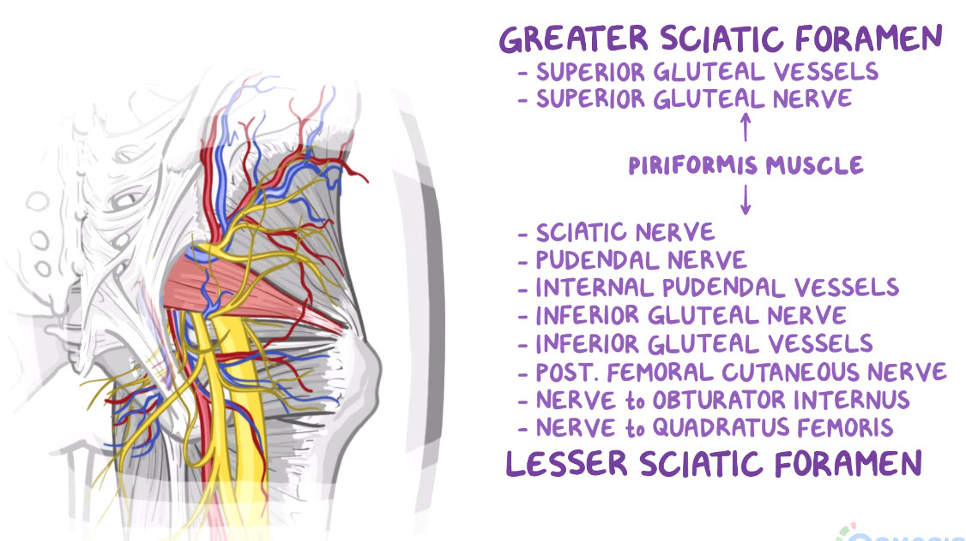
Greater sciatic foramen→ Pelvis

Slide 6
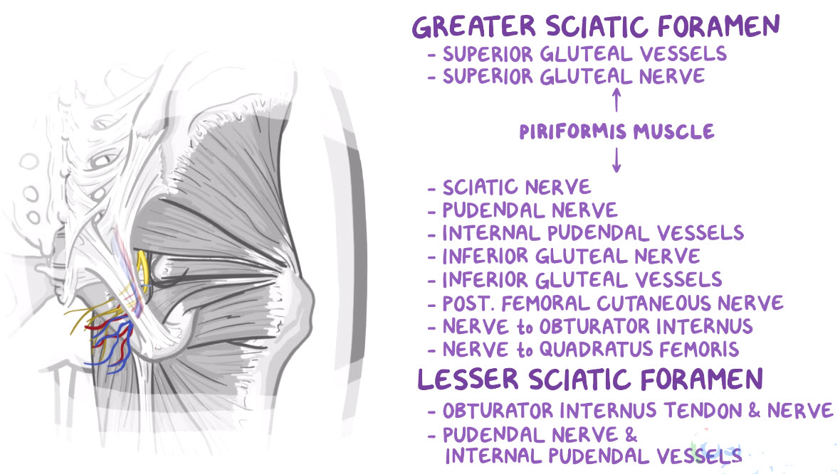
Lesser sciatic foramen→ Perineum

Slide 7
Muscle Groups
Deep group (from above downwards) | Actions
Piriformis Superior gemellus Obturator internus Inferior gemellus Quadratus femoris | Abduct flexed hip Laterally rotate extended hip Extensile ligaments supporting the posterior aspect of the hip joint
Superficial group (from inwards outwards) | Actions
Gluteus minimus Gluteus medius | Hip abduction & medial rotation Stabilize pelvis on femur *
3. Gluteus maximus | Extension of flexed hip+ Hip abduction & lateral rotation Lateral stabilizer of hip & extended knee
4. Tensor fasciae latae | - Lateral stabilizer of extended knee

Slide 8
Deep group: important attachments
All insert to medial surface of greater trochanter EXCEPT: quadratus femoris inserts to quadrate tubercle & intertrochanteric crest
Piriformis passes from within the pelvis through the greater sciatic foramen
Obturator internus passes from the deep surface of the obturator membrane through the lesser sciatic foramen

Slide 9
Deep group: Nerve supply
Priformis→N. to piriformis (S1, S2)
Superior gemellus & obturator internus→ N. to obturator internus
(L5, S1, S2)
Quadratus femoris & inferior gemellus→ N. to quadratus femoris
(L4, L5, S1)

Slide 10
Superficial group : Gluteus medius & minimus
Both arise from gluteal surface of ilium
Insert to lateral surface of greater trochanter

Slide 11
Superficial group : Gluteus medius & minimus
Stabilizing the stance
Trendelenburg's test / sign: positive in muscle weakness or superior gluteal n. injury

Slide 12
Superficial group : Gluteus maximus
Aponeurotic part to iliotibial tract
Tendinous part to gluteal tuberosity
Supplied by inferior gluteal nerve (L5, S1, S2)

Slide 13
Superficial group : Tensor fasciae latae
Stabilizes extended knee via iliotibial tract
Supplied by superior gluteal nerve (L4, L5, S1)

Slide 14
Nerves (8)

Slide 15
Vessels & Lymphatics
Superior & inferior gluteal aa. Are branches of internal iliac artery.
Superior is larger and divides into 2 banches to the gluteal mmm. & hip joint.
Both aa. Form anastomosis around the hip
Veins pass to the pelvis venous plexus
Deep lymphatics pass to internal iliac nodes. Superficial lymphatics pass to superficial inguinal nodes.

Slide 16
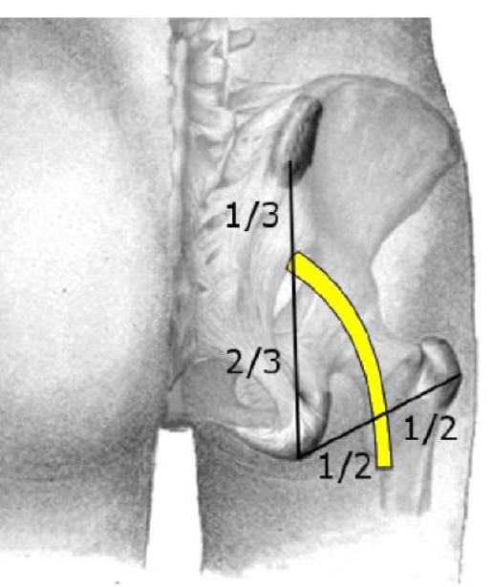
Surface anatomy of sciatic nerve

Slide 17
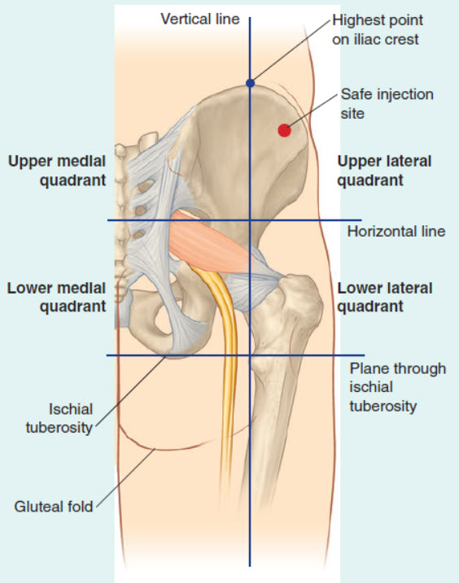
Surface anatomy of intramuscular injection

