Slide 1
Introduction To Enterobacteriaceae and E. coli
University of Mustanisiriya
College of Medicine
Department of microbiology
Dr Ali Abdulwahid
Notes:
1

Slide 2
The Enterobacteriaceae
Overview
Large group of Gram-negative rods
Found worldwide in soil, water, and vegetation.
Some are part of the normal intestinal flora of animals and humans
Others are pathogenic for humans eg. salmonellae and shigellae,
Involve many genera :
Escherichia,
Shigella,
Salmonella,
Enterobacter,
Klebsiella,
Serratia,
Proteus, and many others.

Slide 3
Common characteristics
Members of this family share these common characteristics:
Gram-negative bacilli.
Aerobes or facultative anaerobes
All species ferment rather than oxidize glucose with the production of acid or acid and gas.
Either motile with peritrichous flagella or non-motile.
Catalase positive
Oxidase-negative
Grow well on MacConkey agar

Slide 4
Morphology and Identification
Typical Organisms
Short gram-negative rods
Some species possess a capsule such as Klebsiella species (large and regular capsules), whereas other species lack the capsules.
Culture
E coli and most of the other species form circular, convex, smooth colonies with distinct edges.
Enterobacter colonies are similar but more mucoid.
Klebsiella colonies are large and very mucoid
The salmonellae and shigellae produce colonies similar to E. coli but do not ferment lactose.
Some strains of E. coli produce heamolysis on blood agar.

Slide 5
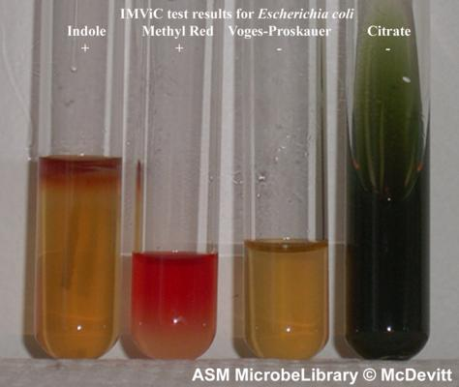
Growth charecteristics
The organisms of this family display different patterns of carbohydrate fermentation and amino acid decarboxylation and other enzymes, which are used in biochemical differentiation
IMVIC test : The four biochemical tests widely employed in the classification of enterobacteria are , which involve : the indole (I) , methyl red (MR), Voges-Proskauer (VP) and citrate utilization tests (C).
triple sugar iron (TSI) agar,
https://microbeonline.com/imvic-tests-principle-procedure-and-results/

Slide 6
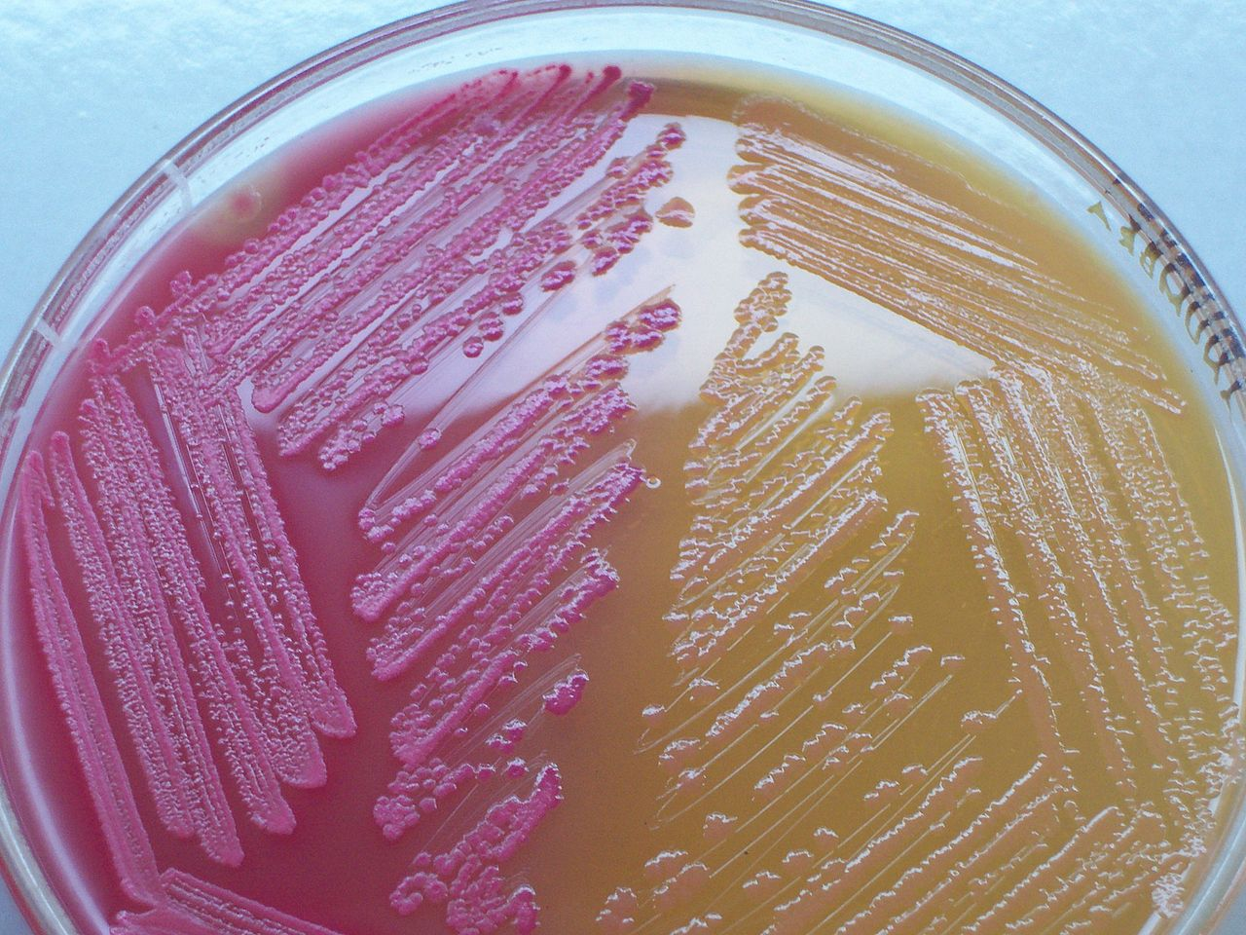
Culture on differential media such as ( eosin-methylene blue [EMB], MacConkey agar) are used to differentiate between lactose fermenting (LF) and none lactose fermenting enteric bacteria
These media containing carbohydrates (such as lactose ) and special dyes as pH indicators (such as methylene blue)
MacConkey agar with LF and non-LF colonies
By Medimicro - Own work, Public Domain, https://commons.wikimedia.org/w/index.php?curid=4511724

Slide 7
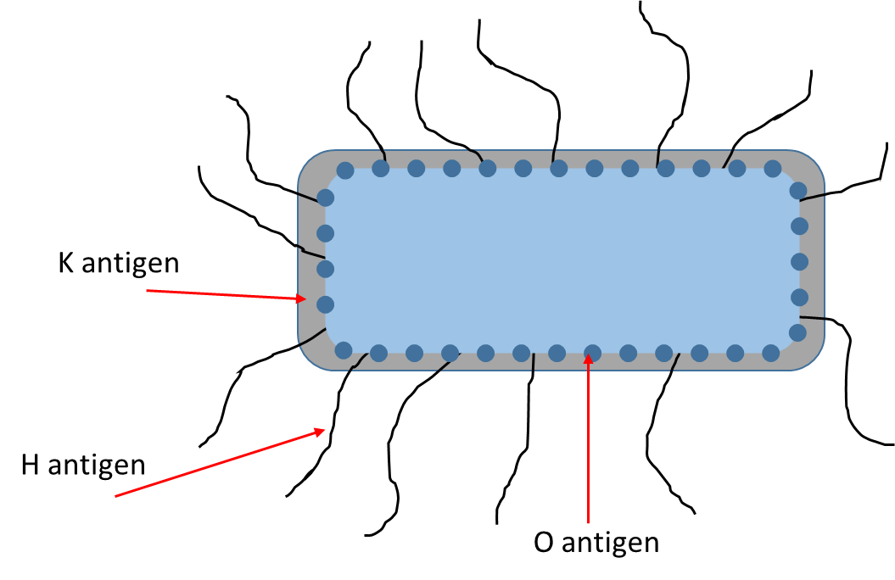
Antigenic Structure
Antigenic variability can be used for serogrouping the enteric bacteria
Three major antigens involved :
O antigens (somatic antigens): polysaccharide chains in the lipopolysaccharide complex (LPS) of the outer membrane
H antigens (flagella antigens) consisting of protein located on flagella
K antigens (capsular): Linear polymers of the outer membrane consists of a repeated units of carbohydrate (sometimes proteins as well)
The bacteria can be detected in agglutination assays with specific antibodies against these antigens
the antigenic formula of an E. coli can be O55:K5:H21.
Notes:
7

Slide 8
Main Virulence factors
Surface antigens :
Somatic antigen (O Antigen)
Exerting endotoxic activity
also protects the bacteria from phagocytosis and the bactericidal effects of human complement system .
K Antigen
Provide protection against phagocytosis and antibacterial activity of human normal serum
Fimbriae
Act as adhesion factor that promotes adhesion to human tissue such as in colon, bladder, and others .
Protect the bacteria from being washed away in the UT.

Slide 9
Toxins
Endotoxins: The toxicity of the lipid A portion of LPS of outer membrane
responsible for many of the systemic manifestations of infection.
Exotoxins : such as haemolysins, enterotoxins and cytotoxines
Usually lead to cause watery diarrhea
Antibiotic resistance factors (their encoding genes often are carried on plasmids and can be transferred between related species .
Notes:
9

Slide 10
Medically important species
1- Opportunistic organisms:
• E. coli, Klebsiella, Enterobacter, Proteus species, Morganella, Providencia, Citrobacter, and Serratia
They are members of the normal intestinal microbiota.
Non-invasive
They cause diseases only when they transfer into other body sites or tissues outside their normal intestinal sites or other less common intestinal sites
When normal host defences are inadequate, localized clinically important infections can result, and the bacteria may reach the bloodstream and cause sepsis.

Slide 11
2- Pathogenic organisms
Salmonella, Shigella, and Yersinia species
They are invasive to human and always cause diseases

Slide 12
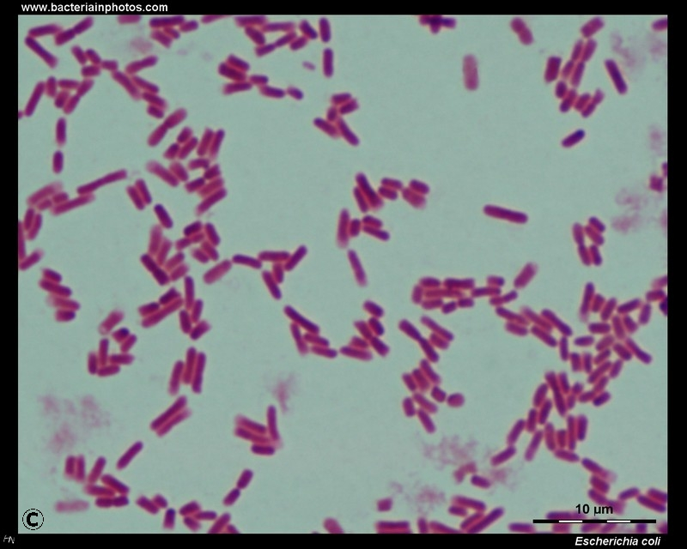
Escherichia coli (E. coli )
Morphology
is a gram-negative, straight rods
arranged singly or in pairs.
It is nonsporing
motile by peritrichate flagella, though some strains may be non-motile.
http://www.bacteriainphotos.com/Escherichia%20coli%20light%20microscopy.html
Notes:
12

Slide 13
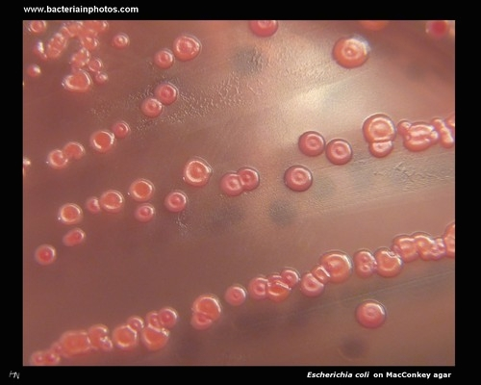
Cultural Characteristics
Colonies are large, thick, grayish white, moist, smooth, opaque or partially translucent disks.
Many pathogenic isolates have polysaccharide capsules.
Some strains may occur in the ‘mucoid’ form.
On blood agar, many strains, especially those isolated from pathogenic conditions, are hemolytic.
On MacConkey’s medium, colonies are red or pink due to lactose fermentation.
In broth, growth occurs as general turbidity and a heavy deposit, which disperses completely on shaking.
Source of picture :
http://www.bacteriainphotos.com/cultivation%20media/MC%20larger/escherichia%20on%20macconkey4.jpg

Slide 14
Biochemical Reactions
E. coli ferments glucose, lactose, mannitol, maltose and many other sugars with the production of acid and gas.
Typical strains do not ferment sucrose.
IMVIC test : Indole and MR positive, and VP and citrate negative (+ + - - )
It is also negative for urease test, H2S production, and gelatin liquefication.

Slide 15
Antigenic Structure
Serotyping of E. coli is based on three antigens (as in other entric bacteria:
the flagellar antigen H
somatic antigen O
the capsular antigen K

Slide 16
Main virulence factors
1- surface antigens : Including : H, O and K antigens
2- toxins : including
endotoxins
exotoxins: two types:
Hemolysins
Enterotoxins (usually cause diarrhea) :
There are three distinct types enterotoxins produced by E. coli
Heat labile toxin (LT)
Heat stable toxin (ST)
iii. Verotoxin (VT) also known as Shiga-like toxin (SLT).

Slide 17
Heat labile toxin (LT)
Heat Stable Toxin (ST)
Like cholera toxin
Multimric toxin (1 A subunit + 5 B subunits)
Activates adenyl cyclase in the enterocyte
increase the level of cyclic adenosine 5’ monophosphate (cAMP),
Increased outflow of water and electrolytes into the gut lumen, with consequent diarrhea.
A small, monomeric toxin
binds to and activates guanylate cyclase in the enterocytes
increase in the level of cyclic guanosine monophosphate cGMP
subsequent hypersecretion of fluid
Shiga-like toxin (SLT).
Comprise one A and five B subunits.
Penetrate the cells and subsequently disrupts protein synthesis.
Destruction of the intestinal villus results in decreased absorption with a relative increase in fluid secretion.

Slide 18
Diseases
Urinary tract infection
E. coli is the most common cause of UTI
Sepsis
The bacteria may reach the bloodstream and cause sepsis in:
Immune-compromised people
Newborns
Sepsis can also occur as a secondary infection to UTI.
Meningitis
E. coli along with group B streptococci are the leading causes of meningitis in infants.

Slide 19
E. coli–associated diarrheal diseases
E. coli strains that cause diarrhea are classified according to their virulence properties and their mechanisms in causing diseases into five groups:
Such groups involved :
Enteropathogenic E. coli (EPEC)
Enterotoxigenic E. coli (ETEC )
Enteroinvasive E. coli (EIEC)
Enteroaggregative E. coli (EAEC)
Shiga toxin-producing E. coli (STEC)
Notes:
19

Slide 20
Enteropathogenic E. coli (EPEC)
One of the leader causes of diarrhea in infants in developing countries.
The infection is associated with severe watery diarrhea; vomiting; and fever.
The infection is usually self-limited but can be prolonged or chronic.
The duration of diyarrhea can be shortened and the chronic infection can be treated by antibiotics
Notes:
20

Slide 21
Enterotoxigenic E. coli (ETEC)
The common cause of “traveler’s diarrhea” and a very important cause of diarrhea in infants in developing countries
The bacteria initially adhere to the mucosal surface of the epithelial cells of the small intestine.
It produces a heat-stable enterotoxin (ST) or a heat-labile (LT) cholera like enterotoxin, or both
The infection is waterborne or foodborne
It is usually of brief duration, involving a rapid onset of loose stools along with variable symptoms , including nausea, vomiting and abdominal cramps.
Antimicrobial prophylaxis can be effective
Antibiotic treatment effectively shortens the duration of diyarrhea.

Slide 22
Enteroinvasive E. coli (EIEC)
The organisms invade epithelial cells of the large intestine, penetrate them and multiply intracellularly, leading to blood and mucus in the stool.
Spreading from one cell to neighbouring cells leads to tissue destruction and consequent inflammation , leading to symptoms of bacillary dysentery
Infections are usually food-borne but there is also evidence of cross-infection between persons (faecal-oral).
The pathogenesis and clinical picture of EIEC infections are ranging from mild diarrhea to frank dysentery, and occurs, in children as well as adults.

Slide 23
Enteroaggregative E. coli (EAEC)
They are able to adhere to particular laboratory-cultured cells in an aggregative or ‘stacked brick’ pattern
causes acute and chronic diarrhea (>14 days in duration) in developing countries.
cause of foodborne infection in developed countries
associated with traveller’s diarrhea and persistent diarrhea in patients with HIV.
produce a low molecular weight heat stable enterotoxin called EAST (‘enteroaggregative heat stable enterotoxin-1)
Some isolates express hemolysins.
Symptoms : watery diarrhea, vomiting, occasional abdominal pain, dehydration >14 days

Slide 24
Shiga toxin-producing E. coli (STEC)
The strain is so called Shiga toxin-producing E coli (STEC) due to the cytotoxic toxins they produce
It is associated with haemorrhagic colitis (a severe form of diarrhea) and with haemolytic uremic syndrome
Infection either sporadic or occur as out breaks of food poisoning (in the community, nursing homes of elderly and day care centres)
Direct and in direct Contamination with human or animal faeces is the main source of infection
Infection can be prevented by thoroughly cooking meat and avoiding unpasteurized products

Slide 25
Treatment and prevention
Treatment
Antibiotic therapy must take into consideration the resistance pattern of the pathogen.
Aminopenicillins, ureidopenicillins, cephalosporins, quinolones, or cotrimoxazole are useful agents.
oral replacement of fluid and electrolyte losses are essential in severe diarrhea
Prevention
Eating thoroughly cooked foods and drink disinfected water is of important to prevent infection for travellers
chemoprophylaxis with anti-infective agents can be used in preventing traveller’s diarrhea

Slide 26
References
Reidle, S., Morse, S. A., Meitzner, T., and Miller, S. 2019. Jawetz, Melnick & Adelberg’s Medical Microbiology , Twenty-Eight Edition. The McGraw-Hill education, Inc. USA
Kumar, S. 2012. Textbook of microbiology. Jaypee Brother Medical Publishers (P) Ltd. New Delhi, India.
Websites :
Microbiology in picture (https://www.microbiologyinpictures.com)
Bacteria in photos (http://www.bacteriainphotos.com)
Microbe online (https://microbeonline.com)

Slide 27
Thank You For Your Attention

