Slide 1
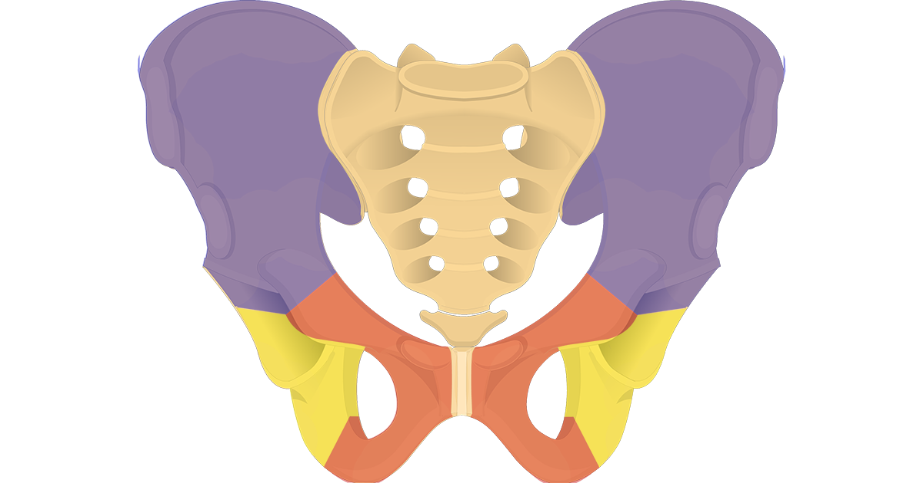
Lower Limb/ Bony Pelvis
Dr. Ahmed Al-Musawi
Human Anatomy

Slide 2
Objectives
Define the lower limb regions
Identify the bony pelvis parts
Define and identify the parts of hip bone
Define the femur and explain the features of its proximal part
Describe the front of the thigh and its contents
Define and describe the femoral sheath
P 543-549

Slide 3
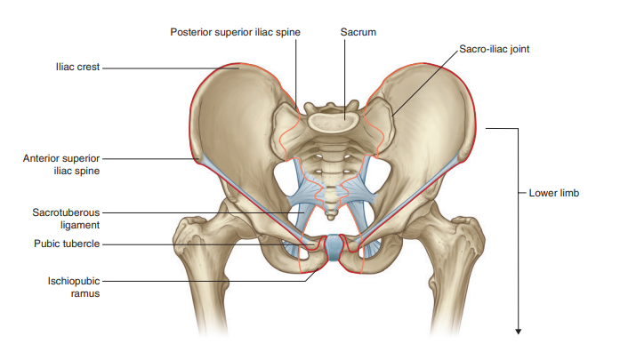
Upper margins of lower limb

Slide 4
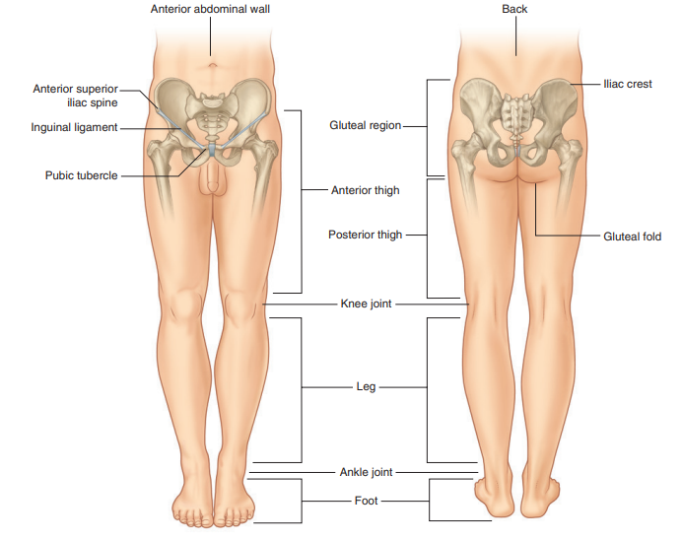
Lower limb regions

Slide 5
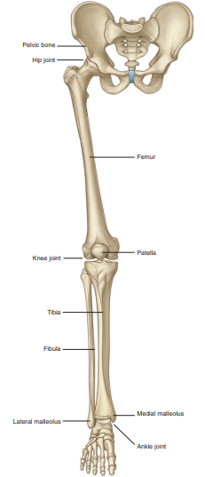
Bones of lower limbs

Slide 6
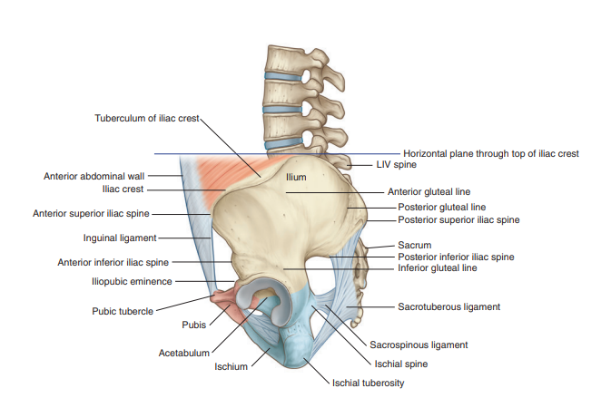
Bony pelvis
Each pelvic bone is formed by three bones (ilium, ischium, and pubis), which fuse during childhood. The ilium is superior and the pubis and ischium are antero-inferior and postero-inferior, respectively

Slide 7
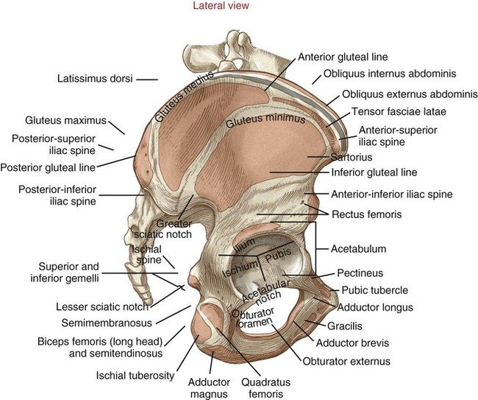
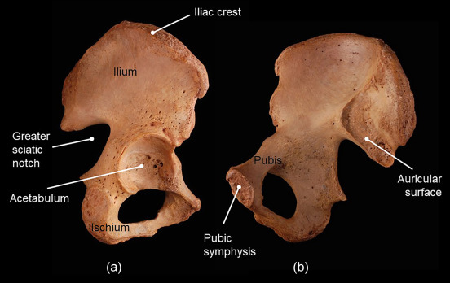
Ilium

Slide 8
Ischium/ ischiopubic rami

Slide 9
Acetabulum

Slide 10
Proximal femur

Slide 11
Posterior view

Slide 12
Front of the Thigh
And femoral sheath

Slide 13
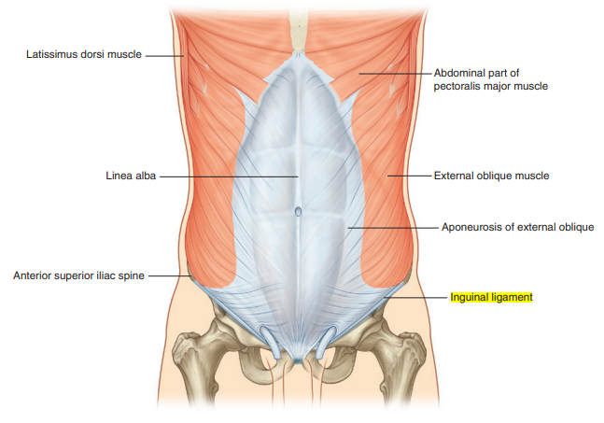
Inguinal ligaments

Slide 14
Fascia lata and iliotibial tract

Slide 15
Saphenous opening

Slide 16
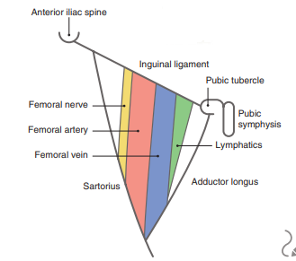
Femoral sheath

Slide 17
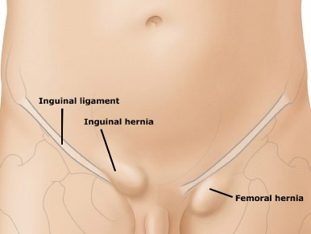
Femoral hernia

