Slide 1
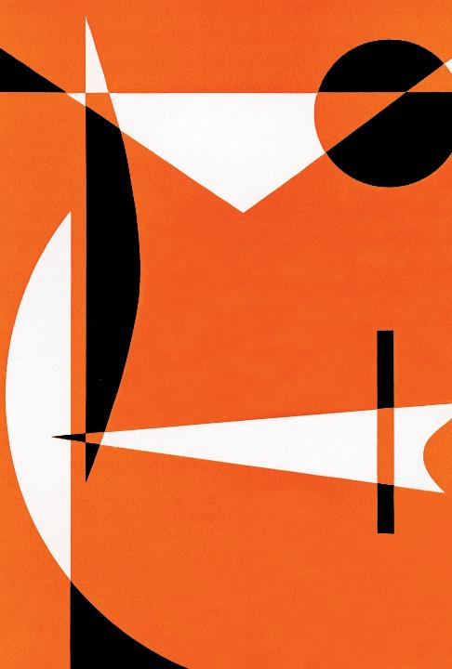
The Scalp & Temporal fossa
Assist. Proff. Dr. Sameh S. Akkila

Slide 2
Objectives/References
1
Take a conceptual overview of the head regions
2
Identify the extent, layers, neurovascular supply & lymphatic drainage of the scalp
3
Recognize the boundaries, contents & relations of the temporal fossa
4
Clinico-anatomical correlations
Gray’s Anatomy for Students: pp. 825, 911, 961

Slide 3
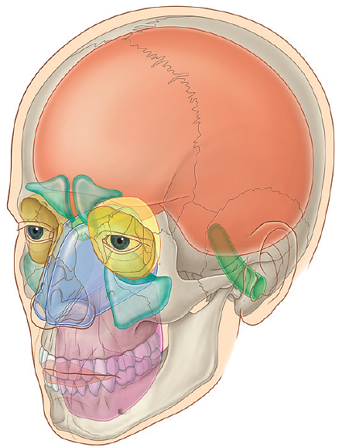
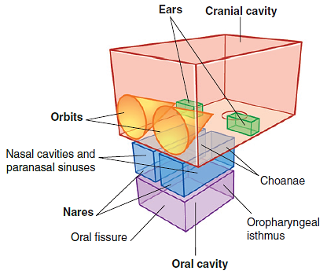
Conceptual overview of the head: Major Compartments
Cranial cavity: contains the brain & meninges
Orbits: contain the eyeballs & extra-ocular muscles
Nose & paranasal sinuses: for breathing, olfaction & speech
Ears: 3 ear parts for hearing & balance
Oral cavity: deglutition, taste & articulation

Slide 4
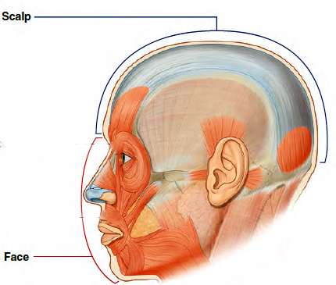
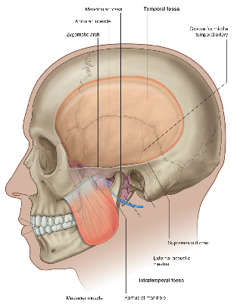
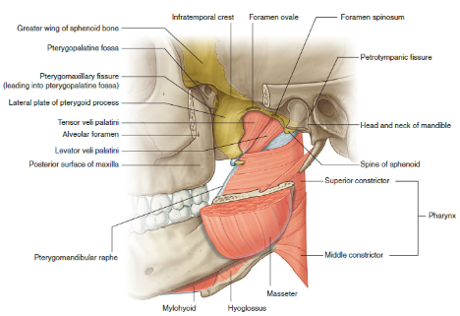
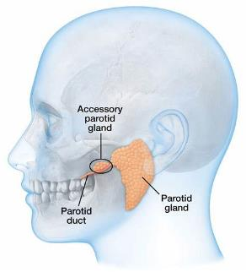
Conceptual overview of the head: Major Regions
Temporal
fossa
Infratemporal
& Pterygopalatine
fossae
Scalp & Face
Parotid
region

Slide 5
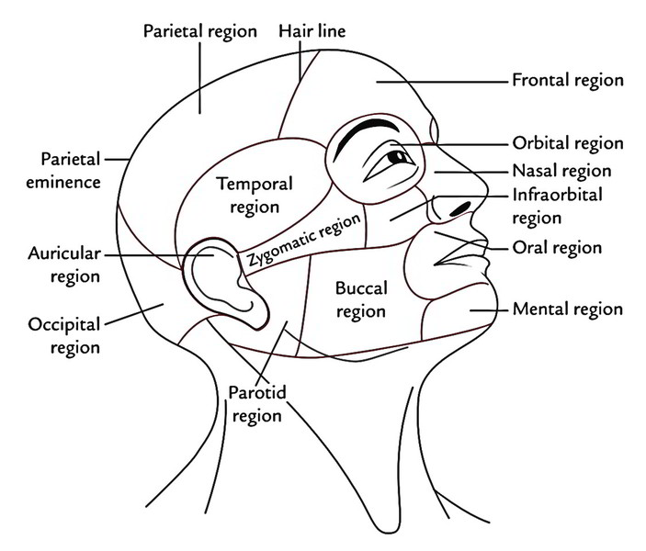
Conceptual overview of the head: Subregions

Slide 6
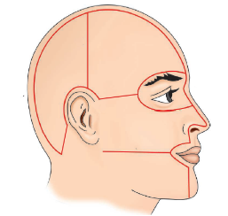
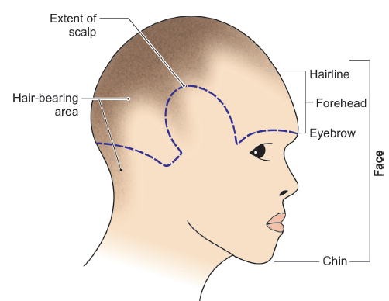
The Scalp: Extent & Quadrants
Anteriorly: EYEBROWS
Laterally: SUPERIOR TEMPORAL LINES (side hair line)
Posteriorly: SUPERIOR NUCHAL LINES (Neck nape)
AR
PR
Vertex
Highest point of the cranial vault
AL
PL

Slide 7
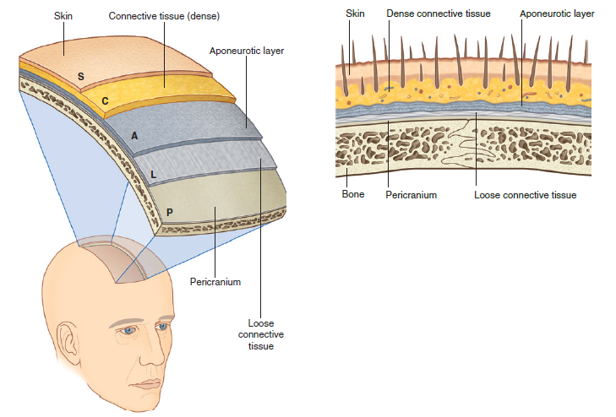
The Scalp: Layers Mnemonic
Move as
one unit
(surgical layer)
S: Skin: Thick, hairy with many sebaceous & sweat glands
C: Cutaneous tissue= Dense superficial fascia
A : Aponeurosis= Galea Aponeurotica of Occipitofrontalis
L: Loose areolar tissue= Subaponeurotic layer
P: Pericranium= outer periosteum of the bones of the cranial vault

Slide 8
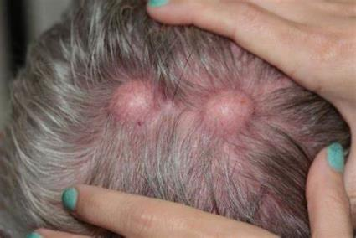
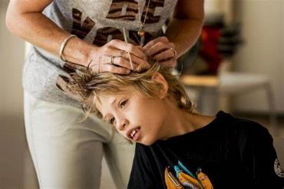
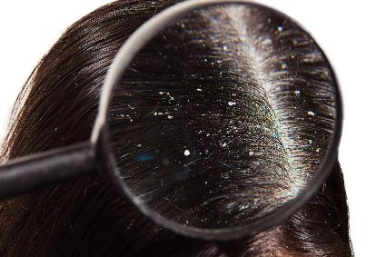
1. Common Scalp Skin diseases
Head lice
Sebaceous cysts
Dandruff

Slide 9
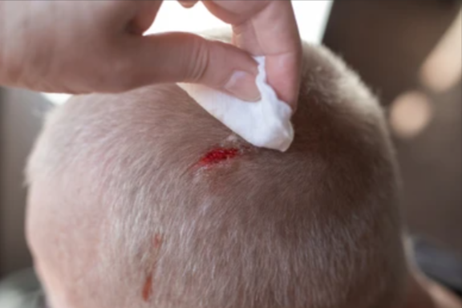
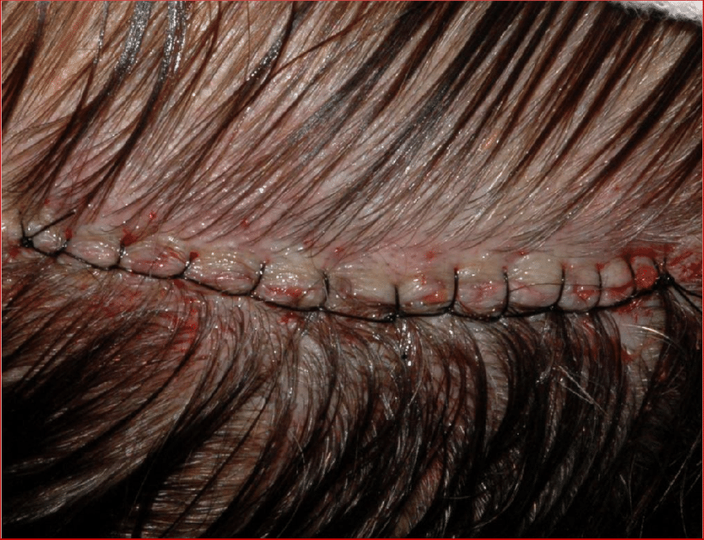
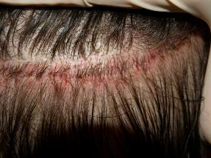
2. The Dense superficial fascia (Connective tissue)
Contains the blood vessels and nerves of the scalp.
Its fibrous strands are fixed to the walls of the blood vessels → prevents retraction of the blood vessels → scalp wounds gape & bleed profusely.
bleeding in the scalp is controlled by application of direct pressure or surgical sutures.

Slide 10
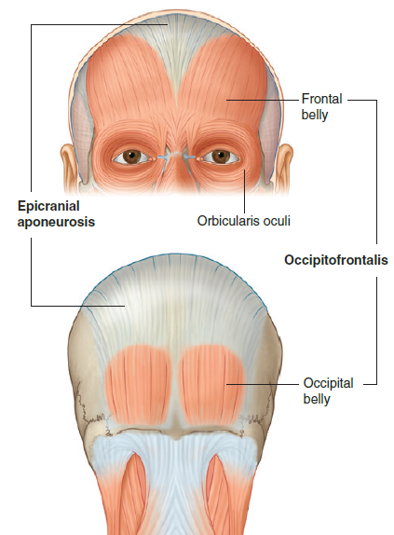
3. Aponeurosis of Occipitofrontalis
Occipitofrontalis | Occipitofrontalis
Belly | Origin | Insertion | Nerve supply | Action
Occipital | Lateral part of superior nuchal line | Galea Aponeurotica | Facial n. (CN VII) [posterior auricular br.] | Draws scalp backward
Frontal | Skin of eyebrow | Galea Aponeurotica | Facial n. (CN VII) [temporal br.] | Raises eyebrows wrinkling the forehead

Slide 11
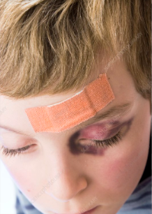
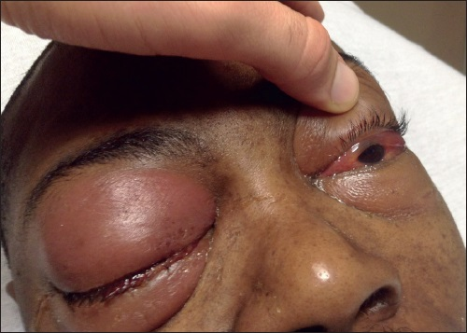
4. Subaponeurotic space (Dangerous area)
Filled with loose areolar tissue beneath the aponeurotic layer. The emissary veins, which communicate the veins of the scalp with the intracranial venous sinuses, pass through this space. The infection in this space readily enters the cranium
through the emissary veins causing thrombosis of the venous sinuses or osteomyelitis of the cranial bones.
This space is closed on all sides except anteriorly, where it extends into the upper eyelid. In this way black eye is produced if there is bleeding in this space due to scalp injury on direct blow to the skull.

Slide 12
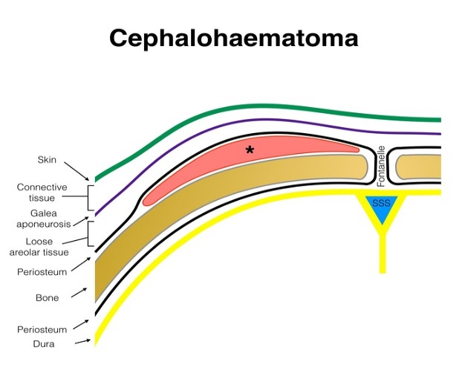
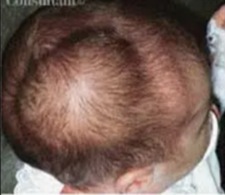
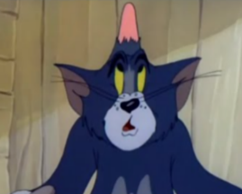
5. Pericranium
Forms a loose covering for the bones except at the sutures, where it is continuous with the endocranium (=inner periosteum of the bones).
Cephalhematoma is the collection of blood underneath the pericranium in injury to the bones of the vault limited to the outline of the sutures of that bone.

Slide 13
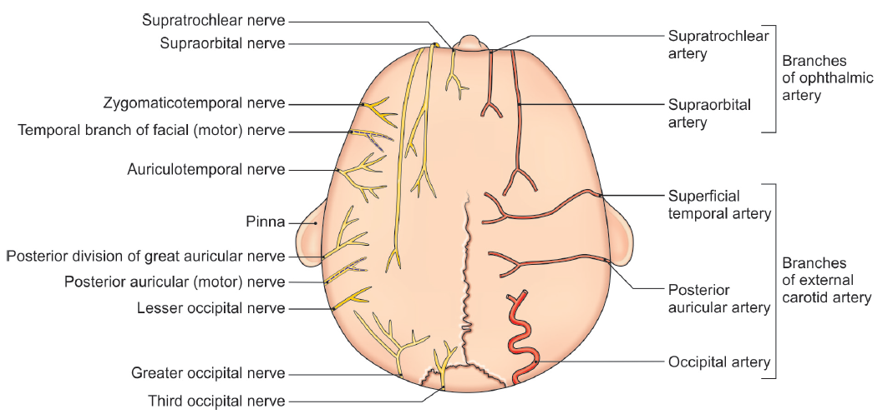
The Scalp: Neuro-arterial supply
V1:Opthalmic division
of trigeminal n (CN V)
V2:Maxillary
division Of CN V
V3: Mandibular
division Of CN V
C2, C3 Ant. Rami →
C2 Ant. Ramus →
C2 Post. Ramus →
C3 Post. Ramus →

Slide 14
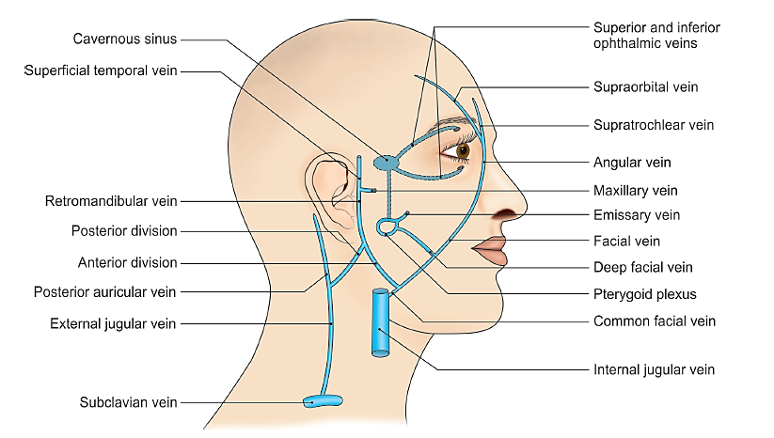
The scalp: Venous drainage (more to come later in details)

Slide 15
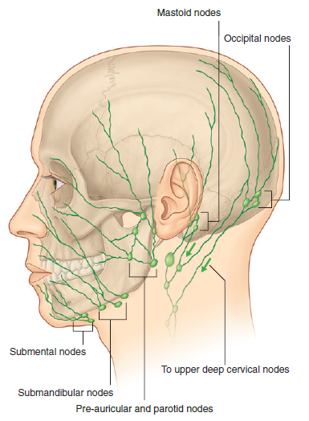
The scalp: Lymphatic drainage
1. The lymphatics in the occipital region → occipital nodes near the attachment of the trapezius muscle at the base of the skull → Upper deep cervical nodes.
2. Lymph from the posterior quadrant → mastoid nodes (= retro-auricular/posterior auricular nodes), behind the ear near the mastoid process → Upper deep cervical nodes.
3. Lymph from the anterior quadrant → preauricular & parotid nodes anterior to the ear on the surface of the parotid gland.
4. Some lymph from the forehead → submandibular nodes through efferent vessels that follow the facial artery.

Slide 16
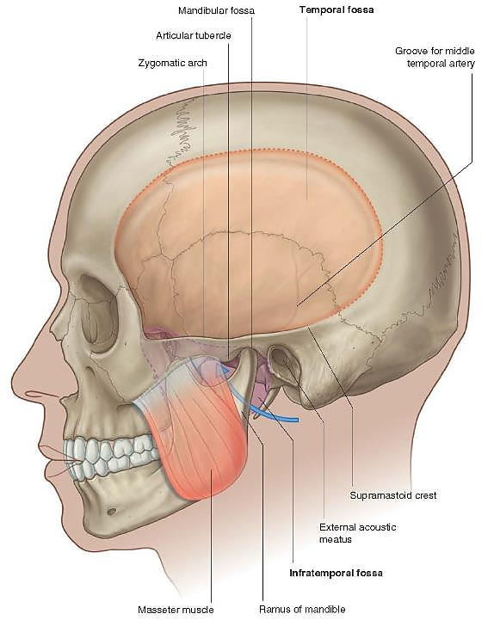
The temporal fossa: Boundaries
& Communications
Anterior : Zygomatic (Z) and frontal (F) bones
Posterior : Inferior temporal line (…..) and supramastoid crest
Superior : Superior temporal line (……)
Inferior : Zygomatic arch
Floor : Parts of frontal (F), parietal (P), temporal (T) and greater wing of sphenoid (S) meeting at an H-shaped suture called the pterion (O).
Roof : temporal fascia.
Communicates inferiorly with the infratemporal fossa via a gap between the zygomatic arch & side of the skull
P
F
T
S
Z

Slide 17
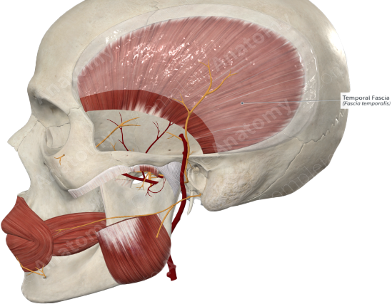
The temporal fossa: Contents
Temporalis muscle & Fascia
Deep temporal nerves
Deep temporal artery (from maxillary a.)
Middle temporal artery (From superficial temporal a.)
Zygomaticotemporal nerve and artery

Slide 18
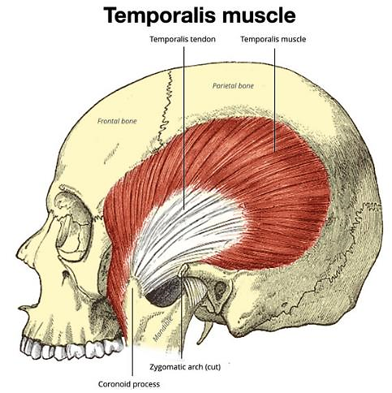
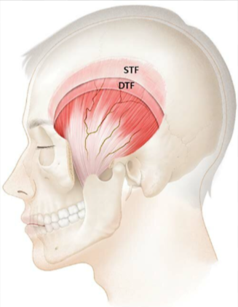
Temporalis muscle & Fascia
The temporal fascia is a thick aponeurotic sheet that covers the outer surface of temporalis muscle. Superiorly, the fascia is single layered and is attached to the superior temporal line.
Inferiorly, it splits into two layers (superficial & deep) which are attached to the inner and outer lips of the upper border of the
zygomatic arch.
Origin | Insertion | Nerve supply | Action
Floor of temporal fossa & temporal fascia | Coronoid process & anterior border of mandibular ramus | Deep temporal nerves [from V3] | Anterior fibers elevate while posterior fibers retract the mandible

