Slide 1
Pediatric leukemias
Dr. Nihal Khalid Yaseen

Slide 2
Learning objectives
To understand the incidence of leukemia in pediatrics.
To recognize various types of leukemia in pediatrics with their clinical presentation and pathology.
To outline a diagnostic approach to a patient with newly diagnosed leukemia.
To recognize treatment outline of leukemia in infants and children with main treatment complications.
To identify survivorship care plan.

Slide 3
Introduction
Pediatric leukemia is a malignant diseases in which genetic abnormalities in a hematopoietic cell give rise to an unregulated clonal proliferation of cells.
Leukemias are the most common malignant neoplasms in childhood, accounting for approximately 31% ( one third) of all malignancies in children younger than 15 years old.
Nearly 80% of cases are ALL (acute lymphoblastic leukemia), 15% AML (acute myelogenous leukemia), 2% acute leukemia of ambiguous lineage, 2-3% CML (chronic myelogenous leukemia), and 1-2% JMML (juvenile myelomonocytic leukemia).

Slide 4
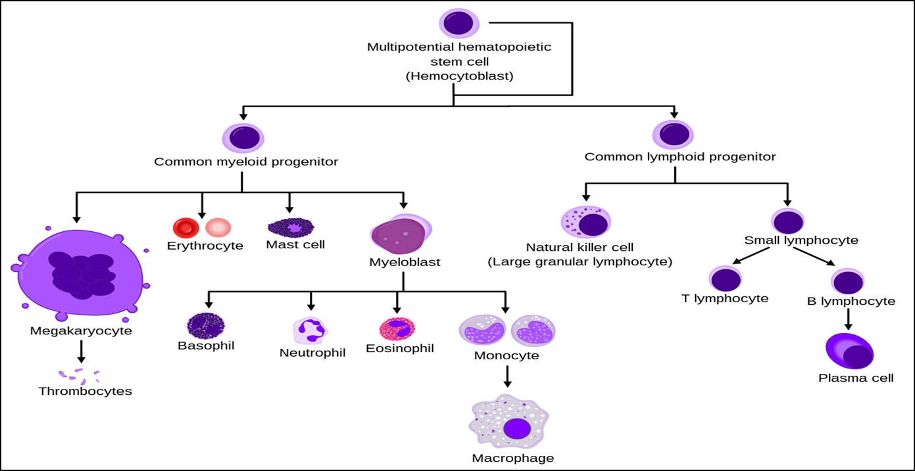
Hematopoiesis

Slide 5
GENETIC SUSCEPTIBILITY | Congenital syndromes: Down syndrome, Fanconi anemia, ataxia telangiectasia, NF-1, Kostmann syndrome Identical twins (higher risk of developing leukemia in a second member)
ENVIRONMENTAL FACTORS | Pesticide exposure, ionizing radiation, childhood infections, prior use of alkylating chemotherapeutic agents.
Epidemiology & risk factors
3-4 cases per 100,000 children in united states.
Peak incidence between 2 and 5 years of age and more common in boys than in girls.
The etiology of ALL is unknown, although several genetic and environmental factors are associated with childhood leukemia as shown in table (1).

Slide 6
Classification
FAB (French- American- British) classification according to cellular morphology where ALL is subclassified into L1, L2, L3 and AML is further subclassified into M0, M1, M2, M3, M4, M5, M6, & M7.
Immunophenotypic classification according to surface markers on blast cells either: ALL which is subclassified into B- lymphoblastic leukemia (B cell origin) which constitutes 85% of cases and T- lymphoblastic leukemia which forms only 15% of cases, AML, or acute leukemia of ambiguous lineage.
The World Health Organization (WHO) classification of ALL is based on cytogenetic and molecular characteristics of blast cells the most famous of these is the BCR ABL fusion gene formed by t(9;22) also termed as Philadilphia chromosome found in most cases of CML and certain cases of ALL also.

Slide 7
CLINICAL MANIFESTATIONS
The initial presentation of ALL usually is nonspecific and relatively brief.
Common symptoms are:- anorexia, fatigue, malaise, irritability, and fever are often present. Bone or joint pain, particularly in the lower extremities, may be present.
Signs and symptoms of bone marrow failure as pallor, exercise intolerance, bruising, oral mucosal bleeding or epistaxis.
Organ infiltration can cause lymphadenopathy, hepatosplenomegaly, testicular enlargement, or central nervous system (CNS) involvement (cranial neuropathies, headache, seizures, papilledema), ocular involvement may cause blurring of vision from leukemic infiltrates or retinal hemorrhages
Respiratory distress may be caused by severe anemia or mediastinal node compression most frequently seen in adolescent males with T- cell ALL.

Slide 8
Patients with AML may present with:- subcutaneous nodules or “blueberry muffin” lesions (especially in infants), infiltration of the gingiva, signs and laboratory findings of disseminated intravascular coagulation (especially indicative of APL), and discrete masses, known as chloromas.

Slide 9
DIFFERENTIAL DIAGNOSIS
Pancytopenia:- aplastic anemia (congenital or acquired), marrow infiltration from metastatic disease.
Thrombocytopenia:- immune thrombocytopenia (ITP).
Infections:- infectious mononucleosis (fever and lymphadenopathy), CMV infection.
Rheumatological:- juvenile idiopathic arthritis (fever and bone pain)

Slide 10
Diagnosis
Peripheral blood findings (CBC): anemia and thrombocytopenia are seen in most patients. Total WBC count may be low, normal or high, sometimes WBC count may be > 100*10⁹ cells termed as hyperleukocytosis which causes symptoms from hyper viscosity and stasis of blood as CVA, bleeding, and respiratory acidosis.
Blood film examination may show blast cells.
Bone marrow examination: used to confirm the diagnosis. ALL is diagnosed by a bone marrow evaluation that demonstrates >25% of the bone marrow cells as a homogeneous population of lymphoblasts while the diagnosis of AML requires the presence of >20% myeloblasts in bone marrow aspiration or biopsy.
Immunophenotyping using flow cytometry to identify subtype.
Cytogenetics—karyotype and molecular studies.
CSF examination. If blasts are found and the CSF leukocyte count is elevated, overt CNS or meningeal leukemia is present.

Slide 11
Further workup
Chest radiograph: Mediastinal mass more common in T-cell leukemia.
Blood chemistry: Electrolytes, Blood urea nitrogen (BUN), creatinine, calcium, phosphorous, uric acid, Lactate dehydrogenase (LDH), and liver function tests. Patients may present with laboratory or clinical evidence of tumor lysis syndrome due to rapid lysis of malignant blasts leading to hyperuricemia, renal impairment, hypocalcemia, and hyperphosphatemia.
Coagulation profile: Prothrombin time (PT), Partial Thromboplastin time (PTT), and fibrinogen.

Slide 12
Treatment
The single most important prognostic factor in ALL is the treatment
Risk-stratified therapy is the standard of current ALL treatment

Slide 13
Phases of ALL treatment
Induction, aims to eradicate the leukemic cells from the bone marrow. Usually continues for 4 weeks and consists of vincristine, prednisone, and L-asparaginase. Patients at higher risk also receive daunorubicin.
CNS prophylaxis using intrathecal methotrexate.
Consolidation, focuses on intensive CNS therapy in combination with continued intensive systemic therapy to prevent later CNS relapses.
Maintenance phase of therapy, which lasts for 2- 3 years. Patients are given mercaptopurine and methotrexate orally, usually with intermittent doses of vincristine.
A small number of patients with particularly poor prognostic features, may undergo bone marrow transplantation during the first remission.
Philadelphia chromosome–positive ALL receive imatinib; an agent specifically designed to inhibit the BCR- ABL kinase resulting from the translocation.

Slide 14
For AML, various induction chemotherapy regimens exist, typically including an anthracycline (as Daunorubicin) in combination with high- dose cytarabine.
Acute promyelocytic leukemia (APL), characterized by a gene rearrangement involving the retinoic acid receptor [t(15;17); PML- RARA], is very responsive to all- trans- retinoic acid (ATRA, tretinoin) combined with anthracyclines and cytarabine.

Slide 15
SUPPORTIVE CARE
Patients with high WBC counts are especially prone to tumor lysis syndrome as therapy is initiated. The kidney failure associated with very high levels of serum uric acid can be prevented or treated with allopurinol or urate oxidase in addition to aggressive hydration using twice maintenance (3000ml/BSA).
Chemotherapy often pro duces severe myelosuppression, which can require blood and platelet transfusion and aggressive empirical antimibiotics for sepsis in febrile children with neutropenia.
Patients must receive prophylactic Trimethoprim- sulfamethoxazole for Pneumocystis jiroveci pneumonia during chemotherapy.

Slide 16
Improvements in therapy and risk stratification have resulted in significant increases in survival rates, with current data showing overall 5- year survival of ALL approximately 90%. The most important prognostic factors for ALL are shown in table 2. Patients with AML recently achieved survival rates of 60-70%. However, those with APL (acute promyelocytic leukemia) show excellent survival with the addition of ATRA to their treatment regimens. Also, patients with Down’s syndrome have better prognosis due to greater sensitivity to chemotherapy.
PROGNOSIS

Slide 17
Criteria | Good prognosis | Bad prognosis
Age (yr) | 1-10 | <1 , >10
Gender | Female | Male
Race | White | Black, Hispanics
Immunophenotype | B cell | T cell
CNS involvement | No | Yes
Initial WBC count *10⁹/L | <50 | >50
Response to initial treatment as assessed by BMA | Low or absent minimal residual disease | Persistent minimal residual disease
Favorable cytogenetics | Present | Absent

Slide 18
Survivorship care plan
Survivors of childhood leukemia remain at risk for multiple long-term effects of therapy, including cardiac complications (Daunorubicin), neurocognitive issues (cranial irradiation), endocrine and metabolic disorders, obesity, and secondary malignancies (cyclophosphamide). They require close monitoring and follow-up.

Slide 19
References
Nelson textbook f pediatric, 22nd edition, 2024
Lanzkowsky’s manual of pediatric hematology and oncology, 7th edition, 2022
UpToDate

