Slide 1
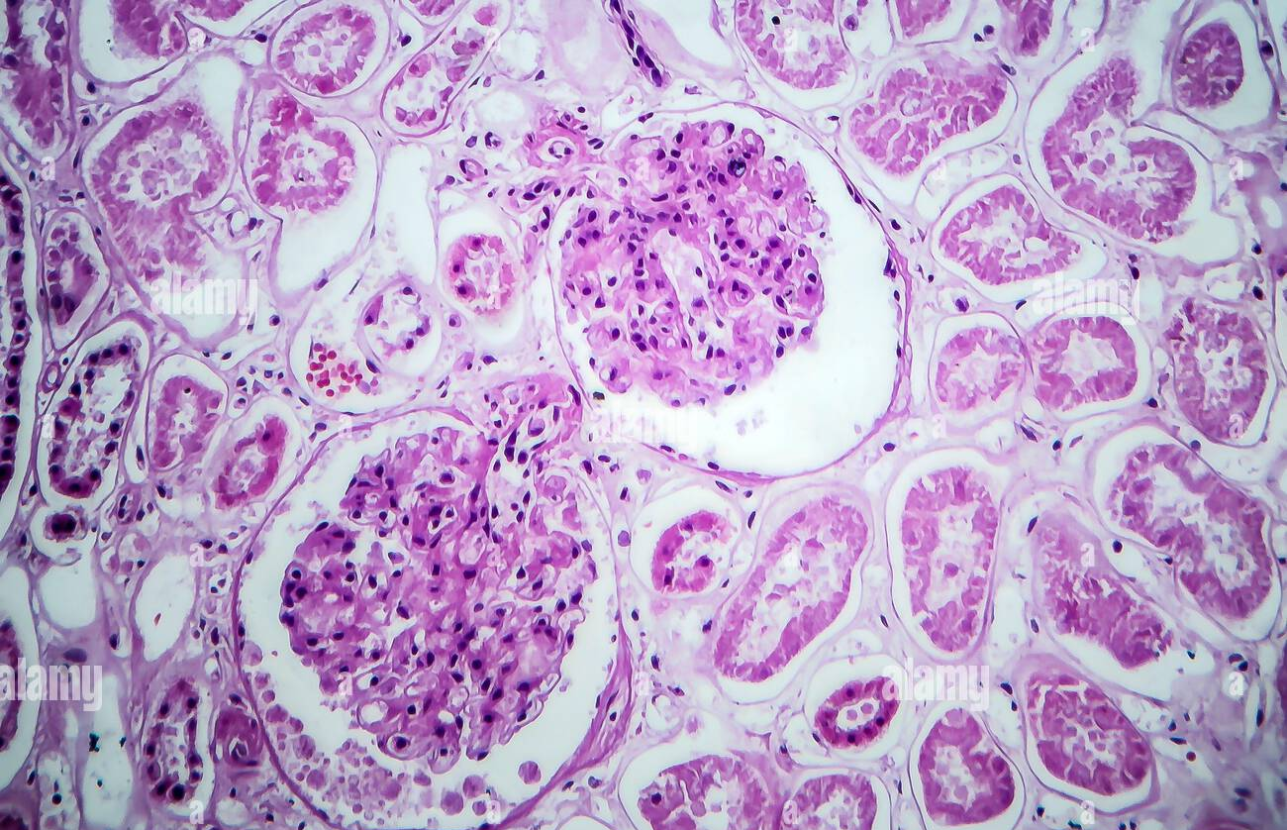
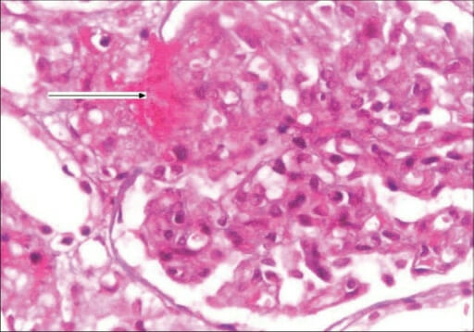
Acute poststreptococcal glomerulonephritis and hemolytic uremic syndrome
Dr. Nihal Khalid Yaseen

Slide 2
Learning objectives
To identify definition and mechanism of various types of hematuria in children.
To understand the mechanism of two common post infectious causes of hematuria and renal injury in children, namely the poststreptococcal glomerulonephritis and the hemolytic uremic syndrome.
To illustrate the clinical presentation of APSGN and HUS.
To learn management of APSGN and HUS.
To explain the prognosis of APSGN and HUS.

Slide 3
Background
Hematuria, defined as the persistent presence of more than five RBCs/hpf in uncentrifuged urine it may occur with fever and/or exercise. However, significant hematuria is generally considered as >50 RBCs/hpf.
Causes of red color urine:-
Heme- positive urine without RBCs may be caused by the presence of either hemoglobin or myoglobin. Hemoglobinuria without hematuria can occur in the presence of acute or chronic hemolysis. Myoglobinuria without hematuria occurs in the presence of rhabdomyolysis resulting from skeletal muscle injury and is generally associated with a fivefold increase in the plasma concentration of creatine kinase.
Drugs, foods (blackberries, beets), or dyes used in food and candy, various urinary metabolites.
Glomerular diseases usually painless and often associated with brown, cola- or tea- colored, or burgundy urine, proteinuria >100 mg/dL via dipstick, urinary microscopic findings of RBC casts, and deformed urinary RBCs.
Tubular diseases also painless may be associated with leukocytes or renal tubular casts.
Lower urinary tract sources of hematuria may be associated frequency, dysuria, fever and sometimes flank pain and renal colic with gross hematuria that is bright red or pink, terminal hematuria, blood clots, normal urinary RBC morphology, and minimal proteinuria on dipstick.

Slide 4
Diseases commonly manifesting as glomerulonephritis include:- postinfectious glomerulonephritis, membranoproliferative glomerulonephritis (MPGN), Henoch- Schönlein purpura nephritis, systemic lupus erythematosus (SLE) nephritis, and hemolytic- uremic syndrome.

Slide 5
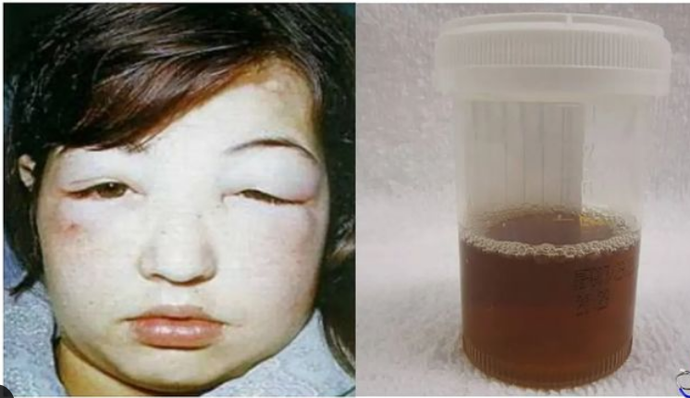
APSGN

Slide 6
Definition, etiology, and epidemiology
It is acute nephritic syndrome characterized by the sudden onset of gross hematuria, edema, hypertension, and renal dysfunction following throat or skin infection by certain nephritogenic strains of group A β- hemolytic streptococci.
Although it is usually sporadic, sometimes epidemics seen following throat infection in winter months and skin infection in warm months.
Molecular mimicry, whereby circulating antibodies elicited by streptococcal antigens react with normal glomerular antigens leading to complement activation considered as a probable mechanism of immunologic injury.
Pathologically, the glomeruli appear enlarged and relatively bloodless and show a diffuse mesangial cell proliferation with polymorphonuclear leukocyte infiltration. Immunofluorescence microscopy reveals a pattern of “lumpy- bumpy” deposits of immunoglobulin and complement on the glomerular basement membrane and in the mesangium.

Slide 7
Clinical manifestations
The disease is most common between 5-12 years and uncommon before the age of 3 years.
The typical patient develops an acute nephritic syndrome 1- 2 weeks after streptococcal pharyngitis or 3- 6 weeks after a streptococcal pyoderma.
The history of a specific infection may be absent because symptoms may have been mild or have resolved without treatment.
The severity of kidney involvement varies from asymptomatic microscopic hematuria with normal renal function to gross hematuria with acute renal failure.
Depending on the severity of renal involvement, patients can develop various degrees of edema, hypertension, and oliguria.
Patients are at risk for developing encephalopathy and/ or heart failure secondary to hypertension or hypervolemia. Hyper tensive encephalopathy must be considered in patients with blurred vision, severe headaches, altered mental status, or new seizures.
Respiratory distress, orthopnea, and cough may be symptoms of pulmonary edema and heart failure. Peripheral edema typically results from salt and water retention and is common.
The acute phase generally resolves within 6- 8 weeks. However, persistent microscopic hematuria can persist for 1- 2 years after the initial presentation.

Slide 8
Diagnosis
The clinical diagnosis of poststreptococcal GN is quite likely in a child presenting with acute nephritic syndrome, evidence of recent streptococcal infection, and a low C3 level.
Urinalysis demonstrates red blood cells, often in association with red blood cell casts, proteinuria, and polymorphonuclear leukocytes.
A mild normochromic anemia may be present from hemodilution.
The serum C3 level is significantly reduced in > 90% of patients in the acute phase and returns to normal 8- 10 weeks.
A positive throat culture report might support the diagnosis.
A rising antibody titer to streptococcal antigen(s) confirms a recent streptococcal infection. The antistreptolysin O titer is commonly elevated after a pharyngeal infection. Also, the best single antibody titer to document cutaneous streptococcal infection is the antideoxyribonuclease B level.
MRI of the brain is indicated in patients with severe neurologic symptoms and can demonstrate posterior reversible encephalopathy syndrome due to hypertension.
Chest x- ray is indicated in those with signs of heart failure or respiratory distress.
Renal biopsy should be considered only in the presence of:- acute renal failure, proteinuria of nephrotic range, absence of evidence of streptococcal infection, and low C3 level persist more than 2 months after onset.

Slide 9
Prognosis and complications
Complete recovery occurs in >95% of children with APSGN.
Hypertension is seen in 60% of patients and is associated with hypertensive encephalopathy in 10% of cases sometimes severe prolonged hypertension can lead to intracranial bleeding and seizures.
Heart failure
Acute renal failure leading to hyperkalemia, hyperphosphatemia, hypocalcemia, acidosis, and uremia.

Slide 10
Treatment
Treatment of hypertension with sodium and fluid restriction diuretics calcium channel antagonists, vasodilators, or angiotensin- converting enzyme inhibitors.
Treatment of acute kidney injury.
10- day course of penicillin to limit the spread of the nephritogenic organisms but have no effect on the natural history of APSGN. Family members of patients with APSGN, should be considered at risk and be cultured for group A β-hemolytic streptococci and treated if positive.

Slide 11
Management of acute kidney injury
Fluid intake, urine and stool output, body weight, and serum chemistries should be monitored daily.
Hypovolemia require fluid resuscitation with crystalloids and vasopressors,
For obstructive nephropathy a urinary catheter might be placed.
Furosemide (2- 4 mg/kg) may be administered as a single IV dose. If there is no response to a diuretic challenge, diuretics should be discontinued, and fluid restriction is essential. Fluids should be limited to 400 mL/m2/24 hr (insensible losses) plus an amount of fluid equal to the urine output for that day and extrarenal (blood, GI tract) fluid losses.
Mild metabolic acidosis is common in AKI because of the retention of hydrogen ions, phosphate, and sulfate, but it rarely requires treatment. If acidosis is severe (arterial pH< 7.15) then acidosis should be corrected partially by the IV bicarbonate to raise the arterial pH to 7.20
Hypocalcemia is primarily treated by lowering the serum phosphorus level (low phosphate diet and phosphate binders). IV Calcium should not be given except in cases of tetany.
In AKI, rapid development of hyperkalemia (serum potassium level >6 mEq/L) can lead to cardiac arrhythmia, cardiac arrest, and death. T he earliest electrocardiographic change seen in patients with developing hyperkalemia is the appearance of peaked T waves. This may be followed by widening of the QRS intervals, ST segment depression, ventricular arrhythmias, and cardiac arrest.

Slide 12
Treatment of hyperkalemia
Deplete body potassium stores, all exogenous sources of potassium (dietary, IV fluids, total parenteral nutrition) should be eliminated. Exchange resin (Kayexalate), 1 g/ kg, should be given orally or by retention enema. These measures take several hours to take effect
Emergency measures taken for more severe elevations in serum potassium (>7 mEq/L), especially if accompanied by electrocardiographic changes, include:-
Calcium gluconate 10% solution, 100 mg/kg/dose (maximum 3,000 mg/dose) counteracts the potassium- induced increase in myocardial irritability.
Sodium bicarbonate, 1- 2 mEq/kg IV, over 5- 10 minutes, shifting potassium from the extracellular to the intracellular compartment.
Regular insulin, 0.1 units/kg, with glucose 50% solution, 1 mL/kg, over 1 hour, shifting potassium from the extracellular to the intracellular compartment
Persistent hyperkalemia should be managed by dialysis.

Slide 13
Early ECG changes showing Peaked T waves

Slide 14
Indications for dialysis in AKI:-
Persistent hyperkalemia.
Severe metabolic acidosis unresponsive to medical management.
Uremia (encephalopathy, pericarditis, neuropathy)
Calcium: phosphorus imbalance, with hypocalcemic tetany that can not be controlled by other measures.

Slide 15
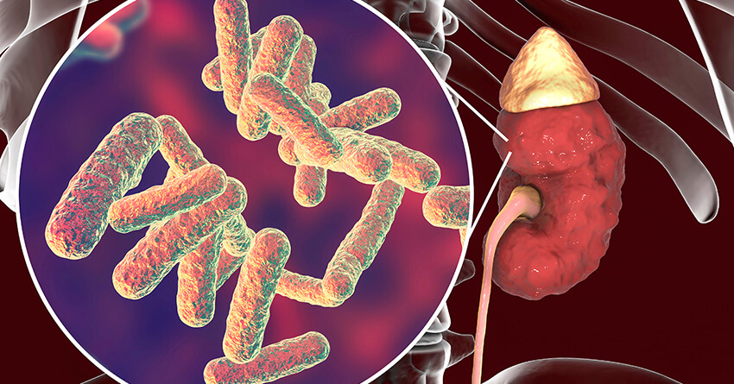
Hemolytic Uremic Syndrome

Slide 16
Hemolytic- uremic syndrome (HUS) is a common cause of community- acquired acute kidney injury in young children. It is the most common form of thrombotic microangiopathy (TMA) in children.
Shiga toxin–producing Escherichia coli (STEC), O157:H7 which causes prodromal acute enteritis and is commonly termed STEC- HUS or diarrhea-associated HUS which is commonly is transmitted by undercooked meat or unpasteurized milk and apple cider. Local outbreaks have followed the ingestion of undercooked, contaminated foods or water supplies.
Hemolytic uremic syndrome (HUS) is characterized by the triad of :
Microangiopathic hemolytic anemia,
Thrombocytopenia,
And acute kidney injury (AKI).

Slide 17
HUS may also occur unrelated to STEC infection (atypical HUS):
Infection with streptococcus pneumoniae or HIV has been associated with non-STEC-HUS.
Genetic and acquired defects in complement function.
Medications.
Malignancy and bone marrow transplant.
Systemic lupus erythematosus.
Pregnancy.

Slide 18
Clinical manifestations
HUS is most common in preschool- and school- age children.
The onset occurs 5- 7 days after the onset of gastroenteritis with fever, vomiting, abdominal pain, and diarrhea. The diarrhea is often bloody but not necessarily so.
After the prodromal illness, which can be mild, the sudden onset of pallor, petechiae, weakness, and lethargy heralds the onset of HUS, due to microangiopathic hemolytic anemia and thrombocytopenia.
Oliguria can be present in early stages but may be masked by ongoing diarrhea because the prodromal enteritis often overlaps the onset of HUS, particularly with ingestion of large doses of toxin.
HUS can be relatively mild or can progress to a severe and fatal multisystem disease.

Slide 19
Complications
Kidney insufficiency can be mild but also can rapidly evolve into severe oliguric or anuric kidney failure.
Heart failure from volume overload, hypertension, pericarditis, arrhythmias, and severe anemia
CNS involvement; resulting from focal ischemia secondary to microvascular CNS thrombosis or hypertension; causes irritability, lethargy, seizures.
Intestinal complications include severe inflammatory colitis, ischemic enteritis, bowel perforation, intussusception, and pancreatitis.

Slide 20
Differential Diagnoses
Other microangiopathies: Thrombotic Thrombocytopenic Purpura (TTP), DIC, malignant hypertension.
Other causes of renal insufficiency and hematuria: SLE, bilateral renal vein thrombosis

Slide 21
Diagnosis
CBC with smear showing microangiopathic hemolytic anemia with schistocytes, thrombocytopenia, and leukocytosis.
PT and PTT are usually normal.
The Coombs test is negative.
Urinalysis typically shows microscopic hematuria and low- grade proteinuria.
Elevations in serum BUN and creatinine
The stool culture may be negative in patients who have diarrhea- associated HUS.

Slide 22
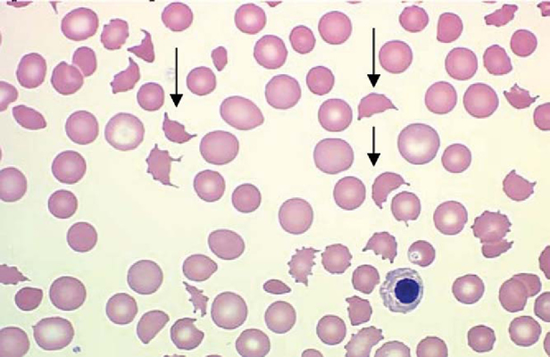

Slide 23
Treatment
Careful management of fluid and electrolytes.
Control of hypertension.
Early institution of dialysis if the patient becomes significantly oliguric or anuric.
Packed red blood cell transfusion if necessary.
Platelets are generally not recommended, because they are rapidly consumed by the active coagulation and theoretically can worsen the clinical course.
Antibiotic therapy to clear enteric toxigenic organisms (STEC) can result in increased toxin release, potentially exacerbating the disease.

Slide 24
PROGNOSIS
With early recognition and intensive supportive care, the mortality rate for diarrhea- associated HUS is < 5%, Most recover kidney function completely, but of surviving patients, 5% remain dependent on dialysis, and up to 30% are left with some degree of chronic kidney disease.
Pneumococci- associated HUS causes increased patient morbidity (>80% require dialysis), with the mortality rate reported as 20%.
The familial, genetic forms of HUS can be insidiously progressive or relapsing diseases and have a poor prognosis.

Slide 26
References
Nelson textbook f pediatric, 22nd edition, 2024

