Slide 1
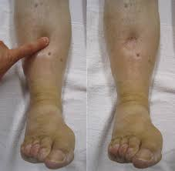
Nephrotic Syndrome and proteinuria in pediatrics
Dr. Nihal Khalid Yaseen

Slide 2
Learning objectives
To identify pathogenesis, clinical manifestations, and types of nephrotic syndrome.
To define diagnostic criteria
To understand disease complications.
To illustrate treatment plan.
To differentiate nephrotic syndrome from other causes of proteinuria.

Slide 3
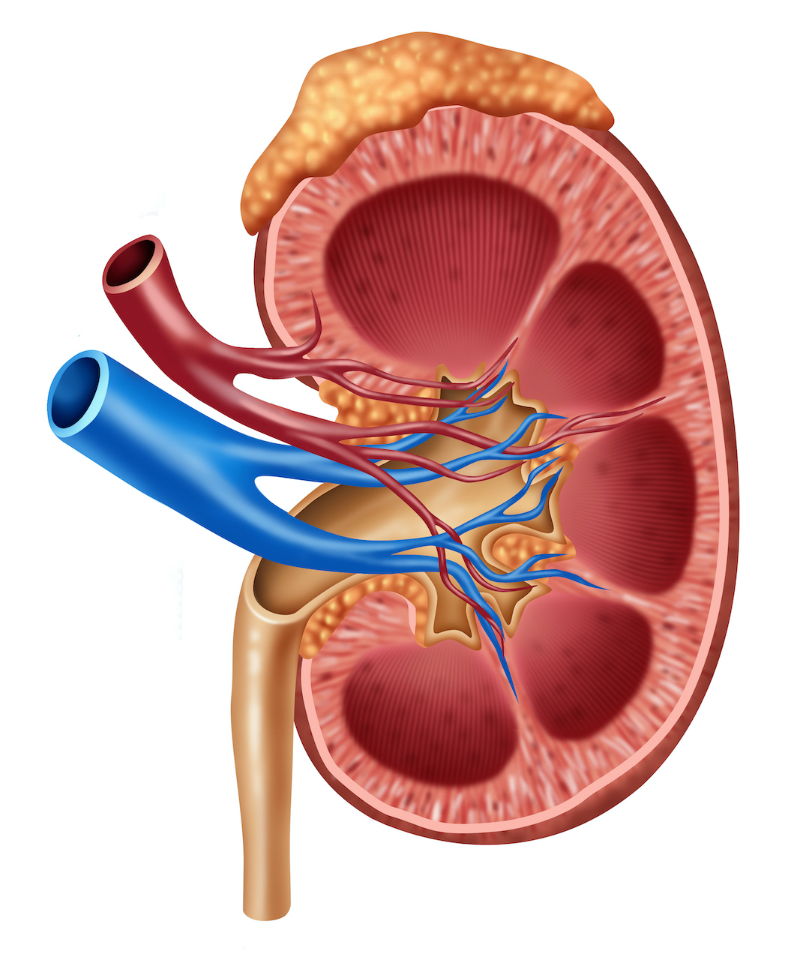
The kidneys are retroperitoneal organs that have outer layer called cortex which contains the glomeruli, proximal and distal convoluted tubules, and collecting ducts, and inner layer; the medulla; which contains the straight portions of the tubules, the loops of Henle, the vasa recta, and the terminal collecting duct.
The blood supply to each kidney usually consists of a main renal artery that arises from the aorta.
The functional unit of the kidney called the nephron.
The glomerular basement mem brane (GBM) forms a continuous layer between the endothelial and mesangial cells on one side and the epithelial cells on the other.
Kidney function is best measured as the glomerular filtration rate (GFR). The GFR may be estimated by measurement of the serum creatinine level.

Slide 4
Nephrotic syndrome
Nephrotic syndrome is the clinical manifestation of glomerular diseases associated with heavy (nephrotic range) proteinuria (i.e. >3.5 g/24 hr or a urine protein:creatinine ratio >2), leading to the characteristic triad of hypoalbuminemia (≤2.5 g/dL), edema, and hyperlipidemia (cholesterol >200 mg/dL).
The primary mechanism for nephrotic syndrome is immune and nonimmune insults to the podocyte (the cells that support the glomerular capillary loop) that lead to foot process effacement of the podocyte, a decrease in number of functional podocytes, and altered slit diaphragm integrity between adjacent podocytes leading to increased protein leakiness across the glomerular capillary wall into the urinary space. The hypoalbuminemia leads to decrease in intravascular oncotic pressure and leakage of plasma water into the interstitium, generating edema. The loss of intravascular volume stimulates vasopressin, ANP and aldostrerone to stimulate sodium and water reabsorption.
Hyperlipidemia is thought to be the result of increased synthesis as well as decreased catabolism of lipids.

Slide 5
Etiology
1- Idiopathic nephrotic syndrome (90% of cases)
Minimal change disease
Focal segmental glomerulosclerosis
Membranous nephropathy
Membranoproliferative glomerulonephritis
2- Genetic cause (congenital nephrotic syndrome), Finnish type.
3- Secondary nephrotic syndrome
Infection (hepatitides B, C, HIV-1, malaria, syphilis, toxoplasmosis, tuberculosis)
Drug induced (captopril, penicillamine, gold, nonsteroidal anti inflammatory drugs)
Immune disorders (vasculitis like SLE and Henoch-Schönlein purpura , serum sickness)
Malignancy (leukemia, lymphoma, Wilms tumor)
Others, amyloidosis

Slide 6
Minimal change nephrotic syndrome
Usually idiopathic, may follow viral upper respiratory tract infection.
Forms approximately 85% of total cases of nephrotic syndrome in children, the glomeruli appear normal and electron microscopy simply reveals effacement of the epithelial cell foot processes.
More common in males and most commonly appears between the ages of 2 and 6 years.
95% of cases respond to steroids.

Slide 7
Focal segmental glomerulosclerosis (FSGS)
Accounts for ~10–20% of children with NS.
May be primary or secondary to HIV infection, vesicoureteral reflux, and IV use of heroin and other drugs of abuse.
The glomeruli show both focal and segmental lesions.
Only 20% respond to steroids.
More than 35% of children with FSGS progress to end-stage kidney disease

Slide 8
Membranous nephropathy
Represents less than 5% of children with NS.
Usually secondary to;-
Systemic infections (hepatitis B, syphilis, malaria, and toxoplasmosis)
Exposure to specific medications (gold, penicillamine)
Autoimmune disease such as systemic lupus erythematosus.

Slide 9
Congenital nephrotic syndrome (CNS)
Nephrotic syndrome that is diagnosed in the first 3 months of life.
May be primary or secondary to TORCHS infection, infantile systemic lupus erythematosus, or mercury exposure.
Primary congenital nephrotic syndrome is due to a variety of syndromes inherited as autosomal recessive disorders the most famous is Finnish type CNS, a rare autosomal recessive disorder that is caused by a mutation in nephrin gene.

Slide 10
Clinical manifestations
Children usually present with mild edema, which is initially noted around the eyes and in the lower extremitiesand may be misdiagnosed as allergic disorder. The edema becomes generalized, with the development of ascites, pleural effusions, and genital edema.
Anorexia, irritability, abdominal pain, and diarrhea are common.
Important features of MCNS are the absence of hypertension and gross hematuria (the so- called nephritic features).

Slide 11
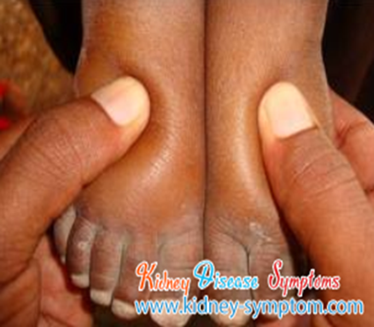
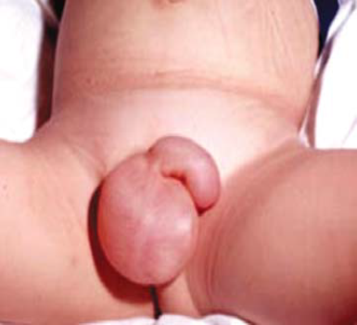
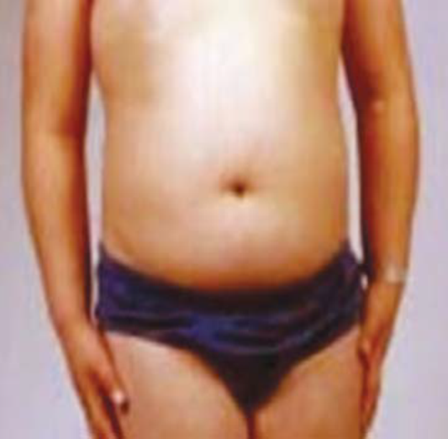

Slide 12
Investigations
Urinalysis: reveals 3+ or 4+ proteinuria, and microscopic hematuria is present in 20% of children.
A spot urine protein: creatinine ratio >2.0.
Renal function tests are usually normal but may be abnormally elevated if there is diminished renal perfusion from contraction of the intravascular volume.
Serum albumin level < 2.5 g/dL
Serum cholesterol and triglyceride levels are elevated.
Serum complement levels are normal.
Kidney ultrasound may be considered to exclude renal malformations and venous thrombosis but is not mandatory.

Slide 14
Renal biopsy indications
Age <1 yr or >13 yr.
Family hx of renal disease.
Extrarenal findings (arthritis, rash, anemia)
Hypertension
Gross hematuria
Renal insufficiency
Low C3
Resistance to steroid therapy

Slide 15
Treatment
prednisone or prednisolone administered as a single daily dose of 60 mg/m2/day or 2 mg/kg/ day to a maximum of 60 mg daily for 4- 6 weeks followed by alternate- day prednisone (starting at 40 mg/m2 every other day or 1.5 mg/kg every other day) for a period ranging from 4- 6 weeks.

Slide 16
Important definitions
Response: the attainment of remission within the initial 4 weeks of corticosteroid therapy.
Remission: a urine protein: creatinine ratio of <0.2 or <1+ protein on urine dipstick testing for 3 consecutive days.
Relapse: a urine protein: creatinine ratio of > 2 or ≥3+ protein on urine dipstick testing for 3 consecutive days after obtaining remission.
Steroid resistance: failure to achieve remission after 4 weeks of corticosteroid therapy.
Steroid dependance: recurrence of proteinuria after stopping steroid or switching to alternate day therapy.

Slide 17
Further measures
Salt and water restriction.
Loop diuretics for volume overload. However, aggressive diuresis can lead to intravascular volume depletion and an increased risk for acute renal failure and intravascular thrombosis.
Severe generalized edema with evidence of intra vascular volume depletion (e.g., hemoconcentration, hypotension, tachycardia), IV administration of 25% albumin (0.5- 1.0 g albumin/ kg) as a slow infusion followed by furosemide (1- 2 mg/kg/dose IV)
Dyslipidemia should be managed with a low- fat.
Aggressive management of infection. In the case of spontaneous bacterial peritonitis third- generation cephalosporin added.
For thromboembolism, anticoagulation therapy including warfarin low molecular weight heparin.
pneumococcal vaccination (with the 13- valent conjugant vaccine and 23- valent polysaccharide vaccine) and influenza vaccination annually to the child and their house -hold contacts; defer vaccination with live vaccines until the prednisone dose is below either 1 mg/kg daily or 2 mg/kg on alternate days.

Slide 18
Alternative therapies
For steroid- dependent patients, frequent relapsers, and steroid- resistant patients are candidates for alternative therapies, as cyclophosphamide, calcineurin inhibitors (cyclosporine or tacrolimus), mycophenolate, and rituximab.
Angiotensin- converting enzyme inhibitors and angiotensin II receptor blockers may be helpful as adjunct therapy to reduce proteinuria in steroid-resistant patients.

Slide 19
Complications of nephrotic syndrome
Hypercoagulability; resulting from: vascular stasis from hemoconcentration and intravascular volume depletion, increased platelet number and aggregability, and increase in hepatic production of fibrinogen along with urinary losses of antithrombotic factors such as antithrombin III and protein S. Deep venous thrombosis may occur in any venous bed, including the cerebral venous sinus, renal vein, and pulmonary veins.
Infections; due to urinary losses of immunoglobulin (Ig) G and complement factors (predominantly C3 and C5), as well as alternative pathway factors B and D, lead to impaired opsonization of microorganisms. Children with nephrotic syndrome are at significantly increased risk for infection with encapsulated bacteria and, in particular, pneumococcal disease. Spontaneous bacterial peritonitis presents with fever, abdominal pain, and peritoneal signs. Although pneumococcus is the most frequent cause of peritonitis, gram- negative bacteria also are associated with a significant number of cases.
Side effects of treatment (steroids cause cataract, obesity mood changes, acne, hyperglycemia, short stature, and hypertension while cyclophosphamide cause infertility, hemorrhagic cystitis, nausea and vomiting)
Renal dysfunction may result from hypovolemia, disease progression, side effect of cyclosporin, renal vein thrombosis.

Slide 20
Differential diagnoses of proteinuria
Transient proteinuria, occurs after fever, exercise, dehydration, cold exposure, heart failure, recent use of epinephrine, seizures, or stress. Usually does not exceed 1- 2+ on the dipstick. No evaluation or therapy is needed and it resolves spontaneously.
Orthostatic proteinuria, patients are usually asymptomatic but have increased excretion of albumin in upright position (may reach 1 gm/ 24 hours) while normal in supine position in the absence of hematuria, hypertension, hypoalbuminemia, edema, and renal dysfunction.
Glomerular proteinuria (mentioned in the lecture).
Tubular proteinuria (seen alongside with glucosuria, phosphaturia, bicarbonate depletion due to failure of tubular reabsorption of proteins in the proximal tubule, the proteinuria is less than the nephrotic range).

Slide 21
Referneces
Nelson textbook f pediatric, 22nd edition, 2024

