Slide 1
Steroidogenesis
Steroid hormones, the lipophilic molecules, are synthesized from cholesterol which in turn is formed from acetate. Plasma low-density lipoproteins derived from diet contribute to the major part of cholesterol. Cholesterol produced in the liver circulates in the form of high-density lipoprotein and low-density lipoprotein.
Major sites of steroid synthesis include the adrenals, testes, ovaries, and placenta.
The four major types of steroid hormones are progestins, androgens, estrogens, and corticoids, which contain 21, 19, 18, and 21 carbons, respectively.
Steroid hormones are synthesized by dehydrogenases and cytochrome P450 enzymes from cholestane, a common cholesterol precursor through hydroxylation and dehydroxylation-oxidation reactions.
Steroid hormones are all synthesized from cholesterol and hence have closely related structures based on the classic cyclopentanophenanthrene 4-ring structure

Slide 2
Cholesterol is the precursor to steroid synthesis and is available through endogenous (synthesis) and exogenous (dietary) mechanisms.
The body requires a constant supply of cholesterol, which is regulated through negative-feedback mechanisms.
Cholesterol is synthesized primarily within the liver but also at secondary sites. When cellular cholesterol levels decrease, formation of HMG-CoA (5-hydroxy-3-methylglutaryl-coenzyme A) reductase (the rate-limiting enzymatic reaction used to synthesize cholesterol within the cell) is stimulated.
After synthesis in the liver, cholesterol is bound to low-density lipoproteins for plasma transport, targeting the adrenal cortex. As low-density lipoprotein targets low-density and high-density lipoprotein receptors, it is then internalized through endocytosis, fuses with lysosomes, and is then hydrolyzed into free cholesterol or stored as cholesterol esters in lipid droplets.
Free cholesterol is transported to the mitochondria by the steroidogenic acute regulatory protein to initiate steroidogenesis.

Slide 3
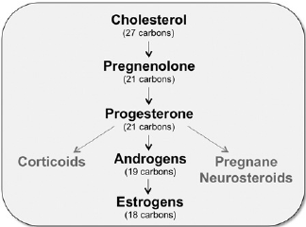
A cholesterol precursor is cleaved to generate the progestins pregnenolone and progesterone. These hormones are essential precursors for all other steroid hormones.

Slide 4
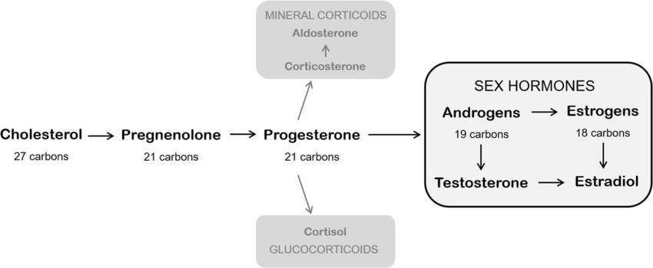
Cholesterol is the essential precursor for all steroid hormones.
Progesterone is the metabolic precursor of other endogenous steroids such as sex hormones (androgens and estrogens) and corticoids. The enzyme aromatase converts androgens in estrogens

Slide 6
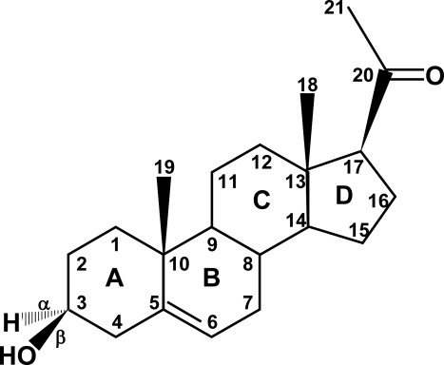
Structure of pregnenolone
The two crucial regulatory steps in this process are the transport of free cholesterol from the cytoplasm into mitochondria and conversion of cholesterol into pregnenolone.
Pregnenolone is derived from cholesterol,
which has a six-carbon side chain attached
to carbon no. 20.
Pregnenolone is a “Δ⁵
compound,” having a double
bond between carbons no. 5
and 6; the action of 3β-hydroxysteroid dehydrogenase/isomerase moves this double bond from the B ring to carbons 4 and 5 in the A ring, forming Δ⁴ compounds. Most of the major biologically active steroid hormones are Δ⁴ compounds.

Slide 7
Cytochrome P450 (CYP) and hydroxysteroid dehydrogenase (HSD) are the two major classes of enzymes, which catalyzes the reactions leading to steroid biosynthesis.
Steroid hormones are classified into five groups:
Glucocorticoids, Mineralocorticoids, Androgens, Estrogens, and Progestogens.

Slide 8
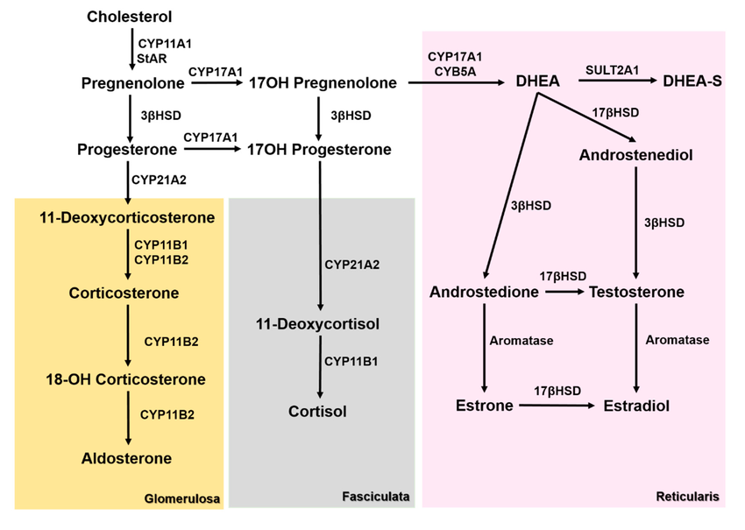
3βHSD—3β-hydroxysteroid dehydrogenase, 17βHSD—17β-hydroxysteroid dehydrogenase, CYB5A—Cytochrome B5A, CYP11A1—cholesterol side chain cleavage enzyme, CYP11B1—11β-hydroxylase, CYP11B2—aldosterone synthase, CYP17A1—17α-Hydroxylase, CYP21A2—21α-hydroxylase, dehydroepiandrosterone (DHEA), dehydroepiandrosterone sulfate (DHEA-S), StAR—steroidogenic acute regulatory protein, and SULT2A1—Sulfotransferase 2A1.

Slide 10
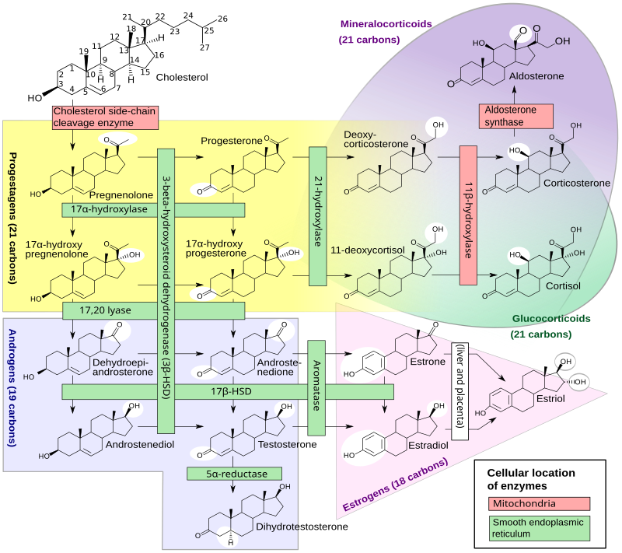

Slide 11
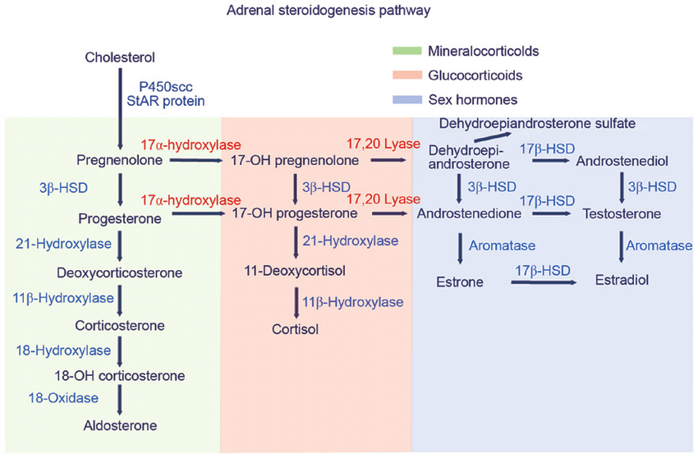

Slide 12
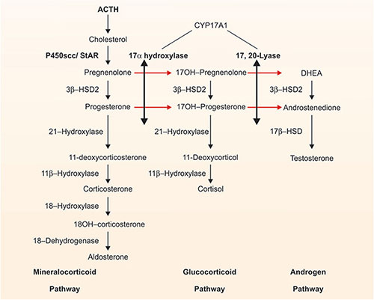

Slide 13
Cholesterol Uptake, Storage, and Intracellular Transport
The human adrenal can synthesize cholesterol de novo from acetate,but most of its supply of cholesterol comes from plasma low-density lipoproteins (LDLs) derived from dietarycholesterol.The intracellular cholesterol economy is largely regulated by the sterol response element binding protein (SREBPs), a group of transcription factors that regulate genes involved in the biosynthesis of cholesterol and fatty acids .Adequate concentrations of LDL will suppress 3-hydroxy-3-methylglutaryl co-enzyme Areductase,the rate-limiting enzyme in cholesterol synthesis
ACTH also stimulates the activity of3-hydroxy-3-methylglutaryl co-enzyme Areductase,LDL receptors, and uptake of LDL cholesterol. LDL cholesterol esters are taken up by receptor-mediated endocytosis, and are then stored directly or converted to free cholesterol and used for steroid hormone synthesis .

Slide 14
LDL cholesterol esters are taken up by receptor-mediated endocytosis, and are then stored directly or converted to free cholesterol and used for steroid hormone synthesis .
Cholesterol can be esterified by acyl-coenzyme A (CoA):cholesterol acyltransferase (ACAT), stored in lipid droplets, and accessed by activation of hormone-sensitive lipase (HSL).
ACTH stimulates HSL and inhibits ACAT, thus increasing the availability of free cholesterol for steroid hormone synthesis.
Cholesterol ester hydrolase and neutral cholesterol ester hydrolase also hydrolyze cytosolic cholesterol esters .

Slide 15
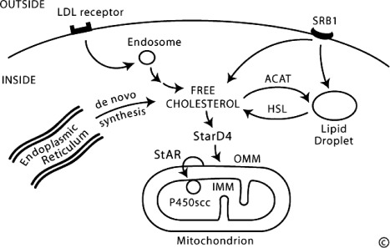
Human cells typically pick up circulating LDLs through receptor-mediated endocytosis, directing the cholesterol to endosomes.
Free cholesterol, produced by the action of HSL, may be bound by StarD4 for transcytoplasmic transport to membrane destinations, including the OMM. In the adrenals and gonads, StAR is responsible for the rapid movement of cholesterol from the OMM to the IMM, where it can be taken up by the cholesterol side-chain cleavage enzyme, P450scc, and converted to pregnenolone.

Slide 16
Delivery of cholesterol to mitochondria
The first step in steroidogenesis takes place within mitochondria. The mechanisms by which cholesterol is transported to and loaded into the outer mitochondrial membrane (OMM).
StAR, which governs the acute steroidogenic response to tropic stimuli, the principal action of StAR is to facilitate the movement of cholesterol from the OMM to the inner mitochondrial membrane (IMM).
StAR is the first-described member of a family of proteins that contain so-called START (StAR-related lipid transfer) domains, which are found in most metazoan organisms (18). Fifteen START domain (StarD) proteins appear to serve roles in binding and mediating the intracellular transfer of lipids in mammals . StarD4 and StarD5 may play roles in moving cholesterol from intracellular lipid droplets to the OMM, but knockout of the gene for StarD4 in mice does not disrupt steroidogenesis

Slide 17
This is a highly complex procedure in which a common precursor is transformed into a specific hormone, designed to have highly specific actions on different target organs. It may briefly be summarized as follows:
•All types of steroids produced in the adrenal cortex are derivatives of cholesterol which is taken up by LDL receptors on adrenal cortical cell membranes.
•A series of complex “shuttles” carry the cholesterol to the inner mitochondrial membrane where steroidogenesis occurs.
•

Slide 18
An Overview of Steroidogenic Enzymes
Most enzymes involved in steroid biosynthesis are either cytochrome P450s (CYPs) or HSDs.
These steroidogenic enzymes are functionally, if not absolutely, unidirectional, so the accumulation of products does not drive flux back to the precursor. All P450-mediated hydroxylations and carbon-carbon bond cleavage reactions are mechanistically and physiologically irreversible .
HSD reactions are mechanistically reversible and can run in either direction under certain conditions in vitro, but each HSD drives steroid flux predominantly in either the oxidative or reductive mode in vivo . However, two or more HSDs drive the flux of a hydroxysteroid and its cognate ketosteroid in opposite directions, some favoring ketosteroid reduction and others favoring hydroxysteroid oxidation.

Slide 19
The presence or absence of specific steroidogenic enzymes in each type of steroid-producing tissue determines the direction and final end-product of the particular cell type’s steroid production.
•The intermediate products are also specific to the enzymes present in the various adrenocortical cell types.
•Some intermediate products, if produced to excess and released into the circulation, may have biological activities that are similar to the steroid end-product.

Slide 20
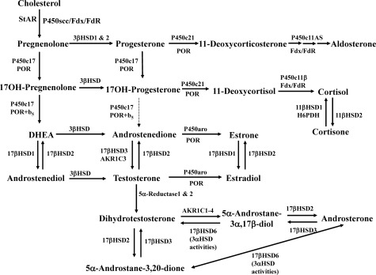

Slide 21
The steroids in the first column are Δ⁵-steroids, which constitute the preferred pathway to C₁₉ steroids in human beings. The dashed arrow indicates poor flux from 17α-hydroxyprogesterone to androstenedione via P450c17, and the three small arrows below P450c11AS emphasize the three discrete steps with intermediates corticosterone and 18-hydroxycorticosterone

Slide 22
A variety of conditions of abnormal steroidogenesis exist due to genetic mutations in the steroidogenic enzymes involved in the process, of which include:
20,22-Desmolase (P450scc) deficiency: blocks production of all steroid hormones from cholesterol
3β-Hydroxysteroid dehydrogenase 2 deficiency: impairs progestogen and androgen metabolism; prevents the synthesis of estrogens, glucocorticoids , and mineralocorticoids ; causes androgen deficiency in males and androgen excess in females
Combined 17α-hydroxylase/17,20-lyase deficiency: impairs progestogen metabolism; prevents androgen, estrogen, and glucocorticoid synthesis; causes mineralocorticoid excess
Cytochrome P450 oxidoreductase deficiency: prevents production of numerous but not all sex steroids , as well as other metabolic reactions.

Slide 23
Androgen- and estrogen-specific
Isolated 17,20-lyase deficiency: prevents androgen and estrogen synthesis.
Cytochrome b₅ deficiency: subtype of isolated 17,20-lyase deficiency; additionally results in elevated methemoglobin and/or methemoglobinemia
17β-Hydroxysteroid dehydrogenase 3 deficiency: impairs androgen and estrogen metabolism; results in androgen deficiency in males and androgen excess and estrogen deficiency in females
5α-Reductase 2 deficiency: prevents the conversion of testosterone to dihydrotestosterone; causes androgen deficiency in males
Aromatase deficiency: prevents estrogen synthesis; causes androgen excess in females
Aromatase excess: causes excessive conversion of androgens to estrogens; results in estrogen excess in both sexes and androgen deficiency in males.

Slide 24
Glucocorticoid- and mineralocorticoid-specific
21-Hydroxylase deficiency: prevents glucocorticoid and mineralocorticoid synthesis; causes androgen excess in females
11β-Hydroxylase 1 deficiency: impairs glucocorticoid and mineralocorticoid metabolism; causes glucocorticoid deficiency and mineralocorticoid excess as well as androgen excess in females
11β-Hydroxylase 2 deficiency: impairs corticosteroid metabolism; results in excessive mineralocorticoid activity
18-Hydroxylase deficiency: prevents mineralocorticoid synthesis; results in mineralocorticoid deficiency
18-Hydroxylase overactivity: impairs mineralocorticoid metabolism; results in mineralocorticoid excess

Slide 25
Miscellaneous
In addition, several conditions of abnormal steroidogenesis due to genetic mutations in receptors, as opposed to enzymes, also exist, including:
Gonadotropin-releasing hormone (GnRH) insensitivity: prevents synthesis of sex steroids by the gonads in both sexes
Follicle-stimulating (FSH) hormone insensitivity: prevents synthesis of sex steroids by the gonads in females; merely causes problems with fertility in males
Luteinizing hormone (LH) insensitivity: prevents synthesis of sex steroids by the gonads in males; merely causes problems with fertility in females
Luteinizing hormone (LH) oversensitivity: causes androgen excess in males, resulting in precocious puberty; females are asymptomatic

