Slide 1
Vitamin B Complex
Dr.Shatha Alkhateeb
Lec.4
B vitamins are a group of nutrients that play many important roles in the body
They are water-soluble, which means the body does not store them. For this reason, the diet must supply them each day.
B vitamins have many important functions and are vital for maintaining good health.
However, factors like age, pregnancy, dietary choices, medical conditions, genetics, medication and alcohol use increase the body’s demand for B vitamins.
In these circumstances, supplementing with B vitamins may be necessary.
Nutritional supplements that contain all eight B vitamins are referred to as B-complex vitamins.
The Vitamins B-complex are family due to :
1-They are found together in the same food.
2-Do similar work in the body, maintain healthy skin and muscles tone enhance immune and nervous system functions and promote cell growth and divisions.
3-Symptoms of one vitamins deficiency may be undistinguishable from others.

Slide 2
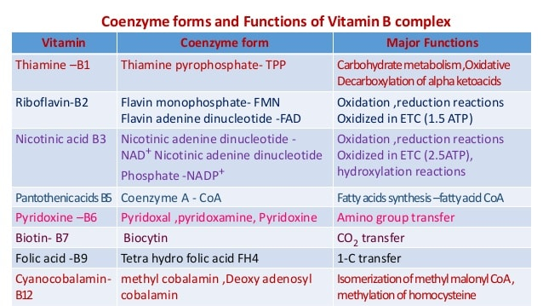

Slide 3
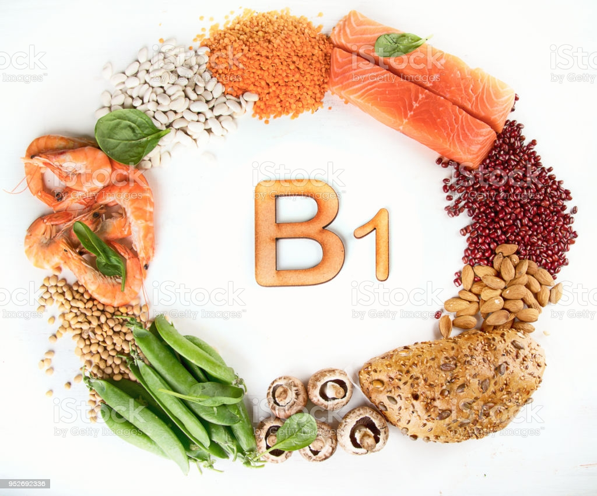
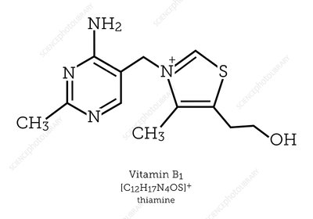
Thiamine (vitamin B₁)
Thiamine or vitamin B₁, named as the "thio-vitamine" ("sulfur-containing vitamin") is a water-soluble vitamin of the B complex.
We need vitamin B1 so that the body can use carbohydrates as energy - it is essential for glucose metabolism.
Vitamin B1 also plays a key role in nerve, muscle and heart function.
Mammals, including humans cannot synthesize thiamine so it has to be obtained from diet via intestinal absorption. Absorption of vitamin B1 involves a specialized pH-dependent, Na⁺- independent carrier mediated mechanism. In order to become a coenzyme thiamine has to acquire a pyrophosphate group.
Thiamine is a colorless compound with a chemical formula C₁₂H₁₇N₄OS. Its structure contains an amino pyrimidine ring and a thiazole ring with methyl and hydroxyethyl side chains linked by methylene bridge.
The intestinal enzyme phosphatase hydrolyzes thiamin into a free form which is then absorbed by the small intestine.
The phosphorylated form of thiamin gets stored in the heart, kidneys, liver, and brain. It has a short half-life of 14 to 18 days; therefore, regular dietary intake of thiamin is necessary.
In the human body, thiamin exists mainly in the form of thiamin diphosphate (TDP), also known as thiamin pyrophosphate (TPP).
This is the main metabolic form of thiamin and serves as a cofactor for many enzymes during the metabolism of glucose, proteins, and lipids.

Slide 4
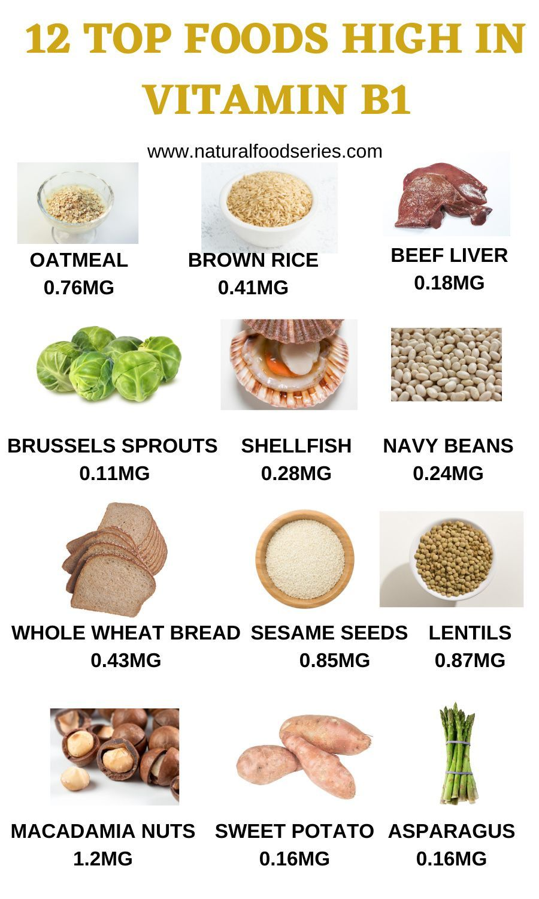
The primary function of B-1 is to help the body convert food to energy.
When we eat, the body breaks food down for fuel use. The body's primary fuel source is glucose, which we get from carbohydrate foods.
B-1 helps the body turn carbohydrates into glucose for fuel.
B-1 along with the other B vitamins, also helps the body metabolize fats and protein.
Helps keep the liver, skin, hair and eyes healthy.
Thiamin is absorbed into the blood from the gastrointestinal tract.
It then circulates in the blood and ultimately gets excreted in the urine.
Small amounts of thiamin are stored in the liver, heart, kidney, and brain, but only for a short duration.
Thiamin Functions
There are three functions of thiamin1:
1. Cofactor for decarboxylation reactions (TPP)
2. Cofactor for the synthesis of pentoses (5-carbon sugars) and NADPH (TPP)
3. Membrane and nerve conduction (Not as a cofactor)

Slide 5
In plants, thiamin is found in its free form, but in animals it is mostly thiamine pyrophosphate. These phosphates must be cleaved before thiamine is taken up into the enterocyte.
Thiamine uptake and absorption is believed to be an efficient process that is passive when thiamine intake is high and active when thiamine intakes are low.
There are two thiamine transporters (THTR), THTR1 and THTR2, that are involved in thiamine uptake and absorption. THTR1 is found on the brush border and basolateral membrane, while THTR2 is only found on the brush border membrane .
Absorption
Thiamine is released by the action of phosphatase and pyrophosphates in the upper small intestine.
At low concentrations, the process is carrier-mediated, and, at higher concentrations, absorption occurs via passive diffusion.
Active transport is greatest in the jejunum and ileum. The cells of the intestinal mucosa have thiamine pyrophosphokinase activity.
The majority of thiamine present in the intestine is in the pyrophosphorylated form .
The uptake of thiamine by the mucosal cell is likely coupled in some way to its phosphorylation/dephosphorylation.
Bound to serum proteins
The majority of thiamine in serum is bound to proteins, mainly albumin. Approximately 90% of total thiamine in blood is in erythrocytes. A specific binding protein called thiamine-binding protein (TBP).
Cellular uptake
Uptake of thiamine by cells of the blood and other tissues occurs via active transport and passive diffusion.
The brain requires a much greater amount of thiamine than in other cells of the body.
About 80% of intracellular thiamine is phosphorylated and most is bound to proteins. In some tissues, thiamine uptake and secretion appears to be mediated by a soluble thiamine transporter that is dependent on Na⁺ and a transcellular proton gradient.

Slide 6
Tissue distribution
Human storage of thiamine is about 25 to 30 mg, with the greatest concentrations in skeletal muscle, heart, brain, liver, and kidneys.
ThMP and free (unphosphorylated) thiamine is present in plasma, milk, cerebrospinal fluid, and, it is presumed, all extracellular fluids.
Excretion
Thiamine and its acid metabolites (2-methyl-4-amino-5-pyrimidine carboxylic acid, 4-methyl-thiazole-5-acetic acid, and thiamine acetic acid) are excreted principally in the urine.
In blood, the thiamin diphosphokinase enzyme converts thiamin into its active form, thiamin pyrophosphate (TPP).
TPP plays different roles during different steps of metabolism, glycolysis, Krebs cycle, and pentose phosphate pathway.
1- TPP works with enzyme functions during the metabolism of carbohydrates, lipids, and branched-chain amino acids.
2-TPP acts as a cofactor at several steps during glycolysis and oxidative decarboxylation of carbohydrates.
3-TPP acts as a coenzyme for the mitochondrial enzyme complexes such as α-ketoglutarate dehydrogenase and pyruvate dehydrogenase.
These enzymes have a critical role in the Krebs cycle and tricarboxylic acid cycle. Thiamin deficiency decreases the activity of these enzymes, which impairs the conversion of lactate into pyruvate, leading to the accumulation of lactic acid.
Lactic acidosis may cause focal damage to certain brain structures, such as mamillary bodies and the posteromedial thalamus, which can be seen on MRI.
The presence of TPP is required by the erythrocyte transketolase enzyme during the pentose phosphate pathway of nucleotide synthesis and provides reduced nicotinamide adenine dinucleotide phosphate for several synthetic pathways.

Slide 7
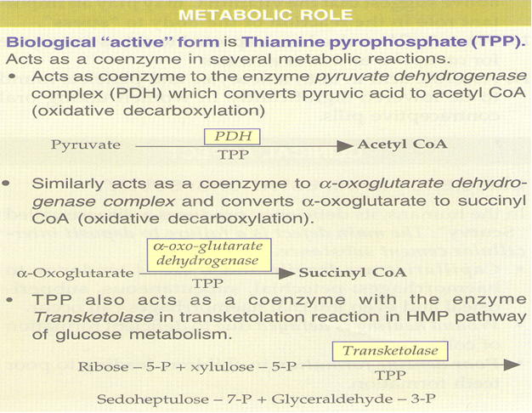
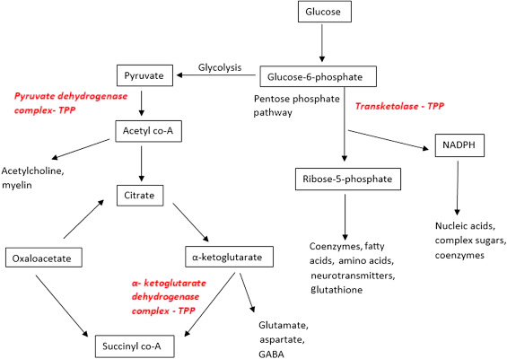

Slide 8
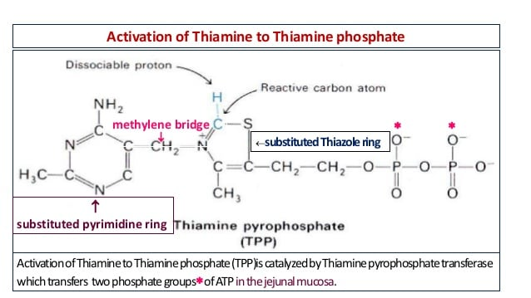
Thiamine diphosphate
Thiamin pyrophosphate plays a key role in the production of energy from food by acting as a coenzyme for four important enzymes.
The synthesis of thiamine diphosphate (ThDP), also known as thiamine pyrophosphate (TPP) or cocarboxylase, is catalyzed by an enzyme called thiamine diphosphokinase according to the reaction
Thiamine + ATP → ThDP + AMP .
ThDP is a coenzyme for several enzymes that catalyze the transfer of two-carbon units and in particular the dehydrogenation(decarboxylation and subsequent conjugation with coenzyme A) of 2-oxoacids (alpha-keto acids).
Thiamine is the precursor of thiamine pyrophosphate (TPP):

Slide 10
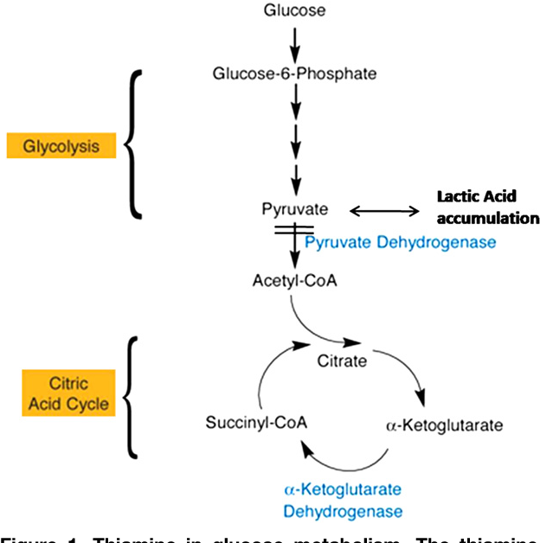
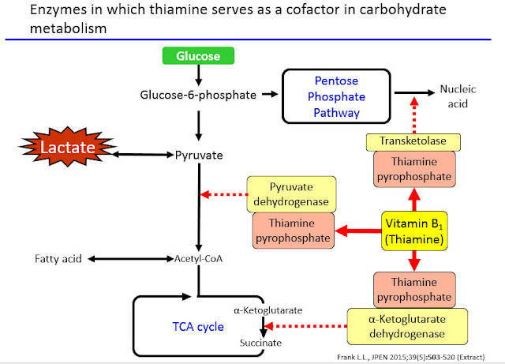
Thiamine in glucose metabolism.
The thiaminedependent enzymes pyruvate dehydrogenase (PDH) and a-ketoglutarate dehydrogenase (a-KGDH) participate in the metabolism of glucose through two biochemical reactions, glycolysis and the citric acid cycle. The main function of these two sets of reactions is to generate adenosine triphosphate (ATP), which provides energy for the cells. Reduced PDH and a-KGDH activity resulting from thiamine deficiency can lead to less ATP synthesis and build-up of the toxic intermediate, lactic acid.
Most importantly, pyruvate dehydrogenase catalyzes the conversion of pyruvate to acetyl-CoA. Thus increased metabolism of glucose will result in thiamine consumption.
In thiamine deficiency ,lactic acid will accumulate to produce severe lactic acidosis. Therefore thiamine deficiency should always be considered in unexplained lactic acidosis.

Slide 11
Focal damage due to lactic acidosis is its effect on vulnerable brain structures (mamillary bodies and postmedial thalamus). There is focal lactate production in the brain. Apoptotic cell death due to N-methyl-D-aspartate toxicity is responsbile for neurologic symptoms in thiamine deficiency
Deficiency
Thiamine derivatives and thiamine-dependent enzymes are present in all cells of the body, thus a thiamine deficiency would seem to adversely affect all of the organ systems. However, the nervous system is particularly sensitive to thiamine deficiency, because of its dependence on oxidative metabolism

Slide 13
Beriberi
Beriberi is a disorder of nervous system
which is actually cause by the deficiency of the thiamine in the diet of the individual, thiamine is basically found in the membranes of neurons and it is involved in the break down of the energy molecules such as glucose.
Beriberi may be found in people whose diet consists mainly of polished white rice, which is very low in thiamine
It can also be seen in chronic alcoholics, Arsenic poisoning causes alterations in cellular metabolism resulting in blockage of thiamine use which results in thiamine deficiency without any dietary shortfall.
Three major forms of the of beriberi
1-Dry beriberi :affecting distal more than proximal limb segments and causing calf muscle tenderness.
2-Wet beriberi :is associated with mental confusion, muscular atrophy, edema, tachycardia, cardiomegaly, and congestive heart failure in addition to peripheral neuropathy.
3-Infantile beriberi :occurs in infants breast-fed by thiamin-deficient mothers (who may show no sign of thiamine deficiency).
Assay for Thiamine Deficiency:
The measurement of erythrocyte (red blood cell) transketolase activity.
Red blood cells, which lack mitochondria, have no alternative means of generating NADPH save the pentose phosphate pathway. Also, NADPH is required to reduce glutathione in order to maintain the normal structure of red blood cell and maintain hemoglobin in the ferrous state. Therefore, the pentose phosphate pathway is essential in red blood cells. Transketolase is a thiamine pyrophosphate-requiring enzyme, which catalyzes reactions in the pentose phosphate pathway. So the level of transketolase activity in the red blood cell is a reliable diagnostic indicator of thiamine status.

