Slide 1
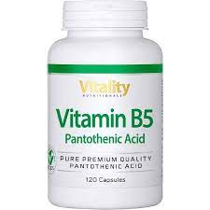
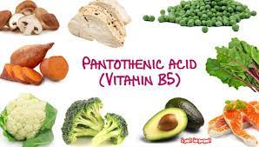
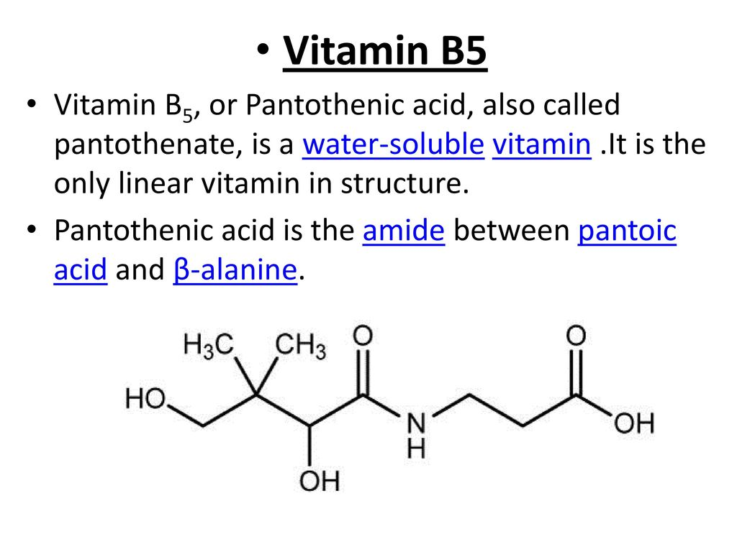
Vitamin B5
Dr.Shatha AL-Khateeb
Lec.5 Cont.

Slide 2
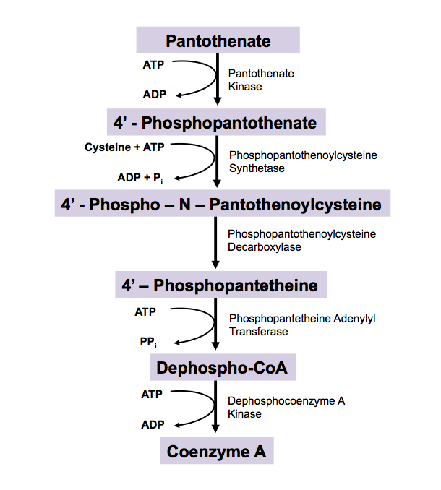
Pantothenic acid is a water-soluble vitamin, one of the B vitamins. It is synthesized from the amino acid β-alanine and pantoic acid .
Pantothenic acid is only one chemical compound. It is a starting compound in the synthesis of coenzyme A (CoA), a cofactor for many enzyme processes, it is a precursor to CoA via a five-step process. The biosynthesis requires pantothenic acid, cysteine, four equivalents of ATP

Slide 3
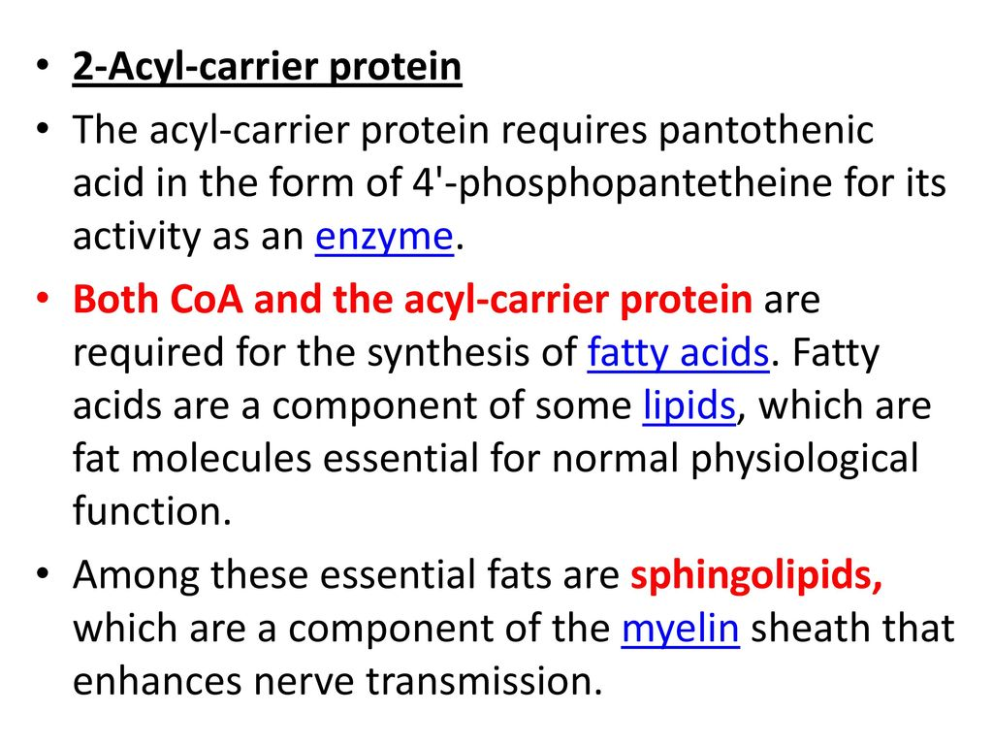

Slide 4
The first step in pantothenic acid utilization is phos-phorylation.
Pantothenate kinase is rate limiting, so that, unlike vitamins that are accumulated by metabolic trapping, there can be significant accumulation of free pantothenic acid in tissues.
It is then used for synthesis of CoA and the prosthetic group of acyl carrier protein.
Pantothenic acid arising from the turn-over of CoA and acyl carrier protein may be either reused or excreted unchanged in the urine.
Pantothenic acid is excreted mainly in the urine as free pantothenic acid and some 4′-phosphopantethenate; no catabolic products are known.
The renal tubular secretion of pantothenic acid, probably by a mechanism common to weak organic acids, results in urinary excretion of the vitamin correlating with dietary intake.
There appear to be two renal mechanisms for regulating the excretion of pantothenic acid:
Active transport.: At physiological concentrations of the vitamin in the plasma, pantothenic acid is reabsorbed by active transport;
Tubular secretion.: At higher concentrations, tubular secretion of pantothenic acid occurs.
Tubular reabsorption appears to be the only mechanism for conserving free pantothenic acid in the plasma.

