Slide 1
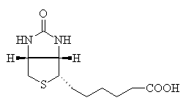
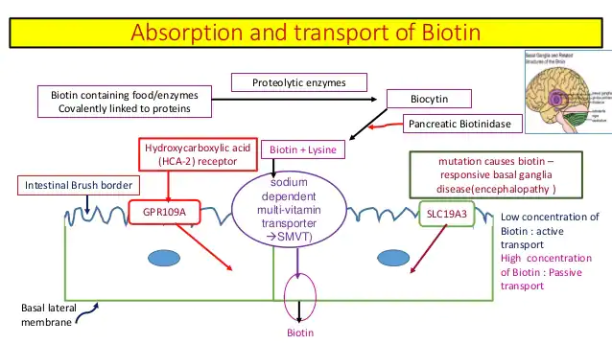
Vitamin B7
Lec.7
Dr. Shatha AL- Khateeb
Biotin vitamin B7also known as vitamin H, is one of the B vitamins, it is a water-soluble B vitamin. The name biotin derives from the Greek word “bios” (to live) and the suffix “-in” (a general chemical suffix used in organic chemistry).
It is classified as a heterocyclic compound, with a sulfur-containing ring fused ureido and tetrahydrothiophene group.
A C5-carboxylic acid side chain is appended to one of the rings. The ureido ring, containing the –N–CO–N– group, serves as the carbon dioxide carrier in carboxylation reactions.
Biotin is a coenzyme for five carboxylase enzymes, which are involved in the digestion of carbohydrates, synthesis of fatty acids, and gluconeogenesis. Biotinylation of histone proteins in nuclear chromatin plays a role in chromatin stability and gene expression.

Slide 2
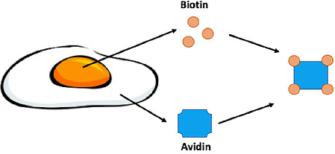
Absorption and storage of Biotin
Biotin is readily absorbed from the small intestine through the portal vein into the general circulation. Excess of the requirements is not stored in the body but is mostly excreted in the urine.
Egg white injury factor (Avidin)
There is a protein in egg white called avidin which is responsible for producing egg white injury.
Avidin binds with biotin tightly in the intestinal tract and prevents absorption of biotin from intestines. Avidin is denatured by cooking and then loses its ability to bind with biotin.
The amount of avidin in uncooked egg white is relatively small, and problems of biotin deficiency have only occurred in people eating abnormally large amounts of raw eggs for many years.
Biotin is enriched in egg yolk while its binding partner, avidin, is found in the egg white. Avidin is a glycoprotein that can bind four molecules of biotin.
Biotin and avidin have an extremely strong affinity for one another. Actually the bond between them is one of the strongest noncovalent protein-ligand interactions found in nature. Once the bond is formed it is unaffected by changes in pH, temperature or organic solvents.
Metabolic functions of biotin
Biotin functions to transfer carbon dioxide in a small number of carboxylation reactions.
The reactive intermediate is 1-N-carboxy-biocytin , formed from bicarbonate in an ATP-dependent reaction.
A single enzyme acts on the apoenzymes of acetyl-CoA carboxylase, pyruvate carboxylase, propionyl-CoA carboxylase, and methylcrotonyl-CoA carboxylase to form the active holoenzymes from (inactive) apoenzymes and free biotin.

Slide 3
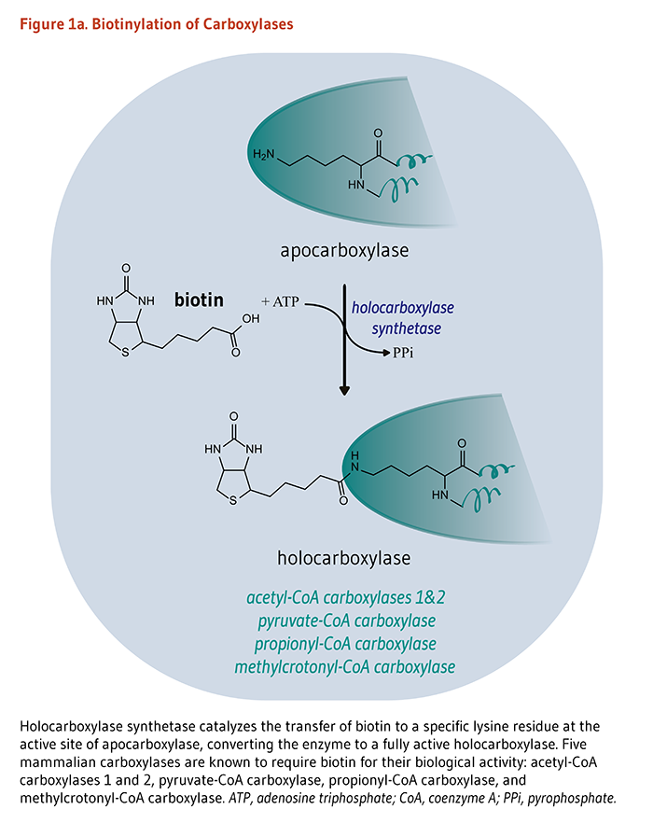
Function
Biotin functions as a covalently bound cofactor required for the biological activity of the five known mammalian biotin-dependent carboxylases . Such a non-protein cofactor is known as a "prosthetic group."
The covalent attachment of biotin to the Apo carboxylase (i.e., catalytically inactive carboxylase) is catalysed by the enzyme, holocarboxylase synthetase (HCS).
"Biotinylation" refers to the covalent addition of biotin to any molecules, including Apo carboxylases and histones.
HCS catalysis the post-translational biotinylating of the epsilon amino group of a lysine residue at the active site of each Apo carboxylase, converting the inactive Apo carboxylase into a fully active holocarboxylase .

Slide 4
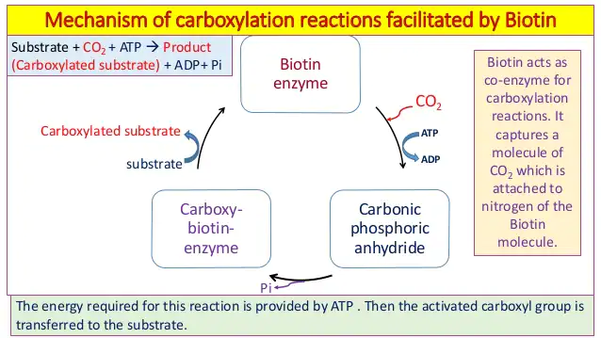
Biotin plays a vital role in:
• 1-Helping the body metabolize proteins, fats and carbohydrates.
• 2-Helping the body process glucose.
•3-It also contributes towards healthy nails, skin and hair. It is therefore found in many cosmetic and health products for the skin and hair.

Slide 5
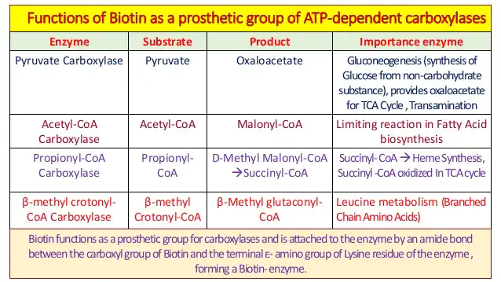

Slide 6
Enzyme cofactor
Biotin is a cofactor that in its active form is covalently attached to the active site of key metabolic enzymes including biotin carboxylase and decarboxylases.
These enzymes catalyze the transfer of carboxyl groups to organic acids to produce important cellular metabolites.
Biotin acts as a carboxyl carrier from one compound to the other. These biotin dependent enzymes are essential for processes such as gluconeogenesis, lipogenesis, amino acid metabolism and energy transduction.

Slide 7
Five mammalian carboxylases that catalyze essential metabolic reactions:
• Both acetyl-Coenzyme A (CoA) carboxylase 1 (ACC1) and acetyl-CoA carboxylase 2 (ACC2) catalyze the conversion of acetyl-CoA to malonyl-CoA using bicarbonate and ATP; malonyl CoA generated via ACC1 is a rate-limiting substrate for the synthesis of fatty acids in the cytosol, and malonyl CoA generated via ACC2 inhibits CPT1, an outer mitochondrial membrane enzyme important in fatty acid oxidation.
ACC1 is found in all tissues and is particularly active in lipogenic tissues (i.e., liver, white adipose tissue, and mammary gland), heart, and pancreatic islets , while ACC2 is especially abundant in skeletal muscle and heart.
Cofactor biochemistry
The enzyme holocarboxylase synthetase covalently attaches biotin to five human carboxylase enzymes:
1-Acetyl-CoA carboxylase alpha (ACC1)
2-Acetyl-CoA carboxylase beta (ACC2)
3-Pyruvate carboxylase (PC)
4-Methylcrotonyl-CoA carboxylase (MCC)
5- Propionyl-CoA carboxylase (PCC)
For the first two(1&2), biotin serves as a cofactor responsible for transfer of bicarbonate to acetyl-CoA, converting it to malonyl-CoA for fatty acid synthesis.
PC (3)participates in gluconeogenesis.
MCC (4)catalyzes a step in leucine metabolism.
PCC(5) catalyzes a step in the metabolism of propionyl-CoA.
Metabolic degradation of the biotinylated carboxylases leads to the formation of biocytin. This compound is further degraded by biotinidase to release biotin, which is then reutilized by holocarboxylase synthetase.
Biotinylation of histone proteins in nuclear chromatin is a posttranslational modification that plays a role in chromatin stability and gene expression.

Slide 8
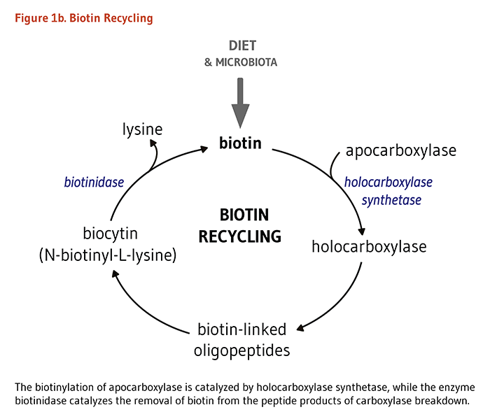
Biotinidase is the enzyme that catalyses the release of biotin from biotinylated histones and from the peptide products of holocarboxylase breakdown .

Slide 10
Inborn metabolic disorders
Biotinidase deficiency which leads to secondary biotin deficiency.
Intestinal absorption is decreased because a lack of biotinidase prevents the release of biotin from dietary protein . Recycling of one's own biotin bound to carboxylases and histones is also impaired, and urinary loss of biocytin (N-biotinyl-lysine) and biotin is increased .
Holocarboxylase synthetase (HCS) deficiency
HCS deficiency results in decreased formation of all holocarboxylases at physiological blood biotin concentrations; thus, high-dose biotin supplementation (10-80 mg of biotin daily) is required .
The prognosis of these two disorders is usually good if biotin therapy is introduced early (infancy or childhood) and continued for life.
Biotin transport deficiency
Biotin transport deficiency who responded to high-dose biotin supplementation . Of note, the presence of a defective human sodium-dependent multivitamin transporter (hSMVT) was ruled out as a cause of biotin transport deficiency.
Phenylketonuria (PKU)
Abnormally elevated concentrations of the amino acid, phenylalanine, in the blood of PKU-affected individuals may inhibit the activity of biotinidase.
Markers of biotin status
Four measures of biotin deficiency have been validated as indicators of biotin status:
(1) Reduced urinary excretion of biotin and some of its catabolites.
(2) High urinary excretion of an organic acid, hydroxyisovaleric acid, and its derivative, carnityl-3-hydroxyisovaleric acid, both of which reflect decreased activity of biotin-dependent methylcrotonyl-CoA carboxylase.
(3) Reduced propionyl-CoA carboxylase activity in peripheral blood lymphocytes.
(4) Reduced levels of holo-methylcrotonyl-CoA carboxylase and holo-propionyl-CoA carboxylase in lymphocytes — the most reliable indicators of biotin status .

Slide 11
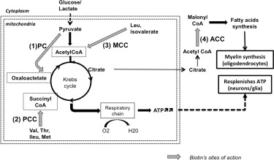
Potential mechanisms of action of high doses of biotin. Targets of biotin are: (1) PC: pyruvate carboxylase, (2) PCC: propionyl CoA carboxylase, (3) MCC: methylcrotonyl CoA carboxylase, (4) ACC: acetylCoA carboxylases. Activation of PC, PCC, MCC may lead to increase ATP production in neurons (and astrocytes) whereas activation of ACC may lead to myelin synthesis by oligodendrocytes.

Slide 12
Vitamin B9

Slide 13
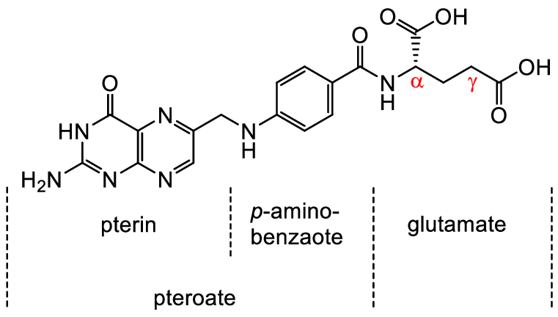
Chemistry
Folic acid is applied to a number of compounds which contain the following groups:
Pteridine nucleus (Pyrimidine and Pyrazine rings).-
Para-aminobenzoic acid (PABA) and-
Glutamic acid. -
Chemically called Pteroyl Glutamic Acid(PGA).
There are at least three chemically related compounds of nutritional importance which occur in natural products,all may be termed (Pteroyl Glutamates).

Slide 14
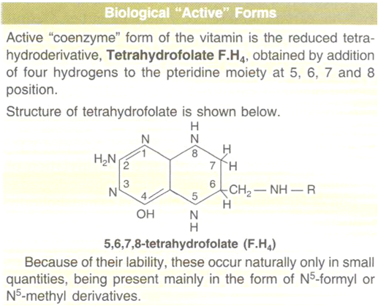
The metabolically active form is tetrahydrofolate, which is formed from folate in two successive NADPH-dependent reductions, both catalyzed by the same enzyme, namely, dihydrofolate reductase.
Biological Active Forms

Slide 15
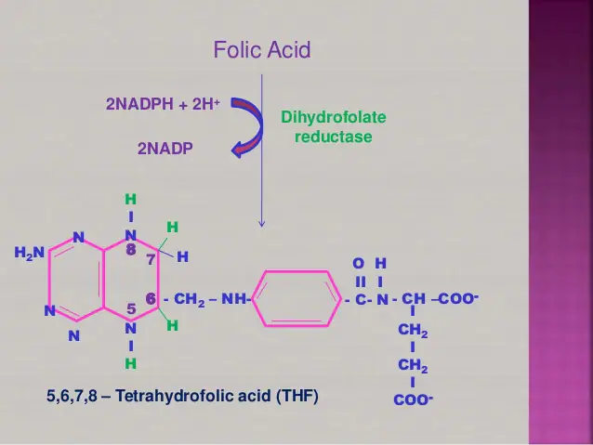
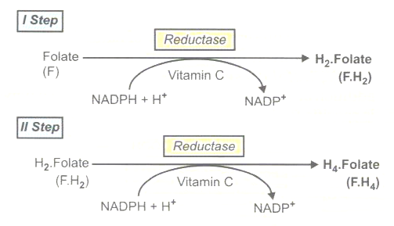
Formation of F.H4
Folic acid, before functioning as a coenzyme, must be reduced first to 7,8-dihydrofolic acid(F.H2) and then to 5,6,7,8 Tetrahydrofolate (F,H4) .

Slide 16
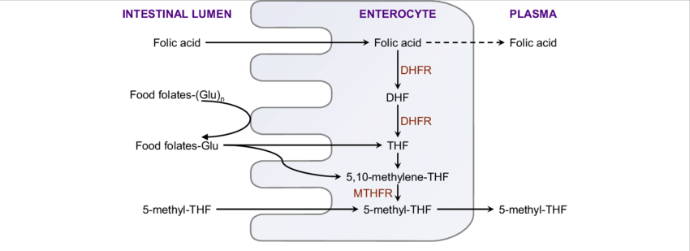
Absorption
Polyglutamates ingested in diet are converted to monoglutamates and dihydrofolates are reduced to tetrahydrofolates by Folate reductase.then converted to methyltetrahydrofolates ,which enter the portal blood and then carried to liver.
Excretion
Urine: 2 to 5 µg ̸ day.This is much increased after an oral dose of folate if the tissues are saturated.
Feces: 20% of the ingested folates that remains unabsorbed + 60 to 90 µg in the bile that is not reabsorbed + some unabsorbed synthesis of folate by bacterial flora of intestine.
Intestinal absorption of dietary folates, folic acid and 5-methyl-tetrahydrofolic acid.
Dietary folates and folic acid at low doses is converted in the small intestine to 5-methyl-THF.
At high oral doses, folic acid enters the circulation through passive diffusion in unmodified form (dotted line).
DHF: dihydrofolate; DHFR: dihydrofolate reductase; Glu: glutamate; (Glu) n : polyglutamate; MTHFR: 5, 10-methylene-THF reductase; THF: tetrahydrofolate.

Slide 17
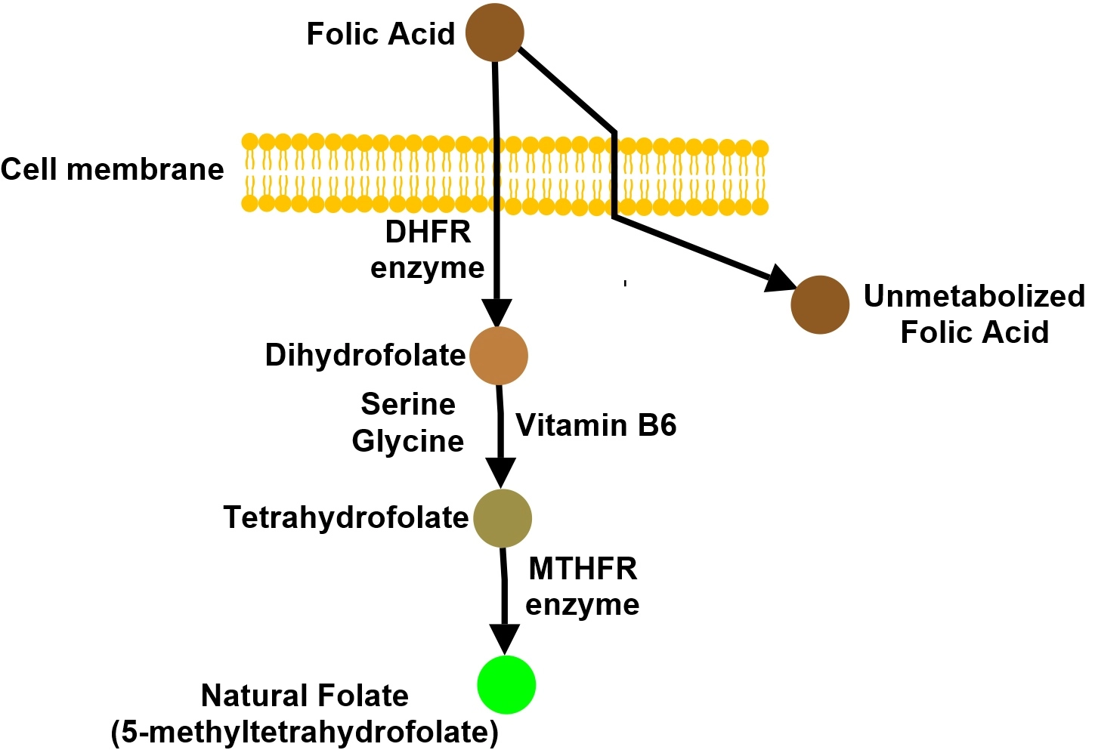
Folic Acid is absorbed through the cell membrane as is natural folate. However because folic acid is not natural, it requires the DHFR enzyme (dihydrofolate reductase) and MTHFR enzymes to convert it to natural folate.
When folic acid is introduced into the body, the DHFR enzyme is not only responsible for continuous circulation of natural folate in the body but is now has the additional burden of metabolizing synthetic folic acid, using up MTHFR enzymes for unnecessary the task of breaking down folic acid.
The DHFR enzyme when activated to break down folic acid also modulates the activity of the MTHFR enzyme.
When folic acid converts to Dihydrofolate, the Dihyrdofolate molecule also modulates the activity of the MTHFR gene.

Slide 18
Function
1-The only function of vitamin B9 (folate) coenzymes in the body appears to be acting as acceptors and donors of one-carbon units (in a variety of reactions critical to the metabolism of nucleic acids and amino acids .
2-Vitamin B9 coenzyme play a vital role in DNA metabolism through the synthesis of DNA from its precursors (‘thymidine’ and ‘purines’.
3-Folate coenzymes are required for the metabolism of several important amino acids, such as the synthesis of methionine from homocysteine. .
4-Prevents serious birth defects in the fetus and new-born such as neural tube.
5- Vitamin B9 helps in producing healthy red blood cells and shields the fetus and pregnant woman from anemia; especially Megaloblastic Anemia.
6- Folic acid helps in digestion and strengthening the nervous system, thus improving mental and emotional health.
7-Vitamin B9 is also important because it is a natural provider of strong immune power and enhances the body’s energy reservoir.
Deficiency
Folate deficiency is most often caused by a dietary insufficiency; however, folate deficiency can occur in a number of other situations. For example, alcoholism is associated with low dietary intake and diminished absorption of folate, which can lead to folate deficiency. Additionally, certain conditions such as pregnancy or cancer result in increased rates of cell division and metabolism, causing an increase in the body's demand for folate .Several medications may also contribute to this deficiency

Slide 19
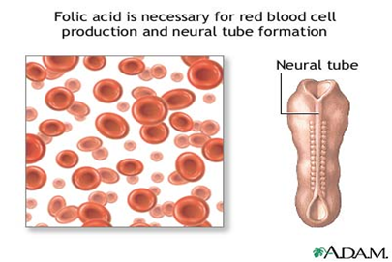
The possible complications include:
1-Megaloblastic Anemia, a condition when red blood cells are larger than normal and develop abnormally.
2-Low white blood cells and platelets
3-Increased risk of heart disease or cancer
4-Worsening of heart disease
5- Birth defects in fetuses
6-Placental abruption
7-Premature birth
8-Low birth weight
9-Infertility
Folic acid for a healthy pregnancy and baby
Folic acid is a B vitamin that helps a baby’s neural tube to grow healthy during pregnancy. The neural tube will become a baby’s brain and spinal cord. But if the neural tube doesn’t close the way it should, it can cause a very serious birth defect
called a neural tube defect (NTD).
Results of deficiency: 1-Megaloblastic anemia. 2-Low birth weight and neural tube defects. 3-Smooth tongue,frequent infections. 4-Elevated homocysteine level( increased risk of heart disease).

Slide 20
