Slide 1
Epidemiology of Mental health

Slide 2
objectives

Slide 13
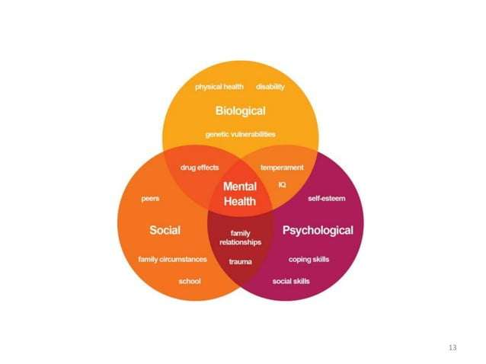

Slide 19
