Slide 1

Pediatric + MSK
Dr .Muna AGZ

Slide 2
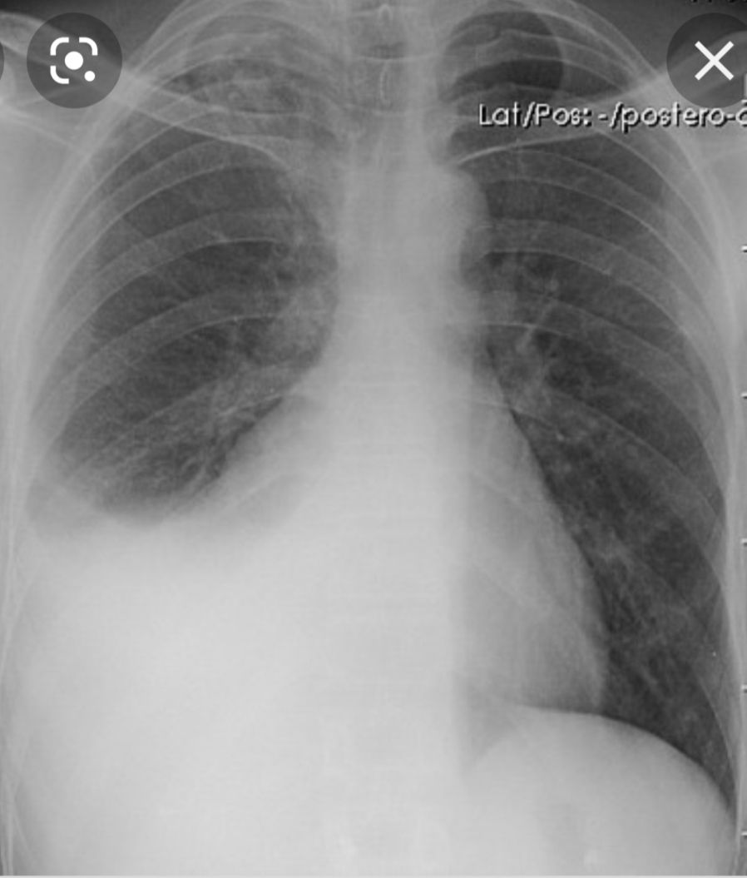

Slide 3
PLEURAL EFFUSION
Rt SIDED MODERATE EFFUSION WITH OBLITERATION OF RT HEART BORDER , DIAPHRAGM AND COSTOPHRENIC ANGLE

Slide 4
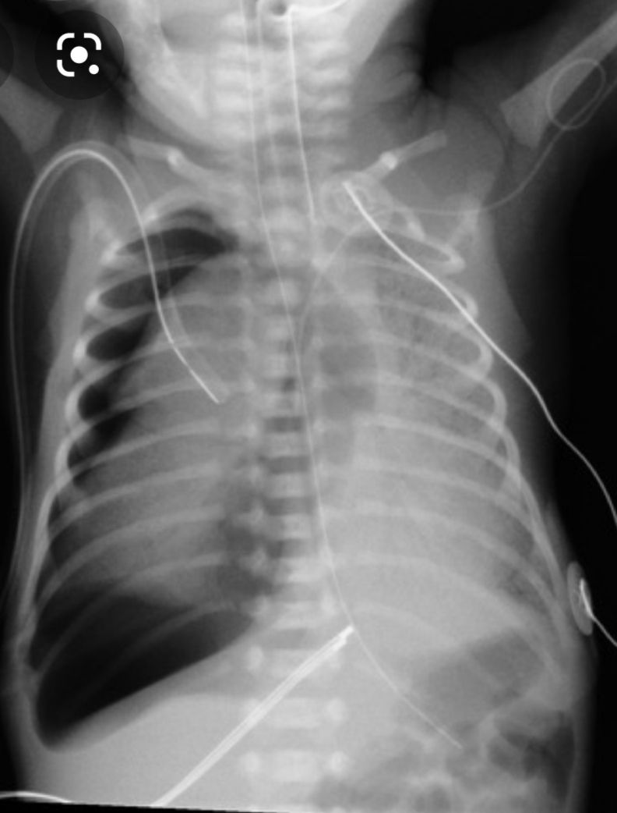

Slide 5
Rt Sided Tension Pneumothorax
Mediastinal Shift To The Lt
Compressed Hemidiaphragm
Rt Sided Chest Tube
Endotracheal tube
Ng tube
ECG leads

Slide 6
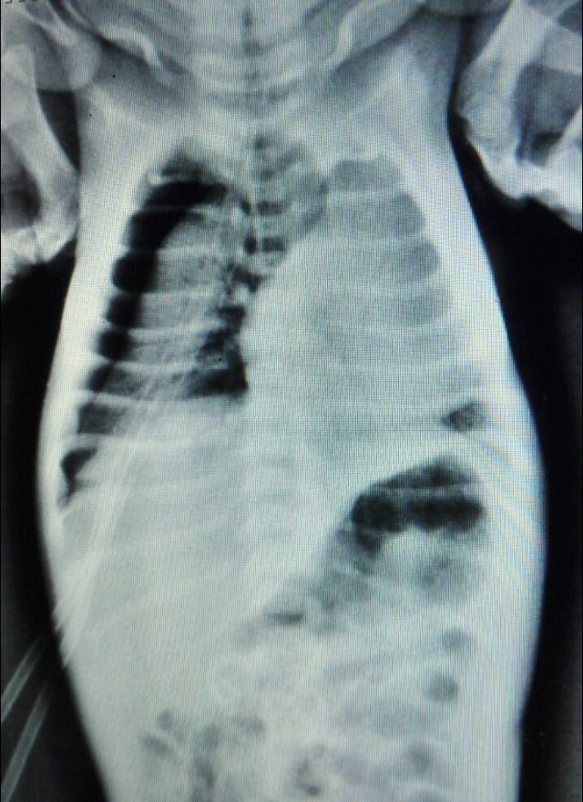

Slide 7
Tension pneumothorax
Rt sided tension pneumothorax with shift mediastinum to the lt side

Slide 8
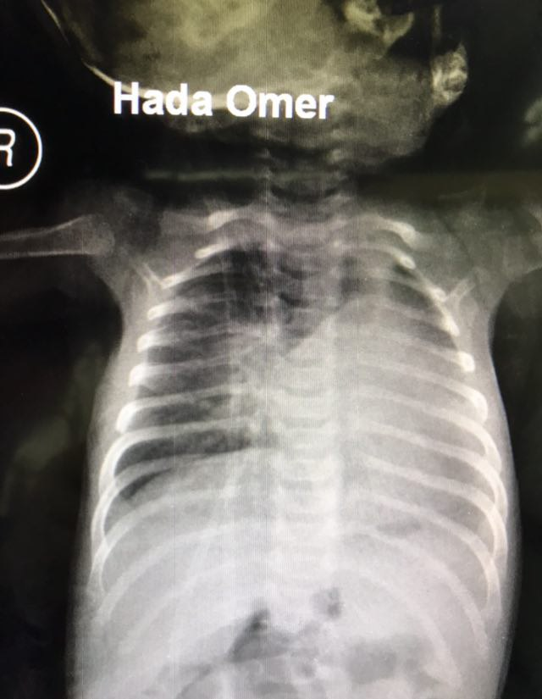

Slide 9
Hyper inflated rt lung
Due to collapse with or with out consolidation of the lt lung with shift mediastinum to the lt side

Slide 10
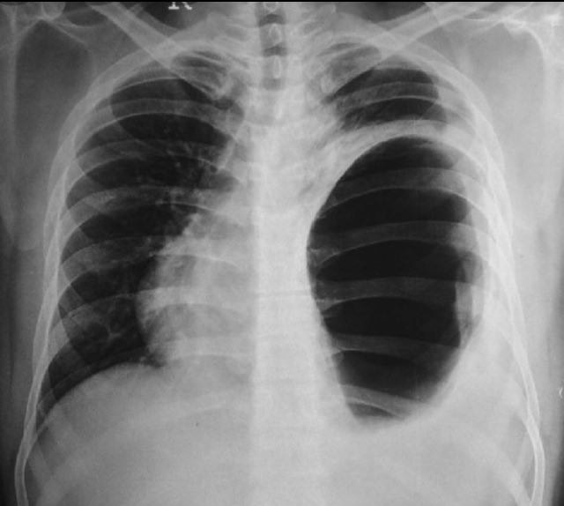

Slide 11
Elevated Lt hemdiaphragm
With enlarged gaseous bubble in to the thorax and shift mediastinum to the LT side

Slide 12
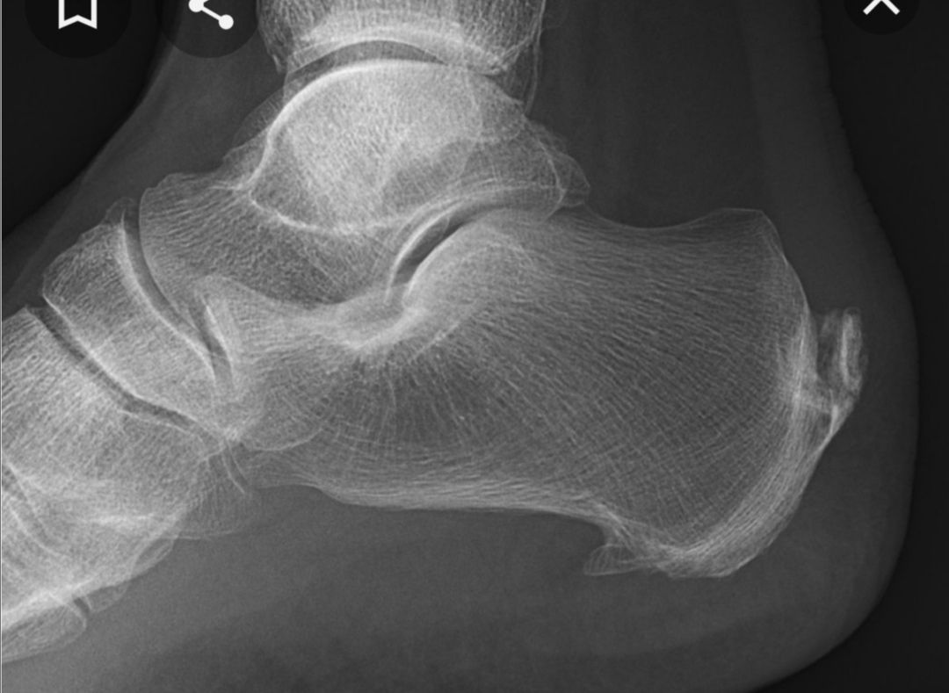

Slide 13
Calcaneal spur
Presented with pain in the heels with long standing or at early morning after wake up

Slide 14
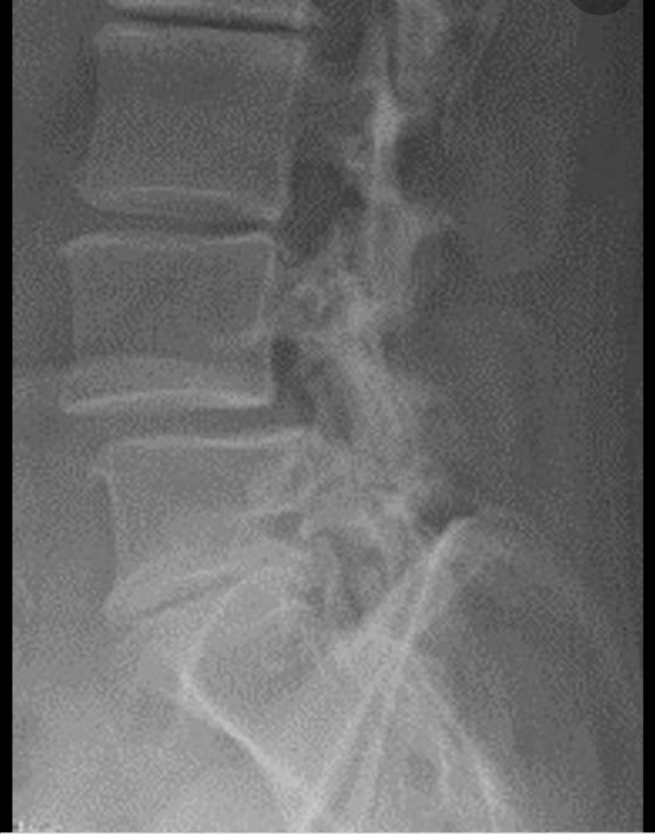

Slide 15
Lumbar spondylolesthesis
Anterior slipping of vertebral body L 4 on L 5 with degenerative changes of L5/S1 vertebra

Slide 16
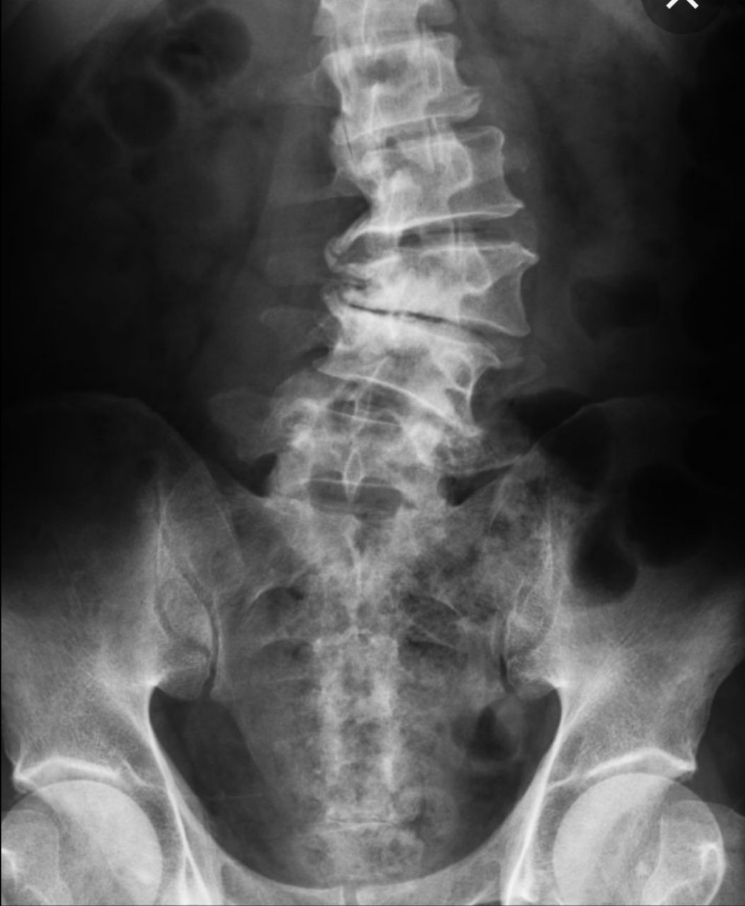

Slide 17
Scoliosis with concavity to the Rt side
Degenerative disc disease with multiple Rt sided marginal osteophytosis

Slide 18
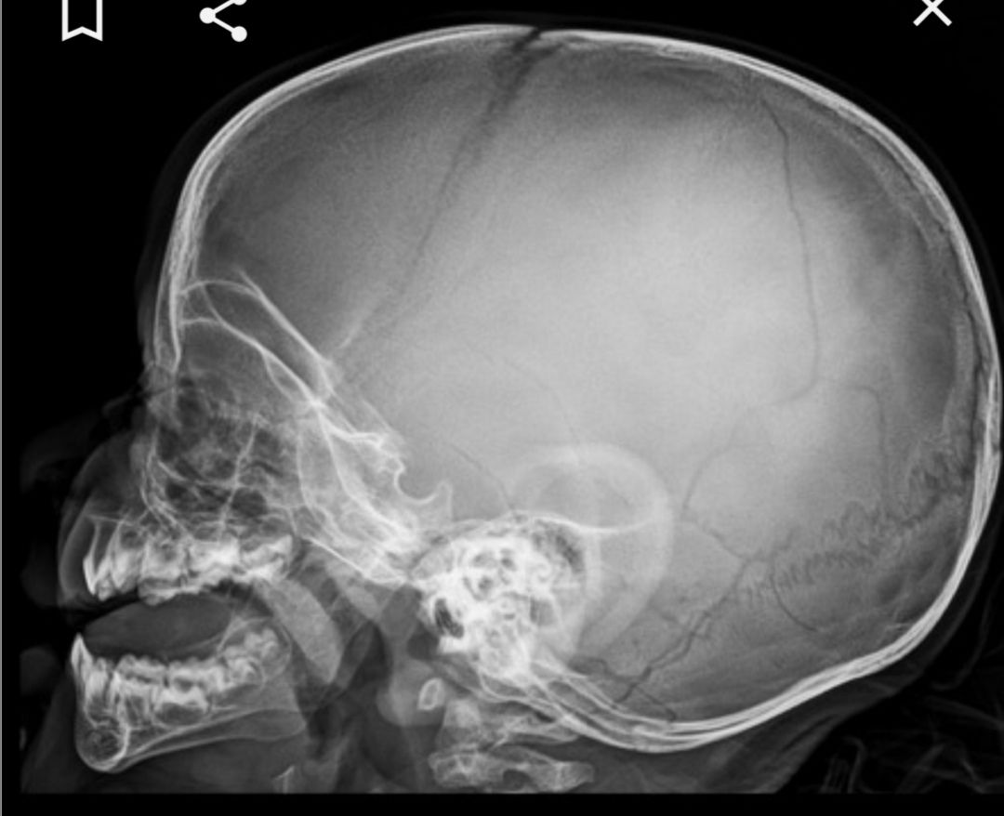

Slide 19
Skull fracture
Linear non displaced fracture of the fronto- parietal junction which is demonstrated as cortical breach of the affected region , these should be differentiated from the bony impression of the middle meningeal artery and bony sutures

Slide 20
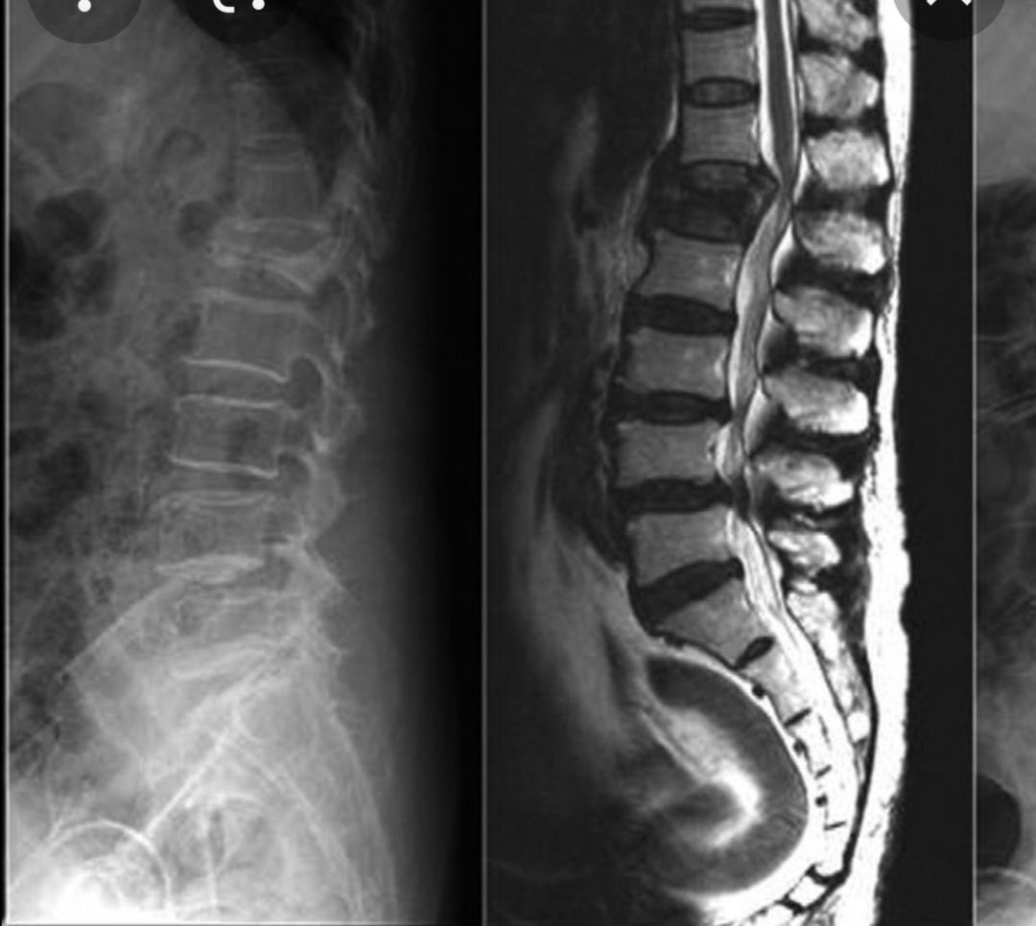

Slide 21
Compression burst fracture
When the vertebral body is fractured and many pieces break in multiple directions
Compressing the anterior thecal sac , or possibly bony chips directed in to the spinal cord with cord injury

Slide 22
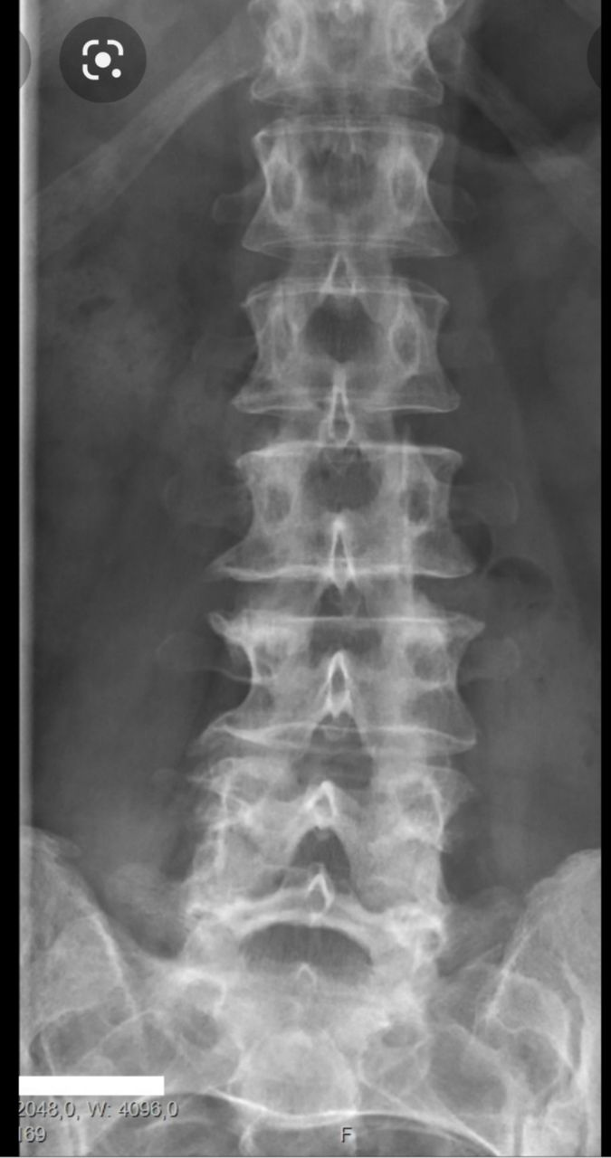
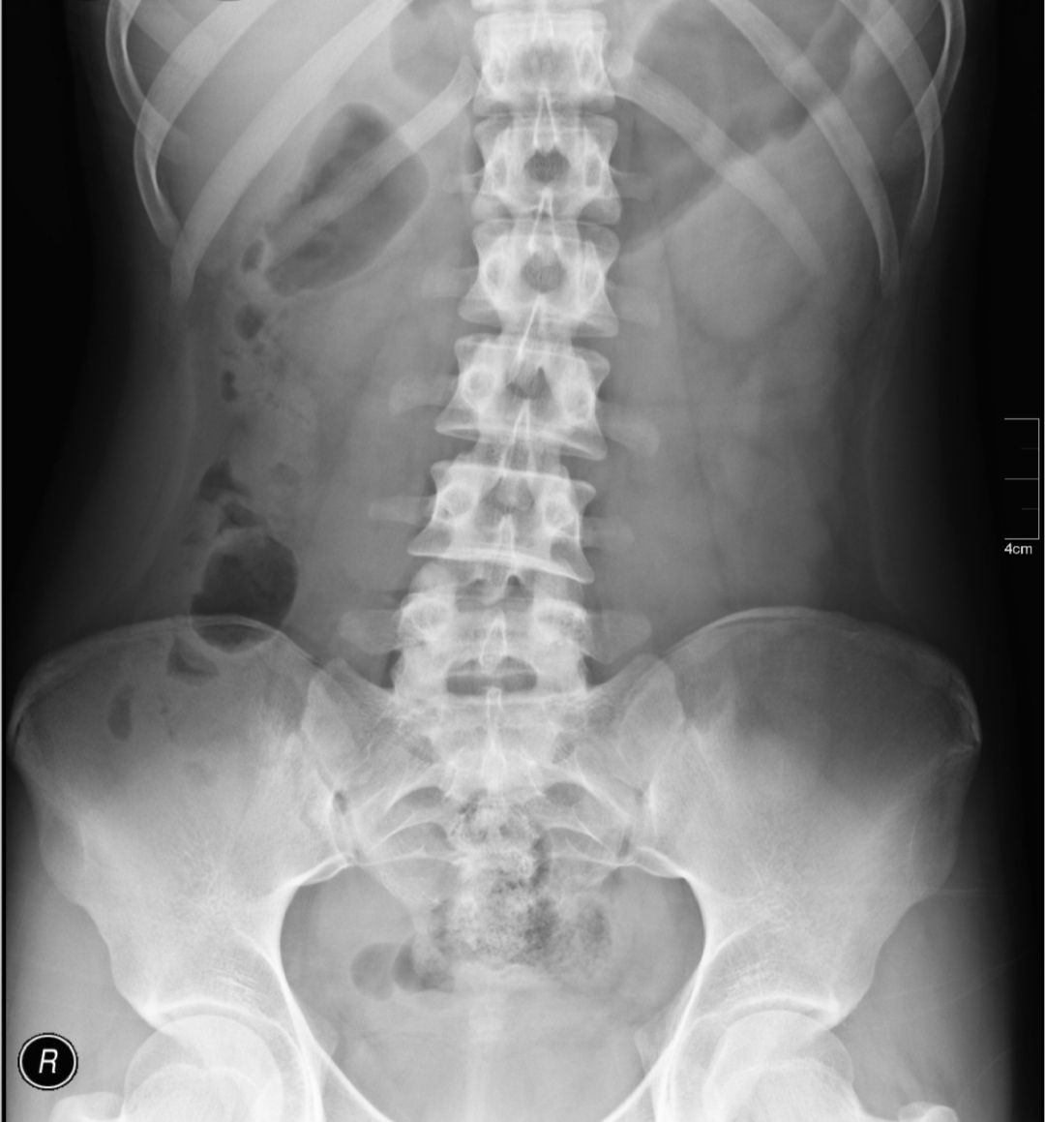
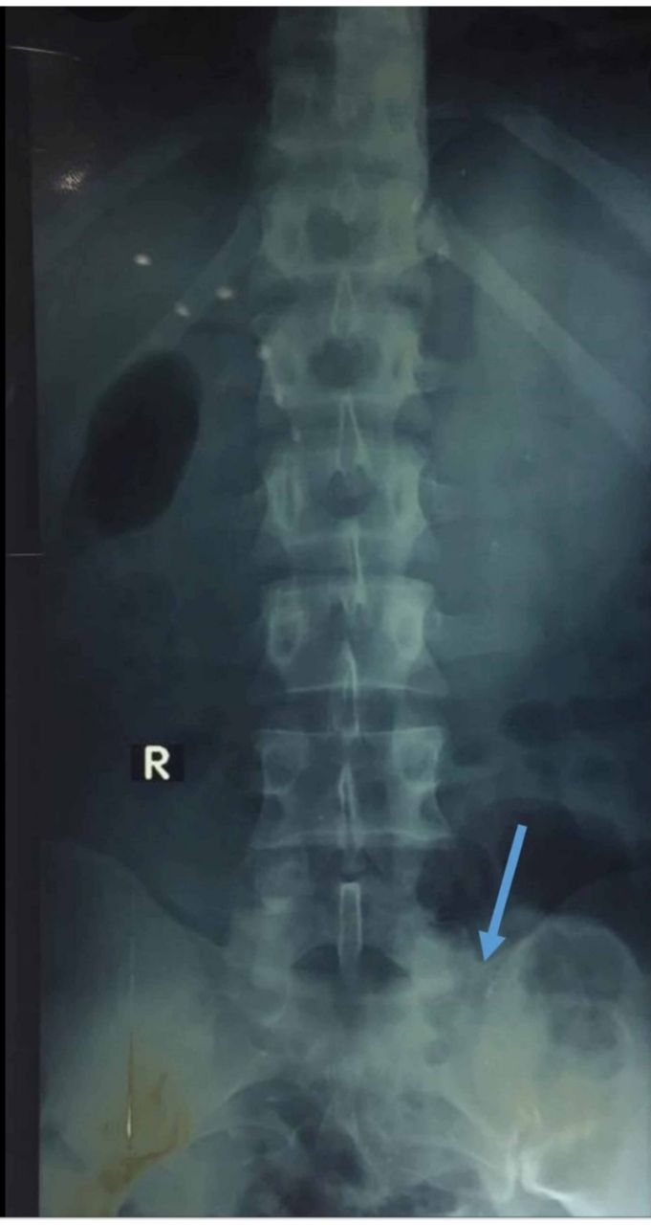

Slide 23
Anomalies of Lumbosacral junction
Left hand image …. lumberized S1
Middle image… normal KUB
Right hand image … sacralized L1

